Slide 1
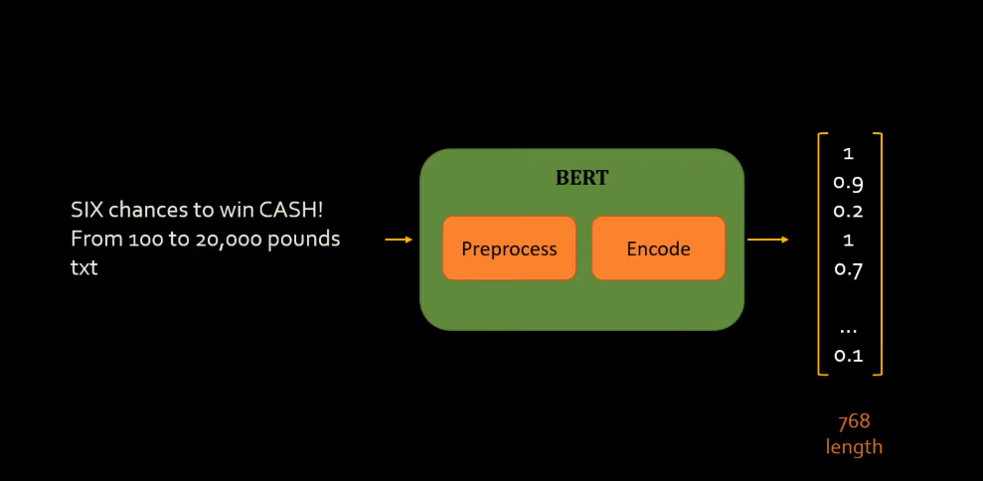
BERT TEXT CLASSIFICATION

