Slide 1
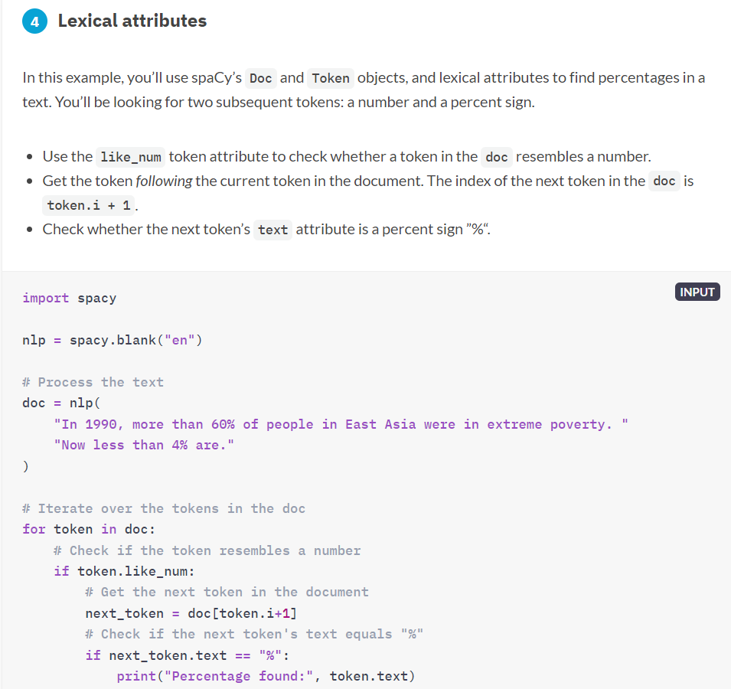
Spacy Library Chapter 1

