Slide 1
Water Quality Prediction using Tableau and SAS
Presented By
Group-6
Goutami Amara
Prathik Mayur Bandi
Mohan Krishna Kavuri
Priyanka Kunchakuri
Rishi Kumar Reddy Mallepally

Slide 2
Introduction
Having access to clean water is a fundamental human right and an important aspect of any health-protection policy. On a global, regional, and local scale, this matters for health and development reasons.
Investments in sanitation and water supply have been demonstrated to be economically beneficial in some areas, with health benefits and healthcare savings more than offsetting the upfront expenses. As a direct result of this rapid development, water quality has been rapidly declining.

Slide 3
Objectives
The objectives of this research are
We will implement data visualization approaches using Tableau for feature interpretation
We will implement machine learning algorithms to predict water quality in SAS

Slide 4
Data Source
The data contain 3276 rows and 10 columns and some of the features contain missing values.
Data Description
The data contain missing values in features like pH, Sulfate and trihalomethanes. The data contain the following features
pH value
Hardness
Solids – Total Dissolved Solids
Chloramines
Sulfate
Conductivity
Organic Carbon
Trihalomethanes
Turbidity
Potability

Slide 5
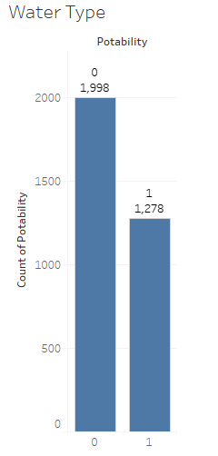
Tableau Visualization
The total number of portable water samples in 1998 and non-potable water samples is 1278. This indicates that the data is imbalanced where the non-potable water sample is lower compared to the potable samples.

Slide 6
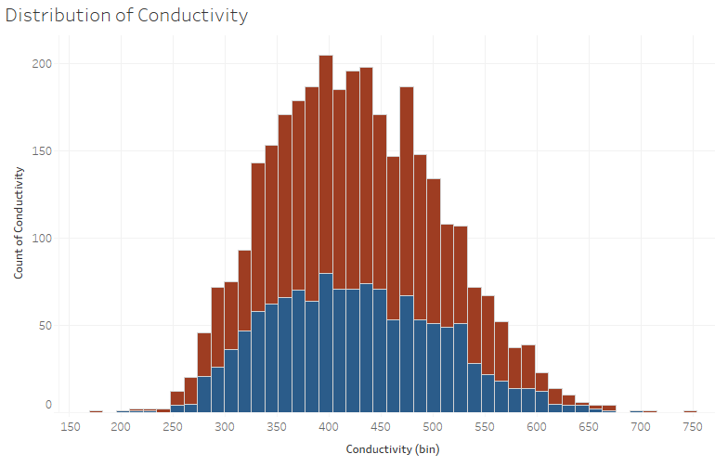
The histogram distribution of conductivity indicates that conductivity lies in same range both in potable and non-potable water. The conductivity of both types of water lies in the range between 250 to 700.

Slide 7
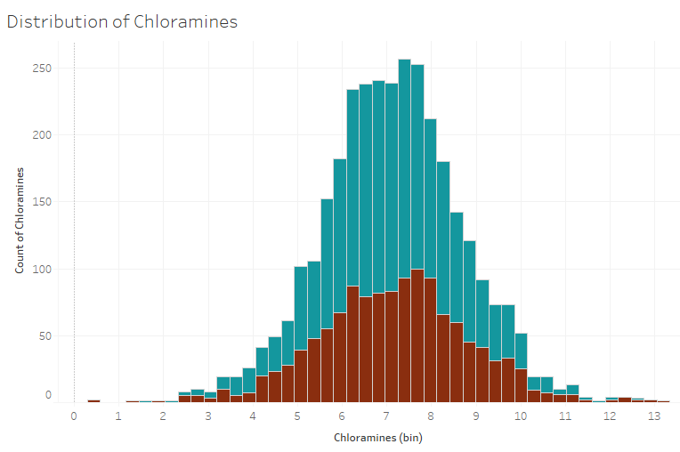
The histogram distribution of chloramine tells the same story where they lie in the same range in both potable and non-potable water. The chloramine lies in the range of 2 to 12 in both types of water.

Slide 8
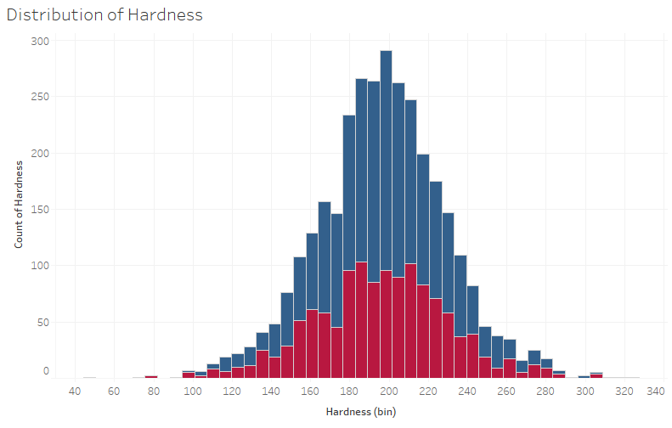
The hardness of both types of water also lie in the range of 100 to 300. The hardness of potable water is maximum observed near to 200 and in case of non-potable water, the maximum hardness is observed between 180 to 220.

Slide 9
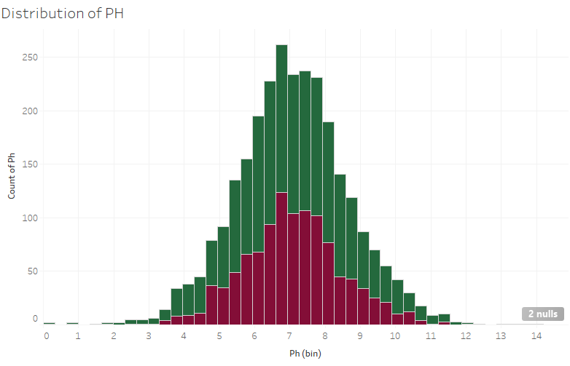
The histogram distribution of pH indicates that the pH value of non-potable water lies in the range of 3 to 10 and in case of potable water, the pH ranges between 2 to 12.

Slide 10
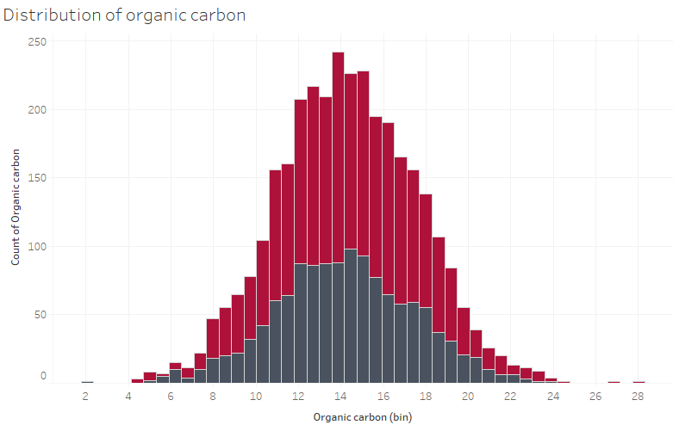
The Organic carbon ranges between 4 to 24 in case of potable water and 5 to 22 in case of non-potable water.

Slide 11
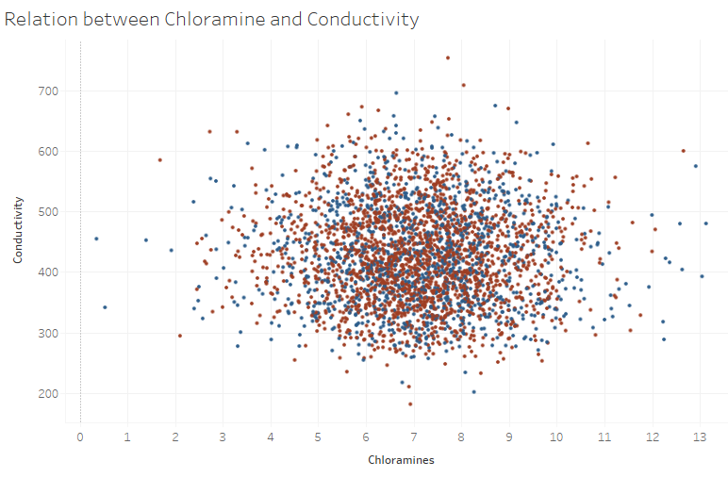
The scatterplot indicates that the water from both types have chloramines ranging between 4 to 10 and conductivity range in between 300 to 600. There is no proper distinction observed between potable and non-potable water.

Slide 12
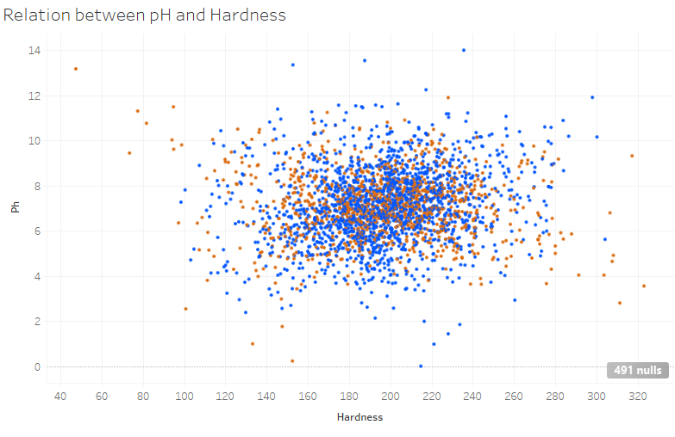
The scatterplot indicates both hardness and pH value almost lie in same range in case of both types of water but the water of both types have common hardness value ranging between 12 to 260 and pH changing between 4 to 10. There is no proper distinction of pH and hardness in case of potable and non-potable water.

Slide 13
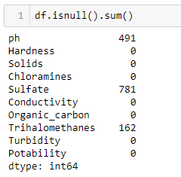
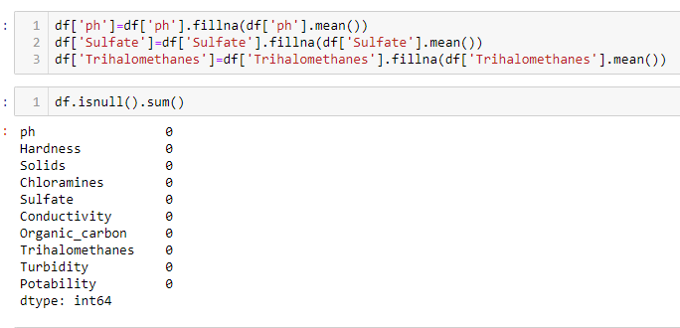
Data Exploration and Preprocessing
Python will be used for exploring the data entry processing of the data.
Most of the missing values are present in sulfate feature. The imputation is done using Python.
All the missing values are imputed with mean values in the feature.

Slide 14
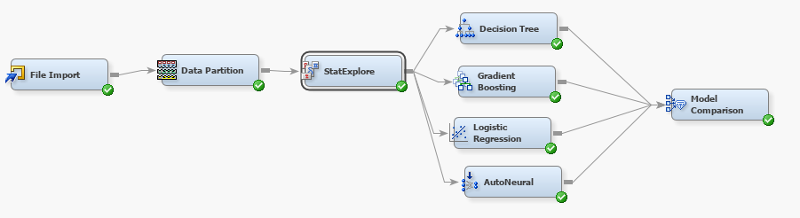
Predictive Modelling
Different predictive modeling techniques will be used such as classification algorithms including logistic regression, decision tree, gradient boosting, and AutoNeural to predict water quality based on different features.
All the models will be evaluated using proper performance metrics such as, classification reports and lift and gain ratios.
The predictive modeling will be carried out with the help of SAS Enterprise Miner. The following algorithms are used to predict water quality

Slide 15
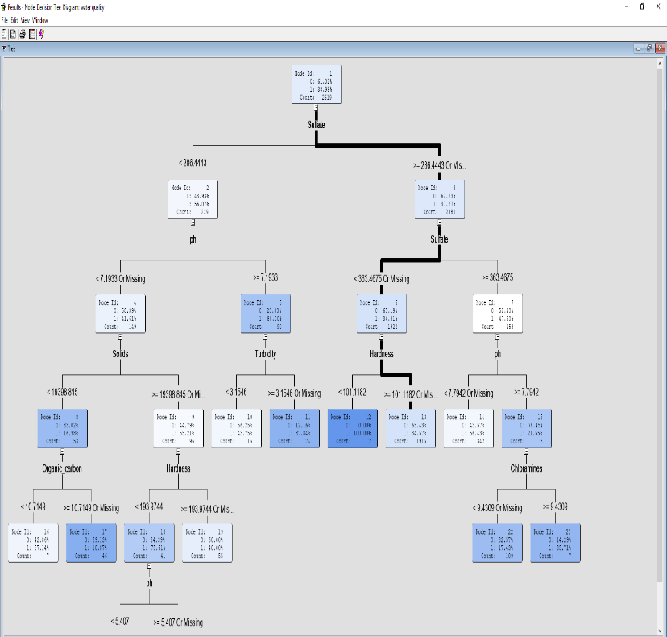
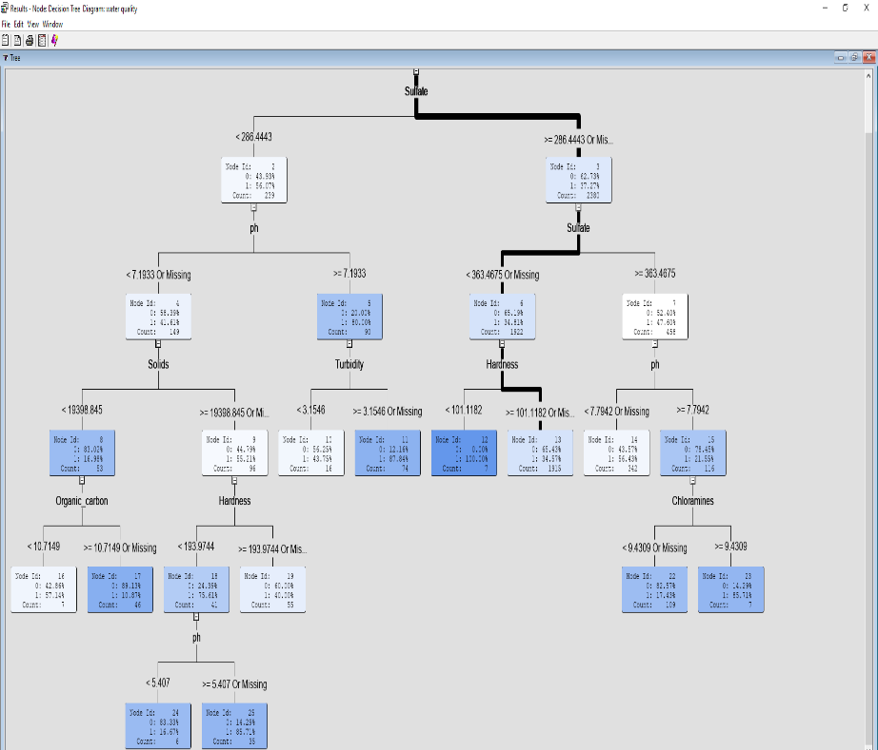
Decision Tree

Slide 16
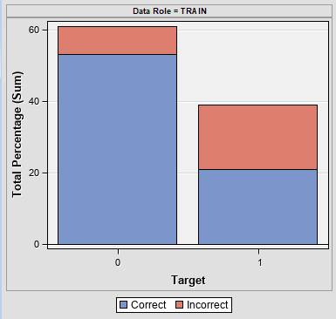
The samples of Potable water is more compared to the samples which are not potable. The misclassification rate in polluted water samples is higher compared to the Potable water samples.

Slide 17
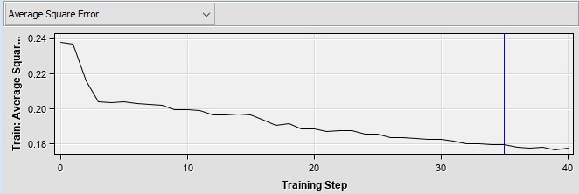
At a training step of 35, it seems to be optimal as it gives the minimum average square error and from that point the error gradually decreases.

Slide 18
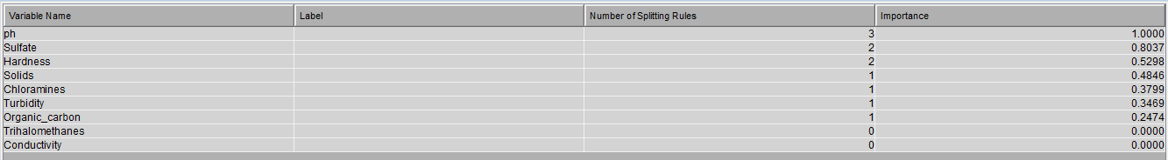
The feature importance indices that the features including pH, sulfate, hardness, solids, chloramines are very important in distinguishing polluted and potable water.

Slide 19
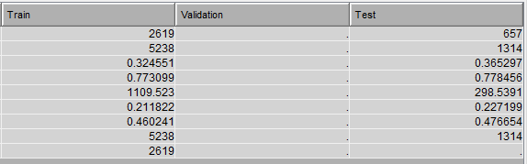
Gradient Boosting Classifier
Gradient boosting classifier is also tested on 657 samples where the test data prediction gave more mis classification then the train data the rate of mis classification is higher than the decision tree that tells decision tree is better in classifying the potability of water.

Slide 20
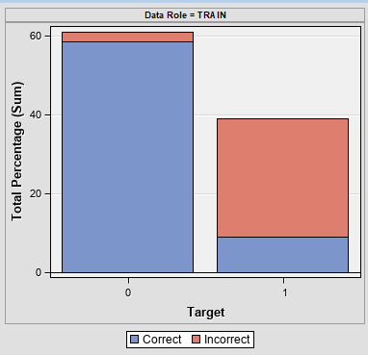
More than half of the samples in polluted water are wrongly classified and the error rate is higher than the error rate given by the decision tree classification model.

Slide 21
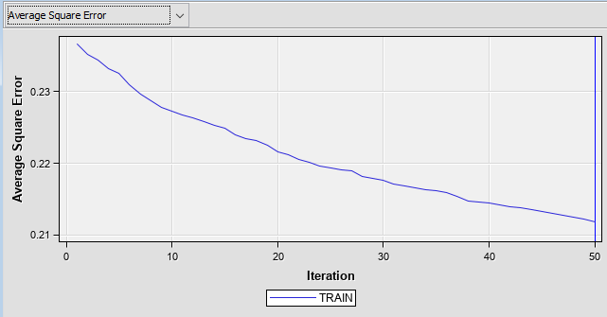
The average squared error is minimum at high iteration where iteration 50 is optimal as it gives the lowest average.

Slide 22
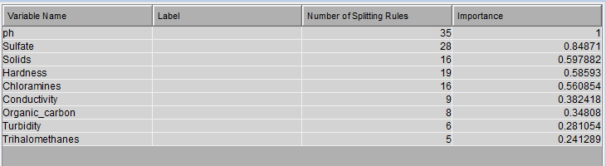
From the variable importance the highest number of splitting rules is observed from the feature pH which is the highest important variable. The Other variable such a sulphate, solids, hardness and chloramines are also having higher importance and these variables can predict the quality of water with high accuracy.

Slide 23
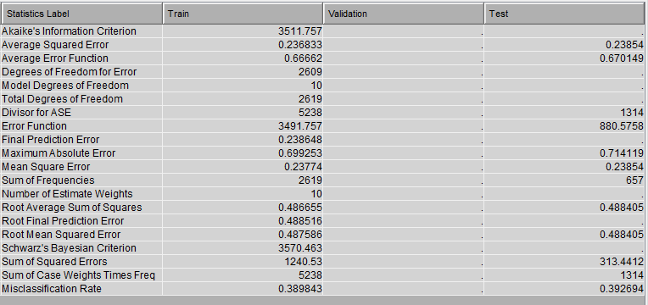
Logistic Regression
The logistic regression is also trained on the same number of samples where the mis classification rate in test data is more than the train data. The average squared error in test sample is lesser than the train samples.

Slide 24
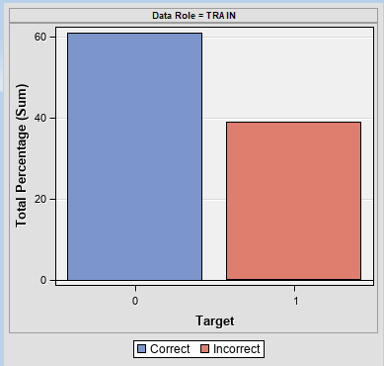
Total percentage of potable water samples are more than the polluted water and logistic regression give high number of misclassified samples in polluted water. All the samples of polluted water are wrongly classified.

Slide 25
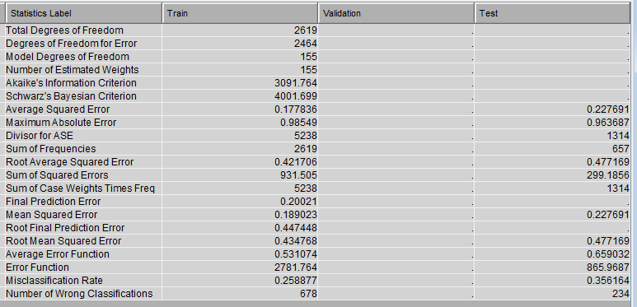
AutoNeural
The auto neural network is also trained on same number of samples which gave 678 wrong classification in train data into 234 wrong misclassification in test data. The rate of misclassification in test data is more than the train data.

Slide 26
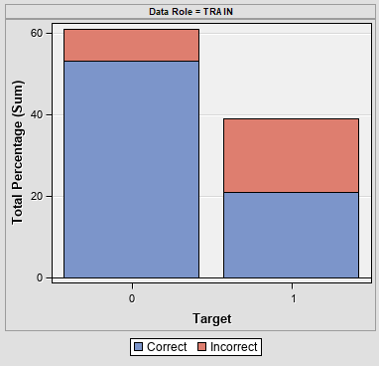
In the train data, around half of the samples of polluted water are wrongly classified and around 10% of the potable water are wrongly classified.

Slide 27
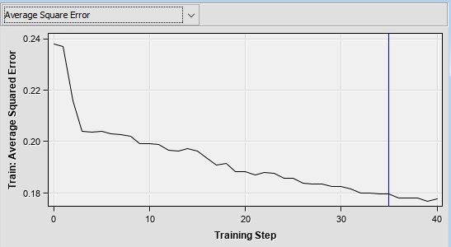
The average squared error is minimum at 35 training step which is optimal. At higher training step of neural mode, the error decreases.

Slide 28
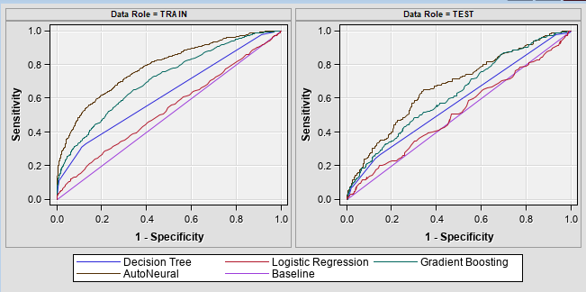
Model Evaluation Criteria and Final Model
Auto Neural model gave the highest sensitivity compared to other classifieds in distinguishing water quality in test data. Also, the auto-neural model gives higher sensitivity compared to other classifiers in test data.

Slide 29
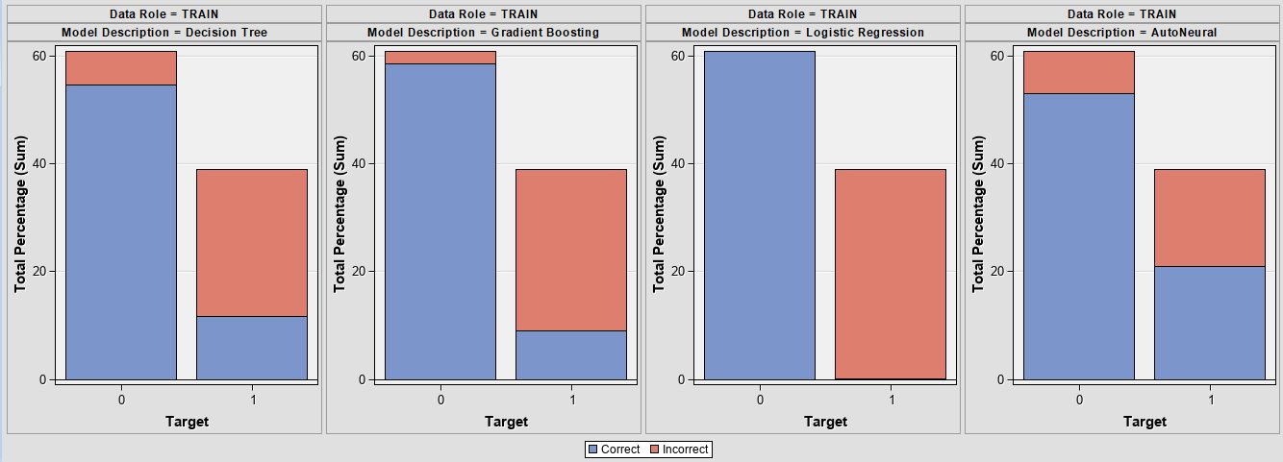
In potable water samples Logistic regression give the lowest mis classification rate and in case of polluted water samples, Auto Neural network gave the lowest miss classification rate. In overall comparison, Auto neural network gives the lowest misclassification rate considering the distribution of samples.

Slide 30
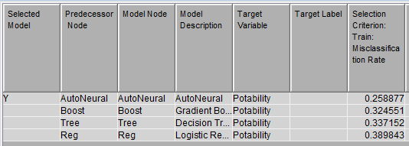
The final model is auto neural model which gave the lowest mis classification rate in training data. The selected criteria was the misclassification rate in training data and target variable was potability which addicted the quality of water.

Slide 31
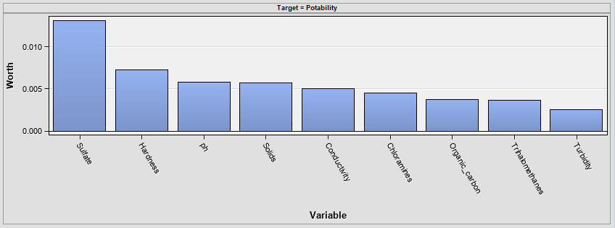
The features like the first sulphate, hardness, pH, solids, and conductivity are having higher importance in predicting the potability of water.

Slide 32
Interpretation and Recommendations
pH, Sulfate, hardness, and solids are very important in the classification of potable and polluted water.
AutoNeural Network gives the highest accuracy in predicting water quality.
Most of the samples contain missing values which are imputed with the help of the average value.
The size of the data is very less and this can be one reason for high rate of misclassification.

Slide 33
Recommendation
The data size should be increased to achieve better accuracy.
The samples should be balanced to achieve minimum misclassification.
The features correlation should be analyzed to get an idea of multi-collinear features.

Slide 34
Summary and Lessons learned
During the visualization we have learnt that the features have common characteristics in both portable and non-potable water. So machine learning algorithms might give confusing results based on the similar patterns observed between potable and non-potable water.
From the visualization perspective, we have learnt different visualization approaches where we have learnt how to change the aesthetic performance of the plots and we also learnt how to build different predictive models in SAS Enterprise Miner.
Due to fewer sized samples, the model struggled to give good performance. Also, the polluted samples are fewer due to which the model gave minimum accuracy.

Slide 35
Future Work
The future work includes adding more informative data that can easily distinguish water quality. Also there are other features such as color and smell which can be added for better clarification of potable and non-potable water.
Non-potable water samples should be balanced as because predictive modeling techniques highly misclassified some samples in test data.

Slide 36
Thank You

