Slide 1

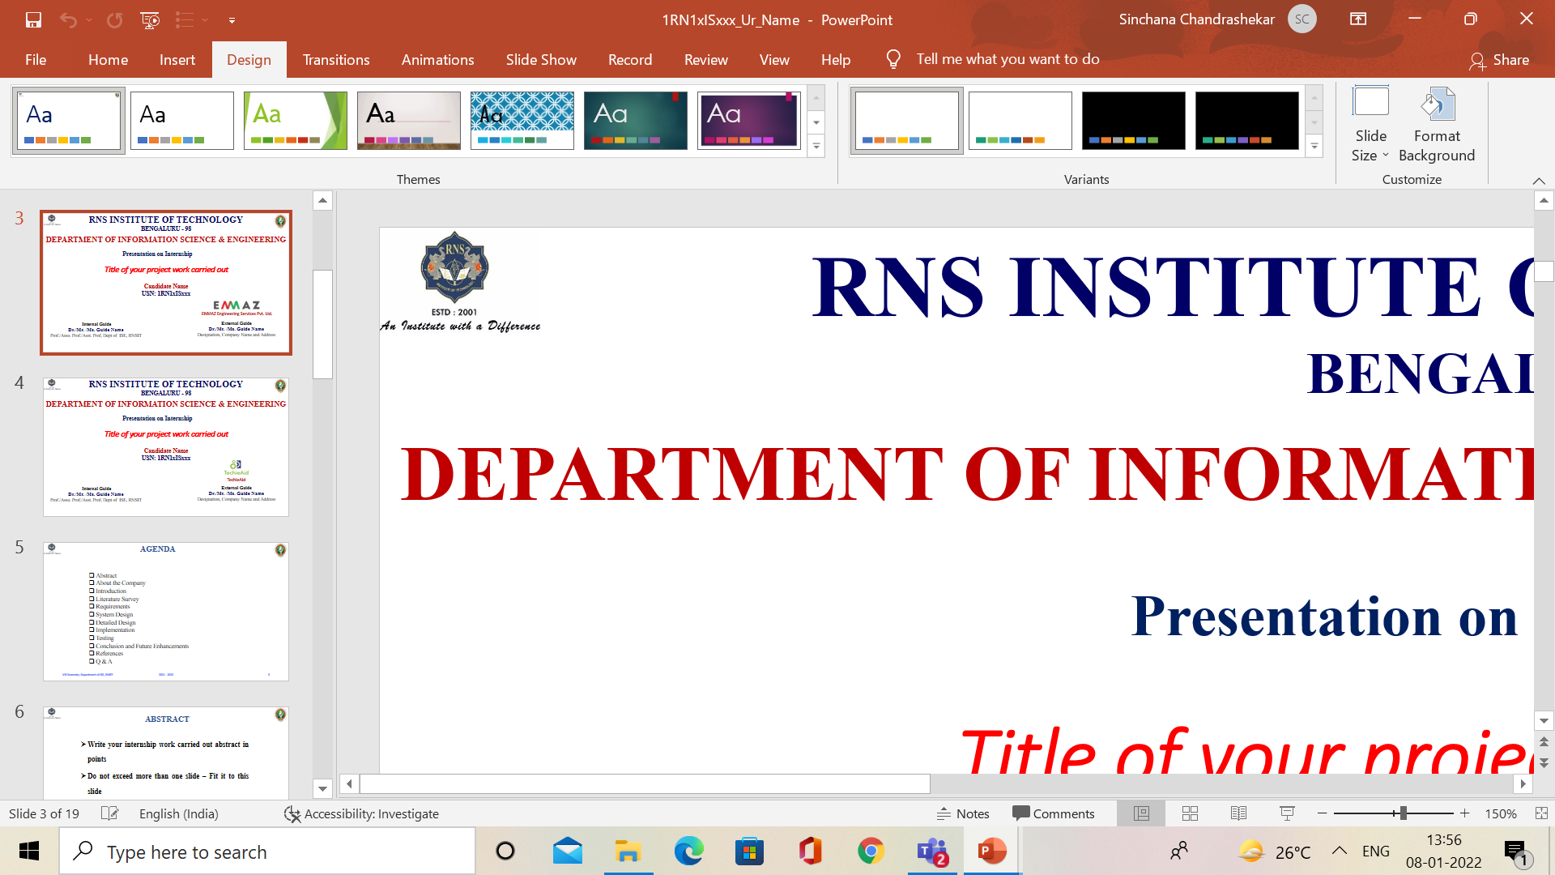

ONLINE FLOWER SHOP
RNS INSTITUTE OF TECHNOLOGY
BENGALURU - 98
DEPARTMENT OF INFORMATION SCIENCE & ENGINEERING
Presentation on Internship
NAME:PRATHIMA HOLLA
USN: 1RN18IS078
ENMAZ Engineering Services Pvt. Ltd.
Internal Guide
Ms. Sowmya SK
Asst. Prof, Dept of ISE, RNSIT
External Guide
Mr. Akshay
Enmaz

Slide 2
AGENDA
About the Company
Abstract
Introduction
Requirements
System Design
Detailed Design
Implementation
Testing
Conclusion and Future Enhancement
References
Q & A

Slide 3
ABOUT THE COMPANY
Enmaz is the IT services company registered under Govt. of India, Ministry of Micro, Small & Medium Enterprises.
Enmaz has a simple yet robust solution that helps any Industry/Factory digtise their workfloor in no time.
The products offered will help in remote monitoring ,controlling and also analysing and machine parameter or process.
Their Mission is to empower their customers with necessary knowledge, skills and resources for them to succeed in their endeavors.

Slide 4
ABSTRACT
Flutter is an open-source cross-platform mobile application development SDK created by Google.
Dart is a programming language designed for client development, such as for the web and mobile apps.
Online Flower Shop is a flower shop management system project. It is a cross platform application which is developed using Flutter .
This application focuses only on the basic front-end of the application and the flutter application is developed on Visual Studio by using Dart as the programming language .

Slide 5
INTRODUCTION
This is a real time project, where we have designed a software for the customers to order flowers online.
General features of online flower shopping is about the details of the flowers available in the store with the details of each flower.
The software uses Flutter which makes it easier to created, fast, reliable and secure

Slide 6
REQUIREMENTS
Software Requirement
Hardware Requirement
Name of the components | Specification
Operating System | Windows 10
Language | Dart
Software development kit | Flutter,Visual studio code
Name of the components | Specification
Processor | 10 th Gen Core i7 Processor
RAM | 8 GB
Hard Disk | 512 GB SSD
Speed | 2.33 Ghz

Slide 7
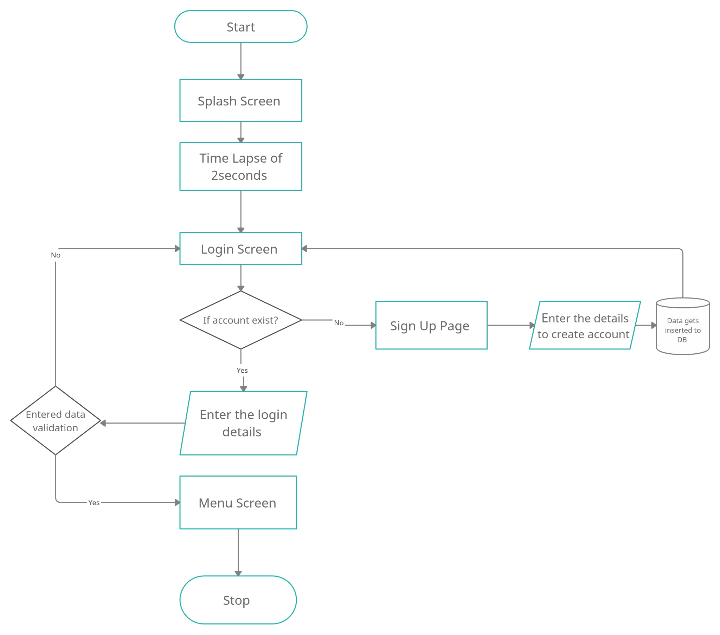
SYSTEM DESIGN
Figure: System Architecture

Slide 8
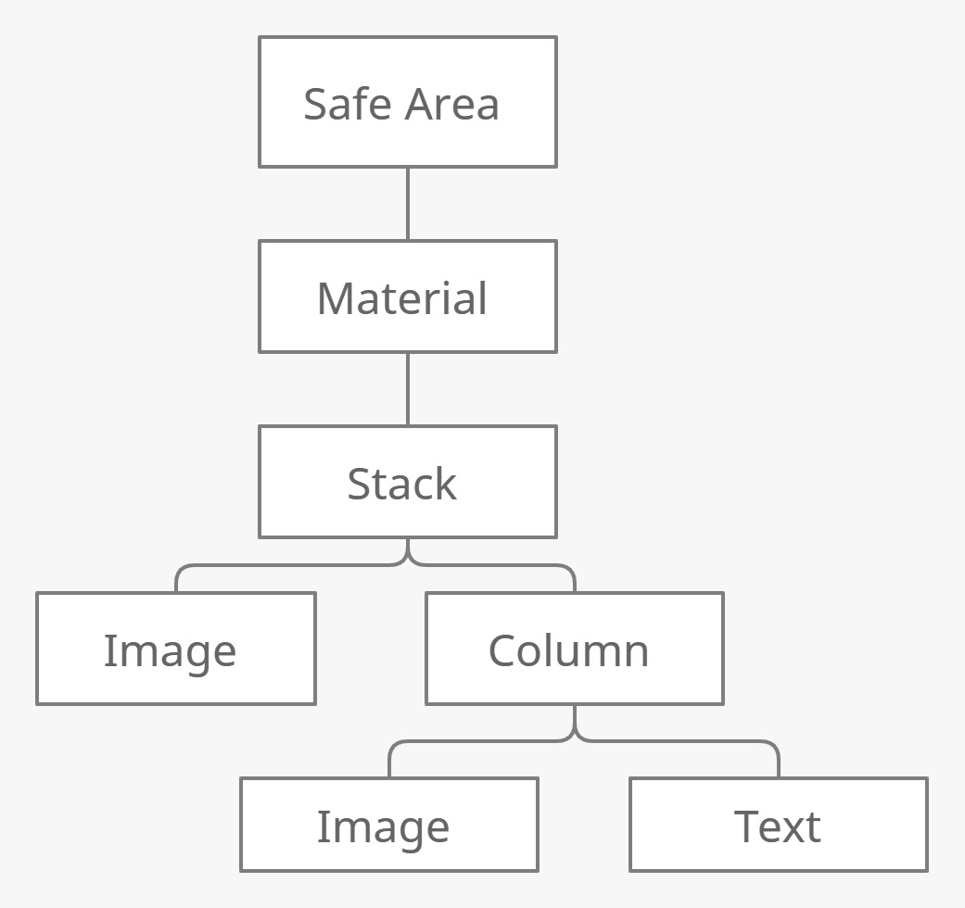
DETAILED DESIGN
Figure : Widget Tree of Splash Screen

Slide 9
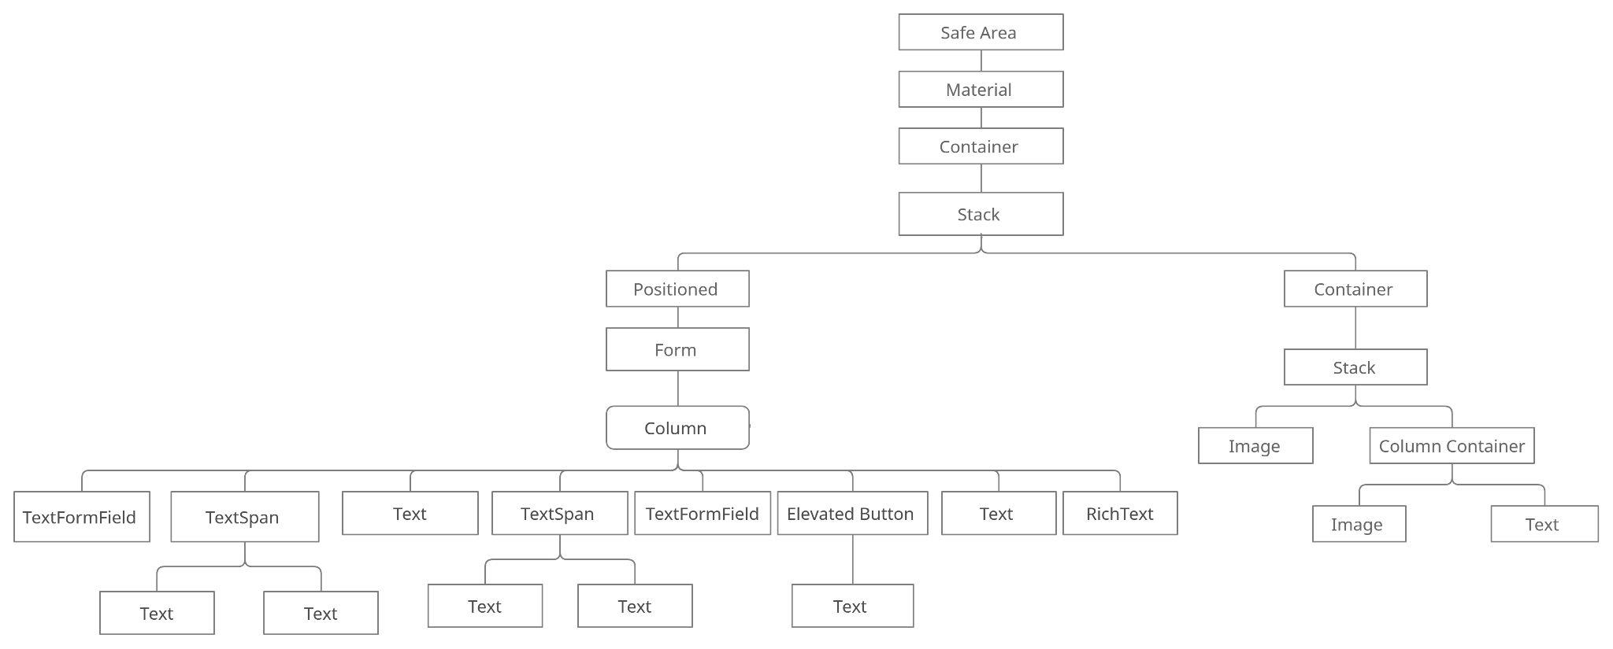
DETAILED DESIGN
Figure : Widget tree of Login

Slide 10
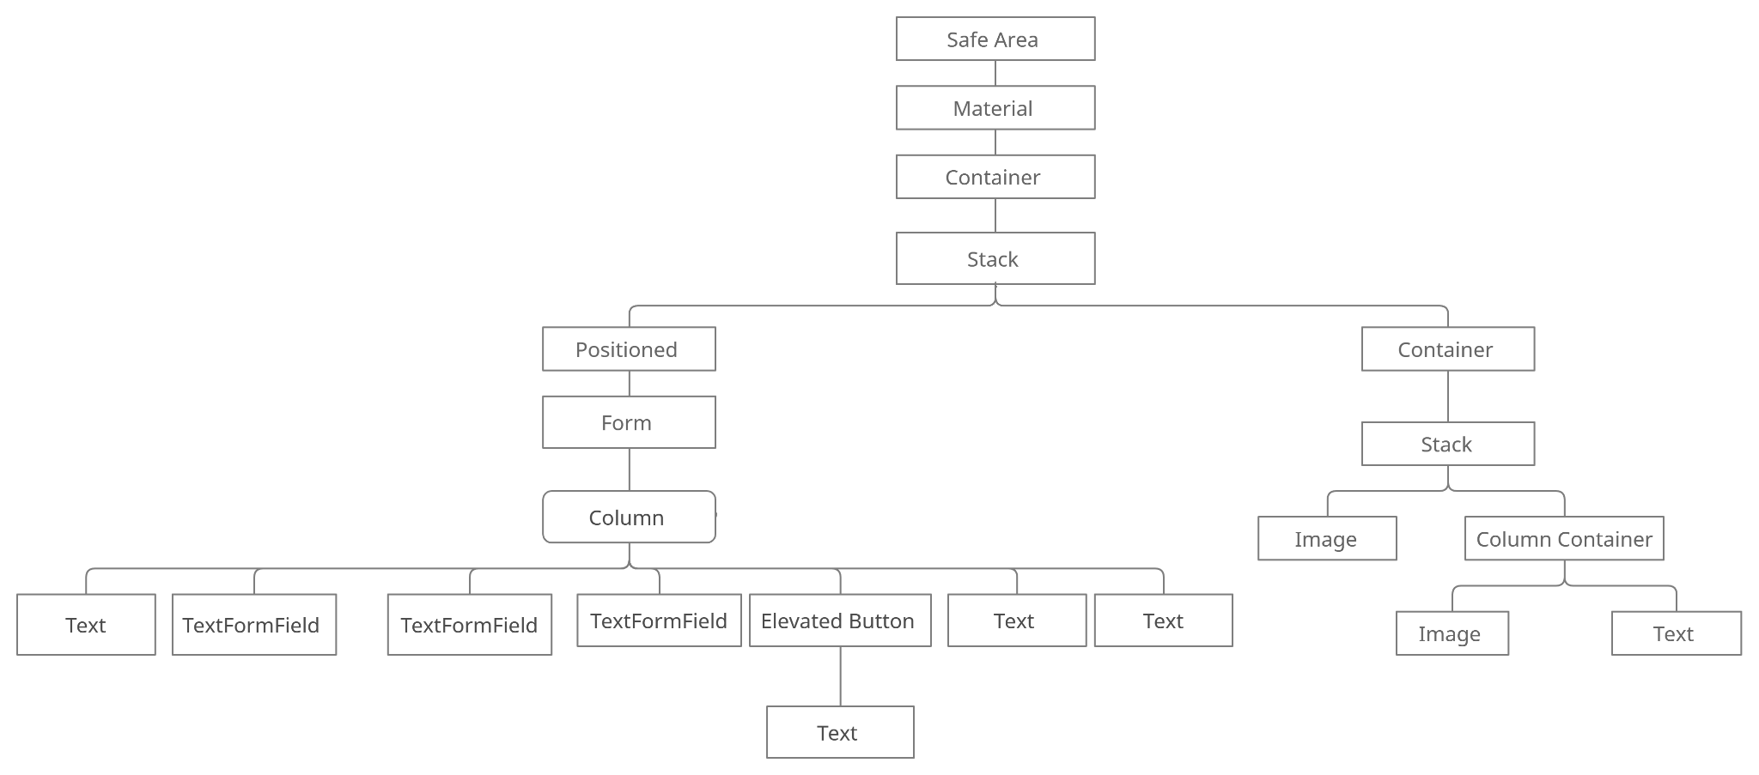
DETAILED DESIGN
Figure : Widget Tree for Sign Up
VIII Semester, Department of ISE, RNSIT
2021 - 2022

Slide 11
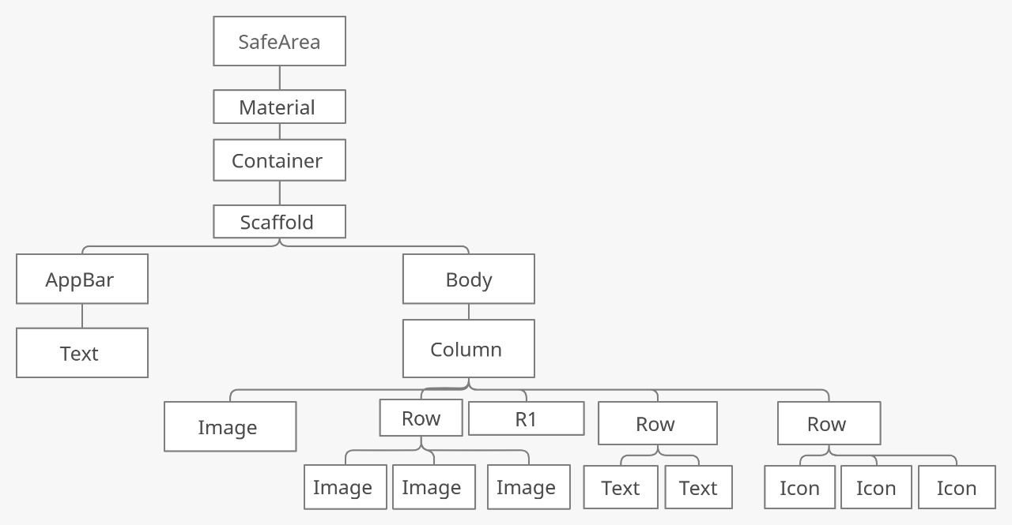
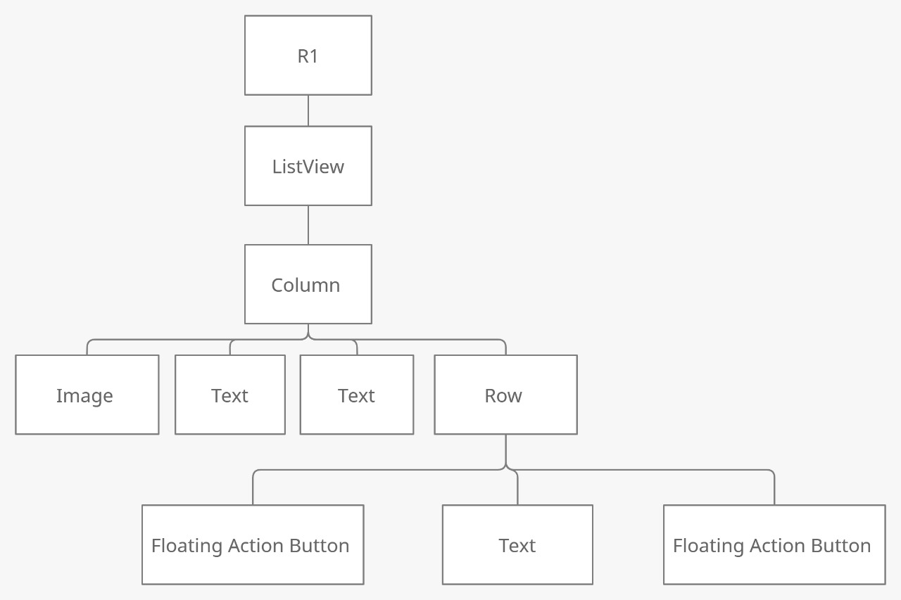
DETAILED DESIGN
Figure : Widget Tree for Home Screen
VIII Semester, Department of ISE, RNSIT
2021 - 2022

Slide 12
IMPLEMENTATION
Creating Table in the DataBase :
Future? _onCreate(Database db, int version){
db.execute( '''
CREATE TABLE $_tableName(
$_columnUserName text not null,
$_columnEmail text not null,
$_columnPAssword text not null)'''
);
}
Inserting Data into Table :
Future insert(Map row) async{
Database? db=await instance.database;
await db?.insert(_tableName,row);
}

Slide 13
IMPLEMENTATION
Navigation Across the Screen :
initialRoute: '/',
routes: {
'/':(context)=>splashScreen(),
'/login':(context)=>loginScreen(),
'/home':(context)=>homeScreen(),
'/signin':(context)=>signInScreen(),
},
Splash Screen :
void nextScreen(){
Future.delayed(Duration(seconds: 2),(){
Navigator.pushReplacementNamed(context, '/login');
};

Slide 14
IMPLEMENTATION
Incrementing and Decrementing the quantity
FloatingActionButton(
child: Icon(
Icons.add,color: Colors.white,
),
onPressed: () {
setState(() {
widget.popular.count++;// incrementing
// decrementing : widget.popular.count –;
});
},
}

Slide 15
TESTING
Unit Testing:
Unit testing is a level of software testing where individual units/ components of a software are tested. The purpose is to validate that each unit of the software performs as designed. A unit is the smallest testable part of any software. It usually has one or a few inputs and usually a single output.
 | Description | Input Data | Actual Output | Expected Output | Status
1 | In login screen | Entering non existing email ID and non existing password | Stays on the login screen | Stays on the login screen | Pass
2 | In login screen | Entering non existing email ID and existing password | Stays on the login screen | Stays on the login screen | Pass
3 | In login screen | Entering existing email ID and correct password | Stays on the login screen | Stays on the login screen | Pass
4 | In login screen | Entering existing email ID and corresponding password | Login | Login | Pass
5 | In signup screen | Enter name, email Id and password | Sign up and proceed to login | Signup and proceed to login | Pass
6 | In home screen | The plus signing clicking | Increments the values | Increments the values | Pass
6 | In home screen | The minus signing clicking | Decrements the values | Decrements the values | Pass

Slide 16
TESTING
System Testing:
System testing is defined as testing of a complete and fully integrated software product. This testing falls in black-box testing wherein knowledge of the inner design of the code is not a prerequisite and is done by the testing team. System testing is done after integration testing is complete. System testing should test functional and non-functional requirements of the software.
 | Description | Input Data | Actual Output | Expected Output | Status
1 | In Sign Up screen | Enter user name, email and password | The data gets stored into the database and goes to the next page | The data gets stored into the database and goes to the next page | Pass
2 | In login screen | Enter username and password | Check if the email Id and password exists in the database | Check if the email Id and password exists in the database | Pass
VIII Semester, Department of ISE, RNSIT

Slide 17
TESTING
Validation Testing:
In this, requirements established as part of software requirements analysis are validated against the software that has been constructed. Validation testing provides final assurance that software meets all functional, behavioral and performance requirements. Validation can be defined in many ways but a simple definition is that validation succeeds when software Function in a manner that can be reasonably by the customer.
 | Description | Input Data | Actual Output | Expected Output | Status
1 | In Sign Up screen | If username not entered | Message stating enter username | Message stating enter username | Pass
2 | In Sign Up screen | If email not entered | Message stating enter email | Message stating enter email | Pass
3 | In Sign Up screen | If password not entered | Message stating enter password | Message stating enter password | Pass
2 | In login screen | If email not entered | Message stating enter email | Message stating enter email | Pass
3 | In login screen | If password not entered | Message stating enter password | Message stating enter password | Pass
VIII Semester, Department of ISE, RNSIT

Slide 18
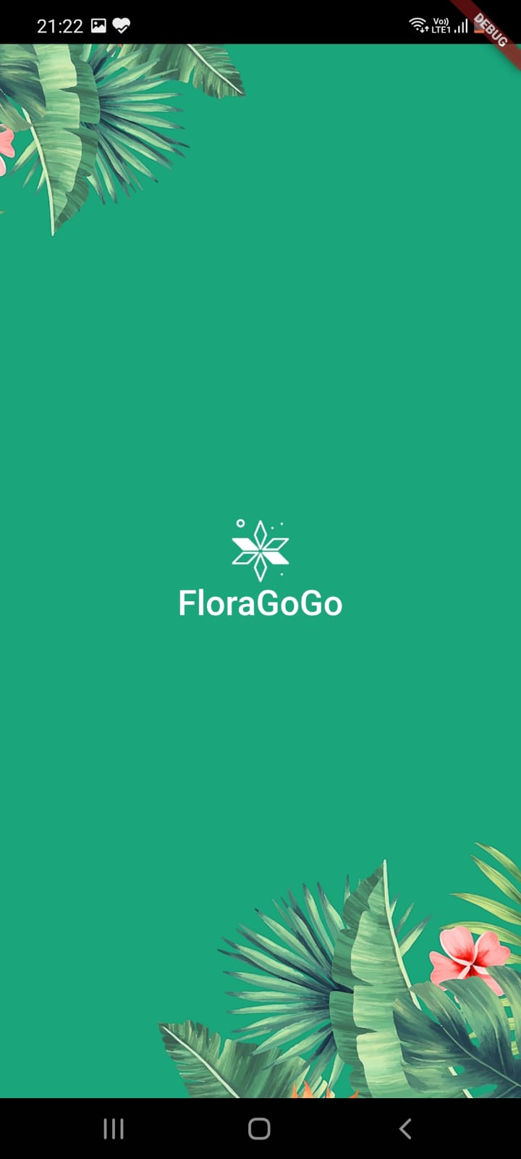
RESULTS
1.Splash Screen:

Slide 19
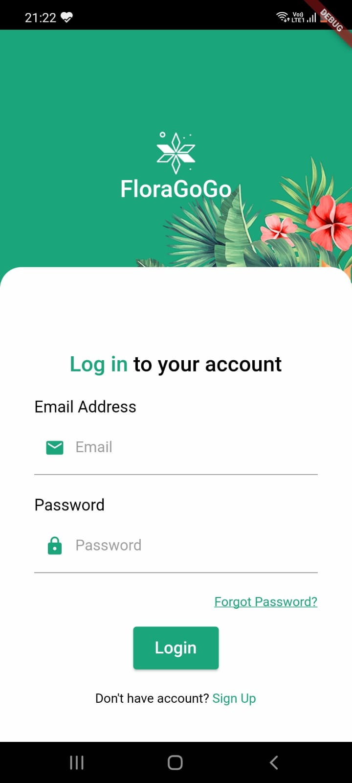
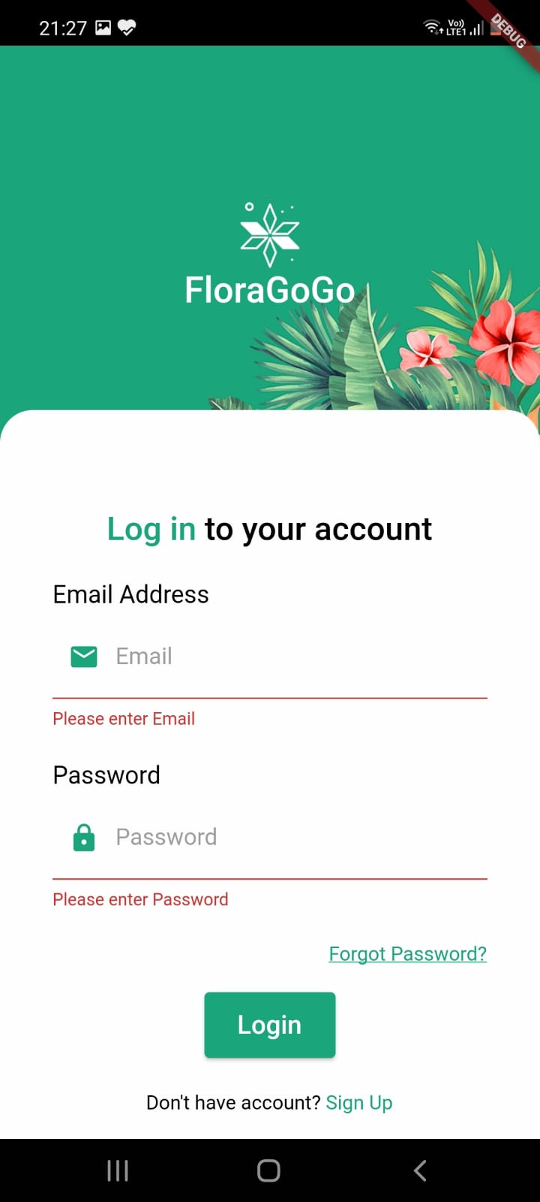
RESULTS
2.Login Screen:

Slide 20
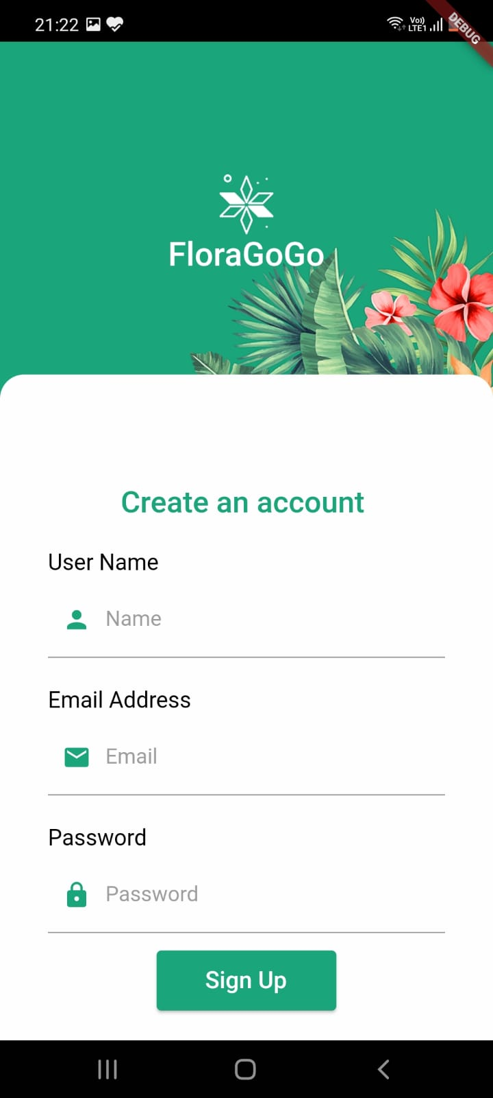
RESULTS
3. SignUp Screen:

Slide 21
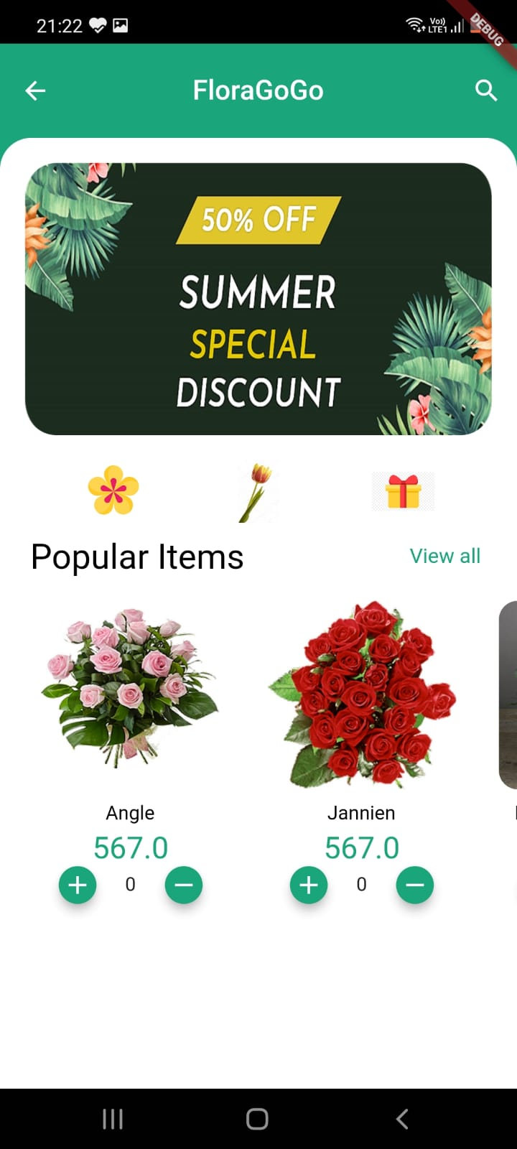
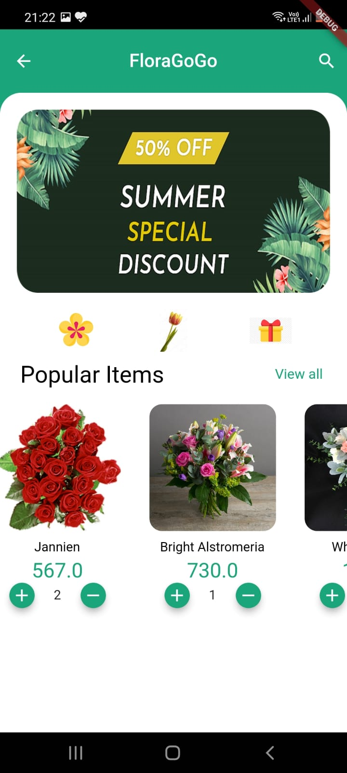
RESULTS
4. Home Page:

Slide 22
CONCLUSION
Online Flower Shop, the online flower selling application is a 4 screen application .
The developed application focuses purely on the UI.
The application performs basic validation of the user using the database.
It has details of flowers that are available in the online application and has an option of choosing the quantity that is needed.

Slide 23
FUTURE ENHANCEMENT
Forgot Password Screen can be implemented
Menu screen can be designed a better way
Features to add items into cart can be done .
Payment Page and Billing Page can be designed.
Backend for this application can be developed.

Slide 24
REFERENCES
[1] https://flutter.dev/
[2] https://www.javatpoint.com/flutter
[3] https://www.geeksforgeeks.org/flutter-tutorial/
[4] https://medium.com/flutter
[5] https://stackoverflow.com/questions/tagged/flutter

Slide 25
Question and Answer

Slide 26
THANK YOU

