Slide 1


Latent Space Representation using Autoencoders and VAEs
Exploring how Autoencoders and Variational Autoencoders learn efficient data representations.
by dudekula prathimabi

Slide 2
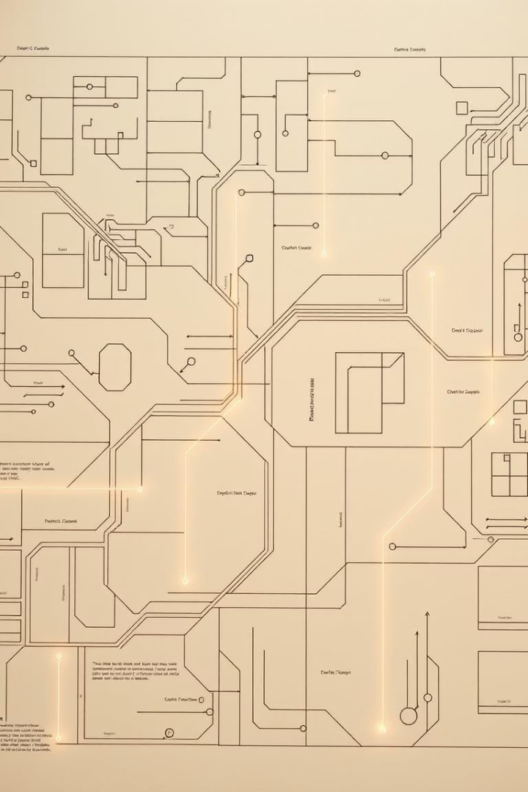
Objectives
1
Build Models
Implement Autoencoders and VAEs.
2
Visualize Latent Space
Understand data distribution in reduced dimensions.
3
Compare Reconstructions
Assess fidelity of generated outputs.
4
Perform Latent Arithmetic
Explore meaningful transformations.

Slide 3
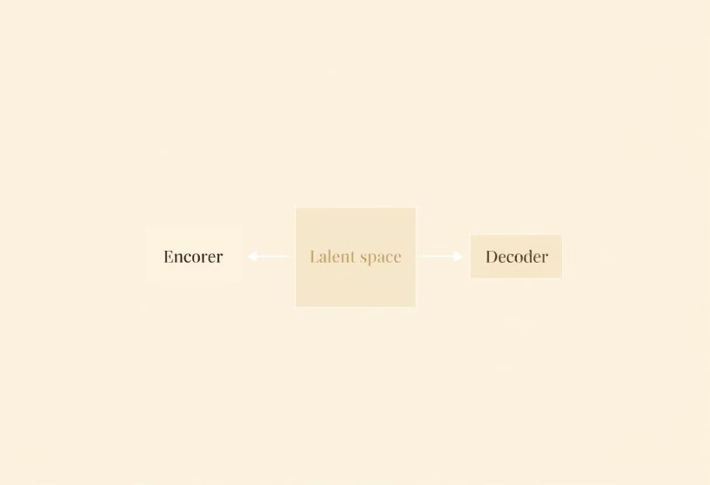
Autoencoder (AE) Architecture
Encoder + Decoder
Maps input to latent vector, then reconstructs output.
Loss Function
Mean Squared Error (MSE) for reconstruction accuracy.
Activation Functions
ReLU for hidden layers, Sigmoid for output (image pixel range).

Slide 4



Variational Autoencoder (VAE) Architecture
Key Difference
Encodes input into a distribution (mean µ and variance σ).
Reparameterization Trick
Enables backpropagation through the sampling process.
KL Divergence
Regularizes latent space to follow a normal distribution.

Slide 5
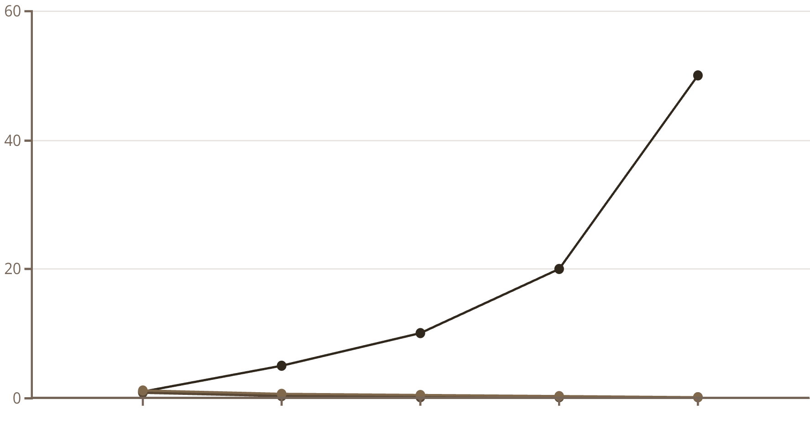
Training Loss Curves
Epoch
AE Loss
VAE Loss
AE loss typically converges faster due to simpler objective. VAE loss includes KL divergence, often higher but ensures smooth latent space.

Slide 6
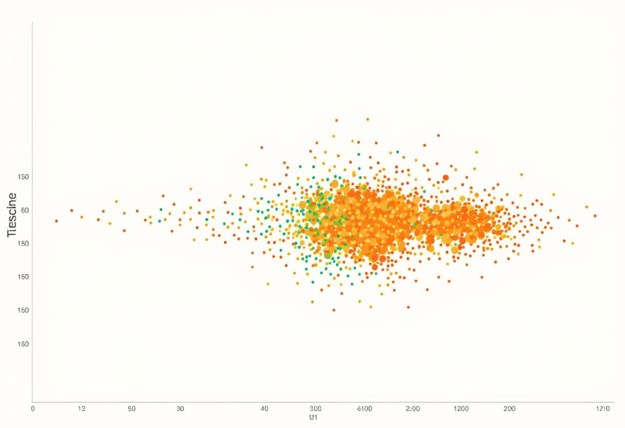

Latent Space Visualization
Using t-SNE to project high-dimensional latent vectors into 2D space.
AE Plot
VAE Plot
Shows distinct, separated clusters. Sparse between clusters.
Clusters are more continuous and overlap. Ideal for generation.

Slide 7
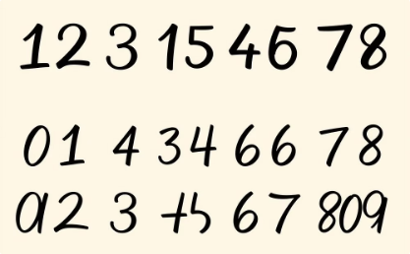
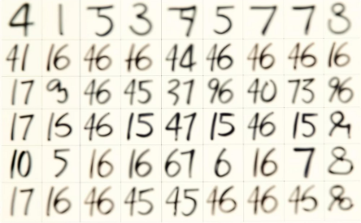
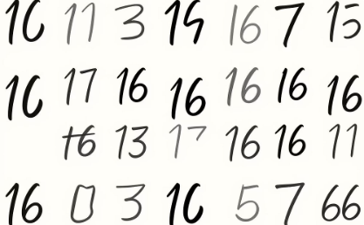
Reconstruction Results
Original Images
Diverse set of input data.
AE Reconstructions
High fidelity, sometimes slightly sharper.
VAE Reconstructions
Smoother, more diverse, less precise fidelity.
AEs aim for exact reconstruction, while VAEs balance reconstruction with latent space regularity for better generalization.

Slide 8
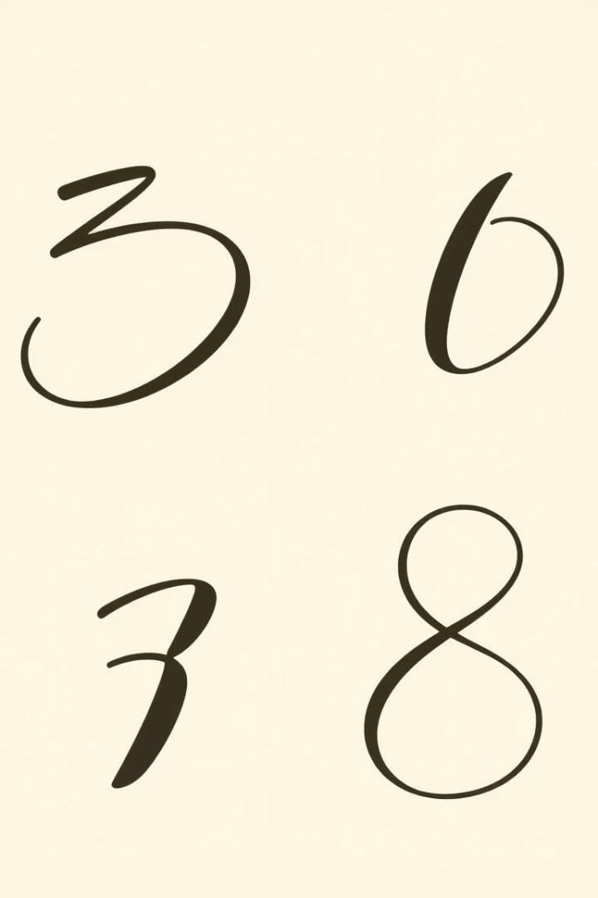



Latent Vector Arithmetic
Interpolating between latent vectors reveals the learned data manifold.
Start (Digit 3)
Latent vector for a "3".
Interpolation
Linearly combine vectors.
End (Digit 8)
Latent vector for an "8".
VAE's continuous latent space enables smooth and meaningful transitions between different data points, like morphing one digit into another.

Slide 9
Comparative Analysis: AE vs VAE
Goal
Data compression & reconstruction
Generative model & reconstruction
Latent Space
Discontinuous; sparse clusters
Continuous; structured distribution
Generative Capability
Poor (random sampling unreliable)
Good (can sample from latent space)
Complexity
Simpler architecture & training
More complex; additional loss term
VAE is superior for generative tasks due to its structured and continuous latent space, allowing for meaningful interpolations and novel sample generation.

Slide 10
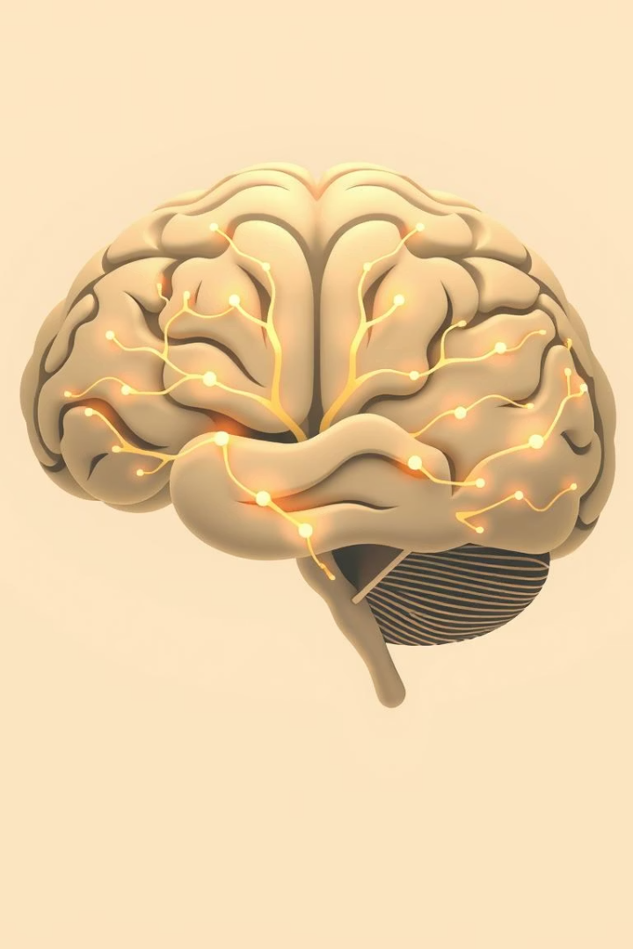
Key Learnings & Next Steps
Latent Space Insights
Represents condensed data features.
Crucial for generative tasks.
Model Differences
AE for efficient data compression.
VAE for generating novel data points.
Future Experiments
Complex datasets (e.g., CIFAR-10).
Incorporate attention mechanisms.
Explore various latent dimensions.

Slide 11
Thank You

