Slide 1
Banking Performance & Strategic Focus
Insights & Recommendations
Presented by: ( Group 6 )
1.Neha
2.Naziya
3.Binita
4.Ananya
5.Pooja
6.Prathmesh

Slide 2
Introduction of Bank
A financial institution licensed to receive deposits and make loans.
Offers savings, checking accounts, loans, credit/debit cards, and more.
Acts as a financial intermediary between depositors and borrowers.

Slide 3
Bank Analysis
How It Works
Key Important Areas
Deposits: Customers place money into bank accounts.
Lending: Banks loan deposited funds to individuals/businesses.
Revenue: Earns interest and fees from loans and services.
Provides services like ATMs, mobile/internet banking, etc.
Complies with national and international financial regulations.
Customer Service – Digital experience and accessibility.
Risk Management – Handling credit, operational risks.
Product Offering – Loans, cards, insurance, etc.
Technology Integration – Mobile apps, AI, automation.
Profitability & Cost Control – Balancing costs and income.

Slide 4
Bank Success An Findings
Key Success
Findings
Strong Customer Base.
Efficient Credit & Debit Transactions.
Low Non-Performing Assets (NPAs).
Data-Driven Decision Making.
High Transaction Volume with Low Operational Costs.
Adaptability to Digital Trends.
High debit transaction frequency on weekdays.
Some branches show high customer engagement.
Credit transactions peak in Q1 and Q3; debit during festivals.
Lower service usage by low-income segments—indicates access gap.
Retention higher in auto-payment and reward-linked accounts.

Slide 5
Areas Where Bank Needs to Focus
Digital Inclusion for rural/low-income customers.
Enhanced transaction monitoring and fraud detection.
Optimize underperforming branches using analytics.
Offer personalized services based on customer behavior.
Improve customer engagement via loyalty and feedback systems.
Streamline operations to reduce cost-to-income ratio.

Slide 6
Excel Insights – Banking & Debit An Credit Overview
Banking analytics empowers financial institutions to make data-driven decisions.
It provides deep insights into loan trends, customer behavior, and transaction patterns.
Dashboards help visualize complex datasets, allowing banks to optimize operations, manage risk, and better serve customers.
This presentation highlights key metrics and performance trends using Excel-based dashboards.

Slide 7
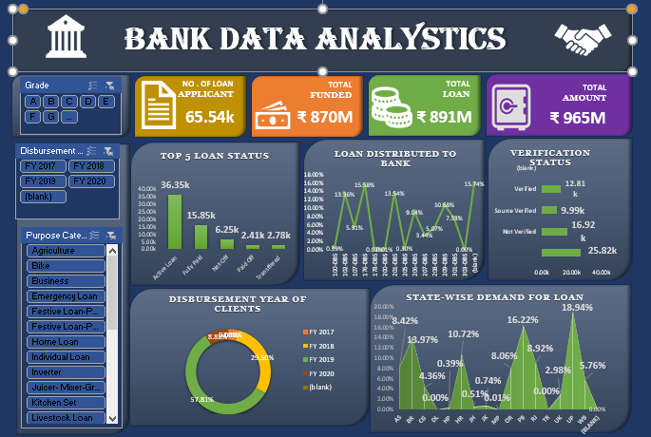
Key Insights –Bank Data Analytics-Dashboard
Over 65K loan applicants with total funding close to ₹870M.
- Home loans are the most sought after, followed by business and agriculture.
- Major disbursements occurred in FY2019 and FY2020.
- State-wise loan demand highest in top three regions: 18.94%, 16.22%, and 13.08%.
- Over 52K applications are unverified, indicating a need for better verification

Slide 8
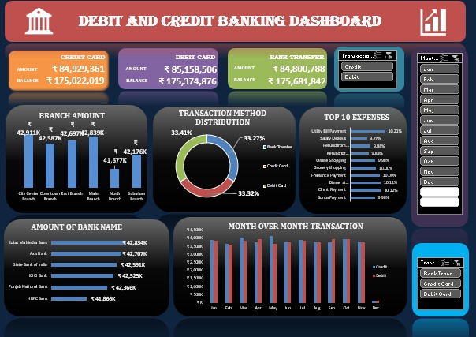
Key Insights –Debit and Credit Banking Dashboard
- Balanced distribution of transactions across bank transfer, credit card, and debit card.
- Top branches show transaction volumes above ₹42K.
- Consistent transaction activity across months with minor seasonal dips.
- Leading expenses include utility bills, rent, and online purchases.
- Multiple banks actively contribute to total balance and transaction volume.

Slide 9
Tableau Insights – Banking & Debit An Credit Overview
Purpose of Analysis:
• Summarized loan and transaction data across dashboards.
Loan growth and high-value customer segments are strong.
Opportunities lie in recovery strategies and transaction optimization.

Slide 10
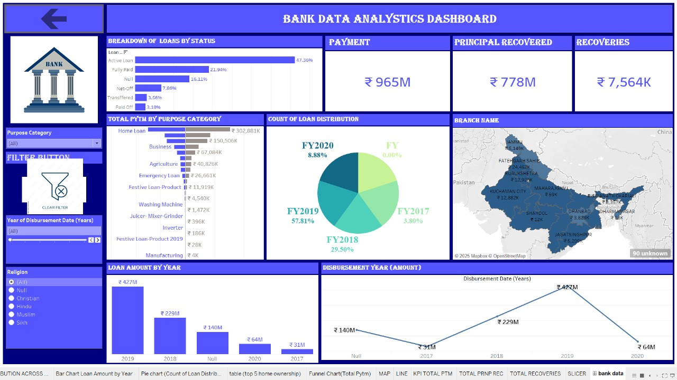
Bank Data Analytics-Dashboard Overview
Key Metrics
Total Payment: ₹965M
Principal Recovered: ₹778M
Recoveries: ₹7,564K
Top Loan Categories:
- Home Loan – ₹302.8K
- Business – ₹150.5K
- Agriculture – ₹40.8K

Slide 11
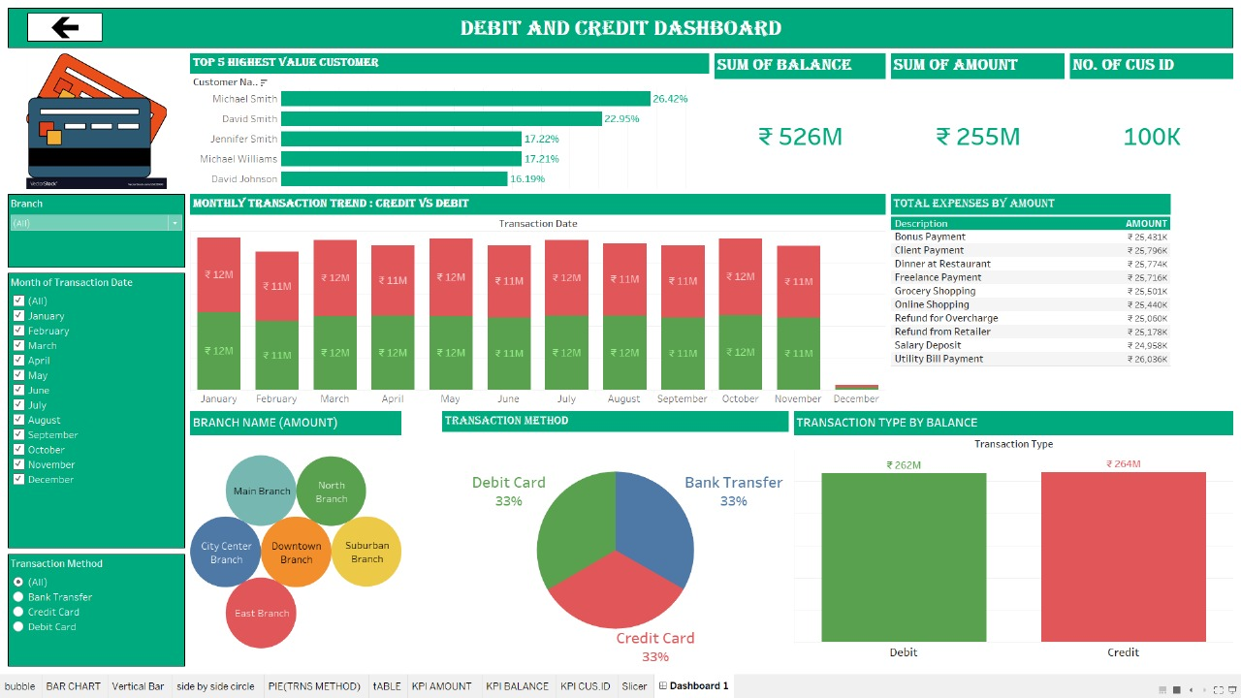
Debit and Credit -Dashboard Overview
Key Metrics
Total Balance: ₹526M
Total Amount: ₹255M
Customer IDs: 100K
Top Customers by Value:
- Michael Smith: 26.42%
- David Smith: 22.95%

Slide 12
Power BI Insights – Banking & Debit An Credit Overview
Purpose of Analysis:
• Consolidated view of banking and debit performance
Data sources: BANKING and DEBIT AN CREDIT
• Focus: Total Loans, Debits, Branch/Product/Customer KPIs.

Slide 13
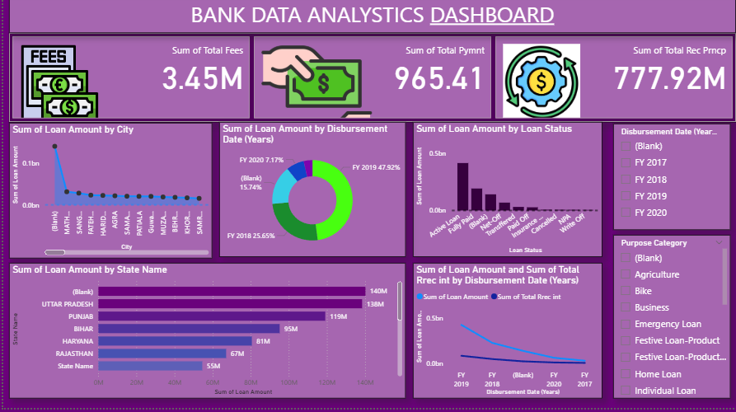
Banking Overview
Key Metrics:
• Total Loan Amount (by product/branch)
• Revenue Breakdown: Interest, Fees, Total
• Product-wise Performance Chart
📌 Insert relevant Power BI visual screenshot here

Slide 14
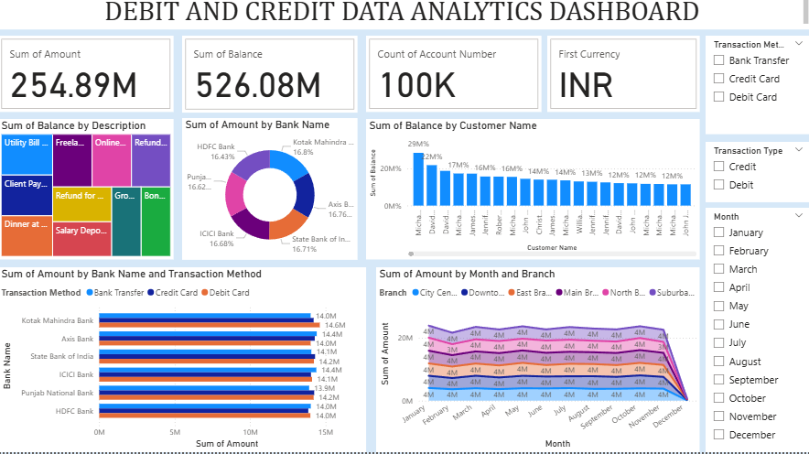
Debit An Credit Overview
Key Metrics:
• Total Debits and Monthly Trends
• Category-wise or Branch-wise Debits
• Customer/Transaction-wise breakdown
📌 Insert relevant Power BI visual screenshot here

Slide 15
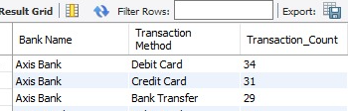
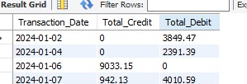
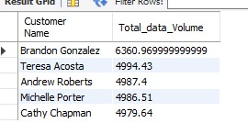

SQL Queries for Debit An Credit Analytics
Breakdown of Transaction Methods per Bank Data sources: BANKING and DEBIT AN CREDIT
Daily Total Debit and Credit Amounts
Top 5 Customers by Total Transaction Volume
Branch wise count of transaction

Slide 16
Conclusion
Bank success relies on efficiency, digital transformation, and customer focus.
Data analytics enables better decisions and profitability.
Continuous monitoring and adaptation are essential in a dynamic market.

Slide 17

Thank You 😊
We appreciate your time and attention!

