Slide 1

Twitter Sentimental Analysis

Slide 2

Table Of Content
Problem Statement.
Project Workflow
Model Building and Evaluation
Model Accuracy
Results
Applications
References

Slide 3


Problem Statement
As social media continues to influence public opinion, there is a growing need for effective sentiment analysis tools. This project focuses on classifying sentiments in 1.6 million tweets from the Sentiment140 dataset, providing valuable insights for businesses and researchers to better understand public sentiment and enhance decision-making.

Slide 4
Project Workflow
Data Loading and Preprocessing
Feature Extraction
Train-Test Split
TF-IDF Vectorization
Extract Data
Data Cleaning
Text Preprocessing
Model Building and Evaluation
Testing
Performance Evaluation
Model Deployment and Saving

Slide 5
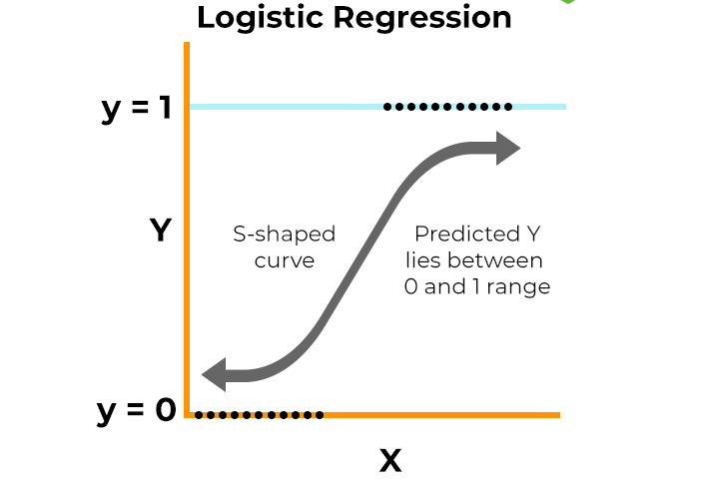

Model Building
What is Logistic Regression?
Logistic Regression is a binary classification algorithm used to predict the probability of an outcome (e.g., positive or negative sentiment).
How Does It Work?
It models the probability of the positive class using the sigmoid (logistic) function.

Slide 6
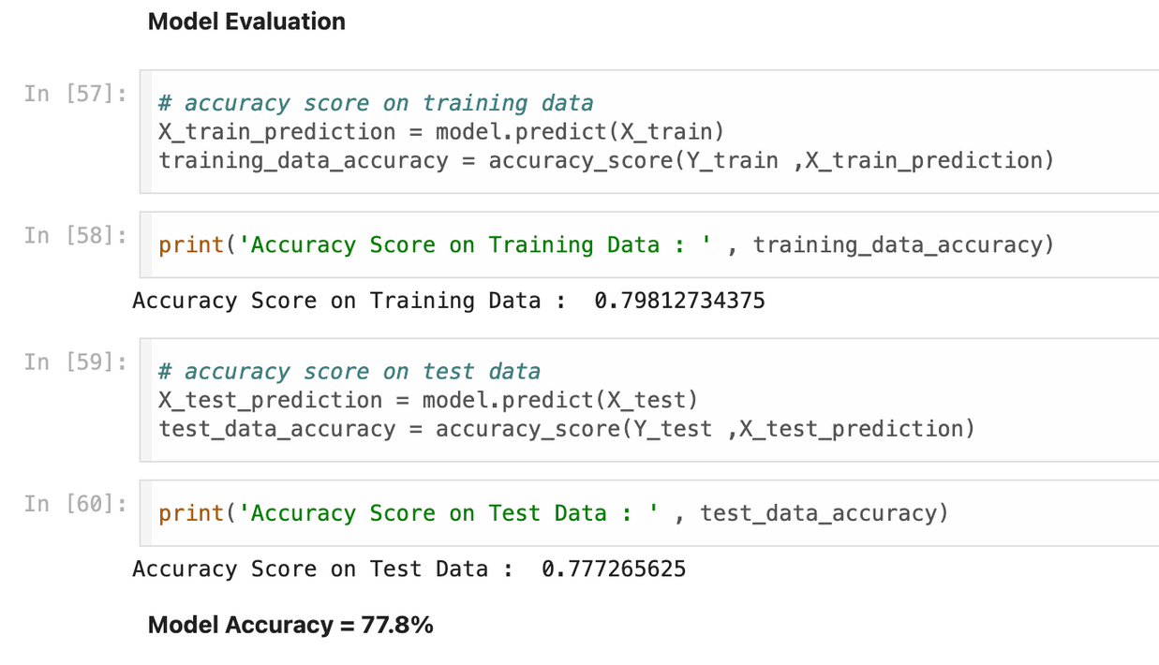
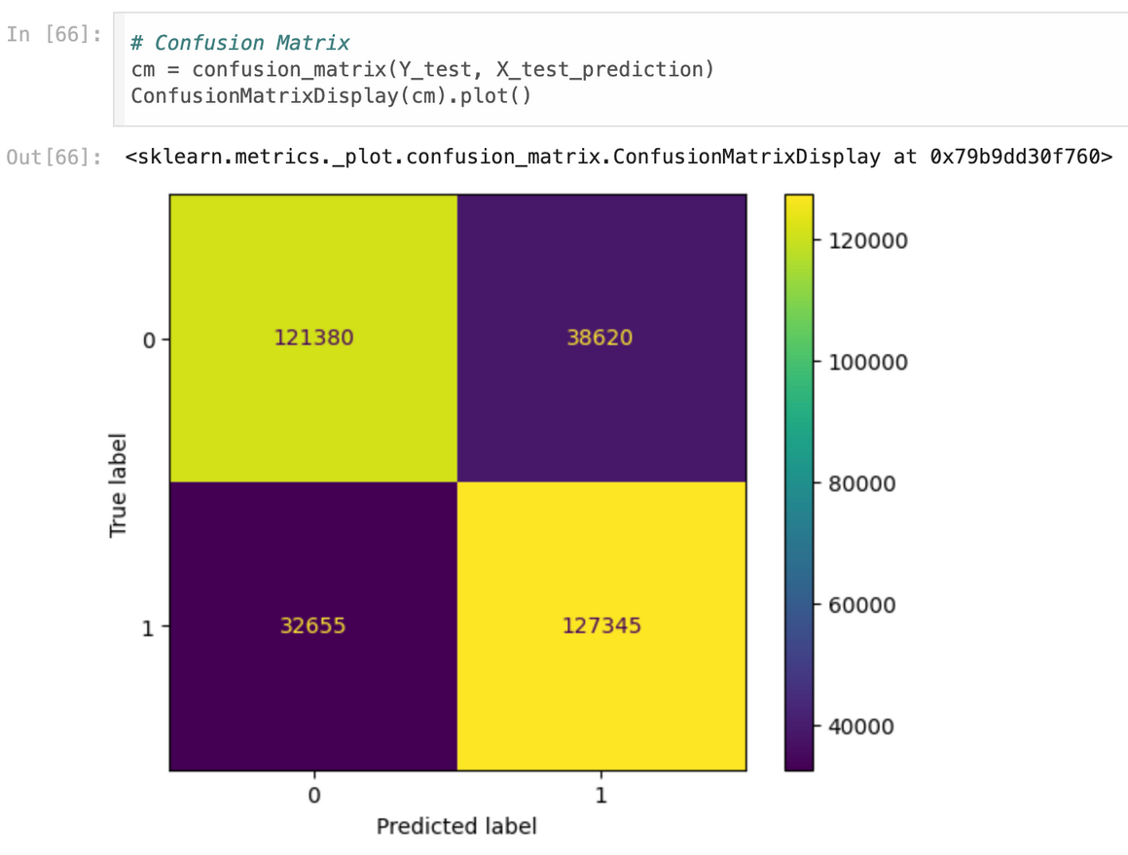
Model Evaluation
SOCIAL MEDIA | QUARTERLY REPORT
DECEMBER 2020

Slide 7
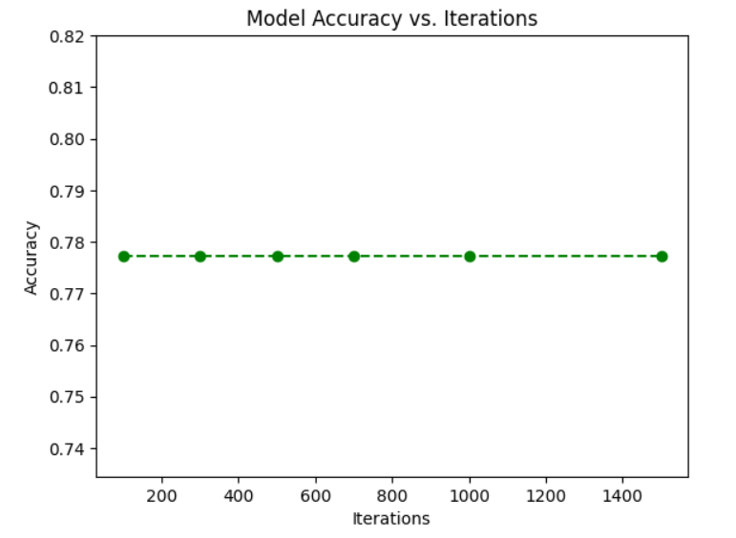
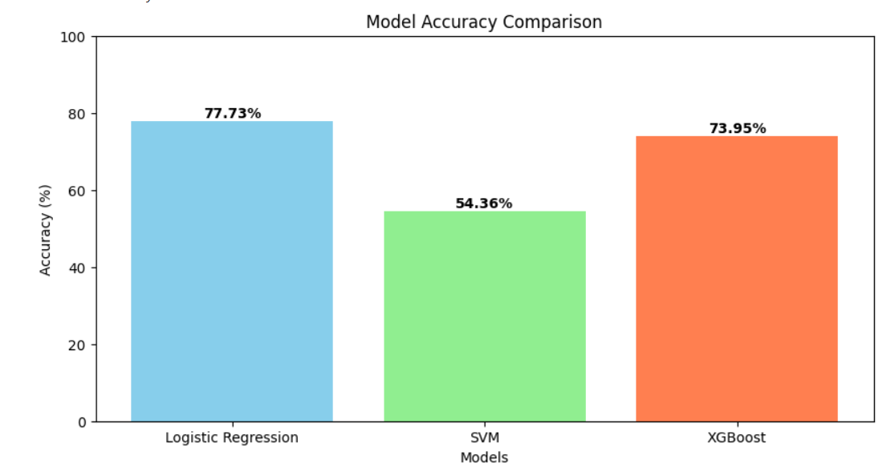
Results

Slide 8
Brand Monitoring:
Companies can track public sentiment toward their brand or products by analyzing tweets.
Market Research:
Businesses can analyze consumer opinions on trends, products, or services.
Political Sentiment:
Analyze public opinion about political candidates, policies, or events.
Applications

Slide 9


Refference
Kaggle Dataset
NLTK Documentaion
Scikit-learn Documentation

