Slide 1


BUSINESS TRACK · DETAILED SUBMISSION ROUND · 8–10 SLIDE DECK + WORKING PROTOTYPE
Building Meesho's Consumer-to-Manufacturer (C2M) Base
Screen on price, not scale. Pay for early conviction in impressions, not rupees. Make nothing until it is sold.
Team 23B0747 · Indian Institute of Technology Bombay
Prathmesh Walimbe · Krishna Kanta Mondal
Live prototype meesho-dice-c2m-iitb.vercel.app
Scan to open
Notes:
Cover. Team 23B0747, IIT Bombay. The deck answers the four questions in the brief across nine sections; the live prototype runs every rule on synthetic data.

Slide 2








1 · SEGMENTATION
2 · MARKET SIZING
3 · PRICE SCREEN
4 · ONBOARDING
5 · SCALE-UP
6 · METRICS & KPIs
7 · ROADMAP
8 · RISKS & GUARDRAILS
9 · OPERATING MODEL
10 · PROTOTYPE
Q1 · Manufacturer segmentation · Which cohorts do we go after first, and what stops each of them?
₹41,560 cr
₹265
4.0%
9.6 lakh
0%
264 mn
FY26 NMV, +39% YoY
FY26 AOV, down 3% YoY
Contribution margin, Q4 FY26 exit (2.3% in Q3)
Transacting sellers, +87% YoY
Commission, now matched: Flipkart fashion at every price (8 Jul 2026)
Annual transacting users, +33%
COHORT A · Offline-only, B2B bulk
COHORT B · Online, active elsewhere
COHORT C · Churned from Meesho
BARRIER SEVERITY × COHORT
from the 24-interview objection set
72%
of 11,645
≈ 8,400 firms
19%
of 11,645
≈ 2,200 firms
9%
of 11,645
≈ 1,050 firms
Barrier | A | B | C | Meesho can fix
Unit-level fulfilment | HIGH | LOW | MED | YES
Inventory risk, build-to-stock | HIGH | MED | HIGH | YES
Returns and RTO exposure | HIGH | MED | HIGH | YES
Unproven demand | HIGH | MED | HIGH | YES
Cash cycle, settlement lag | MED | LOW | MED | PART
Channel conflict, brand dilution | HIGH | HIGH | LOW | PART
PROFILE
PROFILE
PROFILE
Made to order, distributor-fed, zero returns, 45–60 day terms
On Amazon, Flipkart or own D2C; GST and catalogue done
Listed, exited inside two quarters; catalogue dormant
BARRIER
BARRIER
BARRIER
No unit-level ops; build-to-stock is a balance-sheet change
₹800+ basket catalogue loses money at a ₹265 AOV
Weak first 30 orders, then an RTO or returns shock
MOTIVATION
MOTIVATION
MOTIVATION
Idle capacity; export shock (US tariff 50%, Aug–Dec 2025)
264 mn buyers and a Tier-2+ base it cannot reach elsewhere
Sunk catalogue cost; KYC and price history already exist
WHO, AND WHY NOT
LEVER
LEVER
LEVER
Factory Node + demand-confirmed batches
Price check + value-tier catalogue, not a discount
Returns firewall + health-score re-entry
Four of six barriers are HIGH for Cohort A and all four are fixable with infrastructure. Brand dilution at a ₹265 AOV is not fixable, which is why Cohort B gets a separate value-tier catalogue rather than a discount.
REACH
REACH
REACH
Cluster associations (e.g., Tiruppur Exporters’ Association), 40–60 factories a drive
Price-check link via seller agencies and associations; no cold sales calls
Meesho’s own dormant-seller list; one WhatsApp re-invite, KYC already on file
FIELD EVIDENCE · TIRUPPUR, THE PILOT CLUSTER
RESEARCH DESIGN · METHODS, COVERAGE
DELIBERATELY NOT NOW
3,200
₹74,747 cr
Method | n | Output
Manufacturer interviews, 3 cohorts | 8 each | Objection set, barrier grid
Cluster walk-throughs | 2 | Cost Ownership Index
Platform teardown: fees, feed, panel | 4 cats | Landed-price medians
Filings, earnings calls, Udyam, cluster studies | 15+ | FY26 baseline, addressable base
Global C2M teardowns | 7 · 5 mkts | Copy / avoid library
Round 2 fact-check: results, earnings call, Reuters, trade press | 20+ | Corrected margin, precedents
Prototype simulation (synthetic, seeded) | 261 · 4,415 SKUs | Rules tested end to end
Fashion-led ethnic wear, Surat
India’s largest textile cluster (₹1 lakh cr+) ranks last on our cluster AHP (3.28): traders job out weaving, dyeing and stitching, and it sits in the worst return band.
Electronics accessories, import-assembly
No cost ownership, so any price gap has to be funded, and a funded gap is a subsidy with a different name.
knitwear manufacturers
FY26 output; ₹44,747 cr exported, ≈₹30,000 cr domestic
−60 to −70%
750–1,000
US orders under the 50% tariff, Aug–Dec 2025
units shut; tariff now 18%, plus an India–EU trade deal
So what: the export shock proved the motivation, and the rollback is closing the window. Pilot now, and sell C2M as a permanent hedge, not a rescue.
Sources: Meesho FY26 results and Q4 FY26 earnings call (6 May 2026); Flipkart newsroom (8 Jul 2026); Udyam Registration Portal; The Federal, Deccan Herald (Tiruppur, 2025–26); team interviews (n = 24). Cohort shares of the 11,645 addressable base.
Start with Cohort A in Tiruppur and Panipat: its barriers are operational, and operational barriers are the only ones Meesho can remove with infrastructure instead of subsidy.
Notes:
Cohorts come from 24 manufacturer interviews (8 per cohort). Barrier severity is scored from the objection set. Contribution margin shown is the Q4 FY26 exit rate that management called the new baseline; Q3 was 2.3% because of a one-time logistics disruption.

Slide 3



1 · SEGMENTATION
2 · MARKET SIZING
3 · PRICE SCREEN
4 · ONBOARDING
5 · SCALE-UP
6 · METRICS & KPIs
7 · ROADMAP
8 · RISKS & GUARDRAILS
9 · OPERATING MODEL
10 · PROTOTYPE
Q2 · Market sizing and opportunity · How big is the base, and what does closing the price gap do for buyers and NMV?
ADDRESSABLE BASE · BOTTOM-UP
OPPORTUNITY LADDER · PRICE AND NMV IMPACT
WHERE TO PILOT · CLUSTER AHP
4.72 cr
Udyam-registered MSMEs, 98.9% micro
 | Pilot · Day 90 | Scale · Q2+ | Target · Year 4
Clusters · Factory Nodes | 2 · 1 | 5 · 6 | 12 · 12
Active C2M sellers | 60 | 450 | 1,400
Run-rate NMV | ₹86 cr | ₹641 cr | ₹1,995 cr
Share of FY26 NMV | 0.2% | 1.5% | 4.8%
Buyer savings / yr, gap 8–12% | ₹7.4–₹12 cr | ₹56–₹87 cr | ₹173–₹272 cr
Contribution at 4.0% CM | ₹3.4 cr | ₹26 cr | ₹80 cr
Cluster | Cost | Dem | Ret | Node | Inst | Score
Tiruppur | 5 | 5 | 4 | 4 | 5 | 4.68
Panipat | 5 | 4 | 5 | 4 | 4 | 4.52
Ludhiana | 4 | 3 | 4 | 4 | 4 | 3.74
Rajkot | 4 | 3 | 5 | 3 | 3 | 3.70
Surat | 2 | 5 | 2 | 5 | 3 | 3.28
5.28 lakh
above micro (small + medium)
1.1%
1.85 lakh
in manufacturing
35%
55,451
making Meesho’s categories
30%
Criteria: cost ownership, demand on Meesho, returns band, node feasibility, institutional partner (association).
Surat passes a scale screen and fails the price screen. Pilot where cost ownership, low returns and an association to recruit through coincide: Tiruppur (hosiery) and Panipat (home textiles).
HOW BIG, HOW CHEAP
Buyer savings = NMV × g ÷ (1 − g) · g from the 8% gate floor to 12%, the low end of the 12–18% cost edge integration buys. Contribution uses the 4.0% Q4 FY26 exit rate.
19,408
own ≥ 3 of 4 cost levers (COI)
35%
4.8%
₹173–272
₹80 cr
11,645
inside the 12 screened clusters
60%
of FY26 NMV becomes structurally cheaper
₹ cr a year returned to buyers
contribution a year at today’s margin
10X · THE C2M FLYWHEEL
Factories price 8%+ below market
WHY NOW · THE RATE-CARD MOAT IS GONE
Market median falls for everyone
Badge + briefs bring orders
1,400
active C2M sellers by Year 4
12%
Apr 2025
Nov 2025
Nov 2025
Mar 2026
8 Jul 2026
COMPOUNDS
Amazon: no referral fee < ₹300
Flipkart: 0% < ₹1,000; Shopsy 0%
Amazon: 0% referral < ₹1,000
Amazon expands zero fees
Flipkart: 0% on all fashion, any price
Volume lowers unit cost
Batches fill idle capacity
Right-hand figure = conversion from the row above. COI = Cost Ownership Index: raw material, production, scale, automation.
Fees converge to zero. The only price advantage a competitor’s rate card cannot copy is a cost-structure advantage.
Every lap lowers the median resellers are measured against. The price edge compounds instead of being paid for.
Sources: Udyam Registration Portal (team pull; 7.83 cr incl. Udyam Assist, PIB Feb 2026); Meesho FY26 results; Flipkart, Amazon, Business Standard, Outlook Business (2025–26); Round 1 cluster AHP and teardown. Run-rate NMV assumes the Round 1 Year-4 yield of ₹1.43 cr per seller.
11,645 manufacturers in 12 clusters can carry a real price gap. Capturing 12% by Year 4 adds ₹1,995 cr of NMV priced at least 8% below today’s market: ₹173 cr to ₹272 cr a year back to buyers.
Notes:
Funnel and AHP are Round 1 research. Price impact uses a stated formula: savings = NMV × g / (1 − g), with g between the 8% gate floor and 12%, the low end of the 12–18% integration cost edge from the Round 1 teardown.

Slide 4


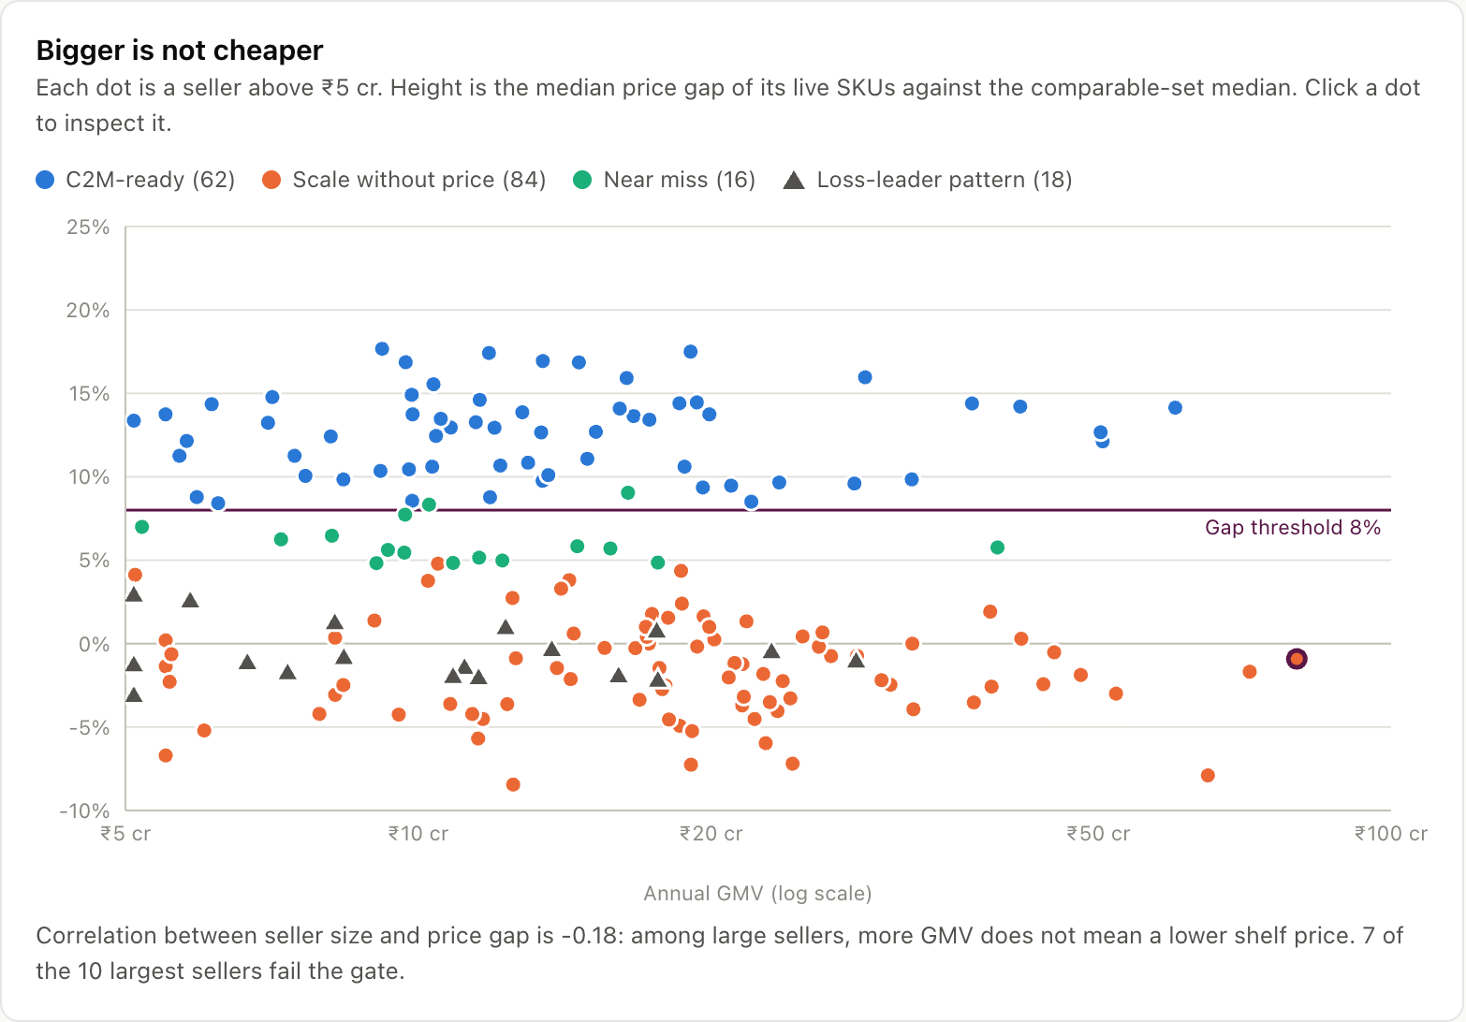



1 · SEGMENTATION
2 · MARKET SIZING
3 · PRICE SCREEN
4 · ONBOARDING
5 · SCALE-UP
6 · METRICS & KPIs
7 · ROADMAP
8 · RISKS & GUARDRAILS
9 · OPERATING MODEL
10 · PROTOTYPE
Q3 · Which manufacturers and categories carry a genuine, defensible price advantage, and which do not despite scale?
CATEGORY SCREEN · 12 SCREENED, 9 IN SCOPE
PRICE TRUTH INDEX · THE SCREEN
BIGGER IS NOT CHEAPER · FROM THE WORKING PROTOTYPE
Category | Cluster | Floor | Idle | Ret. | Frt.
Unstitched saree & dress material | Erode, Bhiwandi | ✓ | ✓ | ✓ | ✓
Home textiles: sheets, towels | Panipat, Solapur | ✓ | ✓ | ✓ | –
Hosiery, innerwear, socks | Tiruppur, Ludhiana | ✓ | – | ✓ | ✓
Moulded plastic housewares | Rajkot, Daman | ✓ | ✓ | ✓ | –
Imitation jewellery | Rajkot, Coimbatore | ✓ | ✓ | – | ✓
Steel kitchenware, utensils | Jagadhri, Wazirpur | ✓ | – | ✓ | –
Basic footwear, PU/EVA | Agra, Bahadurgarh | ✓ | ✓ | – | ✓
Brass décor & lighting | Moradabad | ✓ | ✕ | ✓ | –
Bags, school bags | Nangloi, Kolkata | – | ✓ | – | ✓
Ethnic wear | Surat (largest) | ✕ | ✓ | ✕ | ✓
Fitted western, jeans | Gandhi Nagar, Bengaluru | – | ✓ | ✕ | ✓
Electronics accessories | import-assembly | ✕ | ✓ | – | ✓
Comparable-set median
Order-weighted landed price on delivered orders, per product type. SKUs need ≥ 10 orders.
SKU price gap
gap = (median − seller landed price) ÷ median
Dominant-seller fix
A seller with > 30% of a set’s orders is scored against the median without its own orders.
Catalogue gate
≥ 8% gap on ≥ 60% of live SKUs, sellers above ₹5 cr GMV. One loss-leader cannot buy the badge.
WHERE PRICE IS REAL
Badge + re-rank, with a holdout
Matched control, read at Day 30 (see Roadmap).
Worked example
SKU landed at ₹212 vs a ₹245 median → gap 13.5% ✓. Catalogue: 18 of 24 live SKUs clear = 75% ≥ 60% → badge. A seller with 3 SKUs at −30% and 21 at market clears 13% → no badge.
180
62 · 34%
84 · 47%
r = -0.18
Floor = cost floor below the market median · Idle = spare capacity · Ret. = low return band · Frt. = freight per rupee of value. Rows 10–12 fail two tests: not now.
sellers above ₹5 cr screened
pass the gate
scale without price
size vs price gap
WHY CATEGORY BEATS SCALE · THE RETURN MATH
FOUR VERDICTS, FOUR ACTIONS
The six largest sellers screened (prototype, fictional names)
Return cost per unit kept | at ₹90 / return | at ₹150 / return
30% returns (fitted ethnic) | ₹39 · 14.6% of AOV | ₹64 · 24.3% of AOV
5% returns (home textiles) | ₹5 · 1.8% of AOV | ₹8 · 3.0% of AOV
Gap between the two categories | 13 pp of AOV | 21 pp of AOV
Verdict | Action
C2M-ready (62) | Badge + re-rank + Demand Brief
Scale without price (84) | No badge; offer a value-tier catalogue
Loss-leader pattern (18) | No badge; the catalogue gate holds
Near miss (16) | Factory Node cost help; re-score in 28 days
Seller | GMV | Median gap | Verdict
Moti Sarees · Indore | ₹80 cr | -0.9% | Scale without price
Surya Distributors · Delhi | ₹72 cr | -1.7% | Scale without price
Prem Footwear · Ahmedabad | ₹65 cr | -7.9% | Scale without price
Bharat Shoe Co. · Bahadurgarh | ₹60 cr | 14.1% | C2M-ready
Neel Travel Gear · Surat | ₹52 cr | -3.0% | Scale without price
Annapurna Knitwear · Ludhiana | ₹51 cr | 12.1% | C2M-ready
Returns × fee ÷ units kept. A wrong category swallows the whole 12–18% cost edge before a buyer sees it. ₹90 is our estimate; ₹150 is the seller-guide rate for ≤ 500 g.
7 of the 10 largest fail: they are traders, and scale never became price.
Sources: Round 1 segment scorecard and platform teardown; seller-guide return fees (Shiprocket, Robnu, 2026). Prototype figures come from synthetic, seeded data (fictional sellers) and demonstrate the method, not Meesho’s actual distribution.
Screen on price, not size: badge a catalogue only when ≥ 60% of its live SKUs sit ≥ 8% below the comparable-set median. In the prototype, 7 of the 10 largest sellers fail that test.
Notes:
The category screen uses four cost tests. The Price Truth Index then tests each seller on delivered-order prices. The return-cost range brackets the team estimate (₹90) and published seller-guide rates (about ₹150 for a parcel up to 500 g); confirm against a supplier panel.

Slide 5





1 · SEGMENTATION
2 · MARKET SIZING
3 · PRICE SCREEN
4 · ONBOARDING
5 · SCALE-UP
6 · METRICS & KPIs
7 · ROADMAP
8 · RISKS & GUARDRAILS
9 · OPERATING MODEL
10 · PROTOTYPE
Q4 · Onboarding model · Support stack, risk-sharing and assisted operations for reluctant manufacturers
THE MADE-TO-MEESHO FLOW · ONE MANUFACTURER, END TO END
numbers from the working prototype
1 · Price check
2 · Demand Brief
3 · Batch window
4 · Bulk handover
5 · Node runs unit ops
6 · Settlement
Lowest price at 9% margin ₹213 vs ₹245 median: 13.3% below, qualifies before listing
12 districts, 15,630 orders a week, price band and size mix; first batch 1,900 units
Buyers pre-order (ships in 7 days); 1,052 confirmed, make 1,210 (+15% buffer)
One drop at the cluster Factory Node; 30% of confirmed value, ₹67,223, paid at handover
Pick, pack, ship each order; returns terminate at the node, not the factory
Balance 7 days after delivery: cash in ~11 days vs 50 on distributor terms
EVERY BARRIER HAS A LEVER · COVERAGE
SUPPORT STACK BY COHORT
PRECEDENT · WHAT WE COPY, WHAT WE AVOID
Barrier | Price check | Demand Brief | Batch window | Factory Node | Returns firewall | Prepay
Unit-level fulfilment |  |  |  | ✓
Inventory risk |  | – | ✓ |  |  | –
Returns and RTO | – |  |  | ✓ | ✓
Unproven demand |  | ✓ | ✓
Cash cycle |  |  |  | – |  | ✓
Channel conflict | ✓ | –
A
Offline B2B
Platform | Mechanic | Result
Copy · Pinduoduo | Anonymised demand data to factories (New Brand Initiative) | 900+ factories, 2,200+ custom SKUs, 115 mn orders by end-2019
Copy · Temu | Semi-managed: bulk to local warehouses, platform runs storefront | Targeted 60–80% of US GMV in 2025
Avoid · Shein Brazil | Demanded ~30% price cuts and faster delivery from factories | 336 signed vs 2,000 target; 1 still producing (Reuters, Feb 2026)
Cluster co-op onboarding (40–60 at a time) · price check · briefs · batch window · Factory Node · 30% prepayment
GETTING THEM ON
B
Online elsewhere
Price check → separate value-tier SKUs (not a discount) · briefs · may self-ship
C
Churned
Returns firewall (capped exposure) · health-score re-entry · catalogue and KYC reused
Lesson: fix the operating model and measure the gap that already exists. Never ask a factory for a price cut.
✓ removes · – reduces. The price check prices returns in; the node cuts reverse cost; the firewall caps the rest.
ASSISTED OPERATIONS · WHAT THE FACTORY NODE BUYS (₹98 COST, 9% MARGIN)
RISK-SHARING · WHO CARRIES WHAT
 | Lowest viable price | Below market median | Return cost / unit kept | Margin at ₹221 | C2M badge
Ship each order yourself | ₹219 | 10.8% | ₹8 | 10.0% | ✓ yes
Factory Node | ₹213 | 13.3% | ₹6 | 12.5% | ✓ yes
Risk | B2B today | Made-to-Meesho
Unsold stock | None: made to order | Only the 15% buffer on confirmed orders
Returns handling | None | Node absorbs it; firewall pool caps the loss
Waiting for cash | 45–60 days | 30% at handover; rest ~7 days after delivery
Demand | Distributor orders | Pre-orders plus the pin-code brief
Working capital: 2.5% of revenue on 50-day distributor terms vs 0.6% on a prepaid batch (18% cost of capital). Node rates are proposal assumptions (src/config.js).
Sources: prototype manufacturer app (illustrative seller Kavin Knit Mills, fictional; ₹98 making cost; assumptions in src/config.js); Reuters via FashionNetwork (Feb 2026); KrASIA (Pinduoduo, 2019 data); Tech Buzz China (Temu, 2025).
Keep the B2B risk model: price-check before listing, show demand by pin-code, make only what is pre-ordered, and hand over in bulk to a Factory Node that runs unit operations.
Notes:
The ribbon follows one Cohort A manufacturer through the prototype. Node rates, prepayment share and the pre-order discount are proposal assumptions. Shein Brazil is shown as an anti-precedent: it failed because it squeezed factory prices without changing their operating model.

Slide 6


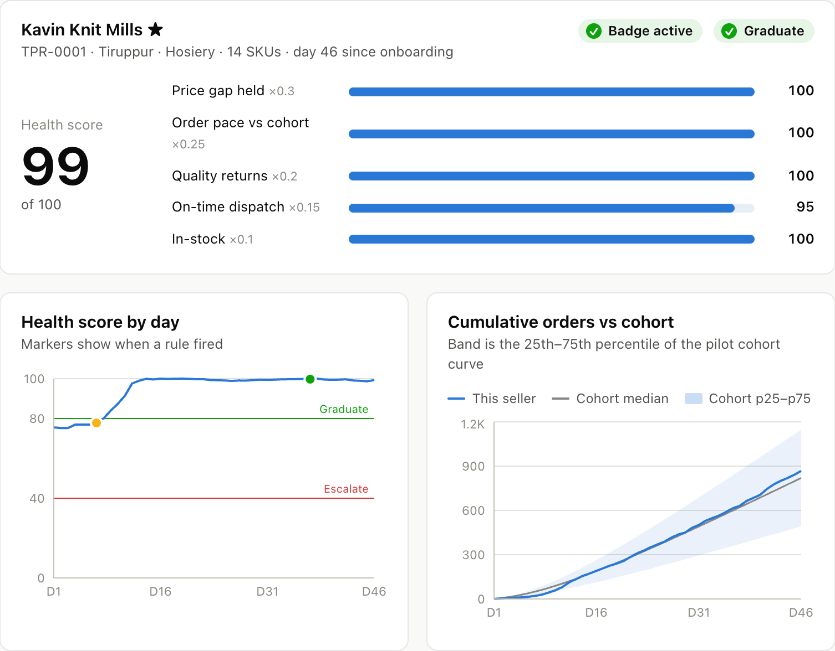
1 · SEGMENTATION
2 · MARKET SIZING
3 · PRICE SCREEN
4 · ONBOARDING
5 · SCALE-UP
6 · METRICS & KPIs
7 · ROADMAP
8 · RISKS & GUARDRAILS
9 · OPERATING MODEL
10 · PROTOTYPE
Q5 · Sustainable scale-up · Early order conviction and retention, without subsidy or handholding
THE COLD-START GAP, IN MEESHO’S OWN WORDS
CONVICTION, THEN RETENTION · WHAT FIRES, WHEN, AND WHAT WE WATCH
“If their quality is not that great, they do not get visibility for orders. And products that have very good quality continue to scale on the platform.”
Stage | When | What Meesho does, automatically | Trigger | Seller sees | KPI
Qualify | Day 0 | Badge on; re-rank inside the category | Passed the price gate | C2M badge | Gap at onboarding
Allocate | D0–D14 | Starter impressions in the 12 Demand Brief pin-codes | Onboarding | First orders where demand is | Orders vs cohort curve
Allocate | D7, D14 | +25K impressions for 7 days (max 2 grants) | Orders < 60% of cohort median | WhatsApp: grant applied | Recovery by D21
Diagnose | Daily | Health Score from five signals (see Metrics) | Every day | Weekly score card | Score 0–100
Remedy | On trigger | Price nudge · QC hold · node offer · restock nudge | 8 rule thresholds | One specific fix | Time to recover
Graduate | D30+ | Batch prepayment unlocked | Score ≥ 80 for 30 days | Cheaper working capital | Graduation rate
Retain | D60+ | Weekly brief refresh; prepaid batches each cycle; Meesho Mall path | Graduated, gap held | Steady demand, fast cash | Active at D90
Human | Exception | Category manager reviews | Score < 40 for 7 days after a fix | A call | ≤ 5 per 100 / month
— Vidit Aatrey, CEO, Q4 FY26 earnings call, 6 May 2026
Implication: a new factory needs orders to prove quality and quality to earn orders. That loop, not price, is why new sellers take a small share of orders in their first 30 days.
IMPRESSIONS, NOT RUPEES · THE GRANT
12
+25K
max 2
≤ 20%
KEEPING THEM
Demand Brief pin-codes get starter impressions
impressions for 7 days if orders < 60% at D7/D14
grants per seller
of category impressions, hard cap
ONE SELLER · KAVIN KNIT MILLS (FICTIONAL), TIRUPPUR
SCALES TO HUNDREDS WITHOUT HEADCOUNT
EXPLICITLY REJECTED
Day 0
Badge on; first batch handed over at the node
Day 7
Orders at D7 were 41% of the cohort median (floor 60%): a grant fires, no one calls
Day 8+
Orders recover into the cohort band; score ≥ 80
Day 37
Graduated: batch prepayment unlocked
90 : 3
~910
Option | Why not
Order subsidy or paid boosts | Buys volume, not conviction; stops the day funding stops
Account managers per seller | Works at 20 sellers, breaks at 200, cannot reach 1,400
Onboarding by turnover | The brief’s own diagnosis: scale is not price
Weakening the quality gate | Protects nobody; grants target traffic, not ranking rules
automated vs human actions
sellers per category manager
Sellers per manager = capacity ÷ escalation rate = 40 ÷ (3 ÷ 68 seller-months) ≈ 910. The 3 escalations are the only human touches in the pilot.
At 1,400 sellers | People | What they do
Account managers (1 per ~20) | ~70 | Chase every seller, every week
Rules + exceptions | ~2 | Review only failed fixes
Sources: Meesho Q4 FY26 earnings call transcript (6 May 2026); prototype Seller Health module (synthetic 60-seller pilot, fixed seed). The category-manager capacity of 40 escalation reviews a month is an assumption.
Pay for early conviction in impressions, not rupees, and let rules fix what the Health Score flags: 90 automated actions to 3 escalations, ~910 sellers per category manager.
Notes:
Meesho already gates visibility on quality. That protects buyers, but a new manufacturer cannot prove quality without first orders. The fix is targeted impressions in the pin-codes where the Demand Brief shows demand, capped at 20% of category impressions, never cash.

Slide 7

1 · SEGMENTATION
2 · MARKET SIZING
3 · PRICE SCREEN
4 · ONBOARDING
5 · SCALE-UP
6 · METRICS & KPIs
7 · ROADMAP
8 · RISKS & GUARDRAILS
9 · OPERATING MODEL
10 · PROTOTYPE
Q6 · Metrics and KPIs · What Meesho tracks across onboarding, activation and retention, and when it steps in
KPI TREE · ONBOARDING → ACTIVATION → RETENTION
C2M SELLER HEALTH SCORE · 0–100, DAILY
NORTH STAR · PRICE-COMPETITIVE C2M NMV
NMV from sellers whose catalogue still clears the ≥ 8% gate
30%
25%
20%
15%
10%
Price gap held today’s gap ÷ gap at onboarding
ONBOARDING
ACTIVATION
RETENTION
Order pace 14-day orders ÷ cohort median (0.3 → 0, 1.0 → 100)
Qualified → listed
Orders at D7 / D14
Active at D90
Quality returns ≤ 1× category norm = 100, 2× = 0
≥ 50% in 30 days · weekly · Category
≥ 60% of cohort median · daily · DS
≥ 75% · monthly · Category
Days to first live listing
First-30-day orders
Gate retention D14 / D30
On-time dispatch 7-day SLA: 80% → 0, 97% → 100
≤ 7 · weekly · Supplier product
≥ cohort p50 for 70% · weekly · Growth
≥ 70% still clear · weekly · Pricing
In-stock live SKUs in stock: 50% → 0, 95% → 100
First batch committed
Days to 10th order
Graduated by D60
WHAT WE WATCH
≤ 14 days · weekly · Category
≤ 10 · weekly · Growth
≥ 40% · monthly · Finance
≥ 80 for 30 days
Graduate: prepayment unlocked
< 40 for 7 days after a fix
Escalate to a category manager
GUARDRAILS (programme level)
Category NMV ≥ pre-period · badged ≤ 20% of category impressions · quality returns ≤ 1.5× norm · escalations ≤ 5 per 100 sellers a month
WHEN TO INTERVENE · THE RULEBOOK (9 AUTOMATIC, 1 HUMAN)
LIVE IN THE PROTOTYPE · 60 PILOT SELLERS TODAY
Signal and threshold | Action
Orders < 60% of cohort median at D7 / D14 | Impression grant (+25K, 7 days, max 2)
Price gap < 8% for 7 days | Price-drift nudge with market median
Price gap < 4% for 3 days | Badge removed; re-entry after 7 days ≥ 8%
Quality returns > 1.5× norm (≥ 30 deliveries) | Badge suspended + QC checklist
Signal and threshold | Action
On-time dispatch < 90% over 7 days | Offer Factory Node operations
In-stock < 70% for 3 days | Restock nudge sized by the Demand Brief
Score ≥ 80 for 30 days | Graduate: batch prepayment
Score < 40 for 7 days after a fix | Human: category manager
Allocate
Diagnose
Remedy
Graduate
6
17
12
25
Average score 90 · 90 automated actions and 3 escalations so far. Remedy (amber) means an automatic fix is running; 3 of those sellers are with a person.
Daily
rules run, grants fire
Weekly
KPI review: Category, Growth
Monthly
recalibrate weights and thresholds
Targets are proposed pilot thresholds, to be recalibrated on the first cohort. Health Score weights and rule thresholds are the ones running in the prototype (src/config.js).
Measure the funnel from qualified to graduated, score every seller daily, and act at fixed thresholds; a person steps in only after an automatic fix has failed.
Notes:
The KPI tree ladders every seller-level metric up to one north star: NMV from sellers whose catalogue still clears the price gate. Guardrails protect the category and existing resellers.

Slide 8
1 · SEGMENTATION
2 · MARKET SIZING
3 · PRICE SCREEN
4 · ONBOARDING
5 · SCALE-UP
6 · METRICS & KPIs
7 · ROADMAP
8 · RISKS & GUARDRAILS
9 · OPERATING MODEL
10 · PROTOTYPE
Q7 · 30-60-90 roadmap · What happens first, in what order, which numbers release the money, and what it costs
30-60-90 PILOT, THEN SCALE · WORKSTREAMS, OWNERS, GATES
WHERE, IN WHAT ORDER · CLUSTER WAVES
Workstream
Owner
Days 0–30
Days 31–60
Days 61–90
Quarter 2+
Wave | When | Clusters and categories | Sellers
Wave 1 · pilot | D0–90 | Tiruppur (hosiery), Panipat (home textiles) | 60
Wave 2 · scale | Q2–Q4 | + Ludhiana (hosiery), Rajkot (plastics, jewellery), Erode (dress material) | 450
Wave 3 · national | Y2–Y4 | + 7 more screened clusters, all 9 categories | 1,400
Price Truth Index + badge test with holdout
Pricing, Growth
Health Score + rulebook live
Data science
Cluster co-ops: Tiruppur, Panipat
Category
Demand Briefs, 5 categories
Data science
Batch window + 30% prepayment
Product, Finance
Factory Node, Tiruppur (partner)
Valmo
Order follows the cluster AHP (cost ownership, demand, returns band, node feasibility, an association to recruit through). Surat stays out.
Each wave opens only when the previous wave’s Day-90 numbers hold.
Wave 2: 5 clusters, 6 nodes, 450 sellers
Category, Valmo
WHEN AND HOW MUCH
Day-30 gate
Day-60 gate
Day-90 gate
WHAT RELEASES THE MONEY · GATES
PRIORITISATION · RICE ACROSS ACQUISITION AND SCALE-UP
MONEY · ₹ CR
Gate | Pass when | If not
Day 30 | NMV per live SKU ≥ 12% over holdout (interval > 0) and ≥ 70% of badged sellers still clear at D14 | Lift < 12%: tighten to a 10% gap and re-run. Decay: stop
Day 60 | 2 associations signed · 60 factories catalogued · briefs live in 5 categories | Hold node spend
Day 90 | 3 of 4: batches in SLA · returns end at the node · retention ≥ 70% · category NMV ≥ baseline | Fix before Wave 2
# | Lever | Stage | R | I | C | E | Score | Yr-1
1 | Price gate + C2M badge | Acq | 100% | 2 | 90% | 2 | 0.900 | ₹0
2 | Health Score + triggers | Scale | 100% | 2 | 85% | 3 | 0.567 | ₹0
3 | Cluster co-op onboarding | Acq | 90% | 2 | 85% | 3 | 0.510 | ₹5 cr
4 | Pin-code Demand Brief | Scale | 100% | 2 | 75% | 4 | 0.375 | ₹6 cr
5 | Demand-confirmed batches | Scale | 85% | 3 | 70% | 5 | 0.357 | in brief
6 | Factory Node (assisted ops) | Acq | 100% | 3 | 80% | 8 | 0.300 | ₹8 cr
7 | Batch prepayment | Scale | 75% | 2 | 70% | 4 | 0.262 | float
8 | Returns firewall pool | Acq | 70% | 3 | 65% | 6 | 0.227 | ₹3 cr
+₹156 cr
Year 3
NPV at 12% (Round 1)
breakeven
Statistical power: 62 sellers × 28 days → standard error ≈ 1.6 pts; minimum detectable lift ≈ 4.5% at 80% power, well under the 12% bar.
RICE = Reach × Impact × Confidence ÷ Effort (Round 1). Reach = share of the 11,645 base; Impact 1–3; Effort in engineering + ops weeks, 8 = physical infrastructure. Diagnostic and free first, capital last.
₹0 capex until the gap is proven; ₹22 cr in Year 1.
No new team: existing owners run each stream.
MSME-TEAM (₹277 cr scheme) could co-fund onboarding.
Prototype check: base +18.2% → fund · weak +4.7% → tighten · decay 40% retained → stop.
Sources: Round 1 RICE scoring, costing and NPV model (12% discount rate) and cluster AHP; prototype Day-30 readout (synthetic, 400-draw bootstrap). MSME-TEAM: Ministry of MSME / ONDC, ₹277 cr over three years (Inc42); eligibility to be confirmed.
Spend nothing until the price gap is proven: ₹0 capex to Day 30, ₹12 cr by Day 90 only if the gate says fund, and ₹22 cr in Year 1 for NPV +₹156 cr.
Notes:
Sequence follows the Round 1 RICE ranking: diagnostic and free first, capital last. Power: 62 sellers over 28 days give a standard error of about 1.6 points on the lift, so the minimum detectable lift at 80% power is about 4.5%, well under the 12% bar. Waves open only when the previous wave's Day-90 numbers hold.

Slide 9
1 · SEGMENTATION
2 · MARKET SIZING
3 · PRICE SCREEN
4 · ONBOARDING
5 · SCALE-UP
6 · METRICS & KPIs
7 · ROADMAP
8 · RISKS & GUARDRAILS
9 · OPERATING MODEL
10 · PROTOTYPE
Q8 · Risks and guardrails · What could go wrong, which rules keep it compliant, and where C2M takes Meesho next
RISK REGISTER · LIKELIHOOD, IMPACT, EARLY SIGNAL, GUARDRAIL
COMPLIANCE BY DESIGN · MARKETPLACE, CONSUMER, DATA, TAX
# | Risk | L | I | Early signal | Guardrail | Owner
1 | The price gap was a promotion | H | H | Gate retention < 70% at D14 | Day-30 stop rule; badge off at < 4% gap | Pricing
2 | Loss-leader SKUs game the badge | M | M | 2–3 SKUs 20%+ below, rest at market | Catalogue gate: ≥ 60% of live SKUs | Pricing
3 | Quality falls with price | M | H | Quality returns > 1.5× norm | Suspend + QC; reinstate at ≤ 1.2× for 7 days | Category
4 | Re-rank starves existing resellers | L | M | Category NMV vs pre-period | Badged ≤ 20% of category impressions | Growth
5 | Capex before demand | L | H | Batch fill rate, node utilisation | No node before the Day-30 and Day-60 gates; partner warehouses first | Valmo
6 | Export recovery pulls factories back | H | M | Tariff 50% → 18%; India–EU deal | Batches fill idle capacity around export runs; C2M as hedge | Category
7 | Rate-card war escalates | H | L | Flipkart 0% on all fashion (Jul 2026) | Compete on cost structure (node, briefs), not fees | Strategy
8 | Shein-style squeeze drives factories away | L | H | Attrition after price asks | Never ask for a price cut; the gate measures the gap that exists | Leadership
Rule | What it requires | Our design
FDI Press Note 2 (2018) | Marketplace may not own or control seller inventory | Seller keeps title at the node; Valmo sells warehousing at arm’s length
FDI Press Note 2 (2018) | Fair, non-discriminatory services; no exclusivity | Badge and grants are published rules any seller can meet; batches fit around B2B work
E-Commerce Rules, 2026 amendment | From 1 Jan 2027: ranking parameters by importance; sponsored listings labelled | Publish the price-gap badge as a ranking parameter; grants are organic, never sold
Dark-pattern guidelines (2023) | No false urgency or hidden terms; yearly self-audit | “Ships in 7 days, ₹20 off” shown before the buyer pays
DPDP Act (2023) | Protect personal data | Demand Briefs use district-level aggregates only
GST | Stock held at a third-party site | Node added as the seller’s additional place of business
Prepayment | Advances must not become inventory purchase or control | Advance via an NBFC partner against confirmed buyer orders
WHAT BREAKS, WHAT’S NEXT
Design responses, not legal advice: Meesho legal confirms each row before the pilot starts.
THE 10X PATH · FROM PILOT TO SUPPLY ENGINE
L = likelihood, I = impact. Why risk 8 matters: Shein pledged $150 mn for 2,000 Brazilian factories and asked for ~30% price cuts; 336 signed and 1 is still producing. Our screen only rewards a gap that already exists.
Year 5+
Factory brands on Meesho Mall
“Value brands … for a billion people” (Aatrey): graduates brand their own lines
ASSUMPTIONS WE STILL HAVE TO VERIFY · BEFORE ANY CAPEX
Year 4
12 clusters · 1,400 sellers · ₹1,995 cr
4.8% of FY26 NMV structurally cheaper
Assumption | Value used | How we verify | By
Seller fee per customer return | ₹90 (team estimate) to ₹150 (seller guides) | Pull from three live supplier panels | Day 7
Factory Node handling and forward cost | ₹9 + ₹42 per unit (proposal) | Partner-warehouse quotes, Tiruppur | Day 45
Pre-order uptake at ₹20 off, 7-day delivery | 55–70% of the suggested batch | A/B test in brief pin-codes | Day 60
Order lift while a grant is active | 1.35× (simulation) | Holdout on the grant rule | Day 30
Year 2
5 clusters · 6 nodes
Briefs and batches become the default onboarding path
Year 1
2 clusters · 60 → 450 sellers
Prove the gap at ₹0 capex; gate the money
Sources: DPIIT Press Note 2 (2018) via Khaitan & Co, Lexology; Consumer Protection (E-Commerce) Amendment Rules 2026 via LexOrbis (notified 9 Sep 2026, in force 1 Jan 2027); Meesho Q4 FY26 call; Reuters via FashionNetwork; Flipkart newsroom; KrASIA.
Every risk has a tripwire in the rulebook and a compliance answer built in; the long game is graduated factories becoming Meesho Mall value brands.
Notes:
Likelihood and impact are team judgement. Compliance rows are a design response, not legal advice; Meesho legal should confirm each. Risk 8 is the Shein Brazil failure mode: the programme never asks a factory for a price cut.

Slide 10

1 · SEGMENTATION
2 · MARKET SIZING
3 · PRICE SCREEN
4 · ONBOARDING
5 · SCALE-UP
6 · METRICS & KPIs
7 · ROADMAP
8 · RISKS & GUARDRAILS
9 · OPERATING MODEL
10 · PROTOTYPE
Q9 · Operating model · How Meesho builds, staffs and defends it, and how robust the unit economics are
SYSTEM ARCHITECTURE · EXISTING DATA → FIVE ENGINES → FOUR SURFACES
TEAM AND OWNERSHIP · PROPOSED
DATA MEESHO ALREADY HOLDS
NEW ENGINES · BATCH + RULES
SURFACES
Workstream | Owner | Pilot | Wave 2
Price Truth Index, badge, experiment | Pricing + data science | 2 | 2
Demand Brief, Health Score, rulebook | Data science | 2 | 3
Supplier panel + WhatsApp flows | Supplier product | 1 | 2
Cluster partnerships | Category (1 per cluster) | 2 | 5
Factory Node operations | Valmo + partner warehouse | 1 | 3
Prepayment via lending partner | Finance | 0.5 | 1
Total people |  | 8.5 | 16
Catalogue
live SKUs, product type, landed price
Price Truth Index
weekly · gate and badge
Search ranking + badge
capped at 20% of impressions
Orders
delivered, NMV, RTO, return reason
Demand Brief
weekly · district demand
Supplier panel + WhatsApp
brief, batch, one-tap commit
Health Score
daily · five signals
Operations
dispatch time, in-stock
Valmo Factory Node
bulk in, unit orders out
Rulebook
event-driven · nine rules
Exposure
impressions by pin-code
Experiment readout
Day 30 · fund, tighten, stop
Category-manager queue
exceptions only
People scale with clusters, not sellers: escalations run at ~910 sellers per category manager, so 1,400 sellers need about two reviewers, not an account team.
HOW MEESHO RUNS IT
New build: four scheduled jobs and one rules engine on tables Meesho already has. No new data integration; the prototype runs all five.
WHY RIVALS CANNOT COPY IT QUICKLY
STRESS TEST · KAVIN KNIT MILLS PRICE GAP
BUILT ON WHAT MEESHO RUNS
 | Value demand ₹200–300 | Tier-2+ reach | Zero fees | Bulk inbound store | Demand data to factories | Pre-order batches
Meesho + C2M | ✓ | ✓ | ✓ | ✓ | ✓ | ✓
Flipkart / Shopsy | – | ✓ | ✓ | ✓ | – | ✕
Amazon | – | – | – | ✓ | – | ✕
IndiaMART (B2B) | ✕ | – | ✕ | ✕ | ✕ | –
Offline distributor | – | ✓ | ✕ | ✓ | ✕ | ✓
0%
4%
8%
12%
16%
Valmo
handles 50–55% of deliveries; a node is one more lane
Margin 9% → 12%
10.3%
Return fee ₹70 → ₹150
10.1%
264 mn buyers
the demand signal behind every brief
Returns 8% → 12%
9.6%
Market median −5%
8.7%
Ads engine
impression inventory for grants; ad catalog +40% YoY
Making cost +10%
8.7%
RTO 14% → 20%
8.3%
0% commission
no fee change needed to make C2M pay
Forward freight ₹42 → ₹55
5.9%
Each rival covers one or two columns. Only the full stack joins value demand to factory capacity. A rate card can be copied in a quarter; this takes years. ✓ yes · – partly · ✕ no.
gate 8%
base 13.3%
Meesho Mall
the graduation path for factory brands
Clears the gate in 6 of 7 single-factor stresses. Freight is the thin spot, so partner-node quotes (Day 45) come before any node capex.
Sources: Meesho Q4 FY26 earnings call (Valmo share, ads, Meesho Mall); Flipkart and Amazon seller-fee announcements (2025–26); Tech Buzz China (Temu); prototype economics model for the stress test. Team sizes are proposals; competitor marks are team assessment from public information.
Five engines on tables Meesho already has, a pilot team of 8.5, and a stack rivals cannot copy with a rate card; Kavin still clears the 8% gate in 6 of 7 stress tests.
Notes:
Stress test: each bar changes one assumption and recomputes the lowest viable price for the illustrative Tiruppur seller with the prototype economics model. The base case is the Factory Node price check.

Slide 11

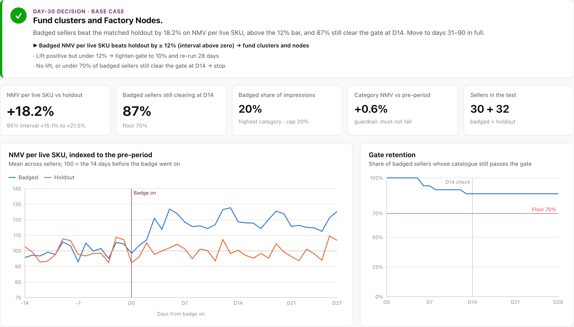

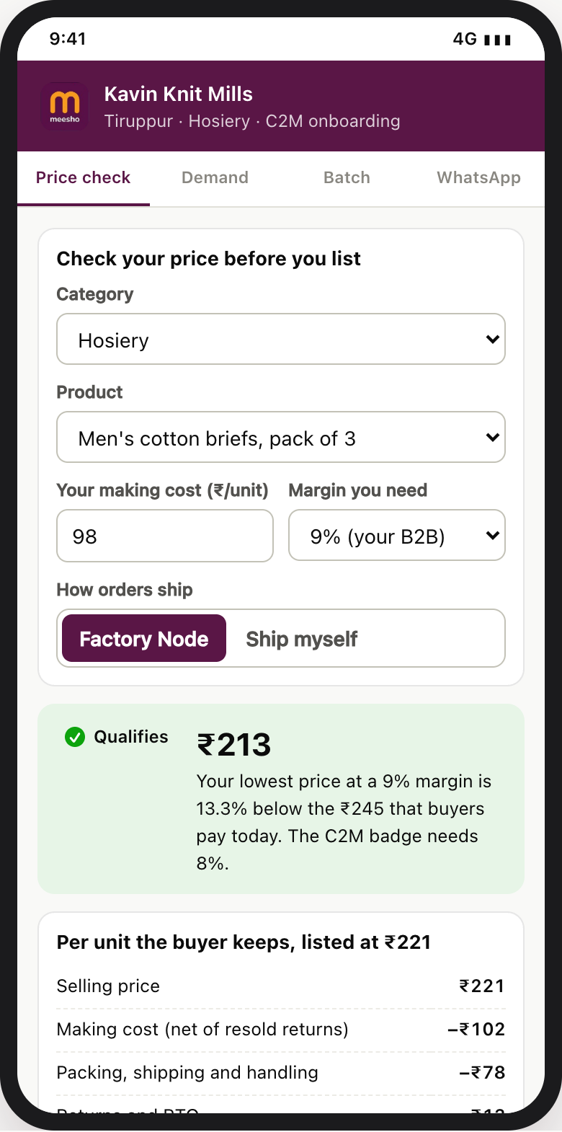
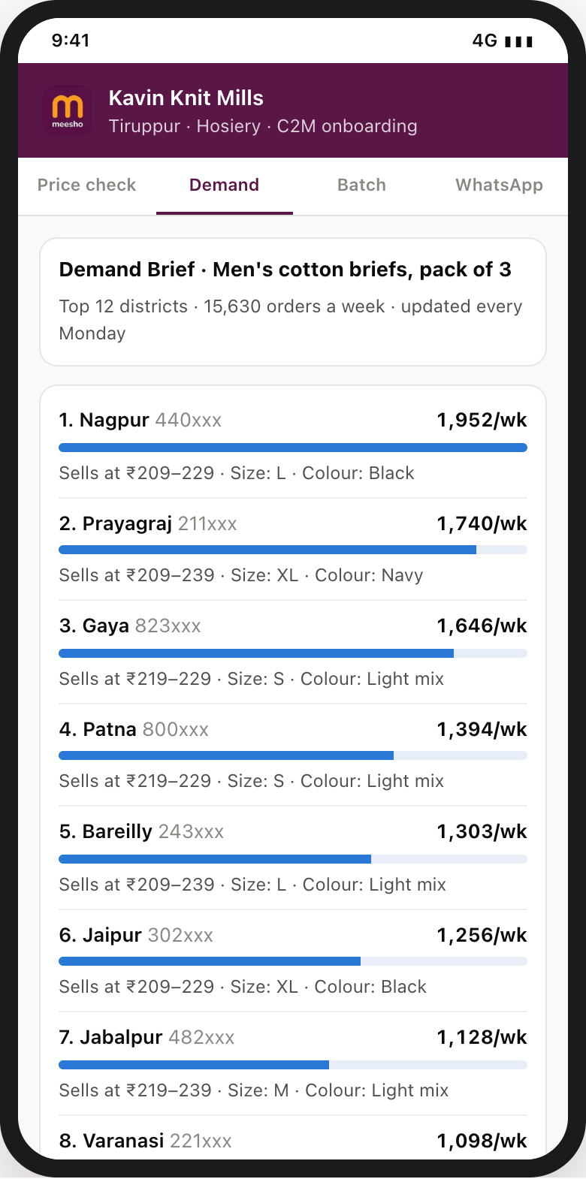
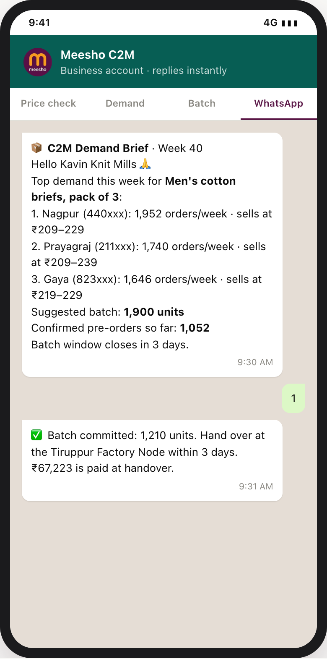
1 · SEGMENTATION
2 · MARKET SIZING
3 · PRICE SCREEN
4 · ONBOARDING
5 · SCALE-UP
6 · METRICS & KPIs
7 · ROADMAP
8 · RISKS & GUARDRAILS
9 · OPERATING MODEL
10 · PROTOTYPE
Q10 · Working prototype · Does it actually run? Every rule on this deck, live
1 · PRICE TRUTH INDEX
2 · DAY-30 READOUT
OPEN IT
meesho-dice-c2m-iitb.vercel.app
Mirror:
prathmesh-28.github.io/c2m-control-tower
Offline: one HTML file, no internet needed
180 screened · 62 pass · 7 of the 10 largest fail
Base +18.2% (CI +15.1% to +21.5%) → fund · weak +4.7% → tighten · decay 40% retained → stop
PROOF, LIVE
3 · SELLER HEALTH
4 · MANUFACTURER APP
HOW MEESHO WOULD RUN IT
Feed | Used for
Catalogue: SKU, product type, landed price | Median, gate, badge
Orders: delivered, NMV, RTO, return reason | Brief, experiment, quality
Operations: dispatch time, stock | Health Score, remedies
Exposure: impressions by pin-code | Grants, 20% cap
One daily batch job plus event-driven rules. No new data integration.
60 sellers scored daily · 90 automated : 3 human · Kavin graduates on D37
Price check ₹213 vs ₹245 → brief → batch of 1,210 → one-tap WhatsApp commit
Built for this submission: React + Recharts, static site. 261 synthetic sellers and 4,415 SKUs across 9 categories, a 60-seller pilot, fixed seed, fictional names. Four model tests run before every deploy. All assumptions live in one config file.
The prototype runs the whole loop on synthetic data (screen, experiment, daily score, manufacturer app), and every rule in it would run unchanged on Meesho’s delivered-order and listing tables.
Notes:
Walkthrough order for a live demo: Overview → Price Truth Index (drag the gate) → Day-30 readout (switch scenarios) → Seller Health (Kavin Knit Mills) → Manufacturer app (price check to WhatsApp commit).

