Slide 1







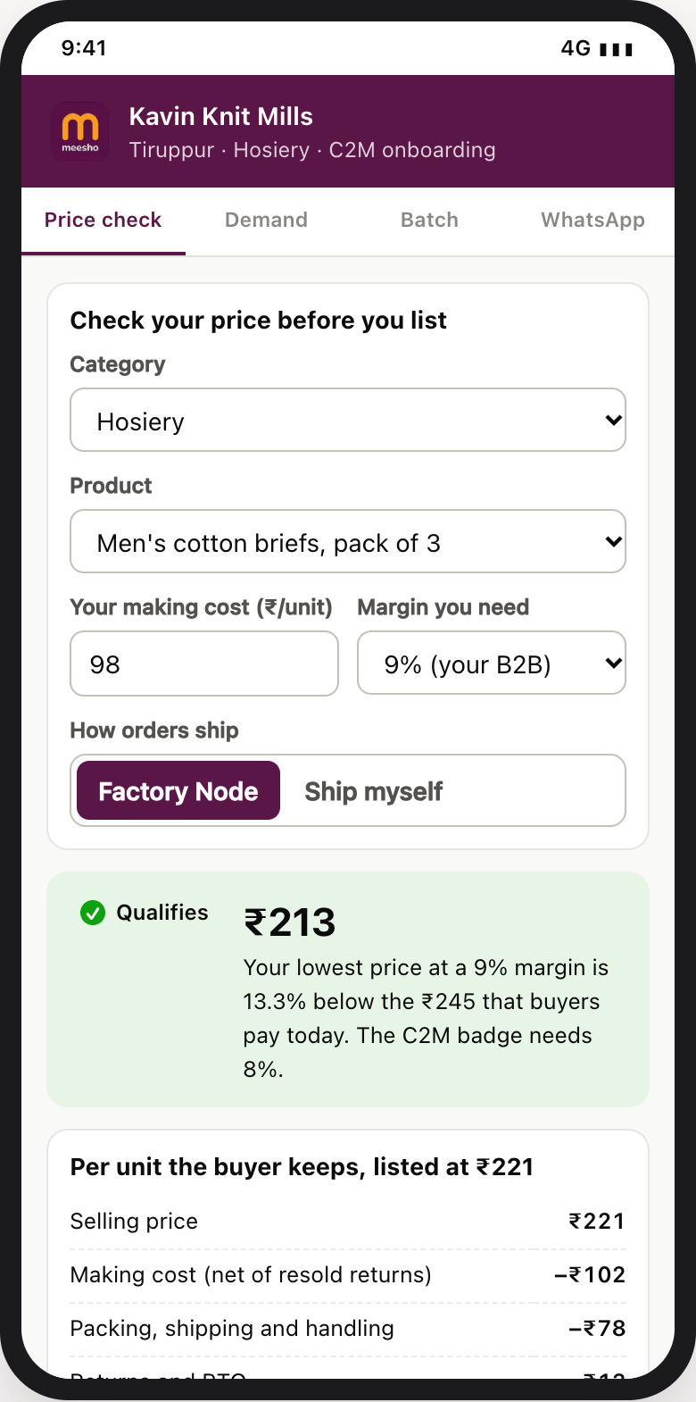
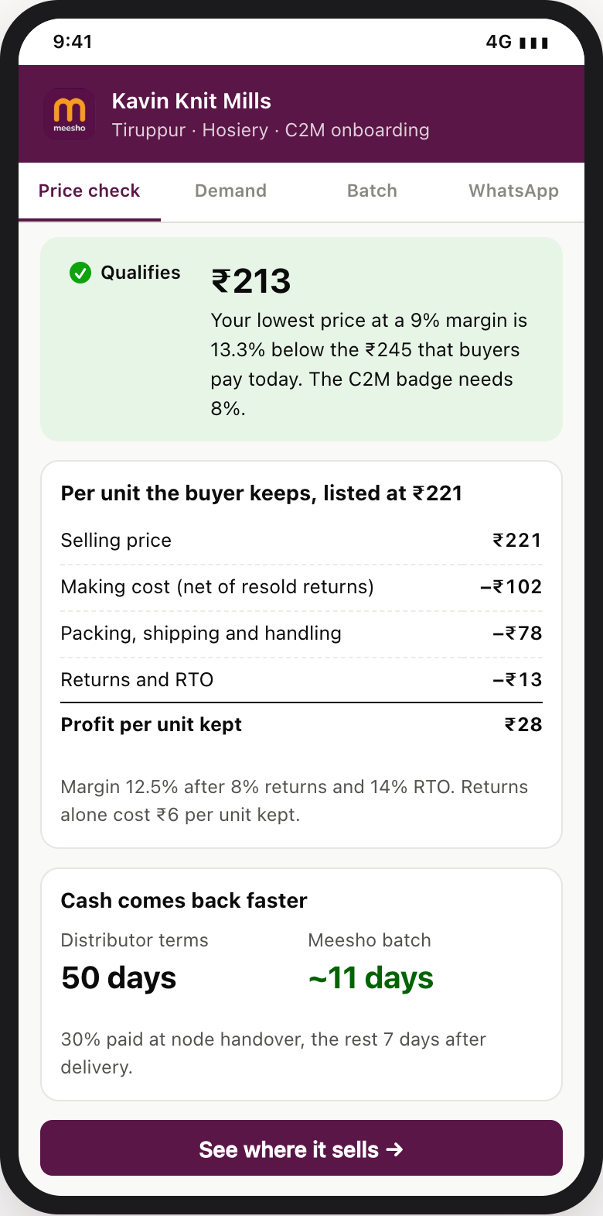
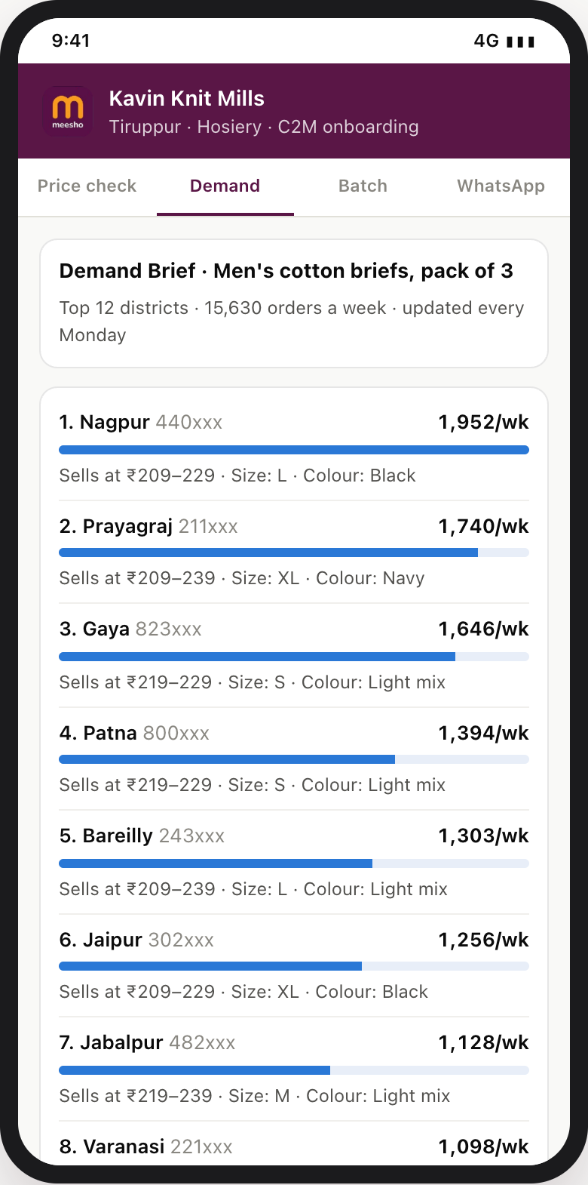
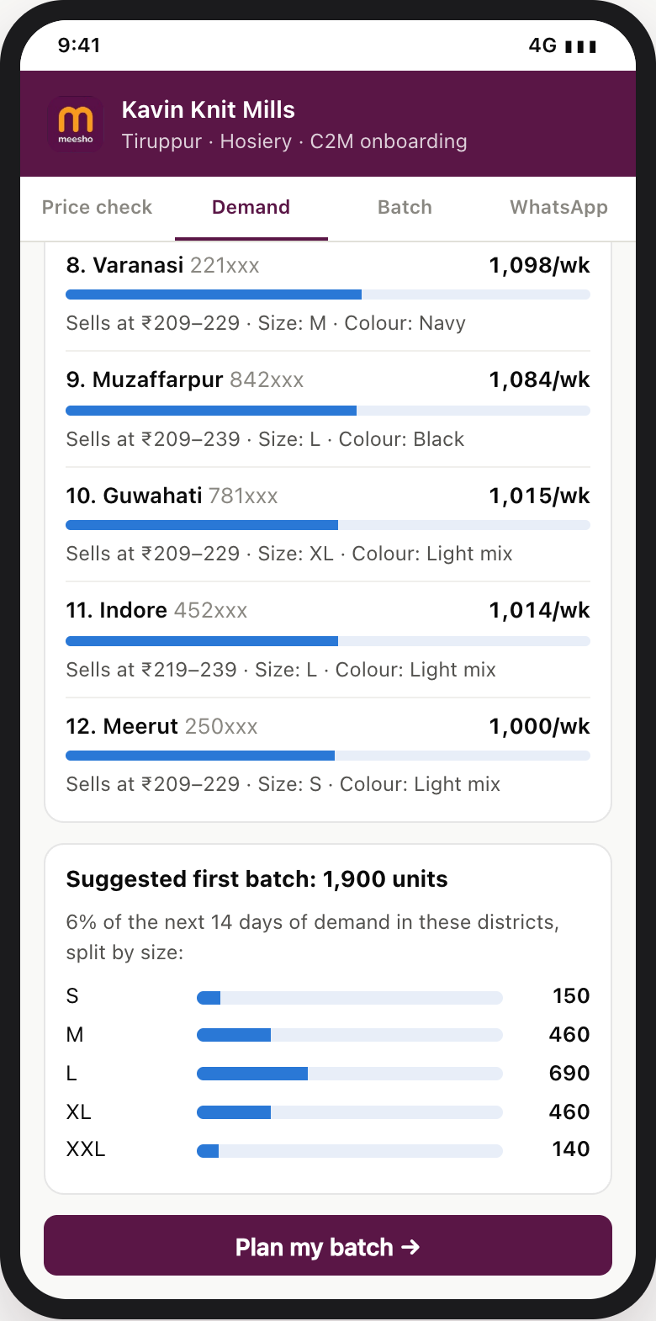
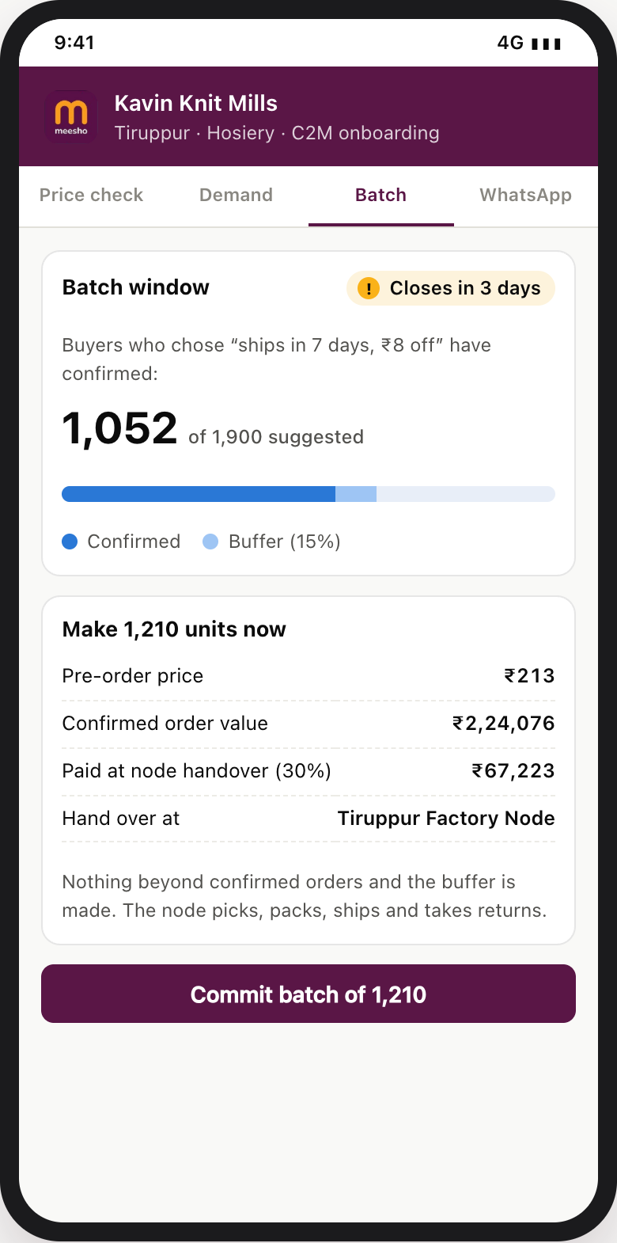
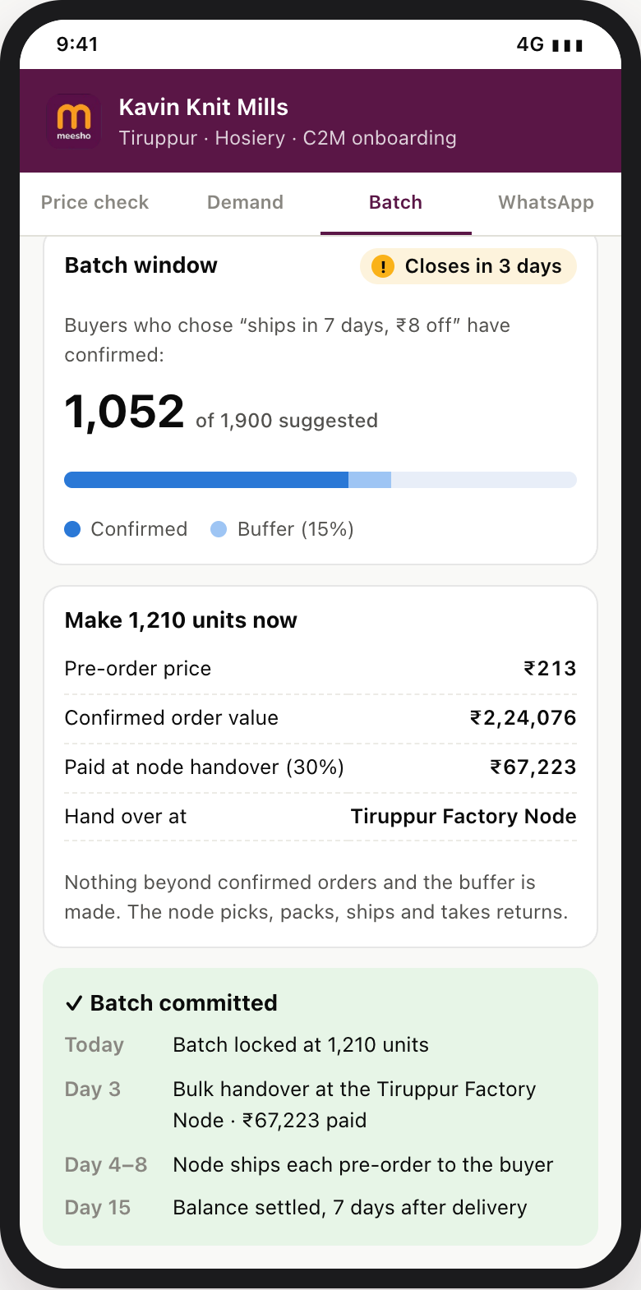
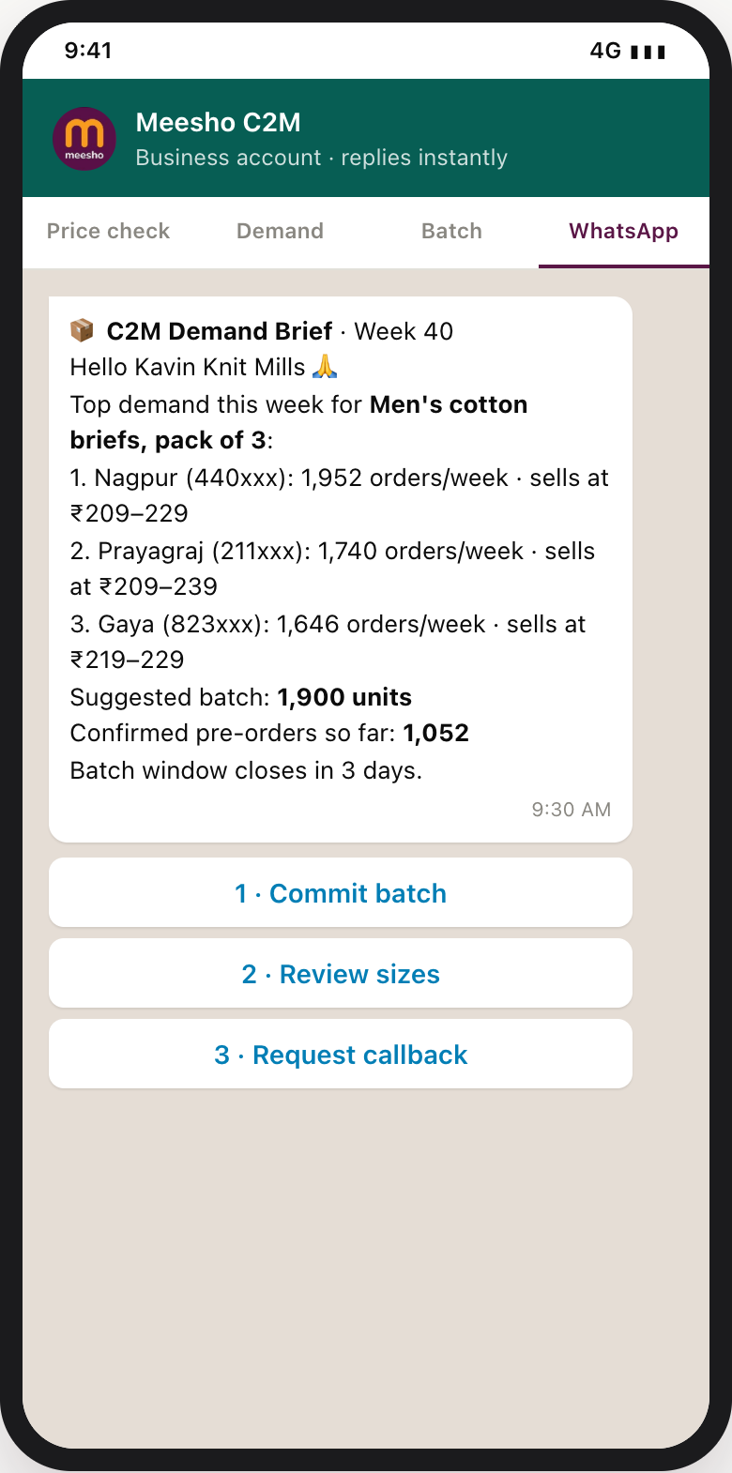
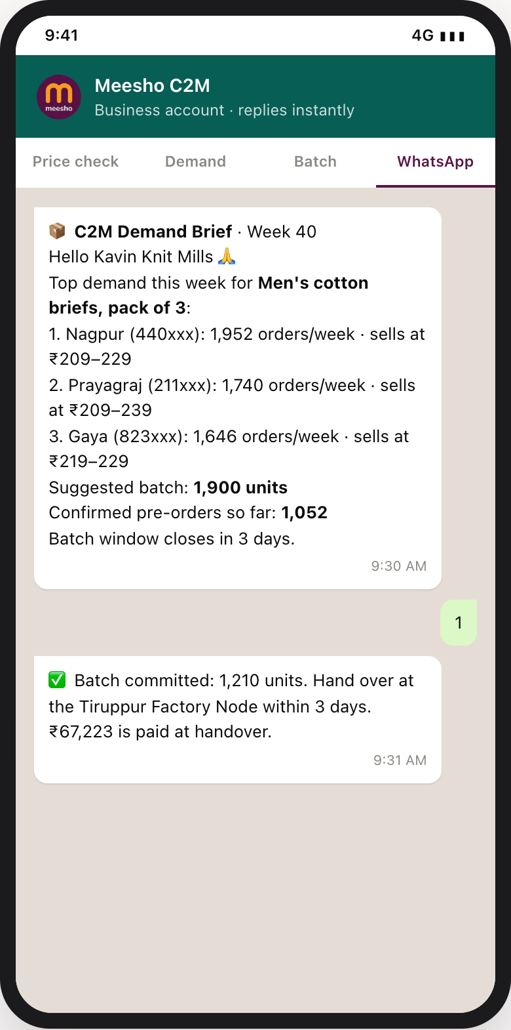



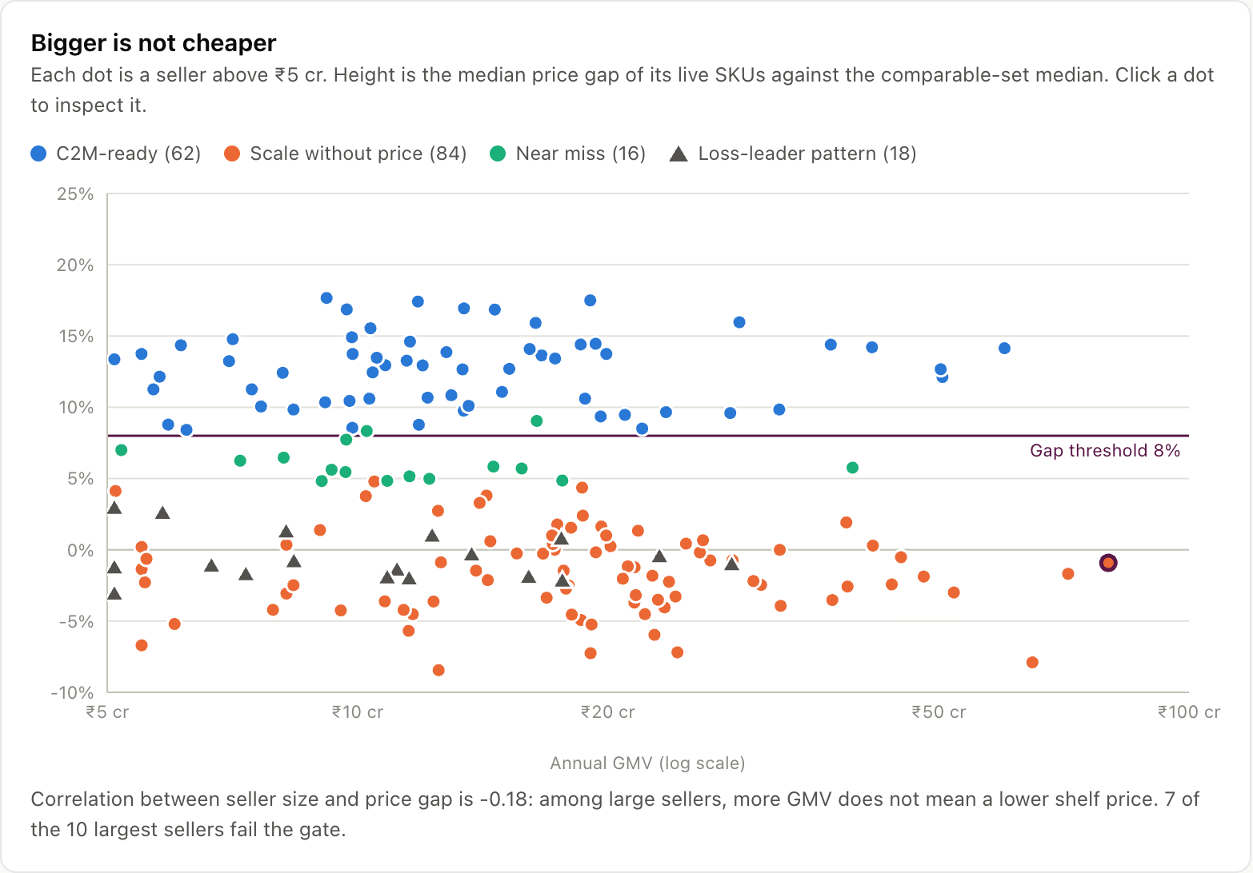
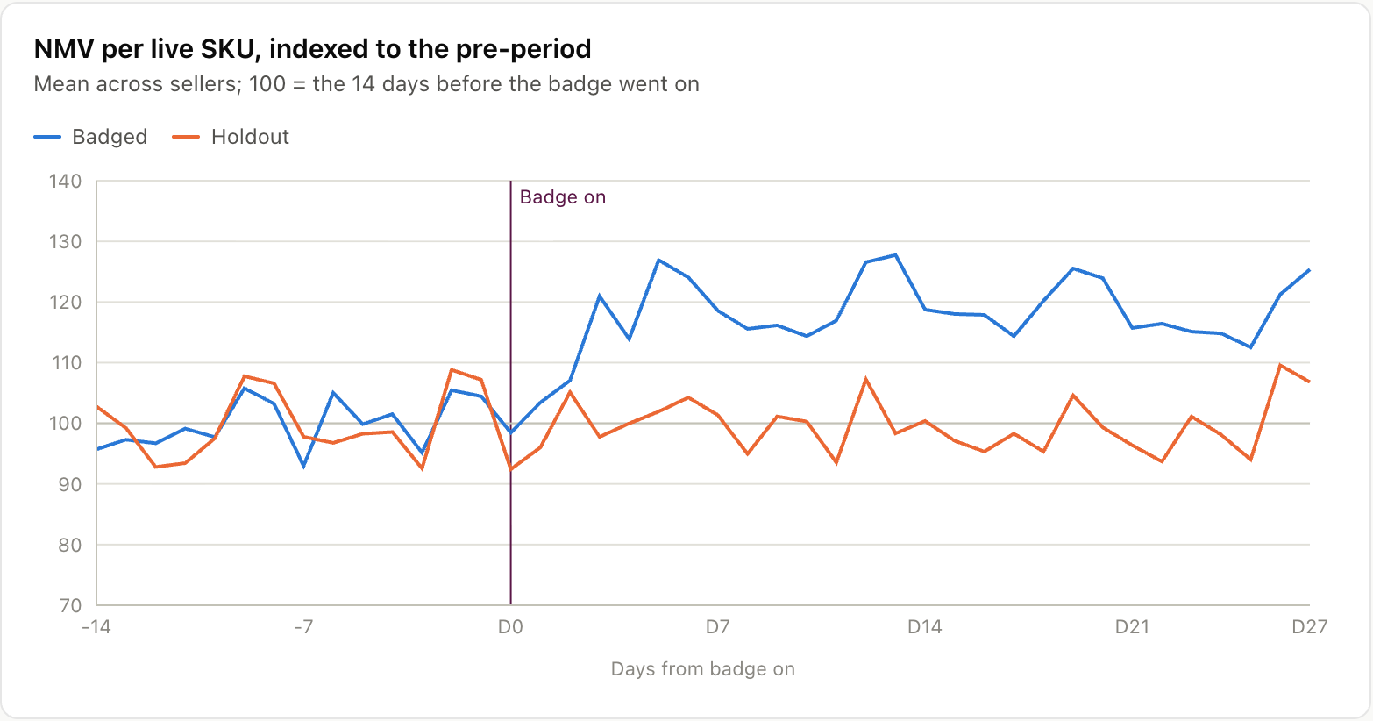
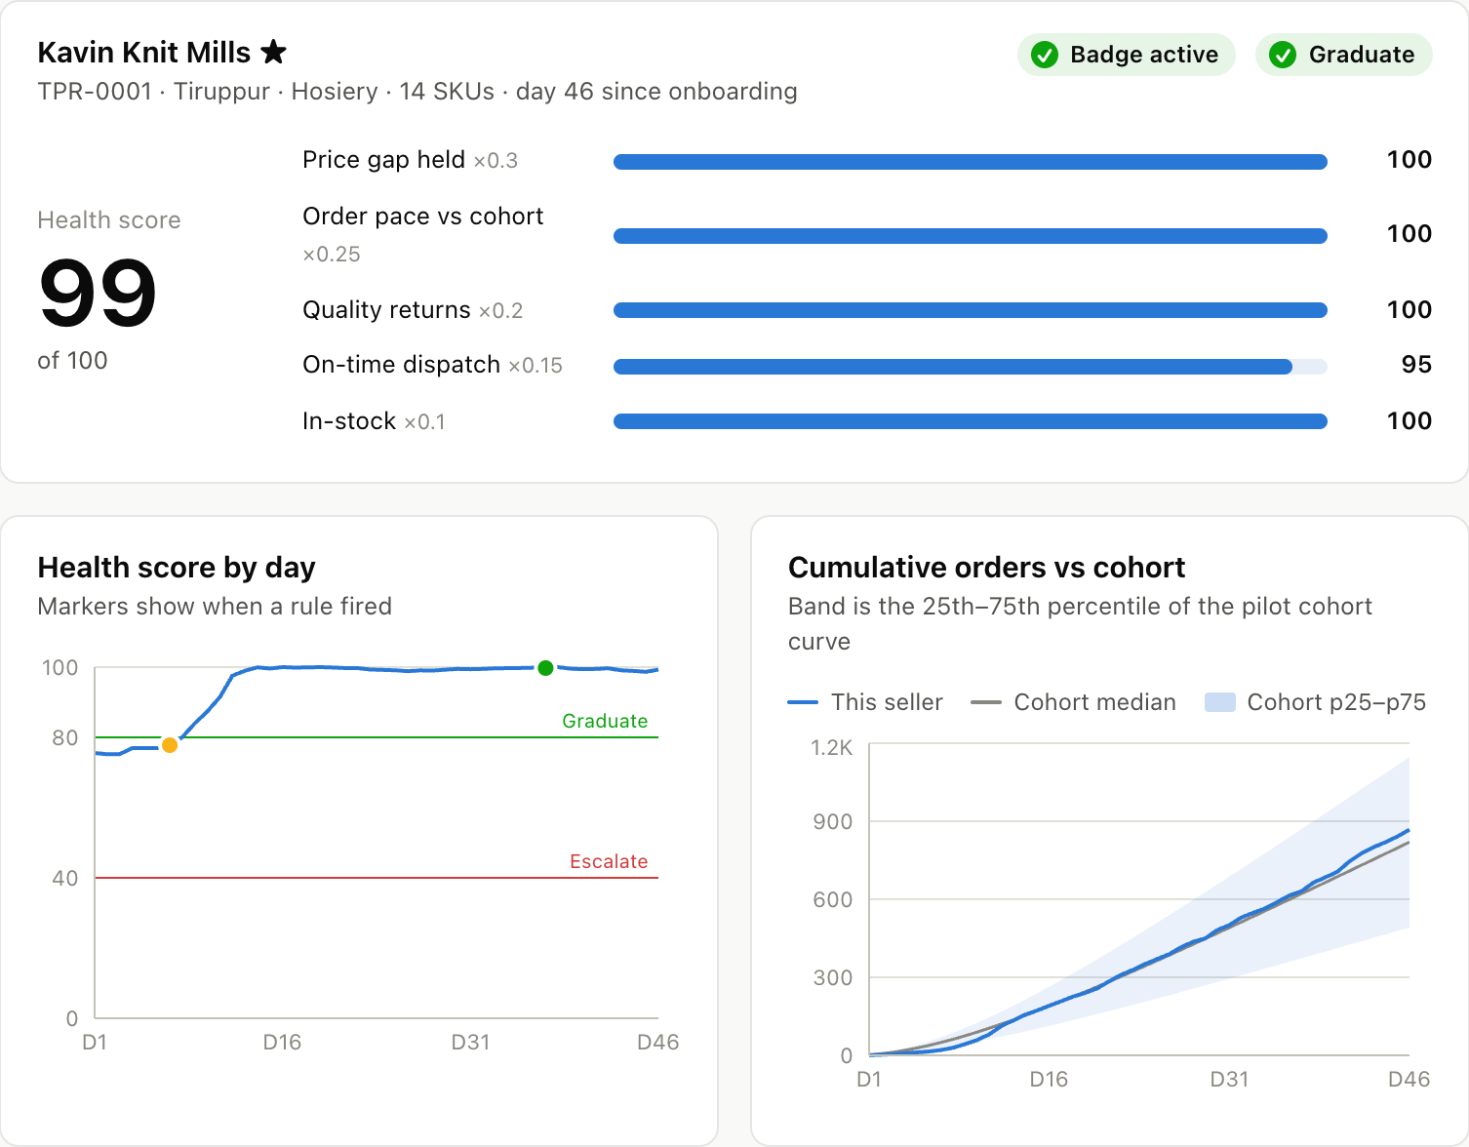




Appendix A · Product walkthrough
Eight phone screens take a factory from “will I make money?” to a prepaid batch, with no e-commerce team
APPENDIX A
1 · Price check: will I make money?
2 · Demand Brief: is there demand?
3 · Batch: must I stock up blind?
4 · WhatsApp: no app, no manager
1
1
1
1
3
2
2
2
2
4
3
3
4
4
3
Inputs + verdict
Profit per pack + cash
Top districts
Suggested batch
Before commit
After one tap
Weekly brief
Reply 1: committed
1
Picks the product, then enters making cost, the margin it needs and how orders ship.
1
This exact product in the top 12 districts: 15,630 orders a week, refreshed every Monday.
1
Buyers who accept “ships in 7 days” for a small discount prepay: 1,052 of 1,900 in a 3-day window.
1
The same brief every week on WhatsApp: top districts, price bands, suggested batch, pre-orders.
2
Verdict before listing: lowest viable price vs what buyers pay; the badge needs 8% below.
2
Each district: orders a week, the price band that sells, the best-selling size and colour.
2
Make confirmed orders + 15% buffer = 1,210 units; 30% of confirmed value is paid at handover.
2
Quick replies: 1 commits the batch, 2 opens the size mix, 3 asks for a callback.
3
Per pack the buyer keeps: making, shipping, returns and failed deliveries, then profit.
3
First batch suggested: 1,900 units (6% of 14 days of demand), split by size.
3
One tap commits the batch; nothing beyond it is made.
3
The owner replies “1”: no app install, no login, no account manager.
4
Cash back in ~11 days (30% at node handover) vs 50 days on distributor terms.
•
Built weekly from search and delivered orders, summed by district: no buyer is identifiable.
4
Day 3 bulk handover at the Tiruppur node; Days 4-8 the node ships; Day 15 the balance is paid.
4
Confirmation: units to make, the node to drop them at, and the cash paid at handover.
Removes: unknown margin · returns exposure · slow cash
Removes: unproven demand · guessing sizes and price
Removes: build-to-stock risk · unit shipping · cash gap
Removes: tech know-how · dashboards · account managers
Meesho’s side: the control tower (desktop, same link)
What the prototype runs on
Open it live
Price Truth Index
every seller above ₹5 cr scored; 7 of the 10 largest fail
Day-30 readout
badge vs holdout: +18.2% → fund
Seller Health Score
five signals, the rule that fired, the next action
261
4,415
9
4
meesho-dice-c2m-iitb.vercel.app
Mirror: prathmesh-28.github.io/c2m-control-tower
Offline: one HTML file in prototype/dist-single
synthetic sellers
SKUs listed
C2M categories
model tests before every deploy
Screens: the live prototype, captured 4 Oct 2026, on seeded synthetic data; Kavin Knit Mills is fictional. Its inputs (₹98 making cost, ₹245 synthetic median) differ from the costed case (₹80 making cost, ₹209 demand-weighted median)
13
Notes:
Product walkthrough. Eight screens of the manufacturer app (Price check, Demand Brief, Batch, WhatsApp), two per tab, captured from the live prototype; coral markers match the numbered lines. Screen values come from the prototype’s seeded synthetic data (Kavin Knit Mills, ₹98 making cost); the costed case in Unit Economics uses ₹80 and the ₹209 demand-weighted median. 13

