Slide 1




BUSINESS TRACK · DETAILED SUBMISSION · ROUND 2
Building Meesho’s Consumer-to-Manufacturer (C2M) Base
FACTORY DIRECT
Screen manufacturers on price, not size, and let them make only what is already sold. 1,400 factories by Year 4 put ₹1,995 cr of NMV 8%–12% below market, for a five-year NPV of ₹75 cr on ₹22.2 cr of capped Year-1 cash.
Team 23B0747
Add photo
Add photo
Prathmesh Walimbe
Krishna Kanta Mondal
Indian Institute of Technology Bombay
Live prototype: meesho-dice-c2m-iitb.vercel.app
Notes:
Cover. Governing thought: screen on price, not size; make only what is sold; 1,400 factories by Year 4; ₹1,995 cr NMV 8–12% below market; NPV from model.mjs.

Slide 2



Primary
Research
Manufacturer
Segmentation
User Personas
& Flow
Awareness
& Strategy
Benchmarking
& Comparison
Best
Practices
Manufacturer
Journey
Cluster
Criteria
Unit
Economics
Financial
Analysis
90-Day Plan
& Risks
Buyers follow price and 35% of MSMEs want online sales, but returns, stock risk and know-how keep factories offline
PRIMARY RESEARCH
Objective: a factory base that sells cheaper, and stays
Three data sets: why factories quit, what buyers pay, what buyers would trade
Bring cost-advantaged factories onto Meesho through Factory Direct, and keep them.
2,365
ICRIER MSME survey [S4]
Why firms that tried e-commerce quit (% of quitters)
279
Team teardown, meesho.com [S10]
Live listings, 5 product types, 2 Oct 2026
n
Team buyer survey
Meesho buyers, last 3 months (kit: research/13)
As-is
Factory
›
Wholesaler +15%
›
Reseller
›
Buyer
Mark-ups stack before the buyer
Reseller’s lowest viable price ₹220: 5.4% above market
Stock and returns sit with resellers
Lacked knowledge
43%
■ listings ■ reviews (demand) · briefs, n = 56
[FILL: Q6–Q8 price ladder: % choosing 7–8 day delivery at ₹10 / ₹20 / ₹40 off · Q9 % paying in advance · Q10 trust in “Sold directly by the manufacturer” · base n on each chart]
Product returns
43%
43%
To-be
Factory
›
Pre-order
›
Factory Node
›
Buyer
Platform charges
42%
High competition
40%
24%
26%
No intermediary mark-up
Factory’s lowest viable price ₹180: 13.8% below
Made only to confirmed orders
Tech / inventory skills
39%
5%
Not profitable
35%
1%
0%
Not enough staff
33%
<200
200–249
250–299
300–399
400–599
600+
≈ ₹1,049 cr
a year
of wholesaler mark-up sits inside Meesho’s nine C2M categories
= ₹41,560 cr FY26 NMV [S3] × 40% in C2M categories [A6] × 6.3% mark-up share of price [A24]
Stock capacity
30%
Coral = operational: a node and batches remove them. 1 in 5 that joined quit; 35% still want to join.
Under ₹200: 11% of listings, 43% of reviews. Buyers pay 3–37% below listing medians.
[FILL: takeaway: the majority answer and its implication]
Challenges to solve (page where we solve each)
Manufacturer interviews: what blocks them, by cohort (Round 1, 8 per cohort)
Price discovery · p9
Unit operations · p6
Inventory & cash · p10
24
Barrier (severity) | Fulfilment | Inventory risk | Returns, RTO | Unproven demand | Cash cycle | Channel conflict
Cohort A | HIGH | HIGH | HIGH | HIGH | MED | HIGH
Cohort B | LOW | MED | MED | MED | LOW | HIGH
Cohort C | MED | HIGH | HIGH | HIGH | MED | LOW
Meesho can fix | YES | YES | YES | YES | PARTLY | PARTLY
✓ Scale ≠ price
✓ List prices overstate demand
✓ Pick, pack, ship per order
✓ Returns handled by the factory
✓ Build-to-stock risk
✓ 45–60 day distributor terms
Demand & visibility · p8
Retention · p8, p12
5 barriers → 6 levers, each owned by a Meesho team (pages 5–10)
owner interviews, cohorts A, B, C
✓ No reviews at the start
✓ District demand unknown
✓ Gap decays after the badge
✓ Quality slips with price
Stakeholders’ voice: published owner and leader interviews (verbatim, ≤ 25 words)
Stakeholder | Opinion (verbatim) | Problem | Problem area | Suggestion for Meesho
VM Navamani, MD, Cossmo Tex (Tiruppur) [S21] | “Currently, domestic business is about 20%, and we are planning to increase it to 35–40% … because export markets are mostly volatile.” | Export orders swing with tariffs | Demand | Pitch C2M as a permanent domestic hedge, not a rescue
Ashwin Kumar, Managing Partner, NASA Impex (Tiruppur) [S21] | “Orders of around 100 pieces tend to double costs … so 500 pieces is our preferred minimum.” | Small runs cost twice as much per piece | Operations | Demand Brief pools district demand into batches of 500+
Vinod Dhamija, Chairman, HCCI Panipat chapter [S9] | “Panipat’s exports had shrunk by 50 per cent, while the domestic market had also been disturbed very badly.” | Idle looms, weak domestic orders | Demand, cash | Panipat is pilot cluster 2; 30% paid at handover
Vidit Aatrey, CEO, Meesho (Q4 FY26 call) [S2] | “If their quality is not that great, they do not get visibility for orders.” | New sellers start with no orders | Visibility | Impression grants for new factories, not order subsidies
Decision: build Factory Direct around the operational barriers (returns, stock risk, unit shipping, cash), not discounts. Owner: Category + Product.
Sources: S2 Q4 FY26 call · S3 FY26 results · S4 ICRIER 2025 · S9 The Tribune · S10 team teardown, 2 Oct 2026 · S21 Apparel Resources · S22 Round 1 interviews | Assumptions: A6, A22–A24 | Survey kit and method: Appendix B
2
Notes:
Stakeholders’ voice uses published interviews. Add 1–2 rows from the team’s own Round 1 interviews (data/primary_research.json → interviews[]) when the notes arrive.

Slide 3



Primary
Research
Manufacturer
Segmentation
User Personas
& Flow
Awareness
& Strategy
Benchmarking
& Comparison
Best
Practices
Manufacturer
Journey
Cluster
Criteria
Unit
Economics
Financial
Analysis
90-Day Plan
& Risks
11,645 manufacturers can carry a real price gap; offline B2B factories (8,400) in hosiery and home textiles go first
SEGMENTATION
Segment evaluation: 12 category segments × 4 cost metrics (weighted)
Target manufacturer personas (cohort score out of 5)
Least likely to adopt
Segment (category) | Cluster | Floor 40% | Idle 20% | Returns 25% | Freight 15% | Score
Saree & dress material | Erode, Bhiwandi | ✓ | ✓ | ✓ | ✓ | 5.0
Home textiles | Panipat, Solapur | ✓ | ✓ | ✓ | – | 4.7
Moulded plastics | Rajkot, Daman | ✓ | ✓ | ✓ | – | 4.7
Hosiery & innerwear | Tiruppur, Ludhiana | ✓ | – | ✓ | ✓ | 4.6
Imitation jewellery | Rajkot, Coimbatore | ✓ | ✓ | – | ✓ | 4.5
Basic footwear | Agra, Bahadurgarh | ✓ | ✓ | – | ✓ | 4.5
Steel kitchenware | Jagadhri, Wazirpur | ✓ | – | ✓ | – | 4.3
Brass décor | Moradabad | ✓ | ✕ | ✓ | – | 3.9
Bags | Nangloi, Kolkata | – | ✓ | – | ✓ | 3.7
Fitted western wear | Gandhi Nagar, Bengaluru | – | ✓ | ✕ | ✓ | 3.2
Electronics accessories | Import-assembly | ✕ | ✓ | – | ✓ | 2.9
Ethnic wear | Surat | ✕ | ✓ | ✕ | ✓ | 2.4
Export-hit knitwear owner
Cohort A · Tiruppur
₹10–50 cr turnover · Cohort A = 72% of SAM ≈ 8,400 firms
4.35
Surat ethnic-wear traders
✕ Job out weaving and stitching: no cost ownership
✕ Worst return band; cluster AHP last (3.28)
Barrier: No unit-level ops; making to stock is a balance-sheet change
Motivation: Idle lines after the US tariff; wants a domestic hedge
Needs: Confirmed orders · no packing team · cash before 45–60 days
Reach: Association camps, 40–60 units each
Import-assemblers
✕ Electronics accessories: cost set by imports
✕ Any price gap must be funded: a subsidy
Domestic home-textile maker
Cohort A · Panipat
Small and medium units, bulky low-return SKUs
4.35
Fitted western-wear makers
✕ Size returns swallow the cost edge
✕ ₹150 fee on every return [S11]
Barrier: Bulky SKUs; no way to handle online returns
Motivation: Exports −50%, domestic −35% this year: idle looms [S9]
Needs: Steady domestic orders · bulk freight · price check first
Reach: HCCI Panipat chapter; Udyam lists
Premium D2C lines (Cohort B)
✕ Brand dilution at a ₹265 order value
✕ The one barrier Meesho cannot fix
Churned Meesho manufacturer
Cohort C · Ludhiana, Surat
Cohort C = 9% of SAM ≈ 1,050 firms
3.55
Barrier: Weak first 30 orders, then a returns or RTO shock
Motivation: Catalogue and KYC already done: sunk effort to reuse
Needs: Returns capped at the node · early orders · penalty-free re-entry
Reach: Dormant-seller list; one WhatsApp re-invite
Recommendation to Meesho
Rows 10–12 fail two tests: not now. Floor ✓ = factory cost ≥ 12% under the demand-weighted median; Returns ✓ = low return band; Freight ✓ = light for its value.
✓ Focus on Cohort A in hosiery (Tiruppur) and home textiles (Panipat): top cost edge, low returns.
✓ Re-invite Cohort C in parallel: KYC and catalogues already on file.
✓ Offer Cohort B a separate value-tier range, never a discount on brand lines.
✓ Screen every seller on price, not turnover: 7 of the 10 largest prototype sellers fail.
Market sizing: TAM → SAM → SOM (firms)
4.72 cr
5.28 lakh
1.85 lakh
55,451
19,408
11,645
1,400
Online-elsewhere D2C maker
Cohort B · metros
Cohort B = 19% of SAM ≈ 2,200 firms
3.05
1.1%
35%
30%
35%
60%
12%
Udyam-registered MSMEs
Above micro (small + medium)
In manufacturing
Make Meesho’s categories
Own 3+ of 4 cost levers
Inside the 12 screened clusters
Active C2M sellers by Year 4
Barrier: ₹800+ basket catalogue loses money at a ₹265 order value
Motivation: 274 mn buyers and Tier-2+ reach it lacks elsewhere
Needs: Value-tier SKUs, not discounts · no brand dilution
Reach: Seller agencies; price-check link
TAM 55,451 make Meesho’s categories · SAM 11,645 own ≥ 3 of 4 cost levers in the 12 clusters · SOM 1,400 active by Year 4 (12%) = ₹1,995 cr run-rate NMV
Decision: target Cohort A in hosiery and home textiles first, re-invite Cohort C in parallel, offer Cohort B value-tier only. Owner: Category · KPI: 60 factories catalogued by Day 60.
Sources: S5 MSME limits · S7 Udyam · S9 · S20 category mix · S22 Round 1 (12-category screen, 24 interviews, cohort split) | Rubrics: Appendix C | ✓ = 5, – = 3, ✕ = 1 | Personas are composites, not real firms
3

Slide 4


Primary
Research
Manufacturer
Segmentation
User Personas
& Flow
Awareness
& Strategy
Benchmarking
& Comparison
Best
Practices
Manufacturer
Journey
Cluster
Criteria
Unit
Economics
Financial
Analysis
90-Day Plan
& Risks
Six users, one flow: buyers prepay, factories make, nodes ship, an NBFC funds and Meesho runs the rules
USERS & FLOW
End-to-end flow for one 1,000-pack prepaid batch: who does what, and when (D = day of the pre-order window)
1 · Recruit
D−10
2 · Qualify
D−7
3 · Brief
D−5
4 · Commit
D−5
5 · Pre-order
D0–3
6 · Make
D0–4
7 · Handover
D5
8 · Ship
D6–12
9 · Settle
D13–19
10 · Score
daily
Association
Camp for 40–60 units
Peers referred to camps
Factory
Commits a 1,000-pack batch
Makes 1,150 (+15%)
Keeps +₹33,840
Meesho rules + data
Price check: ₹180 vs ₹192 gate
Demand Brief: districts, sizes
Pays ₹88,524 net of fees
Health Score; grants if slow
Buyer
Prepays ₹182, waits 7–8 days
Node + Valmo
One truck in; QC sample
Packs, ships; grades returns
NBFC
Advances ₹54,684 (30%)
Repaid from the payout
Six user personas (resellers are affected, not users: the badge is capped at 20% of category impressions)
Value-seeking buyer
Tier-2+ shopper · ~10 orders a year [S1]
Factory owner
4 personas on page 3 (cohorts A, A, C, B)
Category manager
Meesho · ~910 C2M sellers each
Node operator
Partner 3PL in the cluster; Valmo delivers onward
NBFC partner
Lender to marketplace sellers [S26]
Cluster association
Tiruppur and Panipat industry bodies
Wants: lowest price, reliable delivery, easy returns
Pain: 63% still pay cash on delivery [S1]; unsure about prepaying for a 7–8 day wait
Does: prepays ₹182 for a 3-pack instead of ₹209
Gets: ₹26.7 off a pack; a “Sold directly by the manufacturer” badge
Uses: Meesho app; UPI pre-order at checkout
Wants: orders before cutting fabric; no packing team
Pain: build-to-stock risk; 45–60 day distributor terms
Does: price check, commits batches, drops stock in bulk
Gets: ₹18.3 a pack vs ₹7.9 ex-factory; cash in ~11 days
Uses: Supplier app, WhatsApp, voice agent
Wants: category NMV protected; few manual cases
Pain: cannot chase hundreds of sellers by phone
Does: acts only when a score stays below 40 after an automatic fix
Gets: control tower: price screen, Health Score queue, Day-30 readout
Uses: Control-tower dashboard (prototype)
Wants: steady daily volume; clean order data
Pain: idle space between seasons
Does: takes bulk drops; picks, packs, ships; grades returns
Gets: ₹20 a unit (pack ₹6, handle ₹9, freight ₹5); ₹1.3 cr set-up support
Uses: Order feed from Meesho; Valmo pickups
Wants: short, low-risk loans
Pain: cannot see small factories’ order flow
Does: advances 30% of confirmed pre-order value at handover
Gets: repaid from the payout ~7 days after delivery; buyers already prepaid; Meesho covers the first 1% of losses
Uses: Confirmed-order data shared by Meesho
Wants: orders for members hit by export swings
Pain: Panipat exports −50%, domestic −35% [S9]
Does: hosts camps of 40–60 units; vouches for members
Gets: domestic demand for members; MSME-TEAM co-funding, ₹277 cr scheme [S18]
Uses: Camps, member WhatsApp groups
KPI: Prepaid share ≥ 68.5%
KPI: First batch ≤ 14 days
KPI: ≤ 5 escalations per 100 a month
KPI: 95% shipped within 48 h
KPI: Advance within 24 h; losses ≤ 1%
KPI: ≥ 50% of camp units listed
Decision: sign the three partner roles before the first batch (two associations, one Tiruppur node, one NBFC); first prepaid batches in Week 10. Owner: Category + Valmo + Finance · KPI: all signed by Day 60.
Sources: S1 (10.3 orders per buyer a year; 37% of shipped orders prepaid), S9, S12 (₹24 SMB fulfilment), S18 MSME-TEAM, S26 seller loans; prototype (~910 sellers per manager) | Flow numbers: one 1,000-pack batch (page 10) | Personas are composites, not real people or firms
4

Slide 5




Primary
Research
Manufacturer
Segmentation
User Personas
& Flow
Awareness
& Strategy
Benchmarking
& Comparison
Best
Practices
Manufacturer
Journey
Cluster
Criteria
Unit
Economics
Financial
Analysis
90-Day Plan
& Risks
Big idea: Factory Direct lets a factory sell to 274 mn buyers without an e-commerce team, reached through cluster camps
AWARENESS & STRATEGY
Behaviour change, one factory owner (illustrative): from export shock to repeat batches
Day −30
1
➜
Day −10
2
➜
Day −7
3
➜
Day −5
4
➜
Day 5
5
➜
Day 13–19
6
Murugan’s US order is cut under the 50% tariff; a third of his knitting lines sit idle [S8].
At a Tiruppur association meet, Meesho’s cluster team runs a Factory Direct camp for 50 units.
He sends his making cost on WhatsApp: lowest viable price ₹180 vs the ₹192 gate. He qualifies.
A Demand Brief shows which districts buy men’s briefs; he commits a 1,000-pack prepaid batch.
One truck to the Tiruppur node: ₹54,684 lands at handover; the node ships every order.
Paid ₹33,840 more for kept orders, net of fees; he refers two neighbouring units.
Trigger: export shock
Lever: cluster camp
Lever: price check
Lever: Demand Brief + pre-order
Lever: node + 30% advance
Outcome: repeat + referral
Rationale: why factories switch
Channels to reach factories: ATL · TTL · BTL (segment each one targets)
Cluster camps: why · what · how
✓ No pick-pack-ship team needed
✓ Make only confirmed orders (+15%)
✓ 30% cash at handover, rest in ~11 days
✓ ₹18.3 a pack vs ₹7.9 ex-factory
✓ Domestic hedge against export swings
✓ 0% commission; ₹0 RTO fee
ATL reach
TTL reach
BTL reach
Why? Factories sit together: ~3,200 knitwear units in Tiruppur [S8]; ~₹60,000 cr turnover in Panipat [S9].
What? Live price check, Demand Brief demo, node visit, GST and KYC desk.
How? The association hosts; 40–60 units a camp; a factory can list the same day.
Measure: units attended → price checks → listed → first batch, per camp.
• Regional business news + YouTube explainers in Tamil and Hindi (A)
• Supplier-app banner to 1.04 mn existing sellers (C) [S1]
• WhatsApp + Gen-AI voice agents in local languages, already live at Meesho (A, C) [S1]
• Price-check link shared by seller agencies (B)
• Association camps Tiruppur and Panipat bodies, 40–60 units each (A)
• MSME-TEAM / ONDC workshops ₹277 cr scheme to co-fund camps [S18]
• Dormant-seller re-invite one WhatsApp, KYC on file (C)
The offer: product · promotion · place · price
Bottlenecks and solutions
Product
Promotion
Place
Price
Distrust after returns shocks → returns end at the node; a pool caps losses.
Export orders return (tariff now 18%) → batches fill idle lines between export runs.
Fear of a price squeeze → the gate rewards a gap that exists; Meesho never asks for cuts.
Factory Direct stack: price check, Demand Brief, pre-order window, Factory Node, 30% advance, returns firewall. One supplier app, six levers.
Camp + WhatsApp campaign “Your factory, India’s buyers”; buyers see “Sold directly by the manufacturer” and the price gap.
Tiruppur and Panipat first, 12 clusters by Year 4, one partner node each; supplier app, WhatsApp and voice agent.
0% commission · node fee ₹20/unit · ₹0 RTO fee · ₹10 pre-order discount, funded by the ₹11 batch saving
Decision: launch Factory Direct camps with the Tiruppur and Panipat associations. Owner: Category + Growth · KPI: 40–60 units a camp, ≥ 50% of qualified factories listed within 30 days.
Sources: S1 (274 mn buyers; 1.04 mn sellers; Gen-AI voice agents), S8 Tiruppur, S9 Panipat, S18 MSME-TEAM, S21 | Story is an illustrative composite (Murugan is not a real person); its numbers come from the model (Appendix B) | Assumptions: A10, A20, A22, A32
5

Slide 6



Primary
Research
Manufacturer
Segmentation
User Personas
& Flow
Awareness
& Strategy
Benchmarking
& Comparison
Best
Practices
Manufacturer
Journey
Cluster
Criteria
Unit
Economics
Financial
Analysis
90-Day Plan
& Risks
Of three ways to bring factories online, only Factory Direct removes unit operations, stock risk and returns within FDI rules
MODEL COMPARISON
1 · Open marketplace (factory self-ships)
2 · Fully managed (platform buys and holds stock)
3 · Factory Direct (seller-owned stock at a node)
The factory lists, then packs, ships and takes back every return itself.
The factory sells stock to the platform, which prices, stores and ships it.
The factory makes confirmed pre-orders and drops them in bulk; a partner node ships and takes returns.
Factory
Packs each order
Courier
Buyer
Factory
Platform buys
Platform warehouse
Buyer
Factory
Pre-order batch
Factory Node
Buyer
› Factory does: list, pack, ship, take back returns
› Platform does: storefront, payments, courier
› Result: lowest viable price ₹194, 7.2% below: fails the 8% gate
› Factory does: make to the platform’s purchase order
› Platform does: buy, price, store, ship, handle returns
› Result: not allowed: an FDI marketplace may not own seller stock [S19]
› Factory does: make confirmed batches, keep title
› Node and Meesho do: pick, pack, ship, returns; demand data, gate
› Result: lowest viable price ₹180, 13.8% below: clears the gate
Who runs it: Meesho today · Amazon · Flipkart
Who runs it: Temu (fully managed) · Shein
Who runs it: Temu semi-managed · Pinduoduo · Taobao C2M
Comparison of C2M operating models (✓ removes the barrier · – partly · ✕ no)
Costs considered per model (₹ per 3-pack kept)
Strategy considered | Advantages | Disadvantages | Unit ops | Stock risk | Returns | FDI-legal | Low capex
1 · Open marketplace | No capex; the factory keeps control | Needs a packing and returns team; builds stock blind; ₹72 logistics per pack | ✕ | ✕ | ✕ | ✓ | ✓
2 · Fully managed | The factory only makes; the platform runs everything | Platform owns inventory: barred for FDI marketplaces (Press Note 2); price-squeeze risk | ✓ | ✓ | ✓ | ✕ | ✕
3 · Factory Direct | Node runs unit ops; batches only for confirmed orders; seller keeps title | Needs node partners (₹1.3 cr each) and a 7–8 day pre-order wait | ✓ | ✓ | ✓ | ✓ | –
Cost line | Self-ship | Factory Direct
Logistics (forward + pack / node) | 72.4 | 68.4
Unsold stock | 5.6 | 0.9
Working capital | 2.2 | 0.4
Returns (₹150 each) | 13.0 | 13.0
Lowest viable price | ₹194 | ₹180
› Fully managed: not costed; an FDI marketplace may not own seller stock [S19].
› Meesho’s cost: ₹1.3 cr set-up per partner node; 12 nodes by Year 4 (page 11).
› Node fee: ₹20 a unit (pack ₹6, handle ₹9, bulk freight ₹5) vs ₹24 for SMB fulfilment [S12].
What a tick means: the model takes that barrier off the factory entirely (unit ops, stock risk, returns), is allowed for an FDI-funded marketplace, or needs under ₹2 cr of Meesho capex per cluster.
Temu: moved US sellers to semi-managed: 20% of US GMV by Q3 2024 [S16]
Shein Brazil: 336 of 2,000 factories signed; 1 still producing after price-cut asks [S17]
Meesho Valmo: started as a capped H2 bet; now 50–55% of deliveries [S1, S2]
Decision: build Factory Direct (seller-owned stock at partner nodes plus prepaid batches); Meesho never takes title to stock. Owner: Valmo + Legal · KPI: zero inventory-control findings.
Sources: S1, S2 (Valmo 50–55% of deliveries), S16 Temu semi-managed, S17 Shein Brazil, S19 Press Note 2 (marketplace may not own or control seller inventory), S23–S25 | Costs per pack from the unit-economics table (page 10, Appendix C)
6

Slide 7
Primary
Research
Manufacturer
Segmentation
User Personas
& Flow
Awareness
& Strategy
Benchmarking
& Comparison
Best
Practices
Manufacturer
Journey
Cluster
Criteria
Unit
Economics
Financial
Analysis
90-Day Plan
& Risks
Pinduoduo, Taobao, Temu and Shein built C2M on demand data and small batches; RICE puts the ₹0 price gate first
BEST PRACTICES
Best practices: five platforms × five dimensions
Inspiration: what we copy, in order
Parameter | Pinduoduo NBI · China | Taobao C2M · China | Temu semi-managed | Shein on-demand | Shein Brazil (avoid)
Strategy used | Anonymised demand data to factories | Factory-direct value app (Taobao Deals) | Merchant stock in local warehouses; platform storefront | Test every product in a small first batch | Local factories asked for ~30% price cuts
Scale (dated) | 900+ factories, 2,200+ custom SKUs, 115 mn+ orders, end-2019 [S15] | Target 10 bn new orders in 3 yrs, 2020 [S23]; 280 mn buyers, 2021 [S24] | 20% of US GMV, Q3 2024; +80,000 merchants planned [S16] | 100–200 item first runs (2024) [S25] | 336 of 2,000 signed; 1 producing, Feb 2026 [S17]
Data and tech | Search and order data, anonymised | Consumer insight for product R&D | Platform pricing and traffic | Real-time sell-through decides restocks | Demands without demand data
Risk-sharing | Factory keeps its brand; co-developed SKUs | Alibaba finance arms lend to factories | Merchant holds stock and returns risk | Shein absorbs the test-batch risk | Factory bears all cost of the cuts
Meesho copies | Demand Brief | NBFC batch prepayment | Seller-owned node stock | Confirmed-order batches | Never ask for price cuts
Measure
the gap
Share
demand
Batch
on orders
Stock
near buyers
Pinduoduo/Taobao → Pinduoduo → Shein → Temu
Potential pitfalls and our guardrail
✕ Price squeeze (Shein Brazil): the gate measures a gap that exists; no price asks
✕ Platform-owned stock (Temu full-managed): seller keeps title; the node is an arm’s-length 3PL
✕ Order subsidies: impressions, never rupees per order
✕ Capex before demand: no node before the Day-30 gate
R.I.C.E. prioritisation: score = reach × impact × confidence ÷ effort
Pattern: every winner gave factories demand data or finance before asking for anything; the one failure asked for price cuts and gave nothing.
Lever | Reach | Impact | Conf. | Effort | Score | Yr-1
1 · Price gate + C2M badge | 900 | ★★☆ | 90% | 2 p-m | 810 | ₹0
2 · Health Score + rulebook | 900 | ★★☆ | 85% | 3 p-m | 510 | ₹0
3 · Cluster co-op onboarding | 810 | ★★☆ | 85% | 3 p-m | 459 | ₹5.0 cr
4 · District Demand Brief | 900 | ★★☆ | 75% | 4 p-m | 338 | ₹6.0 cr
5 · Prepaid pre-order batches | 765 | ★★★ | 70% | 5 p-m | 321 | ₹0
6 · Factory Node (partner 3PL) | 900 | ★★★ | 80% | 8 p-m | 270 | ₹7.8 cr
7 · Batch prepayment (NBFC) | 675 | ★★☆ | 70% | 4 p-m | 236 | ₹0.2 cr
8 · Returns firewall pool | 630 | ★★★ | 65% | 6 p-m | 205 | ₹3.0 cr
Benefits analysis of Factory Direct (master model)
−13.8%
2.3×
~11 days
−4.7 pts
₹5.8
2%
buyer price vs the ₹209 market (briefs)
factory margin a pack: ₹18.3 vs ₹7.9 ex-factory
cash cycle vs 45–60 days on distributor terms
failed deliveries per C2M order (prepaid pre-orders)
Meesho value per C2M order (page 11)
unsold stock vs 10% building to stock
Sequence: diagnostic and free first, capital last. RICE order already respects dependencies: batches need the brief, prepayment needs batches, the firewall needs the node.
Decision: build in RICE order (price gate → Health Score → co-ops → Demand Brief → batches → node → prepayment → firewall); never ask a factory for a price cut. Owner: Strategy.
Sources: S15 KrASIA, S16 Tech Buzz China, S17 Reuters, S23 Xinhua, S24 Alibaba results, S25 AFP · benefits from the master model (pages 10–11) | RICE: reach = sellers touched in Year 2; effort = person-months; full benchmark table: Appendix C
7

Slide 8
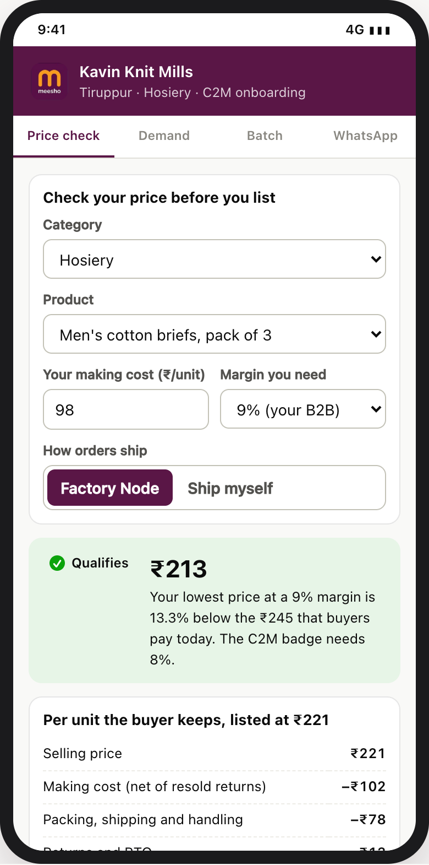
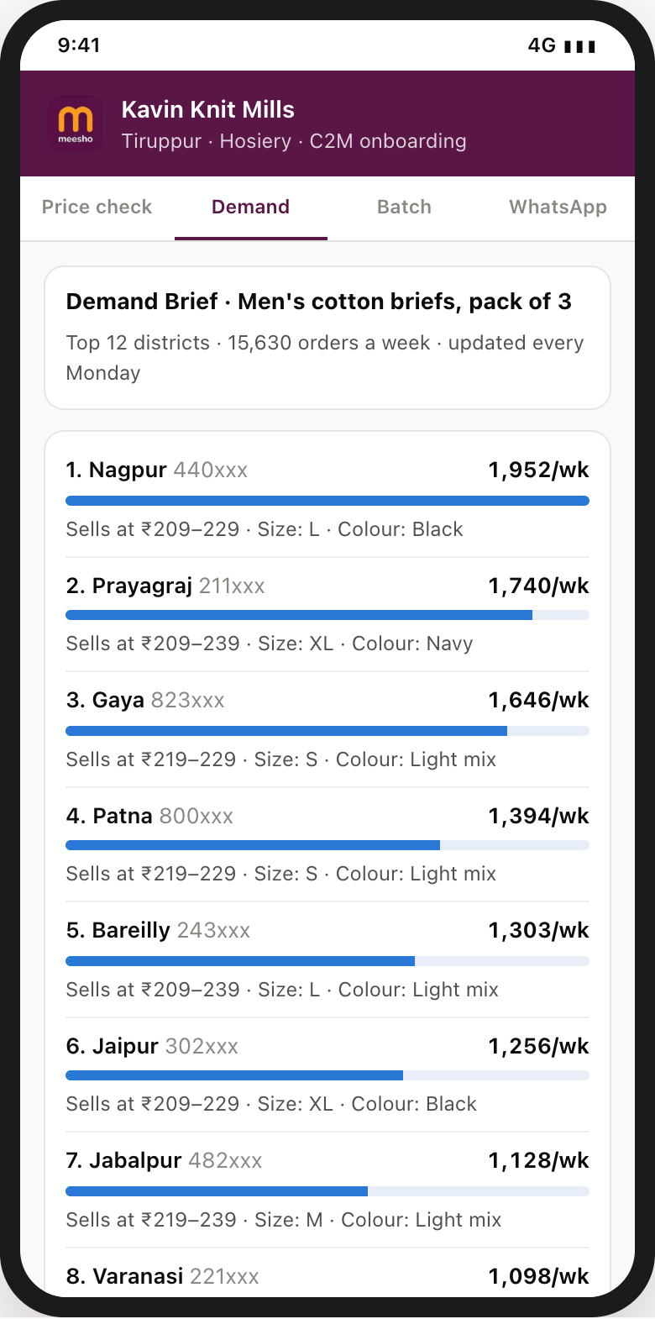
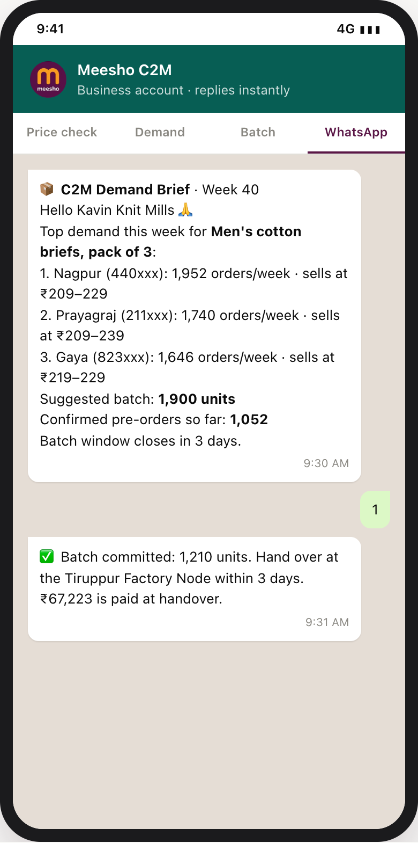
Primary
Research
Manufacturer
Segmentation
User Personas
& Flow
Awareness
& Strategy
Benchmarking
& Comparison
Best
Practices
Manufacturer
Journey
Cluster
Criteria
Unit
Economics
Financial
Analysis
90-Day Plan
& Risks
Seven stages, each with a trigger, a non-cash nudge and a KPI, turn first batches into repeat factories without subsidy
JOURNEY & SCALE-UP
Manufacturer journey: actions, touchpoints, emotions, pain points, interventions, KPIs
Incentives (non-cash) and nudges, stage by stage
Stage | When | Manufacturer action | Touchpoint | Feels | Pain point | Meesho intervention (automatic) | KPI target
Discover | D−30 | Hears of it at an association camp | Camp, WhatsApp | Sceptical | “Platforms mean returns” | Live price check at the camp | Camp → price check ≥ 60%
Qualify | D−7 | Enters making cost | Supplier app | Hopeful | Unsure of the real market price | Gap vs the demand-weighted median | Qualified → listed ≥ 50% in 30 days
First batch | D0–5 | Commits a prepaid batch | Demand Brief, node | Anxious | Fear of unsold stock | Make orders + 15%; 30% advance | First batch ≤ 14 days
Activate | D0–14 | Watches first orders | Score card | Worried | No reviews, slow orders | Starter impressions; +25K grant if < 60% | ≥ 60% of cohort orders at D7, D14
Diagnose | Daily | Reads the weekly score | Health Score | Informed | Unclear what to fix | One rule-based fix at a time | Days to recover
Graduate | D30+ | Scales batches | Prepayment | Confident | Working capital | Prepayment at score ≥ 80 for 30 days | ≥ 40% graduated by D60
Retain | D60+ | Repeats; refers peers | Weekly brief, Mall | Loyal | Export orders return | Weekly brief; Meesho Mall path | Active at D90 ≥ 75%
Stage | Incentive | Nudge
Discover | Free price check | Peer stories at the camp
Qualify | C2M badge + re-rank | Your gap vs the market
First batch | 30% cash at handover | Batch size from the brief
Activate | +25K impressions × 7 days (max 2) | WhatsApp: grant applied
Diagnose | Fix suggestions | One fix, not ten
Graduate | Prepaid batches unlocked | Graduation progress bar
Retain | Meesho Mall path | Top-factory list at camps
Seller Health Score: 0–100, daily
Rulebook: 9 automatic actions, 1 human
Grants scale; people don’t
Channels: WhatsApp, voice agent, supplier app (prototype)
30%
Price gap held
Signal | Action
Orders < 60% at D7/D14 | Grant
Gap < 8% for 7 days | Price nudge
Gap < 4% for 3 days | Badge off
Returns > 1.5× norm | QC hold
On-time < 90% (7 days) | Node offer
In-stock < 70% | Restock nudge
Score ≥ 80 × 30 days | Prepayment
Score < 40 after a fix | A person
90:3
automated vs human actions in the 60-seller simulated pilot
25%
Order pace vs cohort
20%
Quality returns
~910 sellers per category manager; 1,400 sellers need ~2 reviewers, not ~70 account managers. Grant cost: ₹3,750 per seller at most, 20× cheaper than ₹10 an order for 30 days.
15%
On-time dispatch
10%
In-stock
≥ 80 for 30 days → graduate · < 40 after a fix → a person
Price check
Demand Brief
WhatsApp nudge
Decision: switch on grants, the Health Score and the rulebook with the first 60 sellers; cap grants at 20% of category impressions. Owner: Growth + Data Science · KPI: active at D90 ≥ 75%.
Sources: S1 (seller tools: demand intelligence, faster visibility for new sellers, Gen-AI voice agents), S2 | Assumptions: A19 (₹75 per 1,000 impressions); a category manager reviews 40 escalations a month | Prototype: synthetic 60-seller pilot, fixed seed
8

Slide 9
Primary
Research
Manufacturer
Segmentation
User Personas
& Flow
Awareness
& Strategy
Benchmarking
& Comparison
Best
Practices
Manufacturer
Journey
Cluster
Criteria
Unit
Economics
Financial
Analysis
90-Day Plan
& Risks
Tiruppur and Panipat top the cluster AHP (CR 0.016); factories qualify only with 60% of SKUs 8% below market
CLUSTER CRITERIA
Selection criteria and reasoning
Live teardown: what buyers really pay (279 listings, index 100 = demand-weighted median)
Criterion | Reasoning | Data source
Cost ownership | Own raw material, production, scale, automation → a real price edge | Round 1 cost-lever index
Demand on Meesho | The category already sells at volume on Meesho | Teardown [S10]; category mix [S20]
Returns band | Low returns protect the cost edge | Return math; seller guides [S11]
Node feasibility | A partner warehouse and a Valmo lane nearby | Valmo network [S2]
Institutional partner | An association that recruits 40–60 units a drive | Tiruppur, Panipat bodies [S8, S9]
Listing median above what buyers pay
Steel glasses, set of 6
n = 55 · buyers pay ₹262
₹415
+58%
Men’s briefs, 3-pack
n = 56 · buyers pay ₹209
₹323
+54%
Bedsheet + 2 covers
n = 56 · buyers pay ₹325
₹404
+24%
AHP pairwise matrix (CR 0.016 < 0.10: consistent)
Ankle socks, 5-pack
n = 56 · buyers pay ₹128
₹133
+4%
Criteria |  | C1 | C2 | C3 | C4 | C5 | Geo. mean | Weight | Rank
Cost ownership | C1 | 1 | 1 | 2 | 3 | 4 | 1.89 | 0.338 | 1
Demand on Meesho | C2 | 1 | 1 | 1 | 2 | 3 | 1.43 | 0.256 | 2
Returns band | C3 | 1/2 | 1 | 1 | 1 | 2 | 1.00 | 0.179 | 3
Node feasibility | C4 | 1/3 | 1/2 | 1 | 1 | 2 | 0.80 | 0.144 | 4
Institutional partner | C5 | 1/4 | 1/3 | 1/2 | 1/2 | 1 | 0.46 | 0.083 | 5
Bath towel
n = 56 · buyers pay ₹227
₹234
+3%
80
100
140
180
220
● demand-weighted median ◆ listing median | 8% gate ▬ middle 50% of listings
Price gate: assumptions → calculation → result (men’s briefs, 3-pack)
Assumptions
Listing median ₹322.5 [S10]
Demand-weighted median ₹209 [S10]
Gate: SKU ≥ 8% below median
Badge: ≥ 60% of live SKUs clear
Sellers above ₹5 cr GMV
Seller with > 30% of a set’s orders scored without its own orders
SKU needs ≥ 10 delivered orders to count
Re-scored weekly; badge off below a 4% gap
Approach 1: listing median
gate = ₹322.5 × 0.92 = ₹296.7
24 of 56 listings clear (43%)
Too loose: the badge would sit on 4 in 10 listings, including resellers.
Approach 2: demand-weighted median
gate = ₹209 × 0.92 = ₹192.3
6 of 56 listings clear (11%)
Only real cost edges clear: the badge means something.
Cluster scoring → choice
Criteria | Weight | Tiruppur | Panipat | Ludhiana | Rajkot | Surat
Cost ownership | 0.338 | 5 | 5 | 4 | 4 | 2
Demand on Meesho | 0.256 | 5 | 4 | 3 | 3 | 5
Returns band | 0.179 | 4 | 5 | 4 | 5 | 2
Node feasibility | 0.144 | 4 | 4 | 4 | 3 | 5
Institutional partner | 0.083 | 5 | 4 | 4 | 3 | 3
Score · rank |  | 4.68 · #1 | 4.52 · #2 | 3.74 · #3 | 3.70 · #4 | 3.28 · #5
Result: factory floor ₹180 → 13.8% below ✓ · reseller ₹220 → −5.4% ✕
Prototype verdict (180 sellers > ₹5 cr) | Sellers | Action
C2M-ready | 62 | Badge + re-rank + Demand Brief
Scale without price | 84 | No badge; value-tier SKUs
Loss-leader pattern | 18 | No badge: catalogue gate holds
Near miss | 16 | Node offer; re-score in 28 days
Robust: Surat overtakes Panipat only if the demand weight rises from 0.26 to 0.67; equal weights keep the order.
Decision: pilot in Tiruppur and Panipat; run the price gate on demand-weighted medians in weeks 1–3 at ₹0 capex. Owner: Category + Pricing · KPI: badge lift ≥ 12% vs holdout by Day 30.
Sources: S2, S8, S9, S10 team teardown (meesho.com, 2 Oct 2026; 56 listings per query; reviews as demand weights), S11, S20, S22 (cluster scores) | AHP workings: Appendix C | Verdicts: prototype, synthetic sellers
9

Slide 10

Primary
Research
Manufacturer
Segmentation
User Personas
& Flow
Awareness
& Strategy
Benchmarking
& Comparison
Best
Practices
Manufacturer
Journey
Cluster
Criteria
Unit
Economics
Financial
Analysis
90-Day Plan
& Risks
A prepaid 3-pack costs ₹164 vs a reseller’s ₹200.5; of the ₹45 freed, buyers get ₹26.7 and the factory ₹18.3
UNIT ECONOMICS
Unit economics per 3-pack kept, one change per column (Tiruppur men’s briefs)
One prepaid batch of 1,000 packs at ₹182, stage by stage
 | Reseller today | + Factory lists direct | + Factory Node | + Prepaid pre-order batch
Scenario | Existing: buys via a wholesaler, ships, stocks | Step 1: no wholesaler mark-up | Step 2: bulk drop; node packs, ships, grades | Proposed: make confirmed orders + 15%
Per 100 shipped: failed deliveries | 14.0 | 14.0 | 14.0 | 4.6
Delivered | 86.0 | 86.0 | 86.0 | 95.5
Returned by buyers (8%) | 6.9 | 6.9 | 6.9 | 7.6
Kept (paid for) | 79.1 | 79.1 | 79.1 | 87.8
Goods, net of resold returns (₹) | 105.1 | 83.2 | 82.1 | 81.1
Unsold stock written down | 7.1 | 5.6 | 5.6 | 0.9
Logistics: forward + pack / node fee | 72.4 | 72.4 | 70.9 | 68.4
Customer-return fees (₹150 each) | 13.0 | 13.0 | 13.0 | 13.0
Working capital (18% a year) | 2.8 | 2.2 | 2.2 | 0.4
Cost per pack kept | 200.5 | 176.5 | 173.9 | 164.0
Lowest viable price (9% margin) | ₹220 | ₹194 | ₹191 | ₹180
Gap vs ₹209 demand-weighted median | −5.4% | 7.2% | 8.5% | 13.8%
Clears the 8% gate (≤ ₹192)? | ✕ no | ✕ no | ✓ yes | ✓ yes
Stage | What happens | ₹
1 · Pre-order window | 1,000 confirmed; make 1,150 (+15%) | ₹1,82,280 order value
2 · Handover at node | 30% advanced by the NBFC | +₹54,684
3 · Delivery | 46 failed (4.6%) · 76 returned | 878 kept
4 · Revenue on kept orders | 878 × ₹182.3 | ₹1,60,067
5 · Fees | forward ₹40,089 · node ₹20,000 · returns ₹11,454 | −₹71,543
6 · Payout, 7 days after delivery | net of fees; repays the advance | ₹88,524
7 · Balance to the factory | payout − advance | +₹33,840
Where the ₹45 per pack goes (pre-order vs a reseller at ₹209)
₹45 = ₹36.5 lower cost (no wholesaler, node, batches) + ₹8.5 reseller margin
Buyer ₹26.7 · 59%
Factory ₹18.3 · 41%
› Buyer: pays ₹182 instead of ₹209.
› Factory: earns ₹18.3 a pack vs ₹7.9 selling ex-factory (2.3×).
› Meesho: earns per order, not per rupee: ₹5.8 per C2M order (page 11).
Highest making cost that clears the gate: ₹78.7 → ₹80.9 → ₹90.7 (+15%): the levers widen the pool of factories that qualify.
Assumptions (every input carries an [A#] in Appendix B)
Factory
Market
Logistics
Returns
Stock
Making cost ₹80 a pack [A22]
Margin 9% on price [A23]
Capital 18% a year [A30]
Demand-weighted median ₹209 [S10]
Gate −8% = ₹192
Pre-order ₹10 off [A32]
Forward ₹55 self / ₹42 node
Packing ₹10 · node fee ₹20 [A28]
Wholesaler +15% [A24]
Failed 14% (4.6% prepaid)
Returned 8% of delivered [A25]
₹150 return fee · ₹0 RTO fee
Unsold 10% vs 2% [A31]
Salvage 50% · recovery 85%/90%
45 vs 10 inventory days [A30]
Decision: price pre-orders at the gate less ₹10 (₹182), funded by the factory’s ₹11 batch saving. Owner: Pricing + Category · KPI: factory margin ≥ ₹18 a pack.
Sources: S10 (₹209 demand-weighted median), S11 (₹150 return fee, ₹0 RTO fee), S12, S13 | Assumptions: A10, A11, A20, A22–A32 (making cost ₹80 to confirm in interviews) | Workings: Appendix C
10

Slide 11
Primary
Research
Manufacturer
Segmentation
User Personas
& Flow
Awareness
& Strategy
Benchmarking
& Comparison
Best
Practices
Manufacturer
Journey
Cluster
Criteria
Unit
Economics
Financial
Analysis
90-Day Plan
& Risks
₹75 cr NPV at 12% and payback in Year 3; NPV stays positive down to 45% of planned seller yield
FINANCIAL ANALYSIS
Five-year case (₹ cr, nominal; NPV = sum of the PV row)
Opportunity: what each phase is worth (exit run-rates)
 | Year 1 | Year 2 | Year 3 | Year 4 | Year 5
Average active sellers [A3] | 200 | 700 | 1,050 | 1,300 | 1,450
C2M NMV, year average [A4] | 140 | 700 | 1,260 | 1,853 | 2,066
Placed orders (mn) | 9 | 45 | 81 | 119 | 133
Incremental orders × ₹7.3 [A8] | 2.6 | 13.2 | 23.8 | 34.9 | 39.0
Fewer failed deliveries × ₹60 [A11] | 2.6 | 12.8 | 23.0 | 33.8 | 37.7
Benefit to Meesho | 5.2 | 26.0 | 46.8 | 68.7 | 76.7
People [A13, A14] | 3.6 | 6.0 | 7.2 | 7.8 | 7.8
Cluster onboarding [A15] | 5.0 | 3.0 | 2.0 | 2.0 | 0.0
Demand Brief [A16] | 6.0 | 3.0 | 3.0 | 3.0 | 3.0
Factory Nodes [A17] | 7.8 | 2.6 | 2.6 | 2.6 | 0.0
Returns pool, grants, first-loss [A18–A20] | 3.4 | 1.9 | 3.2 | 4.7 | 5.2
Programme cost | 25.8 | 16.5 | 18.0 | 20.1 | 16.0
Net cash flow | −20.6 | 9.5 | 28.7 | 48.6 | 60.7
Discount factor at 12% | 0.893 | 0.797 | 0.712 | 0.636 | 0.567
PV at 12% | −18.4 | 7.6 | 20.4 | 30.9 | 34.4
NPV at 12%
 | Pilot · Day 90 | Year 1 exit | Year 4 exit
Clusters · nodes · active sellers | 2 · 1 · 60 | 5 · 6 · 450 | 12 · 12 · 1,400
Run-rate NMV (× ₹1.425 cr per seller) | ₹85.5 cr | ₹641 cr | ₹1,995 cr
Share of FY26 NMV | 0.2% | 1.5% | 4.8%
C2M orders a day (share of Meesho’s) | 15,000 (0.2%) | 1,13,000 (1.4%) | 3,52,000 (4.4%)
Buyer savings a year (8–12% gap) | ₹7.4 cr–₹11.7 cr | ₹55.8 cr–₹87.4 cr | ₹173 cr–₹272 cr
Meesho value a year | ₹3.2 cr | ₹23.8 cr | ₹74.0 cr
₹74.9 cr
NPV at 15%
₹66.1 cr
IRR
105%
Payback
Benefit vs programme cost (₹ cr, nominal)
Sensitivity: NPV at −20% / +20%
Year 3
Seller yield
48
102
Discounted payback
Incremental orders
60
90
Year 3
Failed-delivery saving
61
89
Year-1 cash (+ people)
Programme cost
61
89
₹22.2 cr (+₹3.6 cr)
Prepaid pre-order share
64
86
Base ₹75 cr; left = worse
Break-even and scenarios
What changed since Round 1, and how money is released
NPV = 0 at 45% of planned seller yield (49% of planned benefit). Positive even with zero incremental orders (₹1 cr) or no failed-delivery saving (₹9 cr): each lever alone almost repays the programme.
Round 1: ₹156 cr NPV counted contribution on every C2M order. Round 2 counts only the 40% that are incremental, plus fewer failed deliveries (₹75 cr); if every order were incremental: ₹186 cr. Value per C2M order = 40% × ₹7.3 + ₹2.8 = ₹5.8.
Bear −₹10 cr
Base ₹75 cr
Bull ₹140 cr
Day 0–30
₹0: badge test on existing order data
20% incremental · 8-pt gap · 75% yield
40% incremental · 15-pt gap · plan yield
55% incremental · 20-pt gap · 110% yield
Day 31–90
₹7.3 cr: 2 clusters, Brief build, 1 node, pool seed
Q2–Q4
₹14.9 cr: 3 clusters, 5 nodes, Brief run
Decision: approve ₹22.2 cr of Year-1 cash as a capped H2 bet, released at the Day-30 and Day-90 gates. Owner: Finance · KPI: Year-1 C2M NMV ≥ ₹140 cr.
Sources: S1 (₹531 cr contribution on 725 mn placed orders; prepaid 37%; NMV ₹11,614 cr on GMV ₹19,054 cr), S3, S11, S13 | NPV: t = 1..5, year-end, no terminal value; year NMV uses average active sellers, the ladder shows exit run-rates | Register: Appendix B
11

Slide 12
Primary
Research
Manufacturer
Segmentation
User Personas
& Flow
Awareness
& Strategy
Benchmarking
& Comparison
Best
Practices
Manufacturer
Journey
Cluster
Criteria
Unit
Economics
Financial
Analysis
90-Day Plan
& Risks
Prove the gap by Day 30, sign partners by Day 60, ship prepaid batches by Day 90, on ₹7.3 cr
90-DAY PLAN
Week-by-week plan for the first 90 days (bars = active weeks · ◆ = milestone · coral lines = gates), then scale
Top risks, sorted by likelihood × impact
Workstream · activity
W1
2 Nov
W2
9 Nov
W3
16 Nov
W4
23 Nov
W5
30 Nov
W6
7 Dec
W7
14 Dec
W8
21 Dec
W9
28 Dec
W10
4 Jan
W11
11 Jan
W12
18 Jan
W13
25 Jan
Q2–Q4
Years 2–4
Risk | L | I | Guardrail | Owner
The gap was a promotion | H | H | Day-30 stop rule; badge off below 4% | Pricing
Export recovery pulls factories back | H | M | Batches fill idle capacity between export runs | Category
Quality falls with price | M | H | Suspend at > 1.5× return norm; QC hold | Category
Sellers game the badge with a few cheap SKUs | M | M | ≥ 60% of live SKUs must clear; dominant-seller rule | Pricing
Node or advances read as inventory control | L | H | Seller keeps title; NBFC lends; 3PL fees at arm’s length | Legal
Re-rank starves resellers | L | M | ≤ 20% of category impressions; category NMV guardrail | Growth
Price screen
Pricing + DS
Medians + scores; badge live
Wave 2 categories
Default check
4-week badge test vs holdout
Supply
Category
Weekly re-score; badge-off rule
Sign Tiruppur + Panipat bodies
5 clusters
12 clusters
Demand
DS + Product
Camps; catalogue 60 factories
450 factories
1,400 factories
Demand Brief build, 5 categories
All 9 categories
Weekly refresh
Pre-order window in buyer app
Operations
Valmo
First prepaid batches
In every brief
Warehouse quotes, Tiruppur
Node set-up after Day-30 gate
6 nodes
12 nodes
Enablers
Finance · Growth · Legal
Node live; returns end at node
Finance: NBFC → 30% advances
Returns pool
H1 budget
Growth: Health Score → grants
2 reviewers
Legal: PN2, GST → badge declared
Day 30
Day 60
Day 90
Day 30 gate
Fund if badge lift ≥ 12% (interval > 0) and ≥ 70% still clear at D14; else tighten to a 10% gap, or stop
Day 60 gate
2 associations signed · 60 factories catalogued · briefs live in 5 categories · NBFC signed
Day 90 gate
3 of 4: batches shipped in SLA · returns end at the node · retention ≥ 70% · category NMV ≥ base
Money released
₹0 to Day 30 → ₹7.3 cr for Days 31–90 → ₹14.9 cr in Q2–Q4 (Year 1 cap ₹22.2 cr)
The ask
Metrics & KPIs: onboarding → activation → retention, with guardrails (north star: C2M NMV still clearing the gate)
Budget ₹0 to Day 30; ₹7.3 cr for Days 31–90; ₹22.2 cr cash in Year 1 (+₹3.6 cr people), capped as an H2 bet
Decisions (1) run the badge test with a holdout from Week 1; (2) name owners in Pricing, Category, Valmo, Finance, Legal; (3) sign the associations, a Tiruppur node and an NBFC by Day 60; (4) declare the price-gap badge as a ranking parameter before 1 Jan 2027
Go / no-go badged NMV per live SKU ≥ 12% above holdout, ≥ 70% still clearing at D14
Stage | KPI | Day 30 | Day 60 | Day 90 | Year-1 exit | Owner · cadence
Scale | Active C2M sellers | Shortlist | 60 catalogued | 60 live | 450 | Category · weekly
Onboarding | Qualified → listed within 30 days | — | ≥ 50% | ≥ 50% | ≥ 50% | Category · weekly
Onboarding | Days to first prepaid batch | — | — | ≤ 14 | ≤ 14 | Category · weekly
Activation | Orders at D7 / D14 vs cohort median | — | — | ≥ 60% | ≥ 60% | DS · daily
Activation | Prepaid share of C2M orders | — | — | ≥ 37% | ≥ 68.5% | Finance · weekly
Retention | Sellers still clearing the 8% gate | ≥ 70% | ≥ 70% | ≥ 70% | ≥ 75% | Pricing · weekly
Retention | Factories active at Day 90 | — | — | ≥ 70% | ≥ 75% | Category · monthly
Guardrail | Badge share of category impressions; category NMV | ≤ 20%; ≥ base | ≤ 20%; ≥ base | ≤ 20%; ≥ base | ≤ 20%; ≥ base | Growth · weekly
North star | Run-rate C2M NMV clearing the gate | — | — | ₹85.5 cr | ₹641 cr | Finance · monthly
Ask: approve the ₹0 Day-30 test now and ₹7.3 cr for Days 31–90, released only if the Day-30 gate passes; Year 1 is capped at ₹22.2 cr.
Sources: S1 (H2 bets: hard budget cap, graduation on adoption and retention), S19 (Press Note 2; E-Commerce Amendment Rules 2026 in force 1 Jan 2027), S26 | Day 1 = Mon 2 Nov 2026 · Day 30 = 1 Dec · Day 60 = 31 Dec · Day 90 = 30 Jan 2027 | Compliance: Appendix C
12

Slide 13
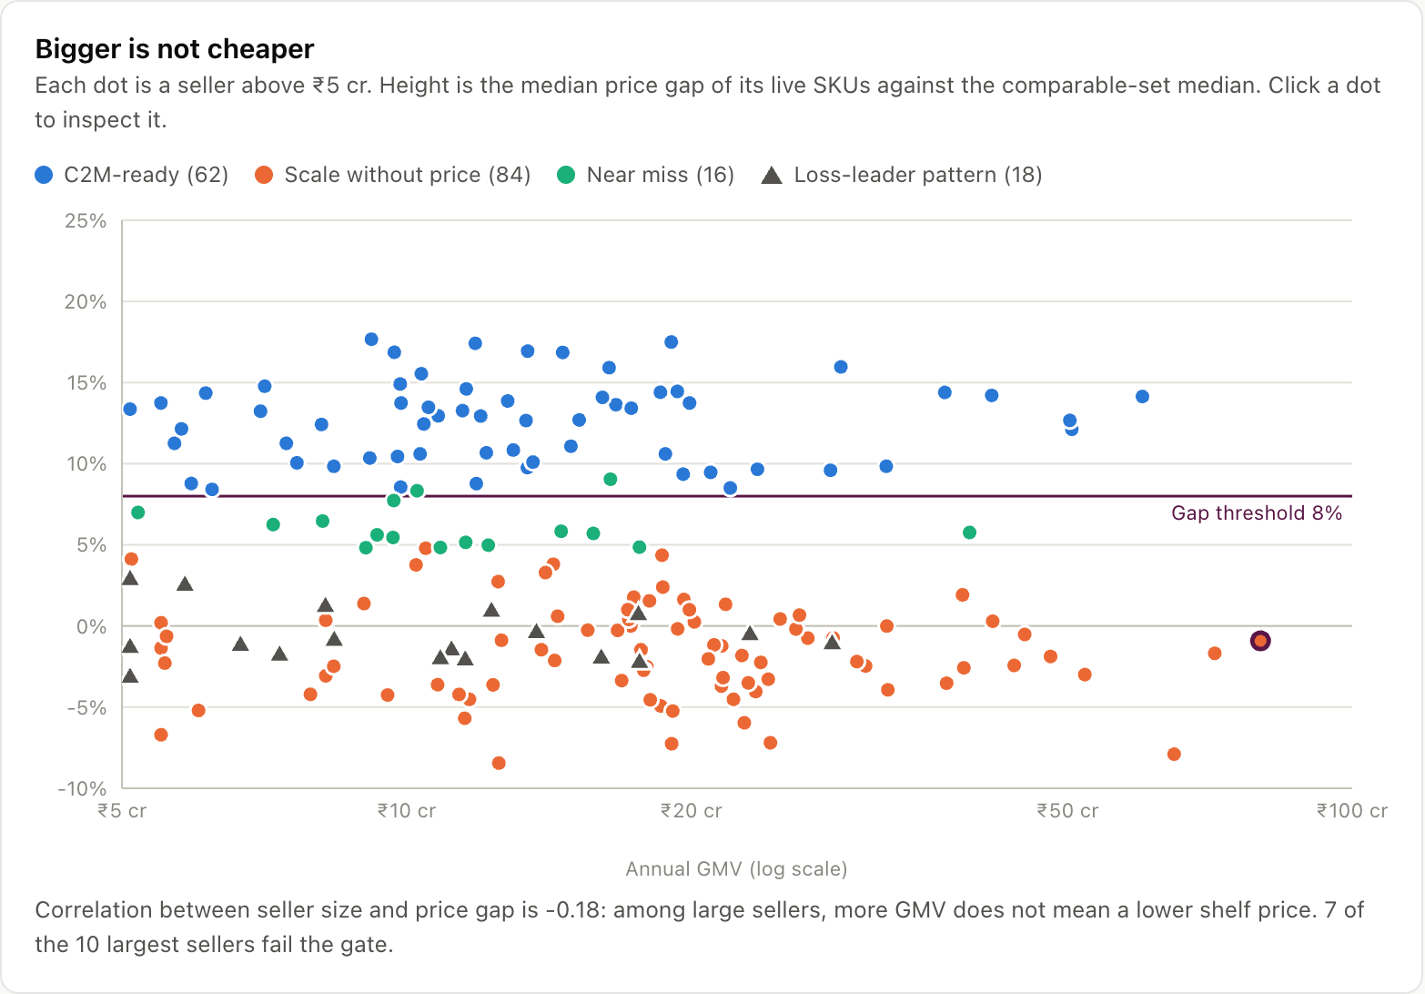
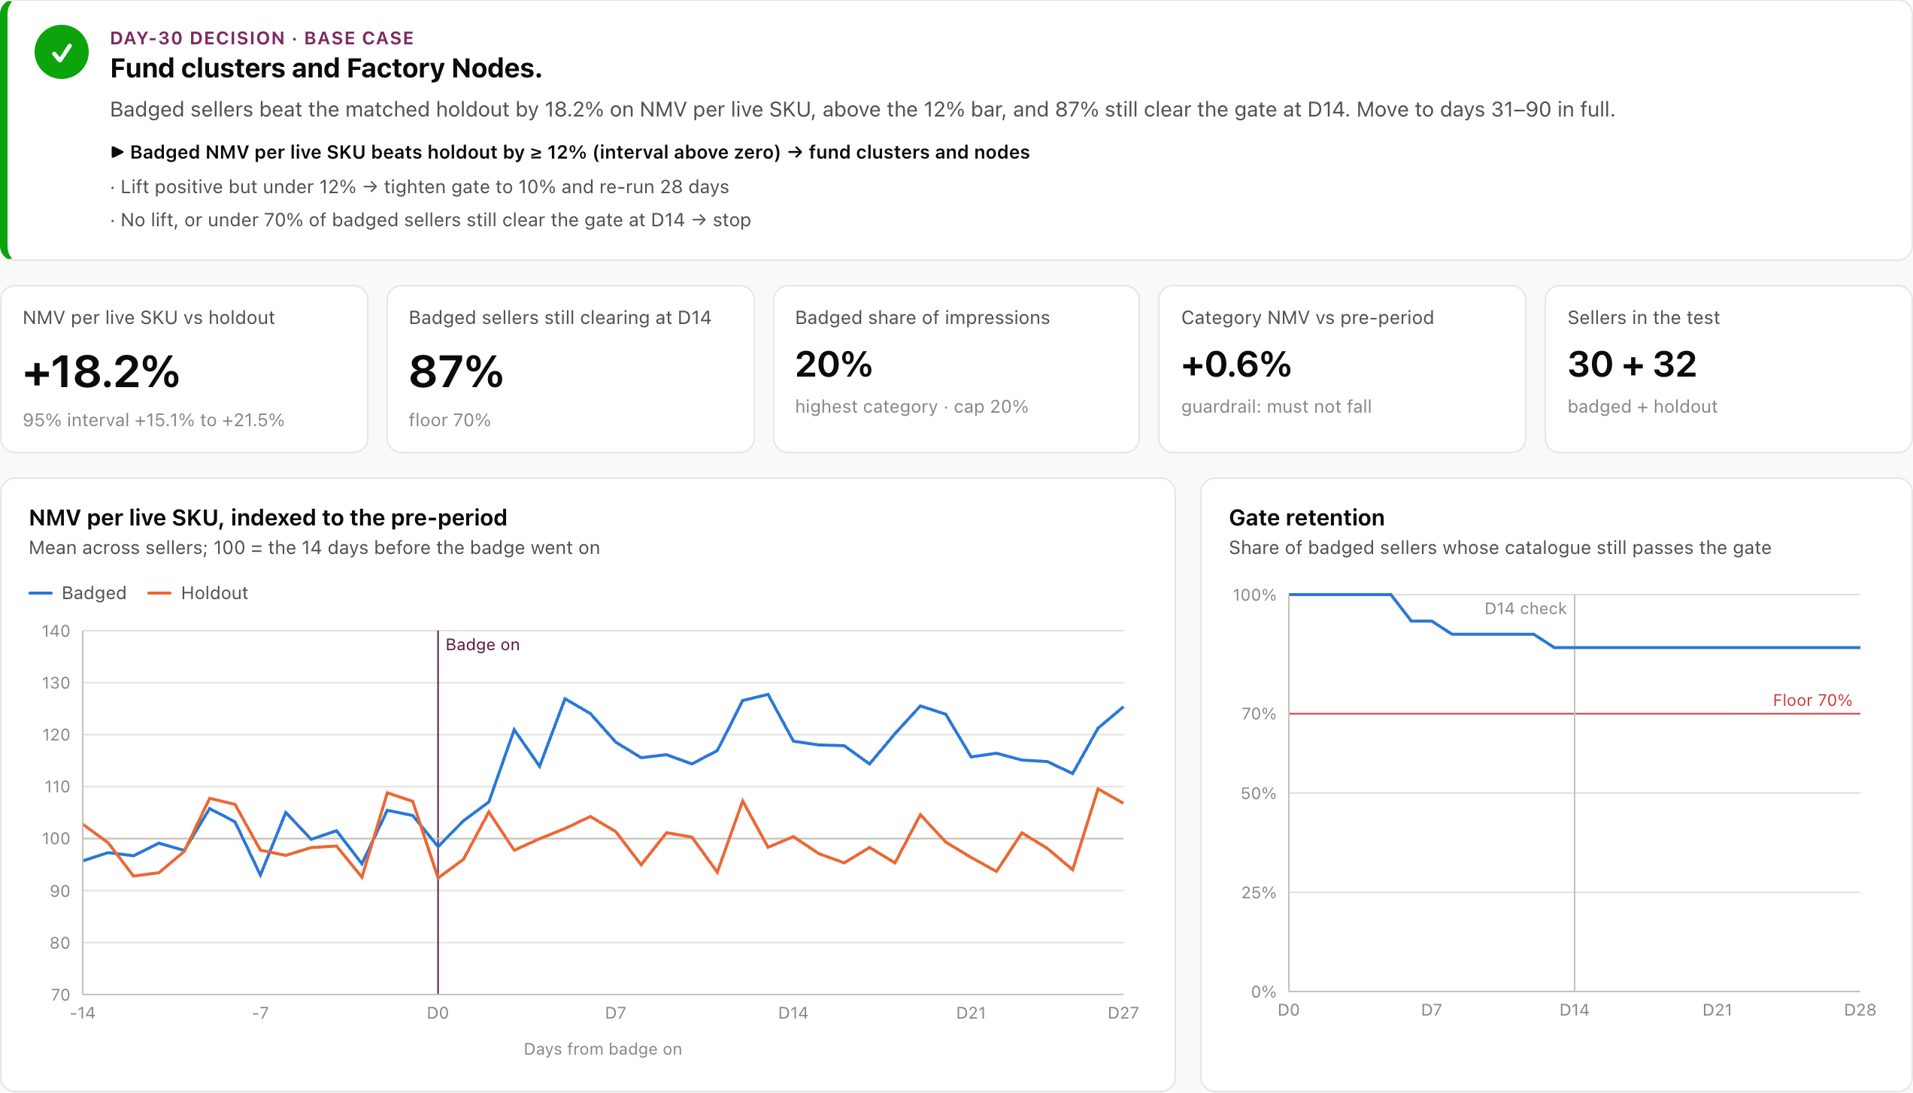
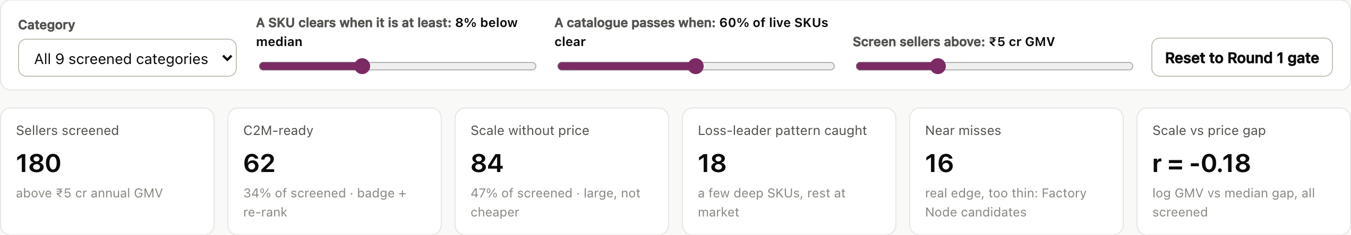
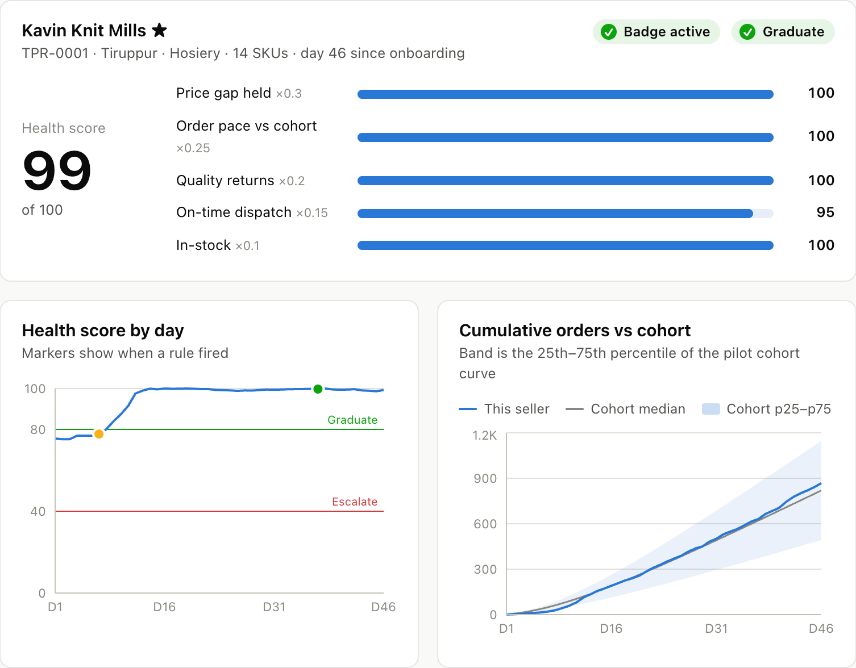
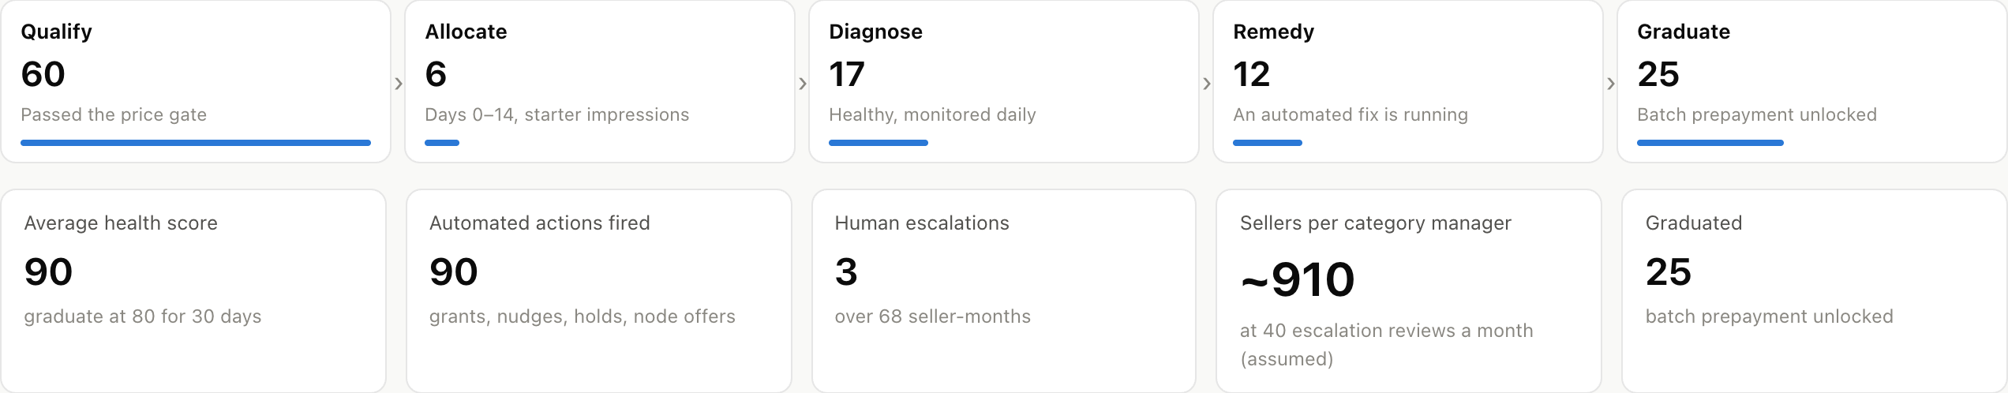
Appendix A · Product walkthrough
The working prototype runs every rule in this deck end to end, on synthetic data that mirrors Meesho’s order tables
APPENDIX A
1 · Price Truth Index supports p9
Size vs price gap for every seller above ₹5 cr: r = −0.18; 7 of the 10 largest fail
2 · Day-30 readout supports p12
Badged vs holdout: +18.2% (interval +15.1% to +21.5%) → fund
5 · Manufacturer app: price check
Lowest viable price vs market median, before listing
supports p5, p10
6 · Demand Brief + batch
District demand → batch size → one-tap commit
supports p4, p8
7 · WhatsApp nudges
Grant applied, batch confirmed, payout dates
supports p8
3 · Gate controls + Seller Health stages supports p8, p9
Gate sliders re-score every seller; 60 pilot sellers by stage
4 · One seller’s Health Score supports p8
Five signals, the rule that fired, the next action
Open it live: meesho-dice-c2m-iitb.vercel.app
Mirror: prathmesh-28.github.io/c2m-control-tower · Offline: one HTML file in prototype/dist-single
Prototype: React + Recharts static site; 261 synthetic sellers, 4,415 SKUs, 9 categories; fixed seed; fictional names; four model tests run before every deploy | Supports pages 4, 5, 8, 9, 12
13

Slide 14
Appendix B · Sources, method, assumptions
Every figure in the deck traces to a numbered source [S#] or a registered assumption [A#] in one master model
APPENDIX B
Sources [S#] (publisher · title · date)
Assumption register [A#] (value · source · confidence H/M/L)
S1 Meesho: Q1 FY27 Shareholders’ Letter (quarter to 30 Jun 2026) (Aug 2026)
S2 Meesho: Q4 FY26 earnings call transcript (6 May 2026)
S3 Deccan Herald; Apparel Resources; Inc42: Meesho FY26 results coverage (May 2026)
S4 ICRIER: Annual Survey of MSMEs in India 2025 (n = 2,365, Fig. 16) (Mar 2025)
S5 Ministry of MSME: S.O. 1364(E): revised MSME limits (21 Mar 2025)
S6 RBI: OBICUS, Q2 FY26: capacity utilisation 74.3% (Oct 2025)
S7 Udyam portal (team pull); PIB: Udyam registrations (Jun 2026; 28 Feb 2026)
S8 The Federal; Deccan Herald: Tiruppur output, exports, tariff impact (2025–26)
S9 The Tribune: Panipat textile industry hit by weak demand, high costs (17 Aug 2026)
S10 Team teardown: meesho.com search: 279 live listings, 5 product types (2 Oct 2026)
S11 Shiprocket; Robnu: Meesho seller fee guides (return fee, RTO policy) (2026)
S12 Shiprocket: Fulfilment pricing: ₹24 per order, 500–3,000 orders a month (2026)
S13 GoKwik via Base; TrackVid: COD vs prepaid RTO benchmarks (industry estimates) (2026)
S14 Flipkart newsroom; Business Standard: 0% commission moves (Amazon, Flipkart) (Nov 2025 – 8 Jul 2026)
S15 KrASIA: Pinduoduo New Brand Initiative (end-2019 figures) (2020)
S16 Tech Buzz China: Temu Watch #6: semi-managed share of GMV (27 Dec 2024)
S17 Reuters via FashionNetwork: Shein tried to turn Brazil into a production hub (Feb 2026)
S18 Inc42: MSME-TEAM: ₹277 cr to onboard 5 lakh MSMEs onto ONDC (2024)
S19 Khaitan & Co; LexOrbis: Press Note 2 (2018); E-Commerce Amendment Rules 2026 (2018; Sep 2026)
S20 Finnovate; Zappchai (DRHP-based): Meesho category mix estimates (2025)
S21 Apparel Resources: Tirupur rewires its growth playbook (owner interviews) (25 Jun 2026)
S22 Team 23B0747: Round 1 research: 24 interviews, cluster AHP, sizing funnel, category screen (Sep 2026)
S23 Xinhua: Taobao C2M: 10 bn new orders for factories in 3 years (27 Mar 2020)
S24 Alibaba Group: December Quarter 2021 Results (Taobao Deals) (23 Feb 2022)
S25 AFP via Malay Mail: Shein statement on 100–200 item first batches (24 Mar 2024)
S26 Bank of Baroda: E-commerce business loans for marketplace sellers (2026)
ID | Assumption | Value | Source | C
A1 | Mature NMV per C2M seller | ₹1.425 cr | S22 | M
A2 | Year-4 capture of SAM | 12% | S22 | M
A3 | Average active sellers, Y1–Y5 | 200 → 1,450 | Team plan | M
A4 | NMV per seller, Y1–Y5 (₹ cr) | 0.70 → 1.425 | Team plan | M
A5 | Typical target factory turnover | ₹25 cr | S5 | L
A6 | Meesho NMV in C2M categories | 40% | S20 | L
A7 | Price gap passed to buyers | 8%–12% | S22 | M
A8 | Incremental share of C2M orders | 40% | Team | L
A9 | C2M GMV per order vs average | 10% | A7 | M
A10 | Prepaid pre-order share | 50% | survey | L
A11 | Failed-delivery gap, COD vs prepaid | 15 pts | S13 | L
A12 | Meesho cost per failed delivery | ₹60 | S11, S13 | L
A13 | Loaded cost per FTE-year | ₹0.3 cr | Team | M
A14 | Programme FTE, Y1–Y5 | 12 → 26 | Team plan | M
A15 | Clusters (year-end); onboarding cost | 5 → 12; ₹1 cr each | S22 | M
A16 | Demand Brief cost, Y1–Y5 | ₹6 cr, then ₹3 cr | S22 | M
ID | Assumption | Value | Source | C
A17 | Nodes (year-end); set-up; life | 6 → 12; ₹1.3 cr; 5 yrs | Team | L
A18 | Returns firewall pool | ₹3 cr; then 0.1% of NMV | S22 | L
A19 | Grant valuation; impressions | ₹75 CPM; 50,000 impr. | Team | L
A20 | NBFC advance; Meesho first-loss | 30%; 1% | S26 | L
A21 | Discount rate; stress rate | 12%; 15% | S22 | M
A22 | Making cost, briefs 3-pack | ₹80 | interviews | L
A23 | Target margin on price | 9% | S22 | M
A24 | Wholesaler mark-up | 15% | Team | L
A25 | Hosiery: failed deliveries; returns | RTO 14%; returns 8% | Team | L
A26 | Return fee to seller | ₹150 | S11 | M
A27 | Failed-delivery fee to seller | ₹0 | S11 | M
A28 | Logistics fees, self / node | ₹55/42 fwd; ₹10/20 | S11, S12 | L
A29 | Value recovered, self / node | 85% / 90% | Team | L
A30 | Capital cost; inventory days | 18%; 45 vs 10 days | S4 | M
A31 | Unsold share; salvage value | 10% vs 2%; salvage 50% | Team | L
A32 | Pre-order discount (7–8 days) | ₹10 | survey | L
Method and sample
Workings index (formula → page)
Teardown [S10]: meesho.com search, 2 Oct 2026; first 56 listings per query; 279 listings, 5 product types; demand weight = review count; plastics query returned none and was dropped.
Interviews [S22]: 24 owners (8 per cohort, Round 1) + 3 published owner interviews [S21].
Buyer survey: [FILL: n, dates, quotas achieved vs target (≥ 150; ≥ 30 per tier); stated intent counted at 50%]
Power: 62 sellers × 28 days, SE ≈ 1.6 pts, MDE ≈ 4.5% at 80% power.
Sizing: NMV = sellers × ₹1.425 cr; savings = NMV × g ÷ (1 − g) → p3, p11
Unit cost: (make + unsold − resold + logistics + returns + capital) ÷ kept → p10
Benefit: orders × (incremental × ₹7.3 + Δfailed × ₹60) → p11
Δfailed: pre-order share × (1 − 37%) × 15 pts = 4.7 pts → p11
AHP: geometric means, CR = (λ − 5) ÷ 4 ÷ 1.12 → p9, Appendix C
RICE: reach × impact × confidence ÷ effort → p7
Master model: deck/source/model.mjs → outputs.json (every slide number is read from it) · prototype results: proto.mjs · teardown data: deck/source/data · survey kit: research/13 | Supports pages 2–12
14

Slide 15
Appendix C · Benchmarks, compliance, model detail
Detailed benchmarking, compliance by design and the model workings behind pages 3, 9 and 10
APPENDIX C
Detailed benchmarking: KPI × company (dated, sourced) and how Meesho uses it
Compliance by design
 | Pinduoduo NBI | Taobao C2M | Temu semi-managed | Shein | Shein Brazil
Year of data | End-2019 | 2020; Dec 2021 | Q3 2024 | Mar 2024 | Apr 2023 – Feb 2026
Factories / merchants | 900+ in C2M production | 1,000 “super factories” targeted | +80,000 planned for 2025 | Network (not disclosed) | 336 signed of 2,000; 1 producing
Demand data to factories | ✓ anonymised | ✓ consumer insight | – platform prices | ✓ real-time | ✕
Who holds stock | Factory | Factory | Merchant, local warehouse | Shein | Factory
Batching | Custom runs | C2M runs | — | 100–200 item first runs | Large runs, fast
Price lever | Demand scale | Finance + insight | Platform-set | Small batches | ~30% price-cut asks
How Meesho uses it | Demand Brief | NBFC prepayment | Seller-owned node | Pre-order batches | Never ask for cuts
Rule | Requires | Our design
Press Note 2 (2018) | Marketplace may not own or control seller inventory | Seller keeps title at the node; Valmo sells warehousing at arm’s length
Press Note 2 (2018) | Fair, non-discriminatory services; no exclusivity | Badge and grants are published rules any seller can meet
E-Commerce Rules, 2026 amendment (from 1 Jan 2027) | Ranking parameters by importance; sponsored labelled | Publish the price-gap badge as a ranking parameter; grants are organic, never sold
Dark-pattern guidelines (2023) | No false urgency or hidden terms | “Ships in 7–8 days, ₹10 off” shown before payment
DPDP Act (2023) | Protect personal data | Demand Briefs use district aggregates only
GST | Stock at a third-party site | Node registered as the seller’s additional place of business
Cohort scoring behind the personas (page 3)
AHP workings (CR 0.016)
Unit-economics workings (per 100 shipped)
Cohort | Price edge 30% | Pool size 25% | Fixable 20% | Speed 15% | New supply 10% | Score
A · Offline B2B | 5 | 5 | 4 | 2 | 5 | 4.35
C · Churned | 4 | 2 | 5 | 5 | 1 | 3.55
B · Online elsewhere | 3 | 3 | 2 | 4 | 4 | 3.05
Method: reciprocal 1–9 matrix → geometric mean of each row → weight = mean ÷ sum of means.
Consistency: λmax = 5.072; CI = (λmax − 5) ÷ 4 = 0.018; CR = CI ÷ 1.12 = 0.016 < 0.10.
Check: weights 0.338 / 0.256 / 0.179 / 0.144 / 0.083 reproduce Round 1’s cluster scores (Tiruppur 4.68, Panipat 4.52).
Robustness: Surat overtakes Panipat only above a 0.67 demand weight.
Kept units = 100 × (1 − RTO) × (1 − returns) = 79.1 (prepaid: 87.8)
Unsold = extra units made × cost × (1 − 50% salvage); 10% build-to-stock vs 2% batch
Logistics = delivered × forward fee + shipped × packing (₹10) or node fee (₹20)
Capital = make cost × 18% × days ÷ 365 (45 vs 10 days)
Floor = cost per kept ÷ (1 − 9%) → proposed ₹164.0 ÷ 0.91 = ₹180.2
Reconciliation checks NPV ₹74.9 cr = Σ PV row (page 11) ✓ · Year-4 NMV ₹1,853 cr (average 1,300 sellers) vs ₹1,995 cr exit run-rate (1,400) ✓ · batch payout ₹88,524 = revenue − fees ✓ · RICE order = dependency order ✓
Rubric (5 =): price edge: sells ex-factory B2B · pool: > 50% of SAM · fixable: all HIGH barriers fixable · speed: KYC + catalogue on Meesho · new supply: new to Meesho. Equal weights give the same order (4.2 / 3.4 / 3.2).
Sources: S15–S19, S22–S25 | Compliance rows are design responses, not legal advice: Meesho legal confirms each before the pilot | Supports pages 3, 6, 7, 9, 10, 12
15

