Slide 1
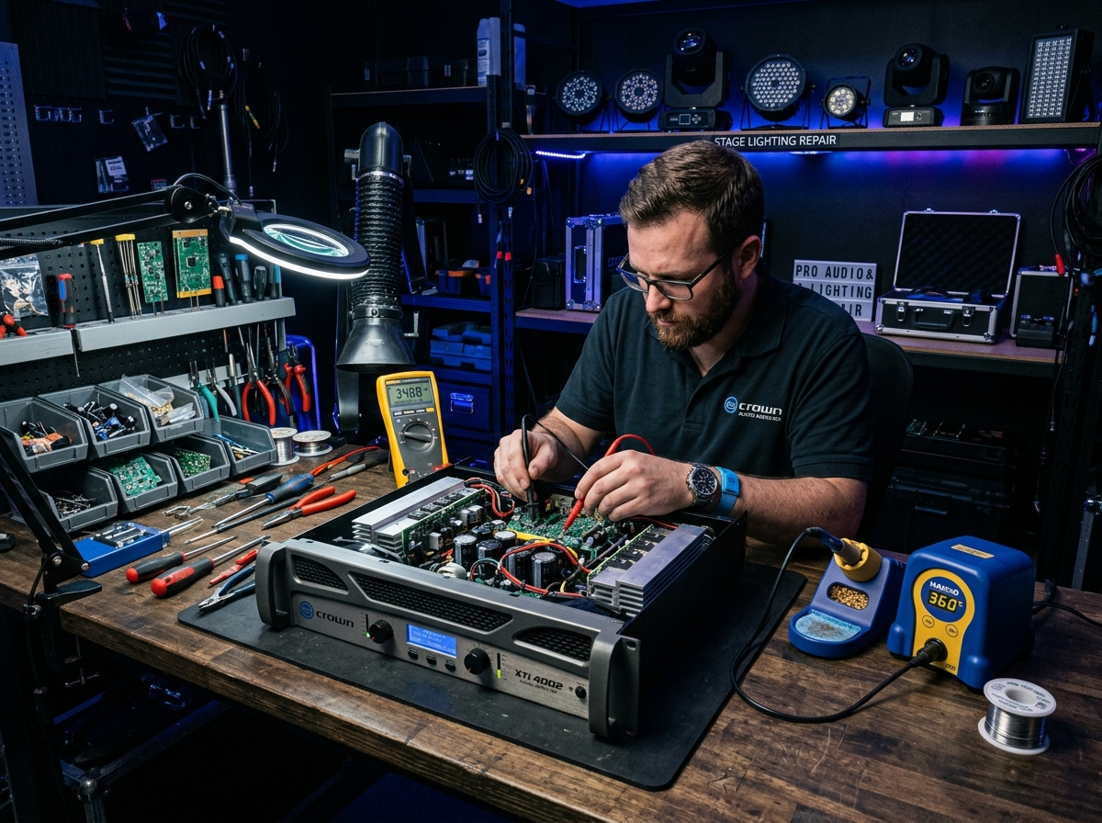
⚡ SURAT'S PREMIER AUDIO & DJ REPAIR CENTER
VIKASH ELECTRONICS
Professional DJ & Electronic Equipment Repairing Services
Expert diagnosis, maintenance, and precision repair for DJ sound systems, Sharpy moving heads, stage lights, power amplifiers, and electronic equipment in Surat.
✓ COMPONENT-LEVEL DIAGNOSTICS
Precision bench testing for event equipment, stage monitors, moving heads, and heavy PA amplifiers.
★ Quality Service & Trusted Repair in Surat
SPECIALIST
Murlidhar Chaudhari
CONTACT
+91 98254 85520
LOCATION
Limbayat, Surat, Gujarat

Slide 2
ABOUT US
WHO WE ARE & OUR EXPERTISE
Trusted Name in DJ & Electronic Equipment Repair
With years of dedicated hands-on experience and expert technical know-how, Vikash Electronics provides reliable, prompt, and precision repair solutions for all types of audio, stage lighting, and visual entertainment electronics.
CHIEF REPAIR SPECIALIST
Murlidhar Chaudhari
Specializing in circuit-level diagnostics, voice coils, moving heads & high-watt PA systems.
CORE REPAIR SPECTRUM:
✔ DJ Sound Systems
✔ Sharpy / Moving Heads
✔ Pro Audio Speakers
✔ High-Power Amplifiers
✔ Stage & DJ Lights
✔ Audio Mixers & Consoles
✔ LED / Smart TVs
✔ Home Theatres & Decoders

Slide 3
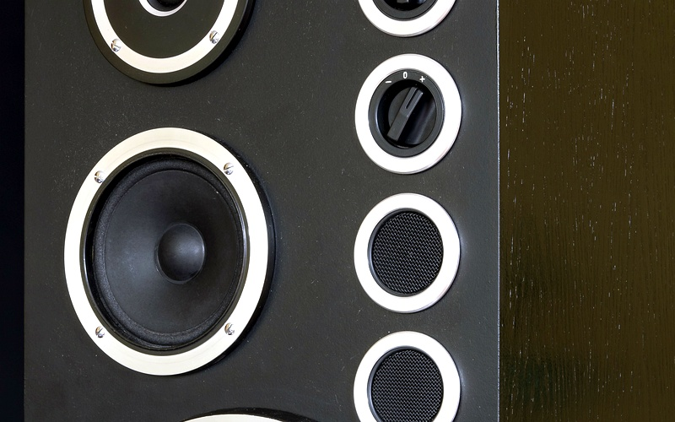
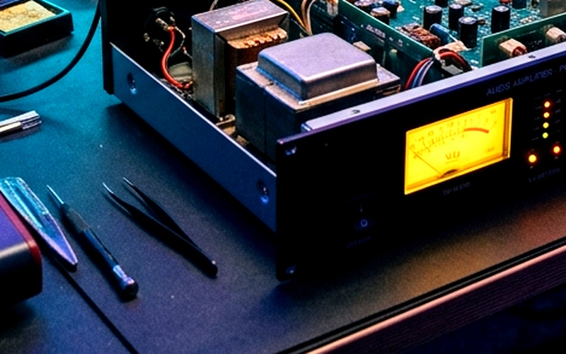
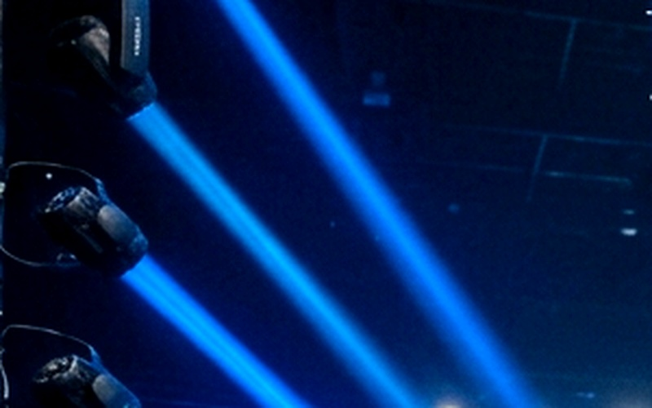
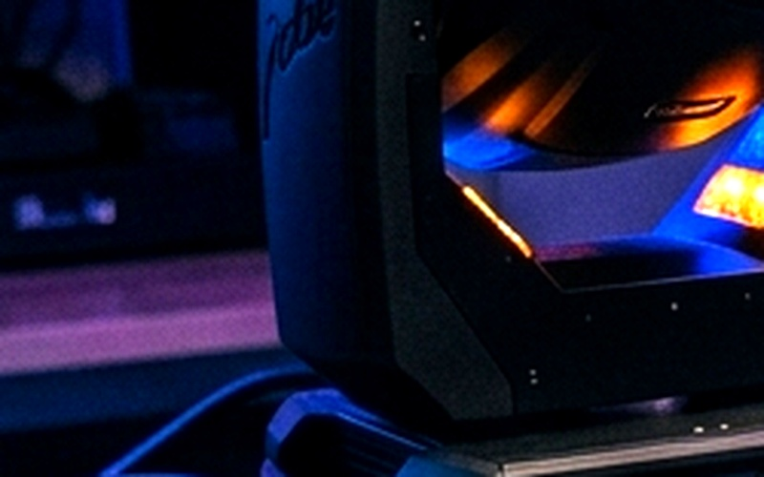
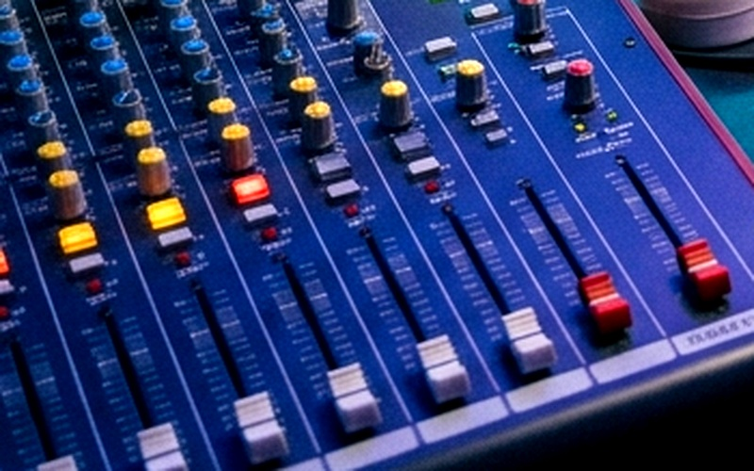
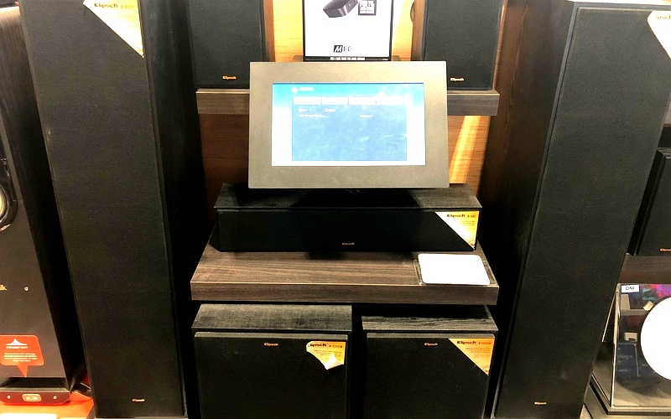
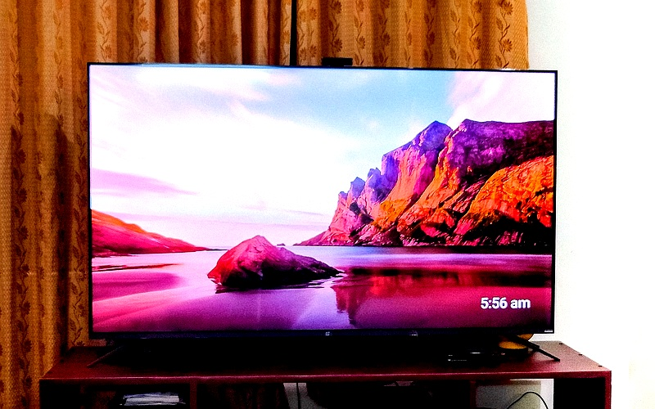
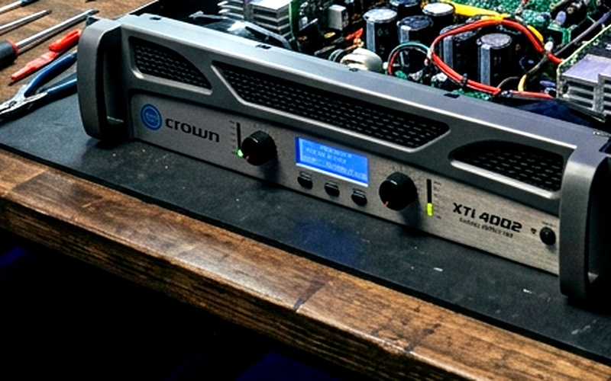
SERVICES OVERVIEW
COMPREHENSIVE REPAIR SOLUTIONS
Speaker Repairing
Amplifier Repairing
DJ Light Repairing
Sharpy / Moving Head
Voice coil rewinding, cone & surround replacement, subwoofers & line arrays.
Power transistor fix, toroidal transformer checks, distortion & protection mode.
LED par cans, laser projectors, strobes, driver boards & DMX controllers.
Pan/tilt motor calibration, gobo & color wheels, ballast & beam lamp change.
Sound Mixer Repairing
Home Theatre Repairing
Smart TV Repairing
Other DJ Electronics
Fader cleaning, potentiometer scratchiness, preamp circuits & multi-channel boards.
AV receivers, 5.1/7.1 channel diagnosis, plate amplifiers, audio calibration.
Component-level repair for LED/Smart TVs, backlight replacement, power boards.
Crossovers, equalizers, smoke/fog machines, power conditioners & custom gear.

Slide 4
AUDIO SYSTEMS
PROFESSIONAL AUDIO & SOUND GEAR REPAIR
Speaker & Subwoofer Repair
Power Amplifiers (DJ & PA)
Audio Mixers & Home Theatres
• Voice Coil Rewinding: High-temperature Kapton / CCAR wire rewinds.
• Cone & Surround Replacement: Re-coning 12", 15", 18" high-excursion woofers.
• Spider Alignment: Centering and dampening for crystal clear bass response.
• HF Compression Drivers: Titanium diaphragm replacements for line arrays.
• Output Transistors: Troubleshooting shorted 2SC5200 / 2SA1943 pairs.
• Toroidal Power Supply: Rectifier diode & filter capacitor bank fixes.
• Thermal & DC Protection: Clearing clip/protect lockups under heavy load.
• Channel Balancing: Eliminating hum, cross-talk, and unwanted distortion.
• Fader & Potentiometer: DeoxIT ultrasonic servicing and slide pot swap.
• Mic Preamps: Low noise op-amp replacement and phantom power 48V fix.
• Surround AV Receivers: 5.1/7.1 channel HDMI & optical DAC repair.
• Plate Amps: Active subwoofer power circuitry and crossover tuning.

Slide 5
STAGE & EVENT LIGHTING
SHARPY MOVING HEADS & DJ LIGHTS
Sharpy / Beam Moving Head Lights
DJ Stage Lights & Effect Gear
✔ Optical Path Alignment: Cleaning heat mirrors, lenses, and collimators.
✔ Stepper Motor Calibration: Smooth 540° pan and 270° tilt movement without slippage.
✔ Gobo & Color Wheel Repair: Sensor hall alignment, magnetic indexing, and color filters.
✔ Electronic Ballast & Igniter: High-voltage ignition troubleshooting and lamp cooling fans.
✔ Bulb Replacement: 7R, 10R, 15R high-output discharge lamps matched to ballast specs.
✔ DMX-512 Protocol: Fixing communication lags, signal termination, and addressing faults.
✔ RGBW LED Par Cans: Constant-current driver board repairs and LED array replacements.
✔ Laser Projectors: Galvanometer scanner alignment, laser diode cooling & TTL modulation.
✔ Strobe & Smoke Machines: High-power strobe capacitors and pump heater element repair.
✔ Event Ready Testing: 2-hour burn-in stress test before dispatch.

Slide 6
WHY CHOOSE US
PRECISION REPAIR & CUSTOMER ADVANTAGE
💰 Component-Level Repair
⏱️ Fast Turnaround for Events
👨‍🔧 Expert Technician with Mastery
Instead of recommending expensive whole-board replacements, we diagnose and replace individual faulty ICs, MOSFETs, capacitors, and diodes to save you money.
We understand that event managers, DJs, and sound engineers have tight timelines. We offer expedited emergency repairs to ensure zero show downtime.
Led by Murlidhar Chaudhari with years of specialized field experience across Indian and imported DJ gear, line arrays, and touring rigs.
🛡️ Genuine High-Grade Spares
🔬 Rigorous Bench Load Testing
🤝 Transparent & Honest Pricing
We source genuine heat-tolerant transistors, original discharge lamps, and high-temp Kapton voice coils for lasting reliability.
Every serviced amplifier and light undergoes intensive thermal and load cycle testing on our Surat workshop bench prior to handover.
Detailed breakdown of diagnosis, required components, and labor fees before undertaking major repairs. No hidden surprise costs.

Slide 7
QUALITY ASSURANCE
OUR SYSTEMATIC REPAIR PROCESS
STEP 1
STEP 2
STEP 3
STEP 4
STEP 5
Intake & Visual Inspection
Component Diagnostics
Precision Component Fix
Load & Stress Burn-In
Handover & Warranty
Thorough inspection for burnt traces, liquid damage, cracked voice coils, or physical impact.
Multimeter, oscilloscope, and signal generator analysis to isolate the exact micro-fault.
Professional desoldering, original replacement parts, heat-sink re-pasting, and optical alignment.
Running gear at rated power output and DMX sequences to verify thermal stability.
Safe packaging, customer demonstration, maintenance guidance, and post-repair peace of mind.

Slide 8
GET IN TOUCH
VISIT OUR WORKSHOP & CONTACT US
VIKASH ELECTRONICS
Surat's Specialized DJ & Electronic Repair Center
📍 Workshop Address:
Plot No. 199, Sarve No. 1-2, Sanjay Nagar,
Near Udhna Yard, Limbayat,
Surat - 394210, Gujarat, India.
📞 Direct Helpline / WhatsApp:
+91 98254 85520 | Technician: Murlidhar Chaudhari
⏰ Working Hours:
Monday to Saturday: 09:30 AM – 09:00 PM
(Sunday: Prior Appointment Only)
READY FOR YOUR NEXT EVENT?
Don't let faulty gear interrupt your show. Whether you are an event sound supplier, DJ, wedding organizer, or auditorium manager, Vikash Electronics guarantees quick and precision repair.
✔ Speakers & Heavy Subwoofers
✔ High Power PA Amplifiers & Crossovers
✔ Sharpy 7R/10R/15R Moving Head Lights
✔ Sound Consoles, DMX Boards & Lasers
🌐 Website: localhost:3000 (vikashelectronics.com)
Call Now: +91 98254 85520

