Slide 1


DAMG6210:
Residential Management System
Group: Database
Prathamesh Pardeshi
Vedant Deshpande
Aniket Bhore
Satadru Debnath
Under the Guidance of Prof. Naveen Kuragayala

Slide 2

Background
The goal is to design and develop a comprehensive Residential Management System using an Oracle database that will enable property managers to automate and streamline their operations, including tenant and lease management, rent and bill collection, maintenance, and repair tracking.
1

Slide 3
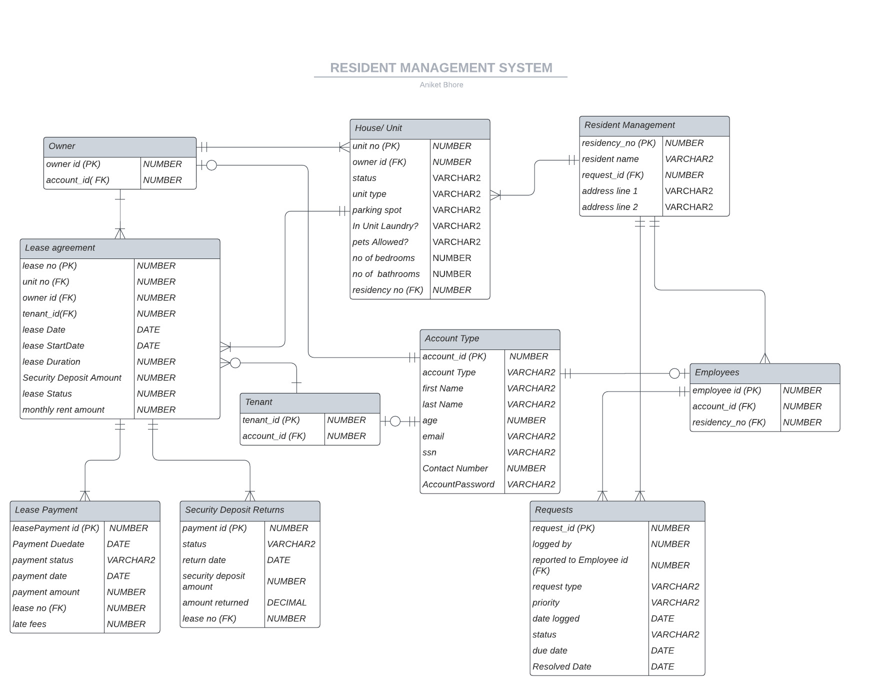
Caption

Slide 4
Team Contributions
Prathamesh Pardeshi: Focus on LEASE_AGREEMENT, LEASE_PAYMENT tables, reports and respective procedures.
Vedant Deshpande: Focus on the REQUESTS, and HOUSE tables and respective procedures.
Aniket Bhore: Focus on ACCOUNT_TYPE, OWNER, EMPLOYEES and TENANT tables, triggers & Views.
Satadru Debnath: Focus on SECURITY_DEPOSIT_RETURN and RESIDENT_MANAGEMENT tables, reports and functions.
3

Slide 5
Team Contributions
Prathamesh Pardeshi: Design, Implement, and Test Procedures and Triggers.
Aniket Bhore: Generate Reports and Insertion of Data in Tables.
Vedant Deshpande: Design and Test Queries related to Functions and generate Views.
Satadru Debnath: Data Insertion, PPT, Design and Implement Sequence.
4

Slide 6
THANK YOU!

