Slide 1


DAMG6210:
Residential Management System
Group: Database
Prathamesh Pardeshi
Vedant Deshpande
Aniket Bhore
Satadru Debnath

Slide 2

Background
The goal is to design and develop a comprehensive Residential Management System using an Oracle database that will enable property managers to automate and streamline their operations, including tenant and lease management, rent and bill collection, maintenance, and repair tracking.
1

Slide 3
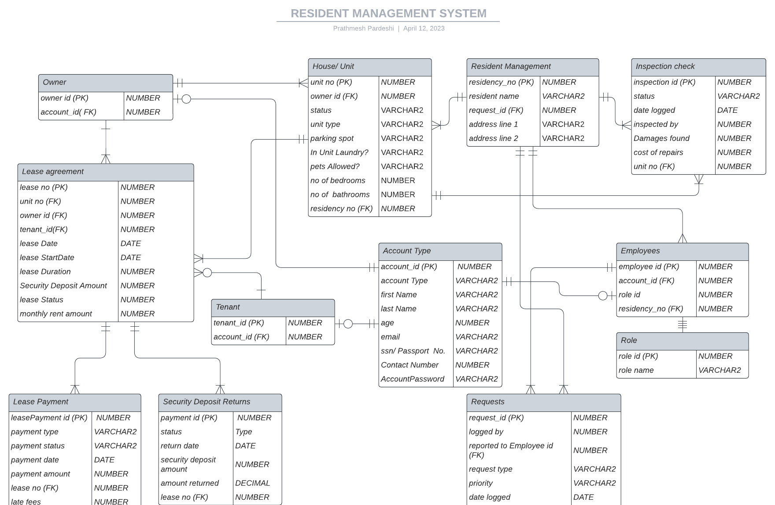
Caption

Slide 4
Team Contributions
Prathamesh Pardeshi: Focus on ACCOUNT_TYPE, OWNER and TENANT tables.
Vedant Deshpande: Focus on the EMPLOYEES, ROLES, and REQUEST tables.
Aniket Bhore: Focus on HOUSE, LEASE AGREEMENT, LEASE_AGREEMENT table.
Satadru Debnath: Focus on INSPECTION_CHECK and RESIDENT_MANAGEMENT tables.
3

Slide 5
Team Contributions
Prathamesh Pardeshi: Design, Implement, and Test Procedures and Triggers.
Aniket Bhore: Generate Reports and Insertion of Data in Tables.
Vedant Deshpande: Design and Test Queries related to Functions and generate Views.
Satadru Debnath: Data Insertion, PPT, Design and Implement Sequence.
4

Slide 6
THANK YOU!

