Slide 1
Lognormal Analytics Case Study: Understanding Our Players
Prepared by: Prathmesh Raut
Date: 21/09/2025

Slide 2
What I Found
After digging into the data, I’ve pulled out the four most important takeaways that I think tell the story of our players.
First deposit is our biggest hurdle. Getting players to put money in for the first time is where we lose most people. In fact, only about 4 out of 10 players who sign up ever make a deposit.
First 48 hours are everything. I found that players who are active in their first day or two are the ones who bring in nearly all of the initial deposit money. If they don't deposit in that early window, they likely never will.
"Same-Day" players are our superstars. The most valuable players we have are those who sign up, deposit, and place a bet all on the same day. They wager more than double the amount of other players in their first month.
Few players drive most of our revenue. It's clear that a small group of big spenders is crucial to our business. The top 10% of our depositors account for a massive 70% of all the money deposited.

Slide 3
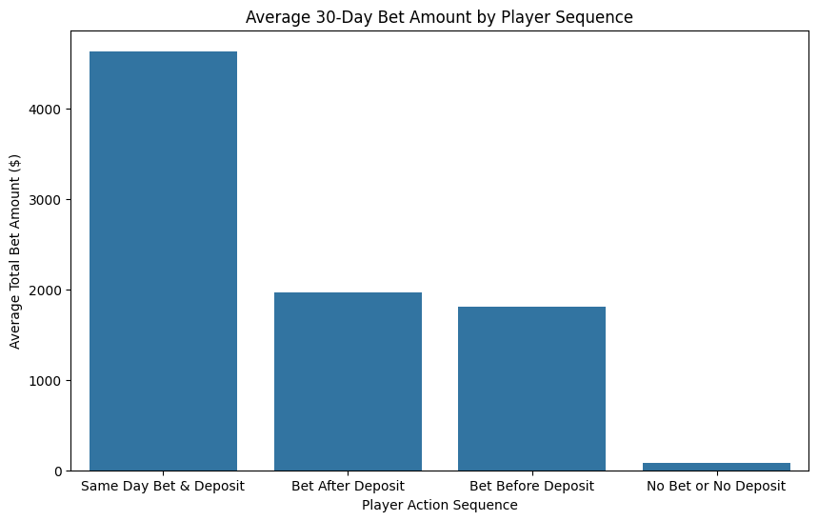
The Player Journey
I started by looking at the path players take from signing up to becoming active. What I saw was a big drop-off right at the start.
As you can see, only 39.2% of players who register eventually make that first deposit. This is our single biggest opportunity for growth.
But there's good news here too. Free bets seem to be working really well. I saw that more people place their first bet than make a first deposit, which tells me they're happy to try out the platform when there's no risk involved.

Slide 4
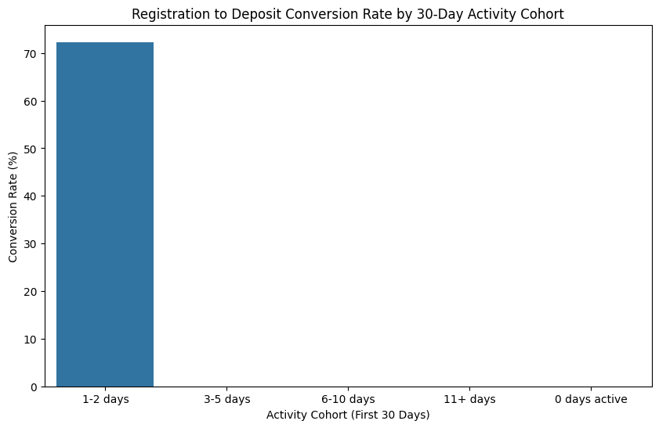
Finding 1: The 48-Hour Conversion Window
When I grouped our players by how active they were in their first month, a really clear pattern emerged.
The players who were active for just 1-2 days had an amazing deposit conversion rate of 72.3%.
In contrast, players who were active for 3 days or more had a 0% conversion rate.
What this tells me is that the first two days of activity are basically the only window we have to turn a new user into a paying customer.

Slide 5
Finding 2: Our Most Valuable Players Act Fast
The players who make a deposit and place a bet on the very same day are our most valuable group, and it's not even close.
On average, this group bets 4,630.78 in their first 30 days. That’s more than double what any other group wagers.
This shows that the players who are the most excited and committed from the start end up spending the most money.

Slide 6
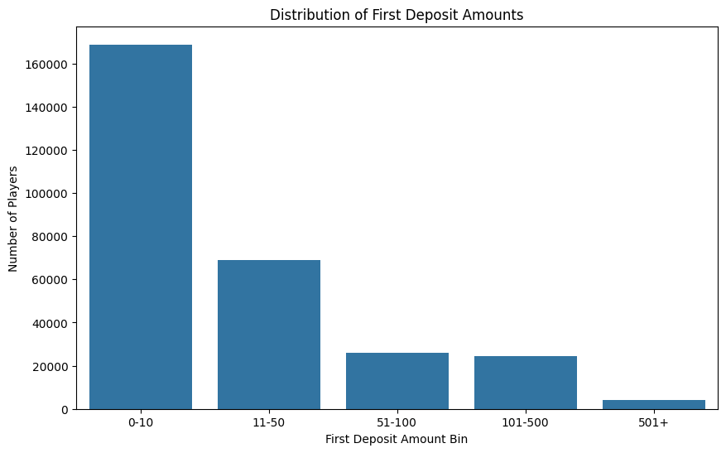
Finding 3: We're Powered by "Whales"
Finally, I looked at where all the money is actually coming from. It’s clear that a small number of big spenders are driving our revenue.
The top 10% of our depositors are contributing a huge 69.7% of all the money deposited.
On the other end of the scale, most of our players start with small deposits, usually 10 or less.
This tells me we have a "whale" economy, and focusing on our biggest spenders is crucial for our success.

Slide 7
My Recommendations: What Should We Do Next?
Focus Everything on the First 48 Hours: I think we should really lean into this window. Let's use welcome bonuses, tutorials, and special offers to encourage new players to deposit as soon as they become active.
Create a VIP Program for "Same-Day" Players: We now know who our most valuable players are from day one. I suggest we treat them like VIPs immediately with special perks to keep them happy and engaged for the long term.
Use Free Bets as a Bridge to a Deposit: Free bets are great for getting people to try the platform. I think we should create a smooth and easy path that encourages them to make their first real deposit right after they've used a free bet.

