Slide 1

RFID + Password-Based Secure Door Lock System
A secure door lock system using RFID and password authentication.
Group Members :
Adwait Bhalerao - 1262241696 Anshul Patil - 1262242165 Avani Srivastava - 1262243686 Prathmesh Borkar - 1262240873 Shreyaa Pandey - 1262242081 Shreyas Newe - 1262241387

Slide 2
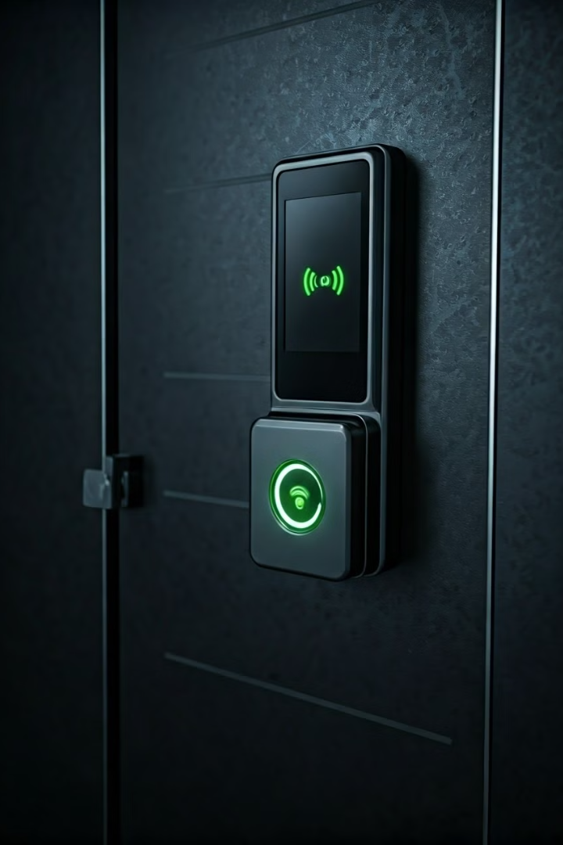
Problem Statement
Traditional lock-and-key systems have security risks, such as key duplication, loss, and unauthorized access. This project aims to develop an RFID-based secure door lock system that uses RFID cards or tags for authentication. Only authorized users with registered RFID tags can unlock the door, enhancing security and convenience. This system can be used in homes, offices, and restricted areas to prevent unauthorized access.

Slide 3
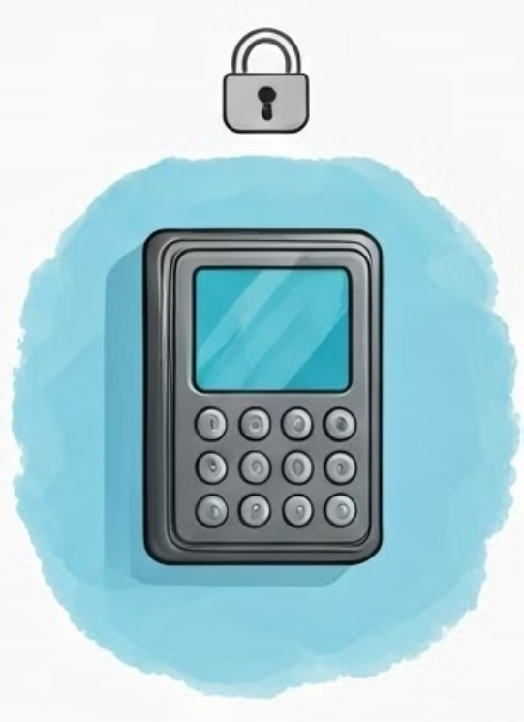
Alternative Solutions & Their Problems
Keypad Lock System
Pros
Cost-Effective
No need of a physical card
Easy to use
Cons
Can be brute forced easily
Passwords can be shared or stolen
Needs regular code changes

Slide 4
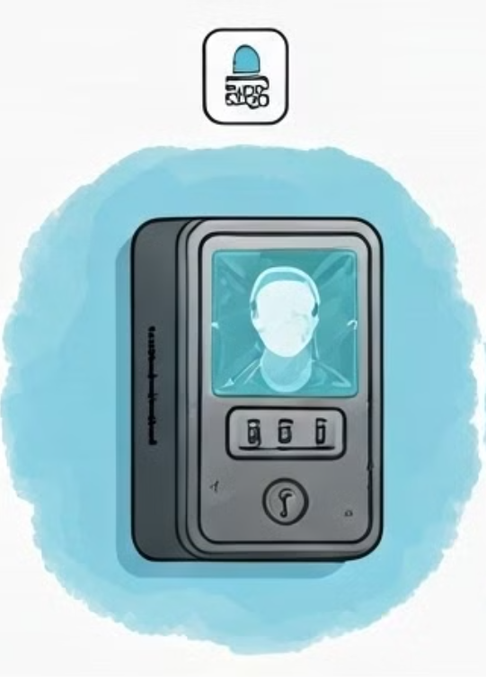
Alternative Solutions & Their Problems
Face Recognition System
Pros
No Need for Physical Cards or Passwords
Fast & Contactless Authentication
Easy to use
Cons
High Processing Power Required
Can Be Fooled by a Photo/Video
Expensive to Implement
Lighting & Angle Issues

Slide 5
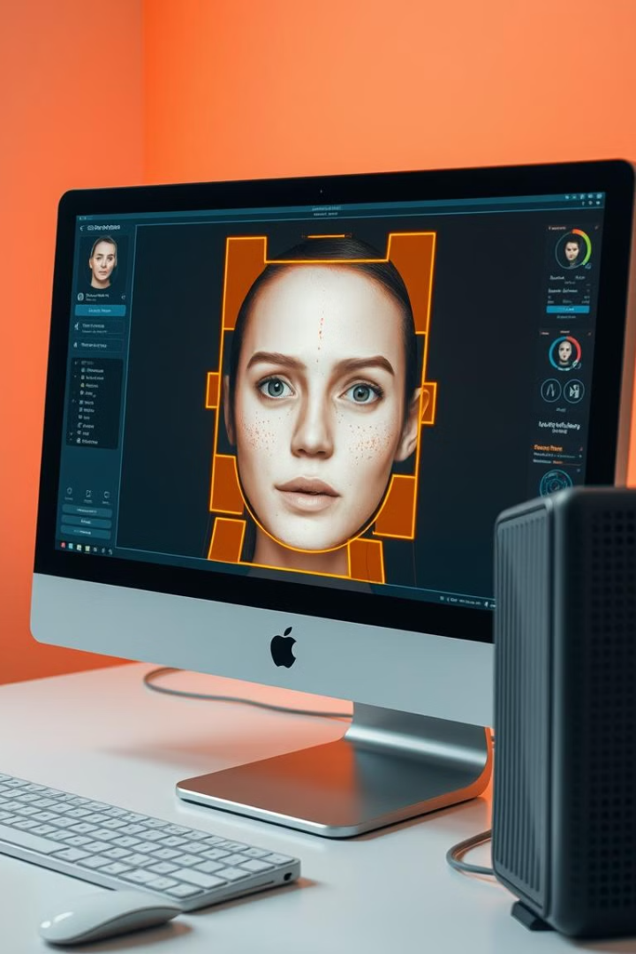
Vulnerability
In 2017 researchers at Bkav Security created a 3D-printed mask with silicone and paper eyes. It tricked Face ID and unlocked the phone. Apple had claimed Face ID was secure against masks, but this proved otherwise.
In 2018 a user’s brother (who looked similar) was able to unlock the phone. The AI mistakenly recognized them as the same person. This showed that poor facial differentiation weakens security.

Slide 6
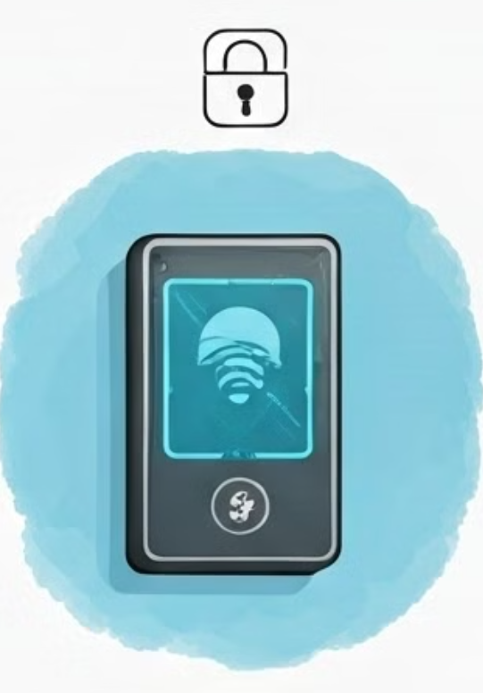
Alternative Solutions & Their Problems
RFID only System
Pros
Fast & Contactless Access
No Need to Remember Passwords
Low Power Consumption
Cons
UID can be easily Cloned or Hacked
No Additional Authentication
Lost Cards are a Security Risk

Slide 7
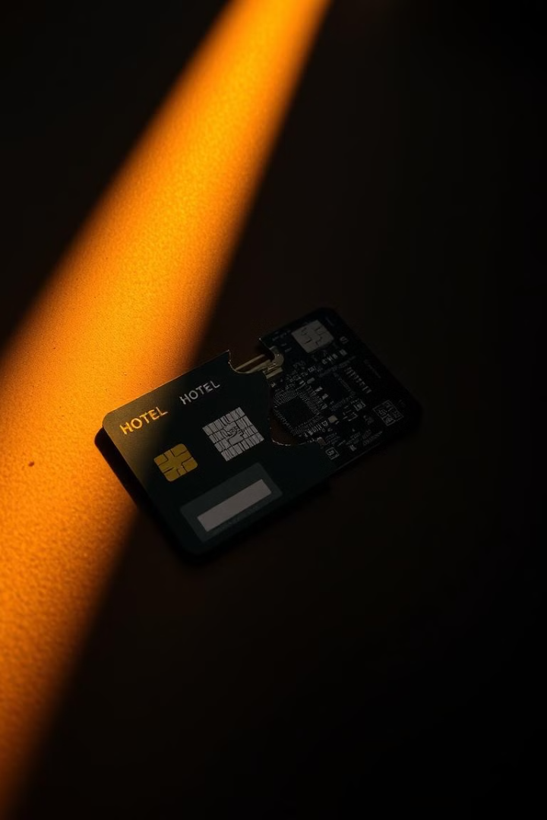
Vulnerability
In 2012 Black Hat Conference it was shown how hackers use a $50 to clone hotel keycards in seconds.
In 2018 thieves used a relay attack to drive and unlock a Tesla Model S.
In 2008 hackers used MIFARE Classic cards to use public transport for free.

Slide 8
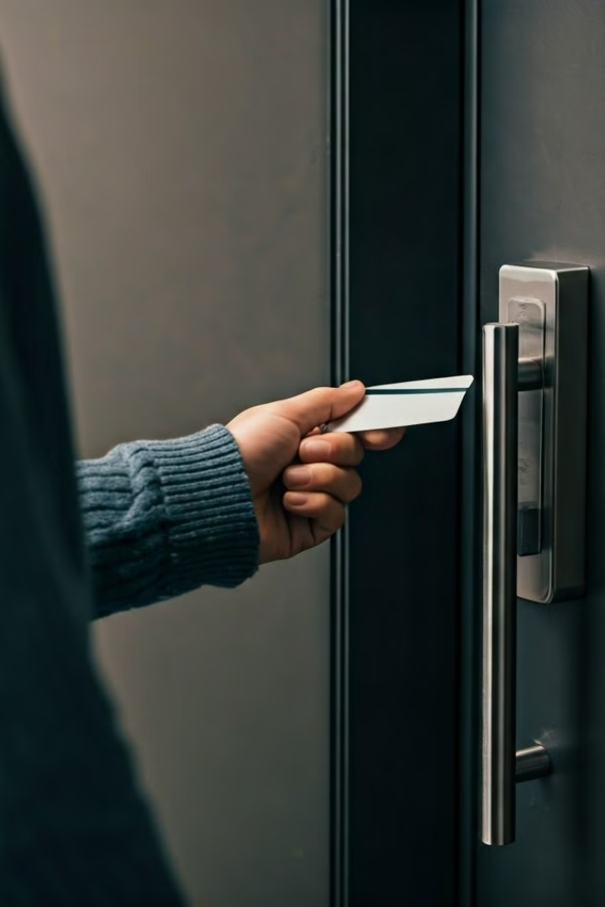
Why RFID + Password?
Stronger Security
UID Cloning
Combines RFID and password authentication.
Cloned UID can't access stored password.
Secure Storage
Contactless/Convenient
Uses MIFARE Classic Block 16 with Authentication.
No need to insert keys or remember Pins.
Faster access control
Difficult to Breach
The authentication only takes a fraction of a second
Resistant to picking and physical tampering

Slide 9
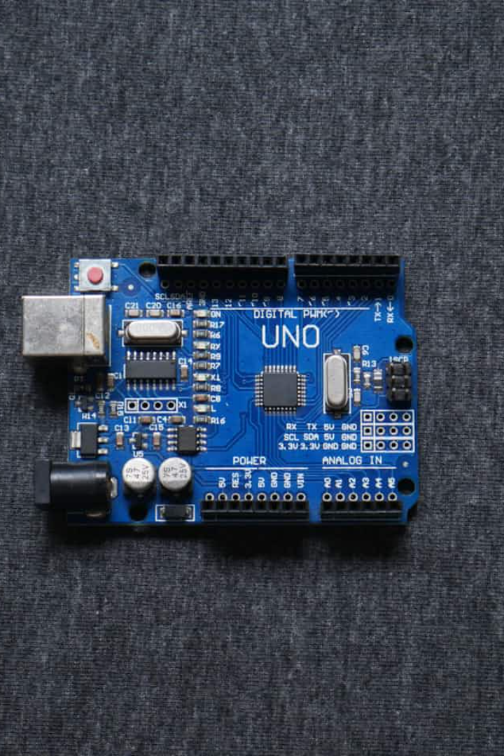




Components Used
Arduino Uno R3
RFID RC522 Module
Main microcontroller.
Reads UID & password.
16x2 LCD
Servo Motor
Displays messages.
Helps to lock and unlock the system

Slide 10

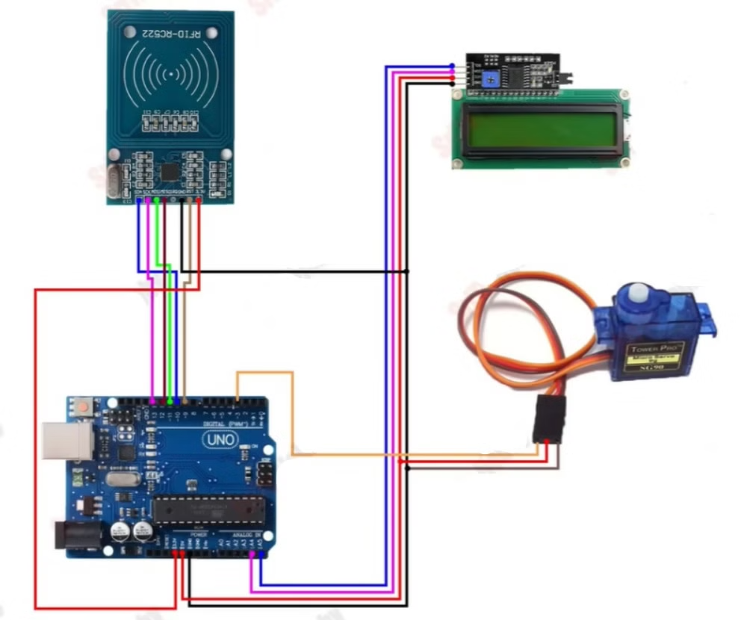
Circuit Diagram & Wiring
RFID Module
1
Connect to Arduino.
2
LCD I2C
Connect to Arduino.
Servo Motor
3
Connect to Arduino.

Slide 11
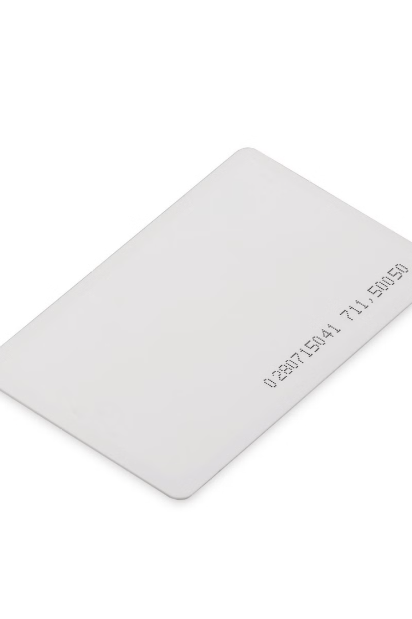




How Our System Works
Scan RFID
Scan the RFID card.
Compare UID
Compare UID with authorized UID.
Read Password
Read Block 16 for the password with Custom Key.
Unlock Door
If password matches "Security", unlock.

Slide 12







Security Features
Correct Password
Protected Block
Access Denied
Need correct password.
Block 16 is protected.
Fails authentication.
System Demonstration
See our RFID system in action. Watch a successful authentication in real time.
Scan Authorized Card
The system recognizes the card's UID.
Password Matches
The stored password matches the card.
Door Unlocks
Servo rotates, granting access.
Witness a failed attempt: unauthorized card, access denied.

Slide 13
Testing Different Scenarios
We tested the RFID system under various conditions. This confirmed the robustness of our layered security approach. Results show that only the real card with the correct password works.
Test Case
Expected Result
Correct UID + Correct Password
✅ Access Granted
Correct UID + Wrong Password
❌ Access Denied
Wrong UID + Any Password
❌ Access Denied
Cloned UID + Any Password
❌ Access Denied

Slide 14
Advantages of Our System
1
High Security
2
Prevents UID Cloning
3
Fast and Efficient
Requires both UID and password. This layered approach strengthens protection.
A copied UID is useless without the correct password. Eliminates cloning risks.
RFID scanning offers instant access. No delays, just quick authentication.
4
Cost-Effective
5
Low Power
Cheaper than fingerprint or facial recognition. Provides security without the expense.
Operates using a simple power supply. Ensures energy efficiency during operation.

Slide 15
Limitations & Challenges
1
Lost RFID Card
2
Damaged RFID Module
3
Not Ideal for Large Scale
If the card is lost, access is lost. The solution is to use a backup card.
If the RFID module fails, the system will not work. Add a biometric as backup.
This is not suited for large-scale security. Enhance with IoT monitoring.

Slide 16




Real-World Applications
Smart Homes
Offices & Workplaces
Hostels & Schools
Gyms & Clubs
Secure rooms and cabinets. Enhance security by restricting access.
Restrict unauthorized entry. Keep workspaces safe and confidential.
Control access for students and staff. Guarantee a secure environment.
Member authentication. Simplify entry with efficient RFID tech.

Slide 17
Future Scope
Add IoT Connectivity
Control door lock using a smartphone or web app. Enable remote access.
Integrate Biometrics
Combine RFID with fingerprint or face recognition. Enhance security even further.
Enable Mobile Authentication
Use NFC on mobile phones. This will serve as an alternative to RFID cards.
Implement Data Logging
Log all access events. Track entries for better security and auditing.

Slide 18
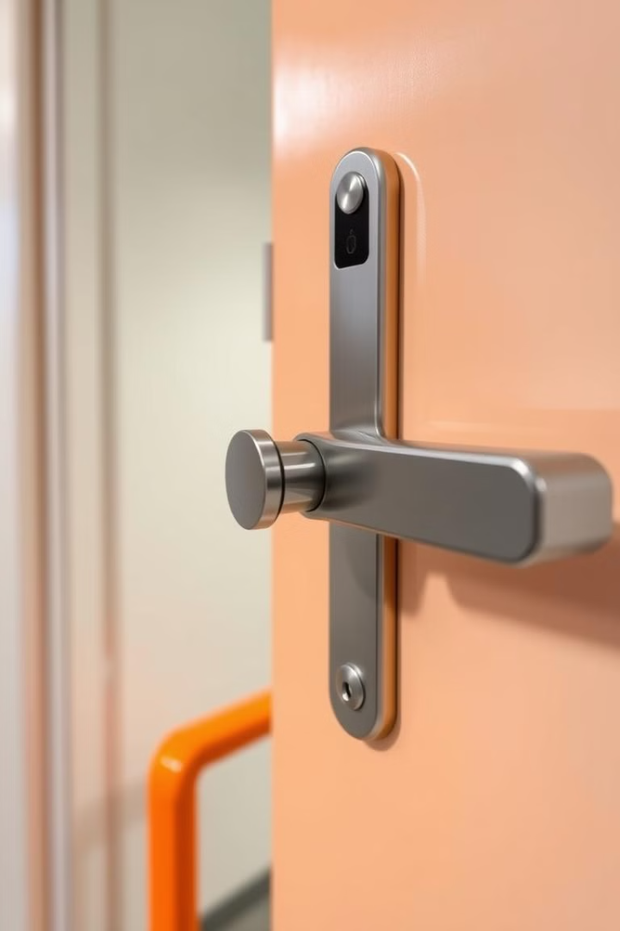
Final Summary
In summary, our system offers enhanced security. It combines RFID with password protection.
This approach overcomes limitations of other systems. It prevents hacking and cloning.
Our system meets real-world security needs.
It is highly adaptable for various applications.
Thank you! Questions?

