Slide 1

EMPLOYEE PROMOTION CLASSIFICATION PROJECT
By Prathmesh Chavan

Slide 2
TABLE OF CONTENT
Data
Overview
Objectve
Process
Accuracy
Measure
Conclusion

Slide 3
Data Overview & Problem Statement
Problem Statement:
Every year, around 5% of the employees are promoted in the company. Based
on the data of employee, find out the main variables that impact an employee’s promotion,
in turn contributing to more benefits to the Company.
Data Description:
Department : specific division where employee works in organization.
Education : Education qualification of the employees.
Previ year rating : previous year overall performance of an employee on a scale of 0 to 5.
KPIs_met >80% : Key performance Indicator (KPI) is higher than 80% or not.
Awards won : Award won or not.
Avg training score : Employee training score out of 100.
Is promoted : Employee Promotion (1 = Promoted and 0 = not Promoted).

Slide 4
OBJECTIVE
“ Who Should Be Promoted? ”
Our End Goal Is To Develop A Model Which Will Help HR Or Managers To Decide Which Employee Should Get Promotion Based On Various Factors.
It Will Save Organizations Time And Effort And Allow Managers To Focus On Other Majory Aspects In The Organization.

Slide 5
Our
PROCESS
Data Preprocessing
Handling Missing Data, Type Casting , Feature Engineering, Handling Imbalanced Data , Feature Scaling.
Exploratory Data Analysis
1
Analysing Data, Hypothesis Testing, Feature Selection
Model Building
2
Comparing Multiple Models, Cross validation, Confusion Matrix,Selecting Best Algorithm Based On accuracy Score And Confusin Matrix
3

Slide 6
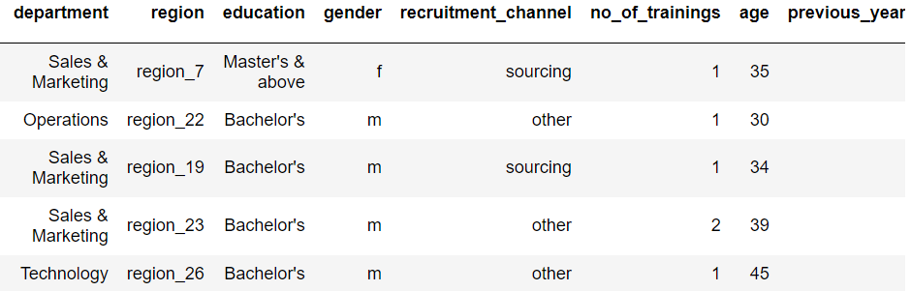
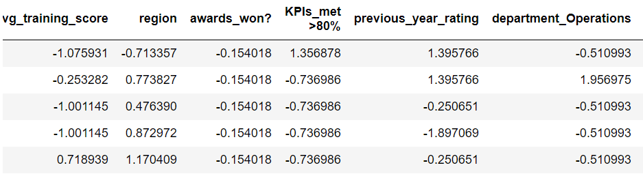
Data Preprocessing
Before Data Processing
After Data Processing

Slide 7
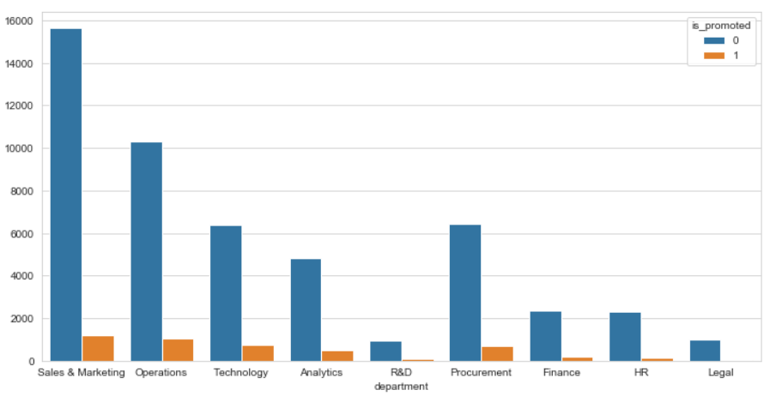
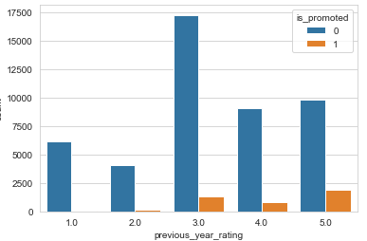
Exploratory Data Analysis
Department Wise Promoted Employees,
Orange Bar Represents Promoted Employee
Previous Rating Wise Promoted Employees, We Can See Employee Having Higher Rank Will Have Higher Chances Of Promotion

Slide 8
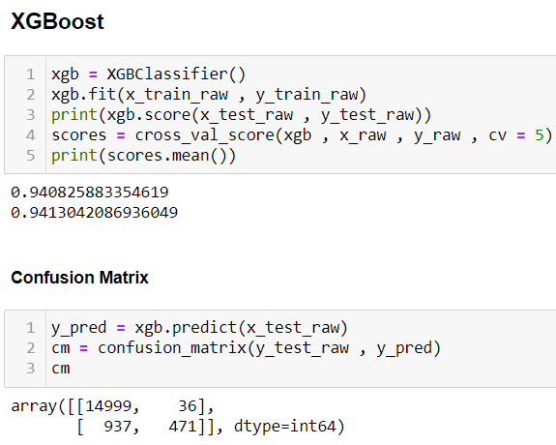
Model Building And Accuracy Measure
In Order To Find Best Model For Dataset I Have Tested Dataset With Multiple Algorithms.
RandomForestClassifier – 93.95%
XGBoost – 94.08%
SVM – 92.11%
KNN – 93.48%
LogisticRegression – 92.22%
Overall Xgboost gives best accuracy with 94% accuracy, also it’s a generalized model
with minimum type1 error and 1 type2 error.

Slide 9
Conclusion And Business Findings
Employees who got promotion had good ratings a year before hey got promoted.
Employees having Masters degree have good chance of promotion
In first 2 years employee will not get promotion
If Employees manages to meet KPI then there is high chance that the employee will get promotion.

Slide 10
THANKS!
Any questions?
You can find me at cprathmesh08@gmail.com
Github Repository
https://github.com/PrathmeshChavan/employee_promotion

