Slide 1
OLIST STORE ANALYSIS
- GROUP 2

Slide 2
GROUP MEMBERS
Prathmesh Chintamani Ganar
Meghana H D
Pulagam Koushik Kumar Reddy
Uddalok Das
Andela Sanjana
Snehal Suresh Dumbre
Mrunali Pramod Kamble

Slide 3
INDEX
Introduction
KPI's
Excel Dashboard
Power BI Dashboard
Tableau Dashboard
Conclusion
Challenges and Overcome

Slide 4
PROCESSING
data Cleaning
Data Visualization
Data Insights

Slide 5
INTRODUCTION
In the fast-paced and ever-changing digital world we live in, it is crucial for businesses to grasp the importance of data and utilize it effectively in order to succeed in the fiercely competitive ecommerce industry. Ecommerce analytics provides a complete set of tools that enable organizations to extract valuable insights from large volumes of data, enabling them to make well-informed decisions, streamline operations, and improve customer satisfaction. Discovering the immense possibilities that ecommerce analytics holds and learn how harnessing the power of data can drive your business towards long-term growth and prosperity.

Slide 6
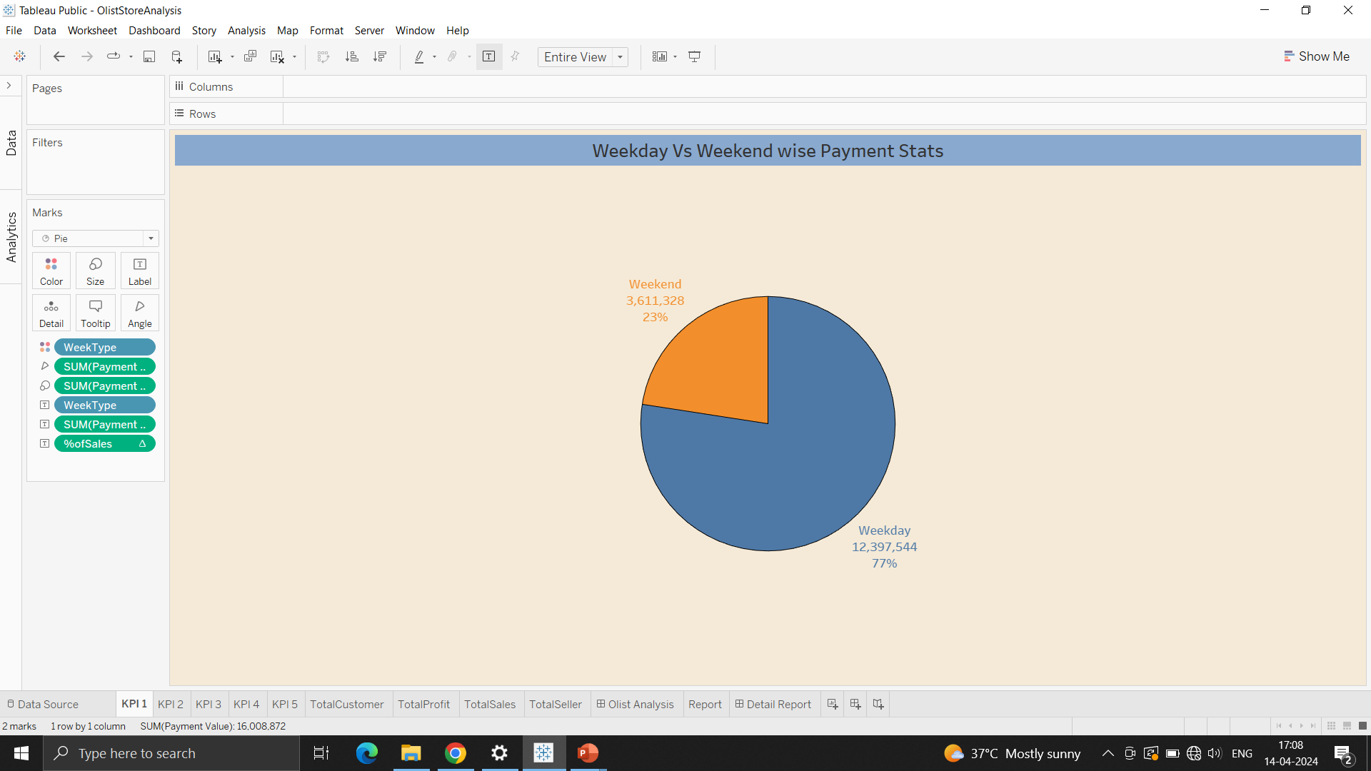
KPI 1: Weekday Vs Weekend Payment Statistics
Examining the difference in payment statistics between weekdays and weekends uncovers valuable chances to enhance ecommerce strategies. Weekdays see a notable increase in payment transactions, while weekends present an opportunity for focused marketing campaigns. By recognizing the unique consumer behaviors and preferences during each period, businesses can customize their promotional activities and allocate resources effectively to boost revenue throughout the week. Additionally, utilizing data-driven insights enables the creation of better marketing strategies, personalized deals, and improved customer interactions, leading to continuous growth and competitiveness in the ever-evolving ecommerce industry.

Slide 7
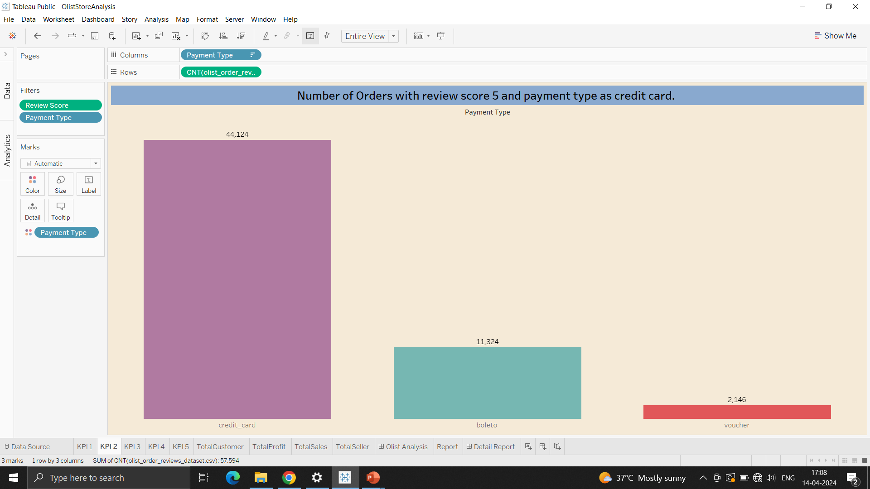
KPI 2: Number of Orders with Review score 5 & Payment type as Credit Card
Among the payment methods that were examined, credit card transactions stand out as the most popular choice, as they received the highest number of orders with a perfect review score of 5. This indicates a strong connection between credit card payments and overall customer satisfaction, potentially pointing towards a smooth checkout process, secure payment handling, and efficient customer support. On the other hand, even though Boleto and voucher payments make up a smaller percentage of the total orders, the number of orders with a review score of 5 for these methods still demonstrates positive customer feedback. Nevertheless, there is room for improvement in optimizing the payment experience for these methods to increase customer satisfaction and loyalty. By studying these relationships, businesses can enhance their payment procedures, customize customer interactions, and foster sustainable growth by prioritizing payment methods that resonate with customer preferences and lead to higher satisfaction rates.

Slide 8
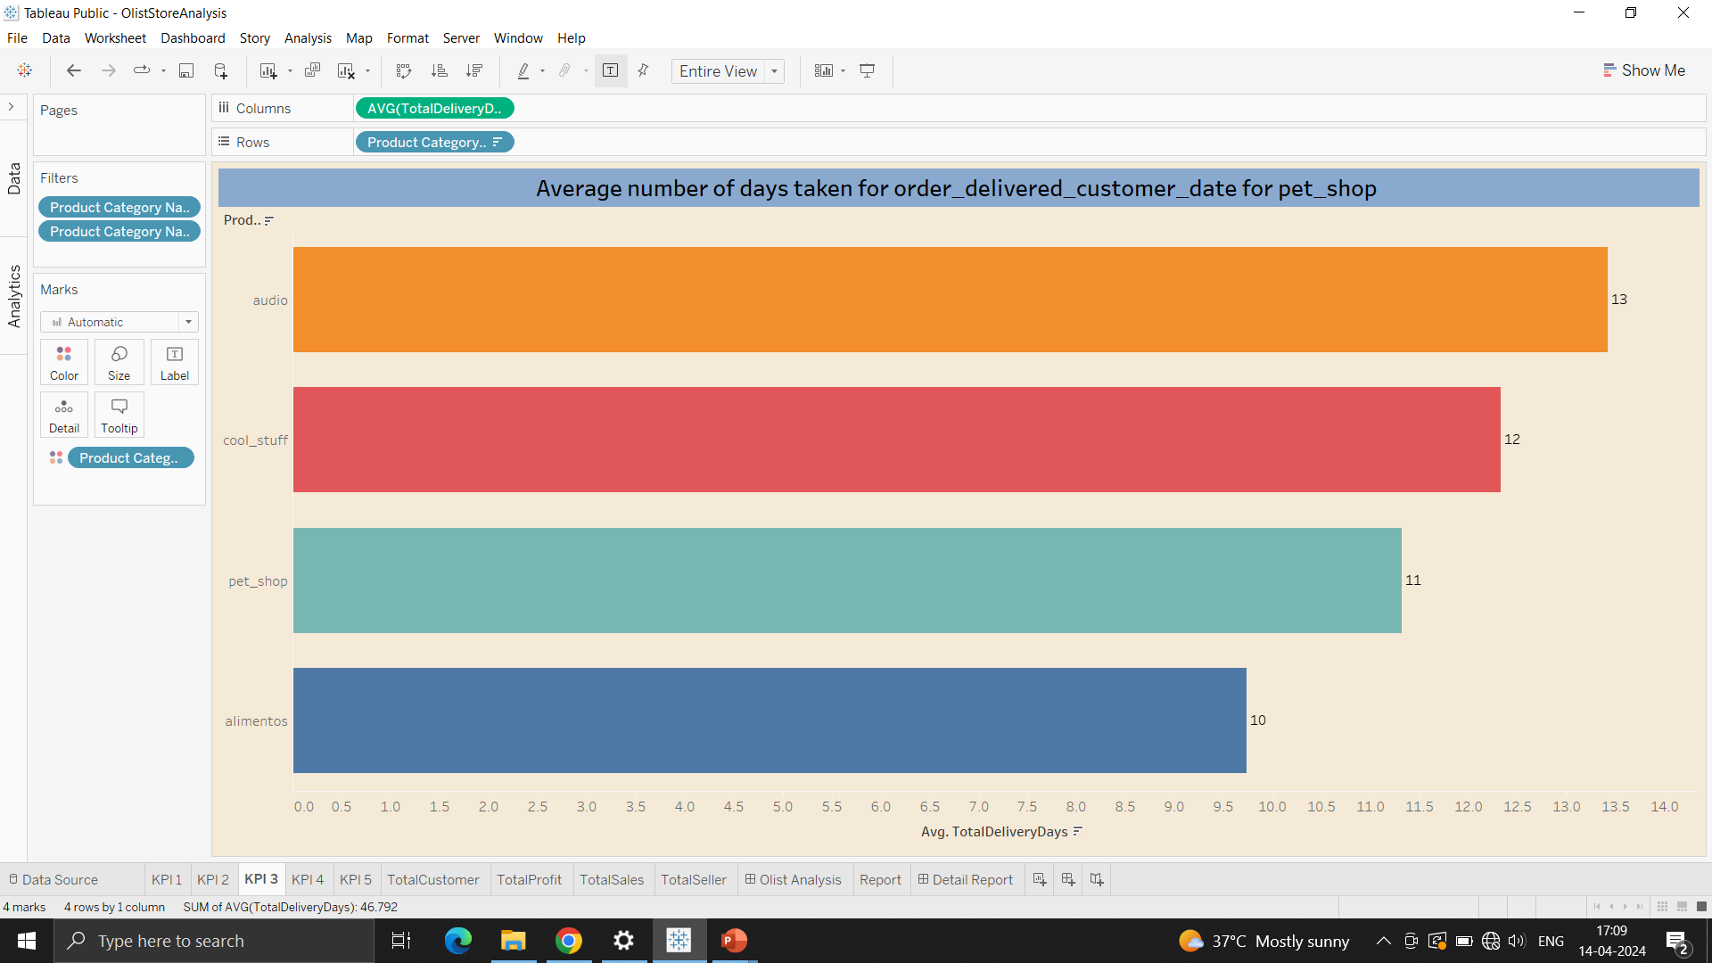
KPI 3: Average Number of Days taken for oder delivered customer date for Pet_shop
The examination uncovers significant differences in the average delivery times among various product categories. Orders from the Pet Shop category show a relatively shorter delivery time of 11 days, indicating effective logistics management and prompt fulfillment processes. On the other hand, orders in the Audio category have a slightly longer average delivery time of 13 days, pointing to potential areas for improvement in the supply chain to streamline delivery processes and enhance customer satisfaction. In contrast, both the Cool Stuff and Alimentos categories display competitive average delivery times of 11 and 10 days, respectively, showcasing efficient logistics operations and successful fulfillment strategies within these sectors. By recognizing and rectifying variations in delivery times across product categories, companies can optimize their logistics networks, enhance customer experiences, and uphold a competitive advantage in the market.

Slide 9
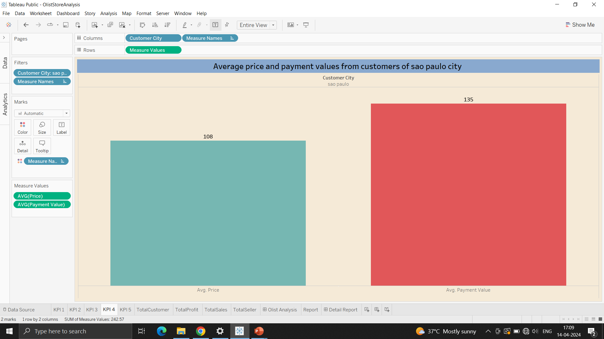
KPI 4: Average Price & Payment Values from Customers of Sao Paulo City
Customers hailing from Sao Paulo City display a moderate average price of 108, showcasing a balanced inclination towards products in different price categories. This indicates a diverse market with potential to cater to various budget segments and consumer preferences. Furthermore, the average transaction amount of 135 signifies a tendency for slightly higher spending among Sao Paulo City customers, potentially driven by factors such as higher disposable income levels or a preference for premium products or services. Understanding these spending behaviors allows businesses to tailor their product offerings, pricing strategies, and marketing efforts to effectively target and engage customers from Sao Paulo City, thereby optimizing revenue potential and fostering enduring customer relationships

Slide 10
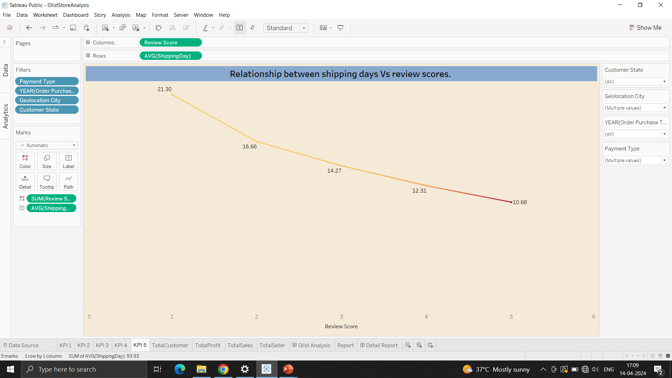
KPI 5: Relationship between Shipping Days Vs Review Scores
The analysis uncovers a distinct negative correlation between shipping days and review scores. As the number of shipping days decreases, review scores tend to rise, indicating increased levels of customer satisfaction. Orders with longer shipping durations, such as those with review scores of 1 or 2, are linked to shipping times of 21 and 17 days, respectively, hinting at potential dissatisfaction due to prolonged delivery periods. On the other hand, orders with shorter shipping durations, corresponding to review scores of 4 or 5, exhibit quicker shipping times of 12 and 11 days, respectively, aligning with higher satisfaction levels. These findings emphasize the significance of efficient logistics operations and prompt order fulfillment in enhancing positive customer experiences and upholding favorable review scores. By streamlining shipping procedures and reducing delivery times, companies can improve customer satisfaction, reinforce brand loyalty, and ultimately stimulate business growth.

Slide 11
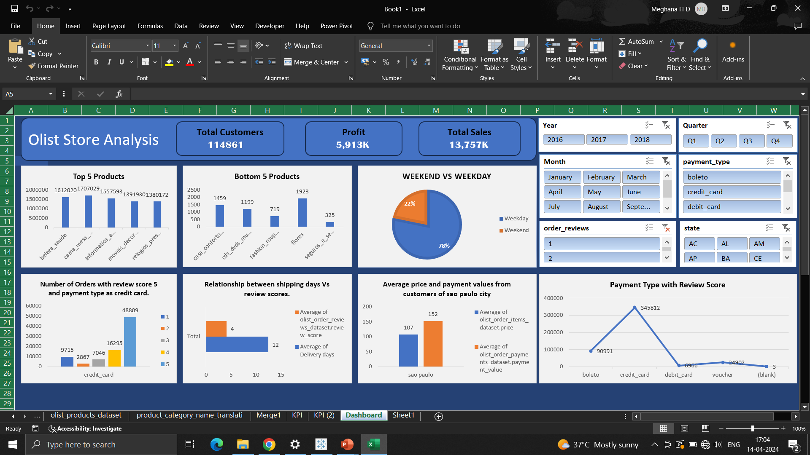
EXCEL DASHBOARD

Slide 12
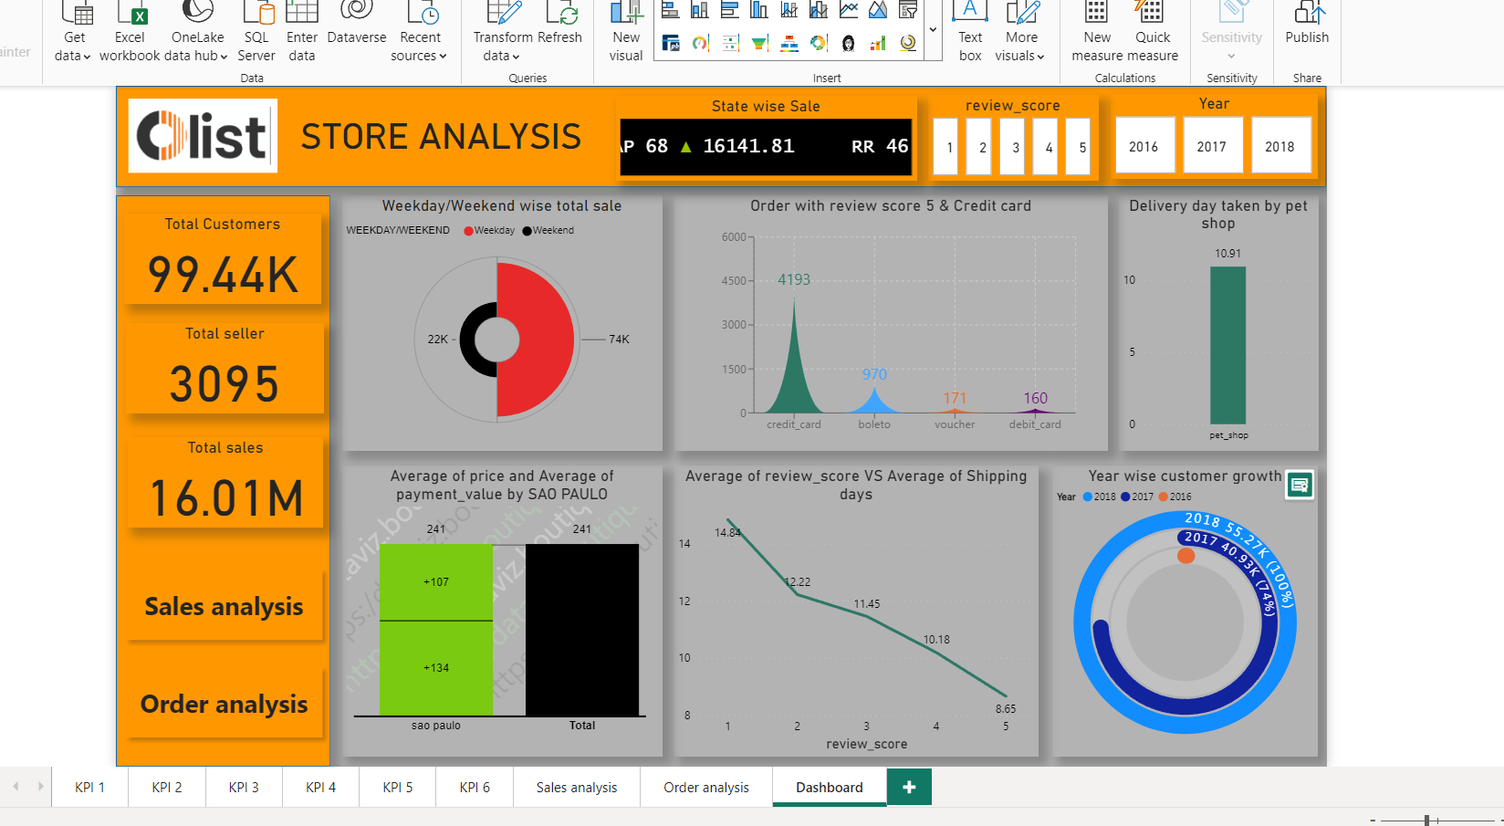
POWERBI DASHBOARD

Slide 13
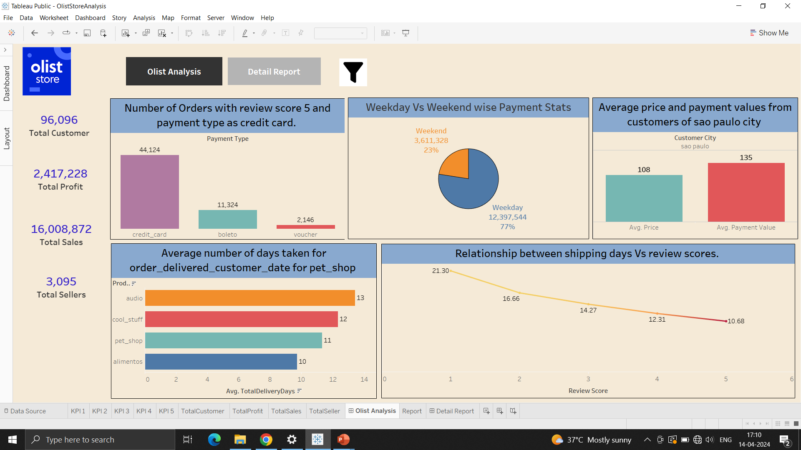
TABLEAU DASHBOARD

Slide 14
CONCLUSION
The integration of robust ecommerce analytics offers unparalleled insights into consumer behavior, market trends, and business performance.
By harnessing the power of data-driven decision-making, organizations can optimize their strategies, enhance customer experiences, and drive sustainable growth in the dynamic digital marketplace.
With continuous refinement and adaptation, leveraging ecommerce analytics becomes not just a competitive advantage but a strategic imperative in navigating the complexities of modern commerce.

Slide 15
CHALLENGES
Data Collection
The e-commerce industry generates massive amounts of data, making it challenging to collect and process.
Overcome: Implementing advanced data collection systems and leveraging automation to streamline the process.
Data Integration
Integrating data from various sources and formats can be complex and time-consuming.
Overcome: Developing data integration frameworks and utilizing data integration tools to streamline the process.
Data Analysis
Analyzing and deriving insights from large volumes of e-commerce data can be challenging.
Overcome: Utilizing advanced analytics techniques, such as machine learning and predictive modeling, to extract valuable insights from the data.

Slide 16
THANK YOU

