Slide 1

Title of Project : Workout Planner and Q&A Chatbot using Gemini API
JSPM’s
Rajarshi Shahu College of Engineering, Tathawade, Pune
(An Empower Autonomous Institute under Savitribai Phule Pune University)
Department of Computer Science and Business Systems
Artificial Intelligence Mini Project
AY-2025-26
Student Name:
Shravan Chavan (RBT23ME139)
Yash Patil (RBT23ET119)
Faculty Name:

Slide 2
Introduction
Objective of the Project:
To develop an intelligent, interactive Workout Chatbot that helps users plan daily workouts, answer gym-related questions, and suggest exercises based on fitness goals using AI and responsive web design.
Scope:
The chatbot provides personalized fitness guidance, workout planning, and Q&A support. It can be integrated with open-source AI models or APIs to enhance user interaction and can be expanded to include diet suggestions, progress tracking, and voice input.
Mapping With SDG Goal:
SDG 3 – Good Health and Well-being
The project promotes healthy living, encourages regular physical activity, and supports mental and physical well-being through accessible fitness assistance.
Key Features:
AI-based workout Q&A and planner
Open-source AI model integration (e.g., Llama 3 / Hugging Face)
Responsive web interface (HTML, CSS, JS)

Slide 3
Algorithm Used
Chosen Algorithm:
Natural Language Processing (NLP) using Transformer-based Model (LLaMA 3 / Mistral)
Reason for Selection:
Capable of understanding and generating human-like responses for gym and workout-related questions.
Provides accurate, context-aware suggestions for fitness routines and plans.
Advantages:
Efficient performance in understanding user queries and generating meaningful answers.
Easy to integrate with web-based chatbot interfaces using APIs or local AI frameworks.
Efficient performance in processing user inputs and generating quick responses.
Easy to implement with modern frameworks like Node.js and open-source AI APIs.

Slide 4
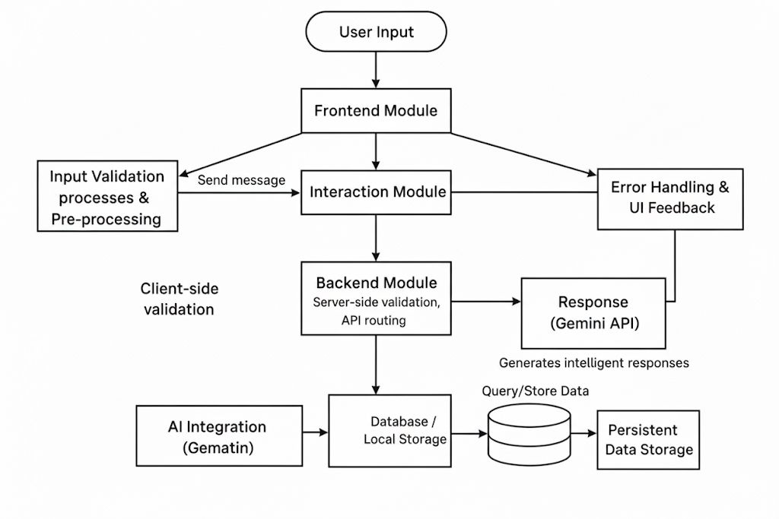
Module

Slide 5
Methodology & Results
Methodology:
1. Problem analysis : Identified the need for an AI-based chatbot that assists users with workout planning and fitness-related Q&A.
2. Algorithm design & coding : Designed and implemented the chatbot using HTML, CSS, JavaScript, and Node.js, integrating the Gemini API for intelligent responses and workout recommendations.
4. Testing & validation : Tested the chatbot for performance, accuracy of responses, and smooth interaction. Validated results across different fitness queries.
Results & Conclusion:
The chatbot efficiently provides workout suggestions, plans, and answers to fitness-related questions in real-time.
Future Scope: Integration with database for user tracking, adding voice assistant features, and developing a mobile-friendly application.

Slide 6
References
Google Gemini API Documentation – https://ai.google.dev
Node.js Official Documentation – https://nodejs.org
Mozilla Developer Network (MDN) Web Docs – https://developer.mozilla.org
W3Schools Tutorials – https://www.w3schools.com
OpenAI & AI Chatbot Concepts, IEEE Papers on AI-based Interaction Systems (2021–2024).

