Slide 1

Dr. D. Y. Patil Institute of Technology , Pimpri , Pune-18
Department of Information Technology
A project on
“FarmToHome”
Presented By: Guided By :
BIT44 Samruddhi Khandge Prof.S.A Nalawade
BIT47 Priti Janorkar
BIT49 Prathmesh Jaiswal

Slide 2
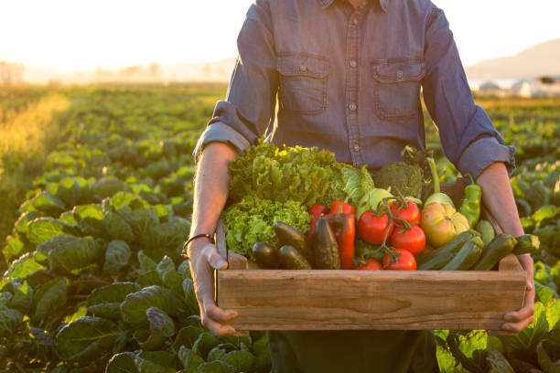
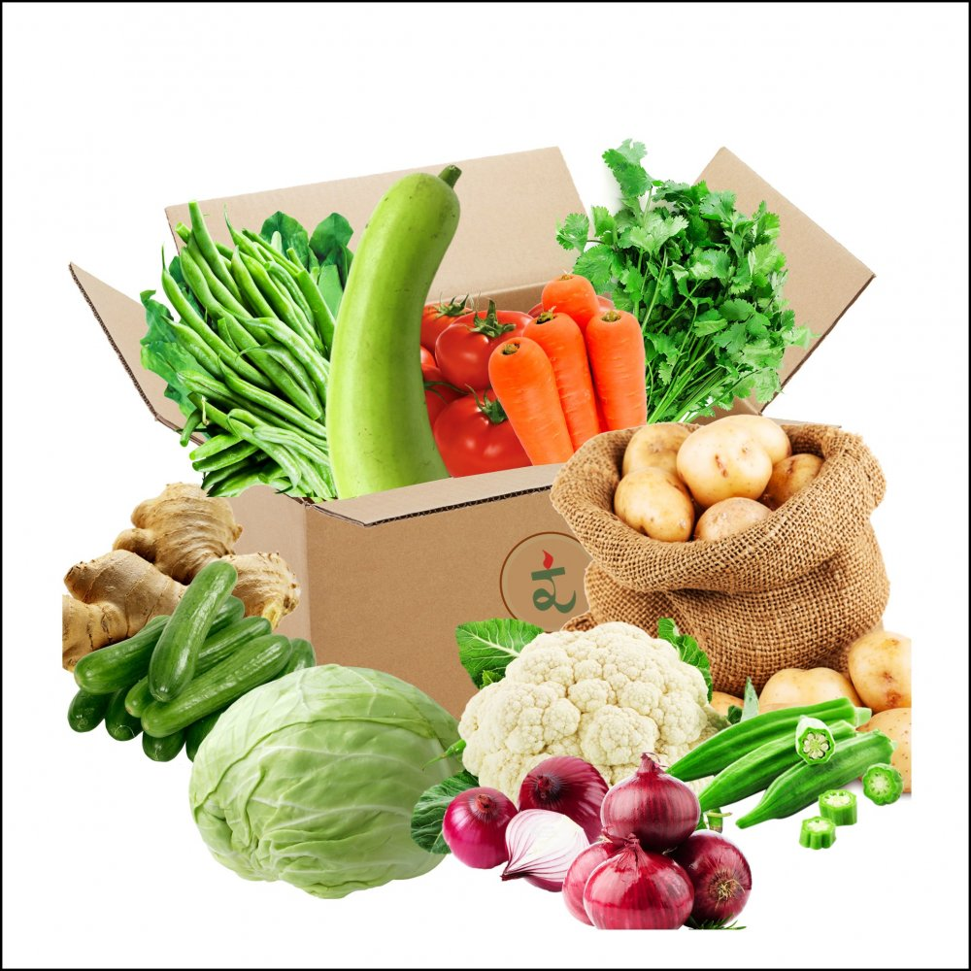
FarmToHome Presented By: BIT44 Samruddhi Khandge BIT47 Priti Janorkar BIT49 Prathmesh Jaiswal

Slide 3
Introduction
For several years, farmers in India have had little liberty in choosing markets and purchasers for their produce.
Farm2Home is web application that will help farmers create agricultural marketing that leads to increased success and increased their standard of living.
All states in the country, except three are directed through state-owned mandis, retail markets where middlemen crush farmers to increase margins.
This system is used for farmer vendor and consumer. Farmer uploads their product with details and vendor will view these details and book that product with in a time.

Slide 4
PROBLEM STATEMENT
A platform on which farmers can sell their produce by farming and buyers will buy that produce with high profit for both by cutting middleman here.
Farmers
Middle man 1
Middle man 2
FARM2HOME
Consumers
Vendors
Market Vendors

Slide 5
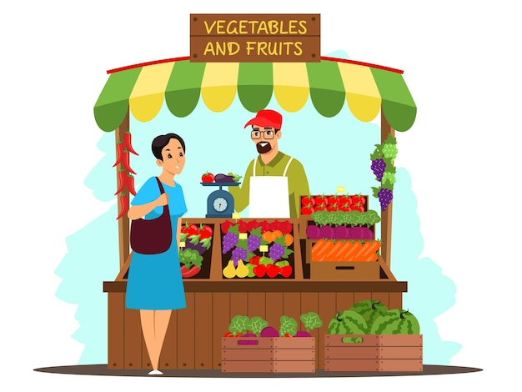

MOTIVATION
Our motivation /aim with this platform is to convert the offline market of selling and buying of farmers crop to digital for the ease of farmers and common people. This will also make common people to buy vegies and fruits at very low price.

Slide 6


OBJECTIVES
To Facilitate Direct Transactions
To Minimize Middleman Interference
To Improve Price Transparency
To Maximize User Satisfaction

Slide 7
SCOPE OF THE PROJECT
This will eliminate the food grains mafia that stores these products in own warehouses in order to increase demand and thus rates of the products, so that it can later be sold at higher profits.
Farmers can use this facility and can learn how it is possible and how they can use e-farming to sell their products.
Farmer earns optimum rates for his stock and also the vendor gets it at lowered costs.
This application converts whole offline manual agriculture market system to online.

Slide 8
PROJECT REQUIREMENTS
Software Requirements :-
Front End : HTML, CSS, JavaScript, Bootstrap.
Back End : PHP, Mysql.
Environment/tools :-
VS Code, Google gallery, xampp-win32-5.5.19-0-VC11, Mysql community server 8.1.0
Hardware Requirements :-
Processor : Intel 3
Installed memory (RAM) : 4 GB
Hard Disk : 256GB
Operating System : Windows 7,8,10,11 - 64 bit

Slide 9
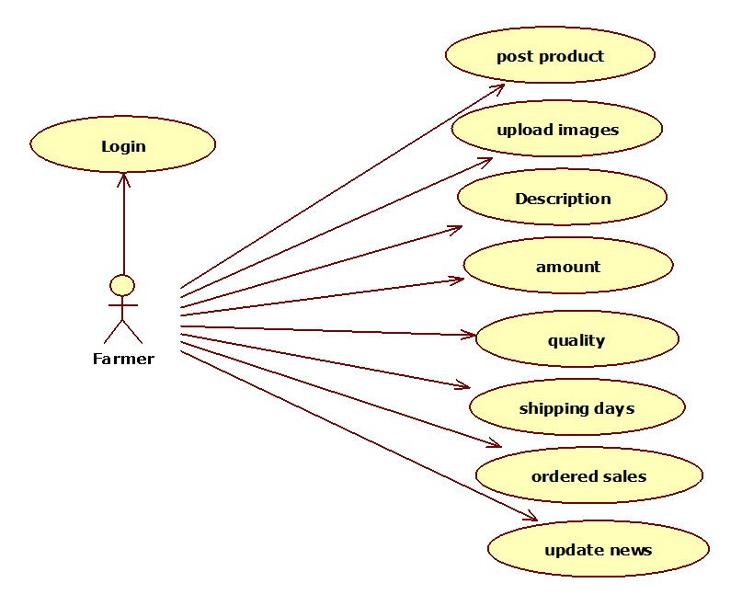
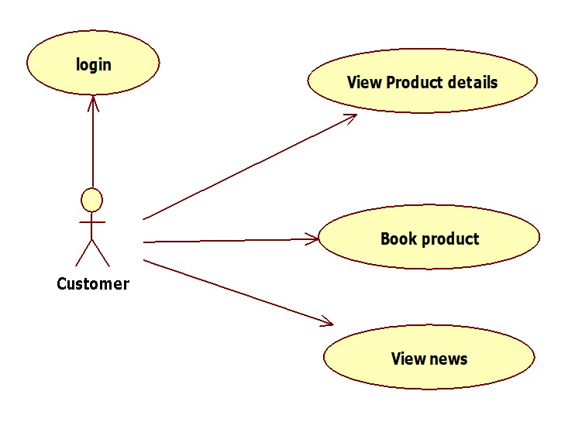
Farmer
USE CASE DIAGRAMS :
Buyer

Slide 10
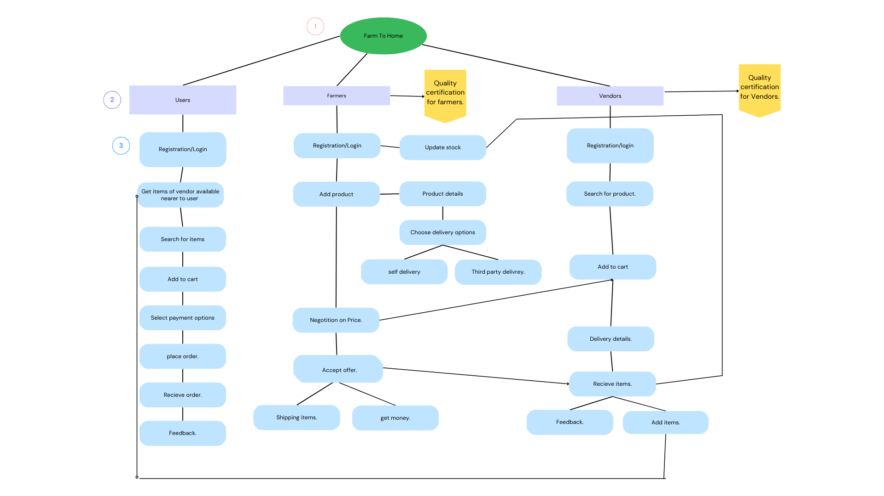
Architectural Diagram

Slide 11
ADVANTAGES
Fresher, more nutritious food
Support for local farmers
Reduced environmental impact
Higher prices
More control over the supply chain

Slide 12
LIMITATIONS
Digital literacy:
Trust issue:
Lack of transparency:
Lack of brand recognition:
Language barriers:

Slide 13

CONCLUSION
It is usually installed on the farmer’s own web site and may integrate into the existing supply chain so that ordering, delivery can be automated to a large extent.
This ingenious application is not only dependable, but also easy to use, enabling individuals to buy farm-fresh goods straight from the source.
Its main purpose for this app is time saving and easy moving to farmers and users.
This new system allows farmers to earn a better living and live with pride.

Slide 14
REFERENCES
Pritam Ramteke, Sandeep Pathak, Pooja Raut, Pradnya Sarade, Naina Palandurkar : Development of Web Based System for Farmer to Consumer Product Selling Through Direct Marketing
Date: 03 March 2020
Dr. Dayanand G. Savakar, Mahesh Bijjaragi, Danesh Telsang : A Web Designed smart farming system: “Application from farmers to customers”
Date: 09 September 2022
Prof. A. A. Bamanikar Harshal Awate, Jay Katre, Hritik Rasal, Akshaya Mahadik : Farmers Agricultural Portal
Date: 05 May 2022
Hayfaa Subhi Malallah, Maiwan Bahjat Abdulrazzaq : Web-Based Agricultural Management Products for Marketing System
Date: 02 January 2023
Gokarni Dhande, Amit Chougule, Anuja Gode, Prof. Reena Deshmukh : Agremart Online Revenue for Farmers
3 October 2022 , IJRASET
Achim Spiller, Anke Zühlsdorf : The Role of Customer Satisfaction Measurement for Service Innovations
February 2007 , ResearchGate
Gilbert Malawit Tumibay , Mar Stephen Bautista Sembrano : Increasing the value of farm products: connecting farmers and consumers through an E-commerce system
10 August 2016 , ResearchGate

Slide 15


