Slide 1


CAPSTONE PROJECT
ONLINE RETAIL SALES ANALYSIS
Presented By: Prathmesh kangane
Student Name: Prathmesh kangane
College Name: Saraswati college of engineering
Department: cse-aiml
Email ID: Prathmesh.kangane2003@gmail.com

Slide 2
OUTLINE:
Problem Statement
Proposed System/Solution
System Development Approach
Algorithm & Deployment
Result (Output Image)
Conclusion
Future Scope
References

Slide 3
Problem Statement:
A UK-based non-store online retailer operating between December 2010 and December 2011 generates thousands of daily transactions across 38 countries. However, business managers lack a unified view of revenue trends, customer purchasing behavior, and product demand by region. Raw transactional data in Excel format makes it impossible to identify top customers, peak revenue months, or high-demand markets without manual effort. The core challenge is to build an end-to-end Power BI dashboard that transforms the UCI Online Retail dataset into an interactive, insight-driven report — enabling management to track Total Revenue, Units Sold, Customer Count, monthly trends, and geographic demand patterns through a single consolidated view.

Slide 4
Proposed Solution:
The proposed solution is a single-page interactive Power BI dashboard built on the UCI Online Retail dataset (541,909 transactions across 38 countries, Dec 2010 - Dec 2011). It delivers real-time visibility into revenue trends, customer behavior, and product demand by geography. The solution consists of the following components:
Data Collection:
Imported the Online Retail Excel file into Power BI Desktop — 541,909 rows with 8 columns: InvoiceNo, StockCode, Description, Quantity, InvoiceDate, UnitPrice, CustomerID, Country.
Verified data types for all columns — set InvoiceDate as Date/Time, Quantity and UnitPrice as Decimal Number.
Data Preprocessing:
Removed rows with null CustomerID (24.93% of rows), filtered out negative Quantity values (cancellations), and removed test/blank entries using Power Query Editor.
Created a calculated column: Revenue = Quantity * UnitPrice using DAX in the Modeling tab.
Machine Learning Algorithm:
Extracted Month from InvoiceDate using Power Query date functions for the Monthly Revenue Trend line chart.
Applied DAX measures: Total Revenue = SUM(Revenue), Total Quantity = SUM(Quantity), Unique Customers = DISTINCTCOUNT(CustomerID).
Deployment:
Designed a single-page dashboard with 3 KPI cards at top, Monthly Revenue line chart, Top 10 Countries bar chart, Top 10 Customers bar chart, and a Product Demand world map.
Applied Top N filters (Top 10) on Country and CustomerID visuals, excluded UK from country chart and blanks from customer chart for cleaner insights.
Evaluation:
Validated KPI card values against Excel pivot table totals to confirm Revenue, Quantity, and Customer Count accuracy.
Applied Power BI theme for consistent color styling and renamed all auto-generated titles to business-friendly labels.

Slide 5
System Approach:
The system follows a structured Power BI development workflow: Extract the Online Retail Excel file, Transform using Power Query Editor (remove nulls, filter cancellations, fix data types), Load into Power BI data model, then Visualize through an interactive single-page dashboard. A Revenue calculated column (Quantity x UnitPrice) is created via DAX. The approach ensures data integrity, accurate KPI measurement, and a clean professional user experience.
Tools & Technologies: Power BI Desktop, Power Query (M language), DAX, Microsoft Excel
Dataset: UCI Online Retail Dataset — Online Retail.xlsx (541,909 rows, 8 columns, 38 countries, Dec 2010 - Dec 2011)

Slide 6
Algorithm & Deployment:
The Power BI dashboard uses DAX (Data Analysis Expressions) as the core computation engine for all KPIs and measures. Data transformation is handled via Power Query M language, and the final report is saved as a .pbix file.
Algorithm Selection:
DAX Measures & Calculated Columns: Revenue = Quantity * UnitPrice (calculated column), Total Revenue = SUM(Revenue), Total Quantity = SUM(Quantity), Unique Customers = DISTINCTCOUNT(CustomerID).
Data Input:
Data Input: InvoiceNo, StockCode, Description, Quantity, InvoiceDate, UnitPrice, CustomerID, Country — 8 columns, 541,909 rows from UCI Machine Learning Repository.
Training Process:
Data Transformation: Removed 135,080 rows with null CustomerID, filtered negative Quantity (cancellations/returns), changed data types, extracted Month from InvoiceDate for trend analysis.
Prediction Process:
Deployment: Saved as OnlineRetail_Analysis.pbix. Dashboard includes 3 KPI cards (Total Revenue, Total Units Sold, Unique Customers), Monthly Revenue line chart, Top 10 Countries bar chart, Top 10 Customers bar chart, and a world map visual.

Slide 7
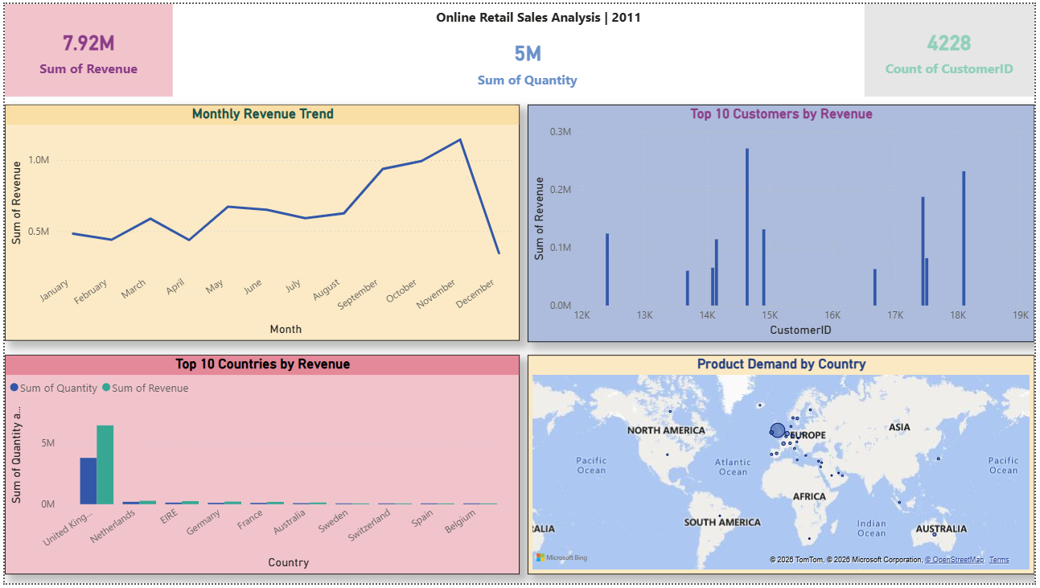
Result:
The Power BI dashboard revealed: Total Revenue = £7.92M, Total Units Sold = 5M, Unique Customers = 4,228 across Dec 2010 - Dec 2011. Revenue peaked in November 2011 (£1.1M) showing strong seasonal demand. United Kingdom dominates sales volume. Top customer (CustomerID 14646) generated £0.28M in revenue alone. Netherlands and EIRE are the top international markets. The world map confirms product demand is concentrated in Western Europe. The dashboard successfully transforms 541,909 raw transactions into 5 clear, interactive business insights enabling data-driven decisions.

Slide 8
Conclusion:
The Online Retail Sales Analysis Power BI Dashboard successfully transformed 541,909 raw transactional records into a clean, interactive single-page report. Key findings: November 2011 is the peak revenue month (£1.1M) indicating strong pre-Christmas demand. The UK accounts for the majority of sales volume. Top 10 customers contribute disproportionately high revenue, indicating a loyal high-value customer segment. Netherlands and EIRE are the strongest international markets. Challenges included handling 24.93% missing CustomerID values and filtering cancellation records (negative quantities). The dashboard empowers management with instant visibility into revenue trends and customer behavior without manual Excel analysis.

Slide 9
Future scope:
Future enhancements include:
Adding a second dashboard page for Product-level analysis — top selling StockCodes, revenue by product description, and return rate by product.
(2) Building a Customer Segmentation page using RFM (Recency, Frequency, Monetary) analysis to classify customers into High, Medium, and Low value tiers.
(3) Integrating a cancellation analysis visual to track return rates by country and month.
(4) Connecting to a live database via Power BI Dataflows for real-time sales monitoring.
(5) Adding forecasting visuals using Power BI built-in Analytics pane to predict next 3 months revenue.
(6) Deploying to Power BI Service for mobile access and scheduled daily data refresh.

Slide 10
References:
UCI Machine Learning Repository - Online Retail Dataset by Dr. Daqing Chen (https://archive.ics.uci.edu/dataset/352/online+retail).
Microsoft Power BI Documentation - docs.microsoft.com/en-us/power-bi.
DAX Guide - dax.guide.
Power Query M Language Reference - docs.microsoft.com/power-query.
Microsoft Learn - Power BI Data Analyst (PL-300) certification course materials.
GitHub Link: https://github.com/Prathmeshkangane/Online-Retail-Analysis.git

Slide 11
Thank You

