Slide 1
Hotel Booking Analysis
A Business Problem

Slide 2
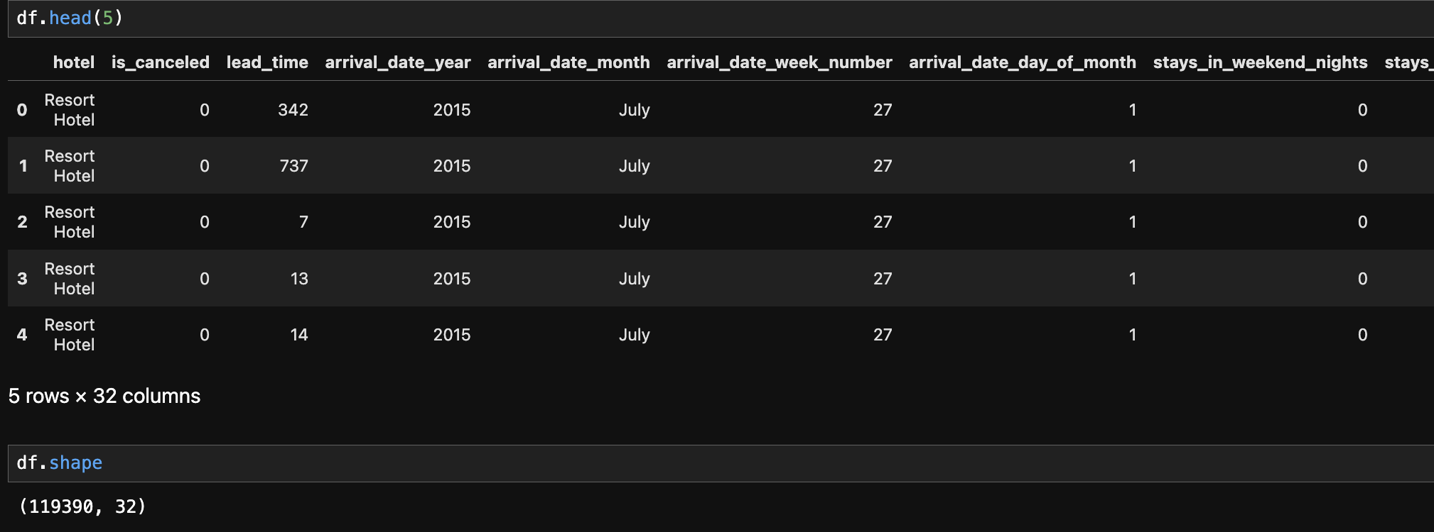
Number of rows and columns in dataset
There are 1,19,390 rows and 32 columns in the dataset.
The datasets contains the booking information of two hotel. One of the hotels is a resort hotel and the other is a city hotel.
City Hotel = 66%
Resort Hotel = 34%

Slide 3
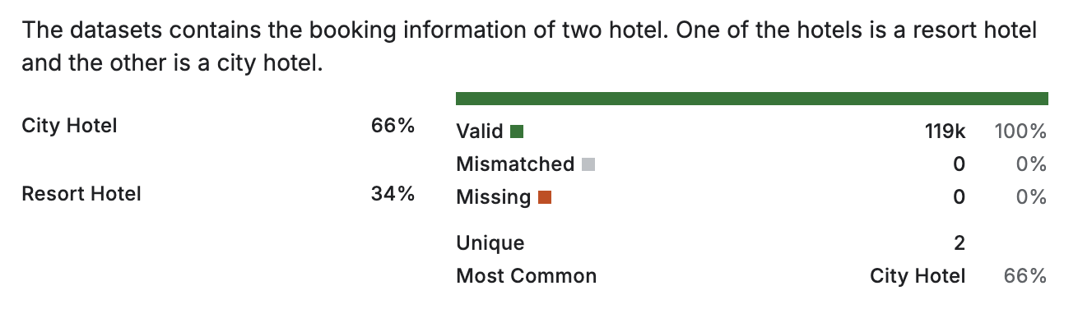
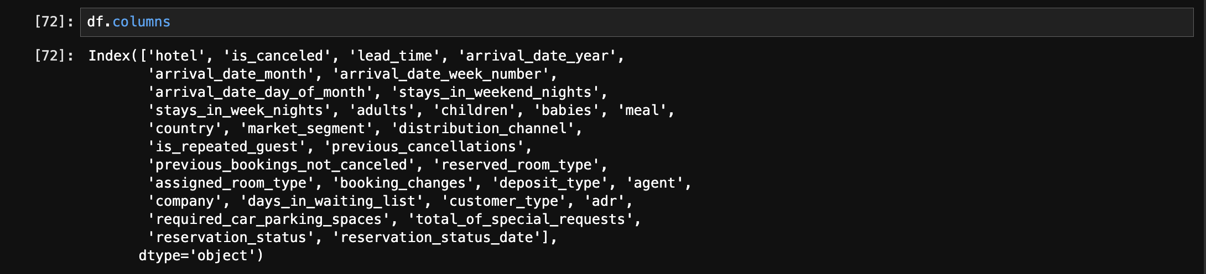
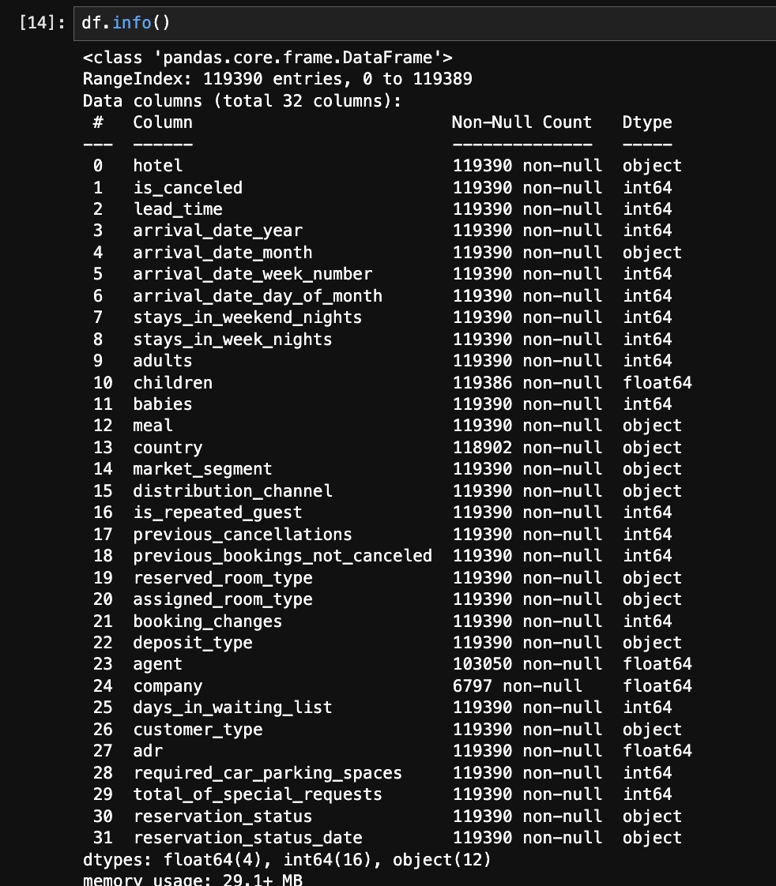
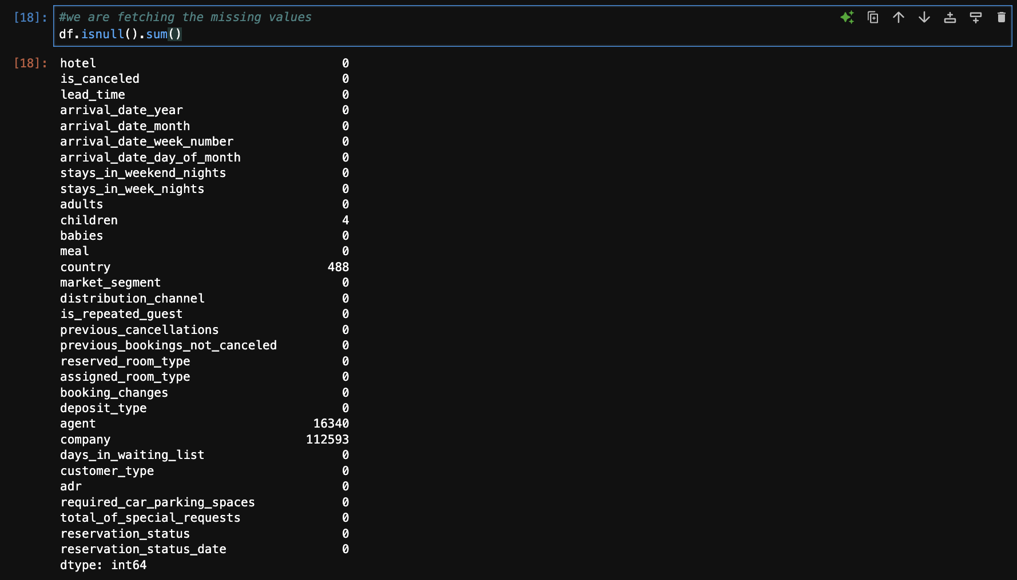
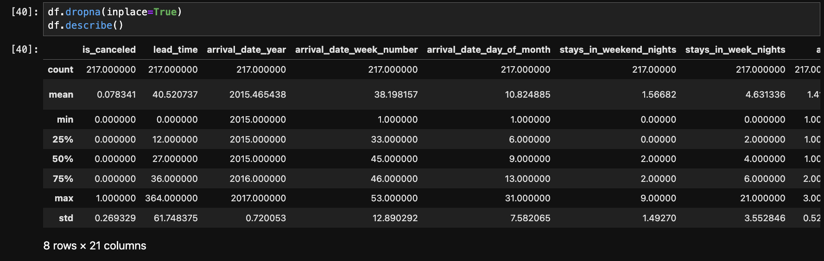
Some screenshot
of
Python
Code for the dataset

Slide 4
PROBLEM DOMAIN?
In recent years, City Hotel and Resort Hotel have seen high cancellation rates. Each hotel is now dealing with several issues as a result, including fewer revenues and less than ideal hotel room use. Consequently, lowering cancellation rates is both hotels' primary goal to increase their eﬃciency in generating revenue, and for us to oﬀer thorough business advice to address this problem.

Slide 5
APPROACH TO SOLUTION
Exploratory Data Analysis (EDA) of the Hotel Booking Dataset using Python.
USE OF DIFFERENT LIBRARIES OF PYTHON FOR DATA VISUALIZATION:
MATPLOTLIB
PANDAS
NUMPY
SEABORN
USE OF MATPLOTLIB AND SEABORN FOR CREATING BAR CHARTS, PIE CHATRTS ETC.

Slide 6
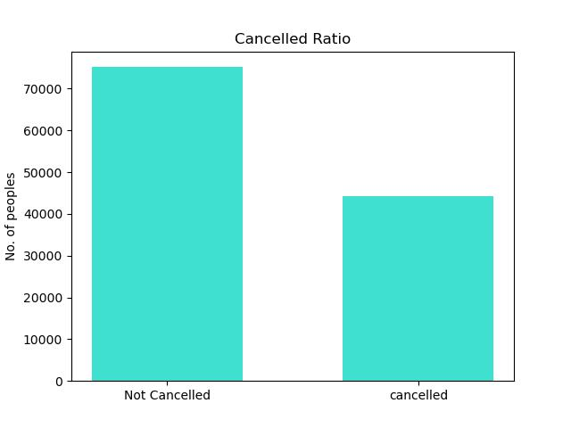
Analysis and Findings
The accompanying bar graph shows the percentage of reservations that are cancelled and those that are not. It is obvious that there are still a significant number of reservations that have not been cancelled. There are still 37% of clients who cancelled their reservation , which has a significant impact on the hotels' earnings.

Slide 7
REASONS FOR HIGHER CANCELLATION RATES
1. Flexible Cancellation Policies
Many hotels offer free or flexible cancellation policies to attract more bookings. This encourages customers to make reservations without strong commitment, leading to higher cancellations.
2. Overbooking and Double Booking
Customers often book multiple hotels to keep their options open, especially when they are unsure about their travel plans or are waiting for better deals.
3. Uncertain Travel Plans
Changes in personal or business travel plans can lead to cancellations. For example:
Business meetings being postponed or cancelled.
4.Booking Channels
Online Travel Agencies (OTAs): OTAs often allow customers to cancel with minimal or no penalty, leading to higher cancellation rates compared to direct bookings.

Slide 8
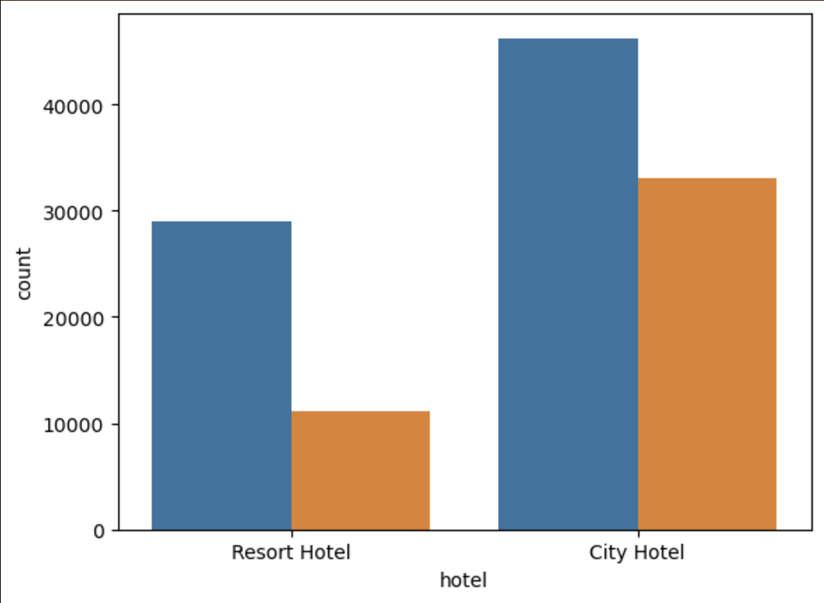
RESERVATION STATUS IN DIFFERENT HOTELS
In comparison to resort hotels, city hotels have more bookings.
Reasons could be:-
It's possible that resort hotels are more expensive than those in cities.
City hotel bookings tend to have a shorter lead time, allowing less time for cancellations to occur
Resort bookings are often made far ahead due to their nature (vacation planning), reducing last-minute changes.
Urban guests often make frequent and dynamic travel decisions for business or personal reasons, increasing the chance of cancellations

Slide 9
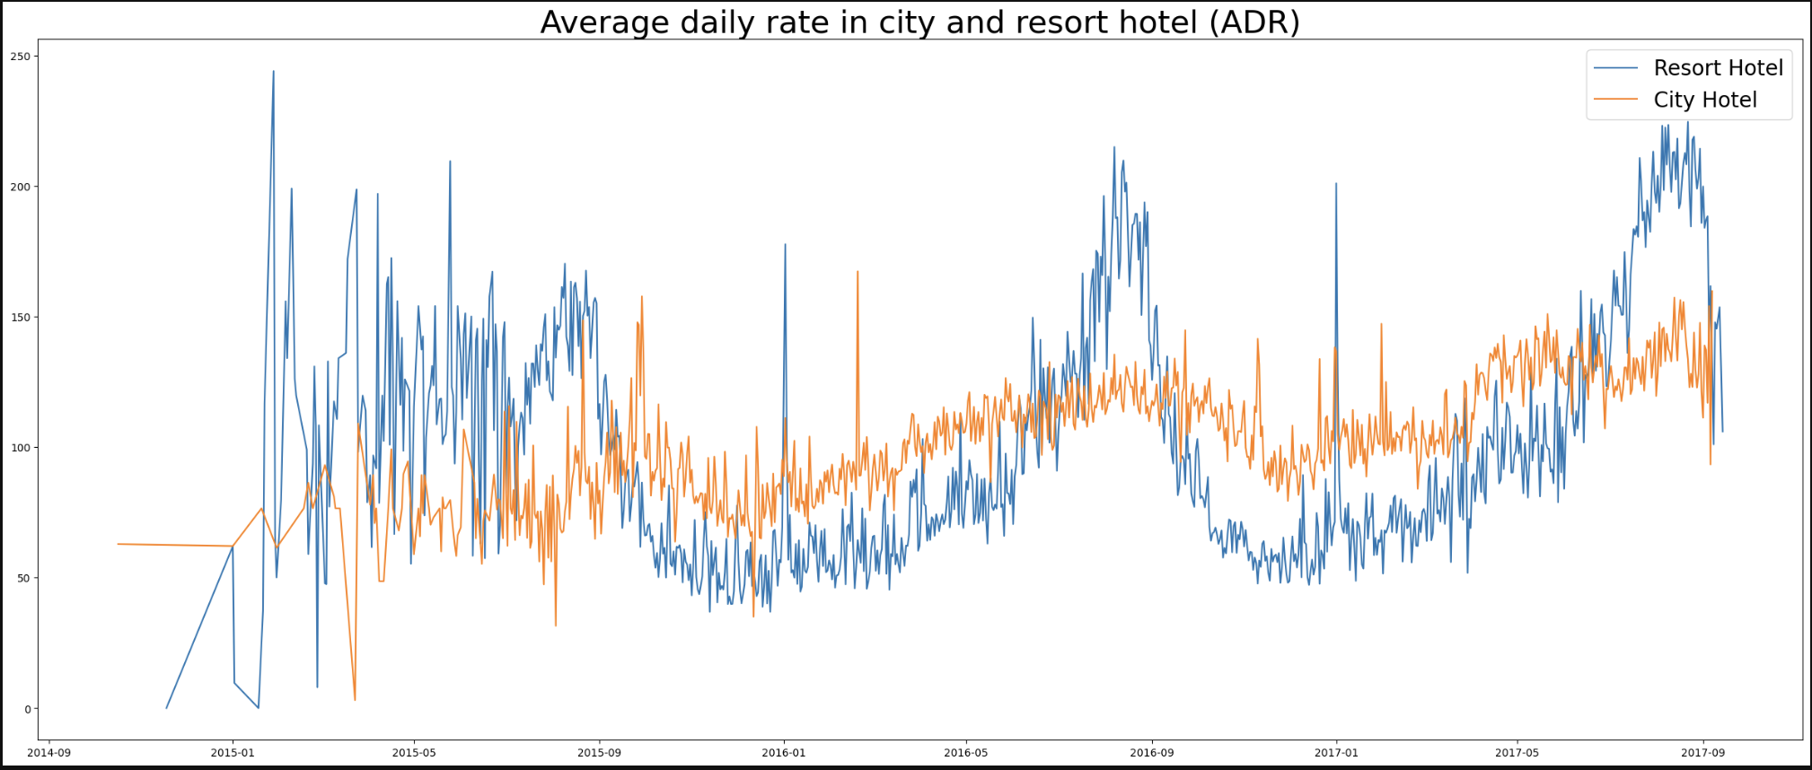
Average daily rate adr in city and resort hotel
ADR:
It is used to measure the average revenue earned per available room per day.
The line graph below shows that, on certain days, the average
daily rate for a city hotel is less than that of a resort hotel, and on other days, it is even less. It goes without saying that weekends and holidays may see a rise in resort hotel rates

Slide 10
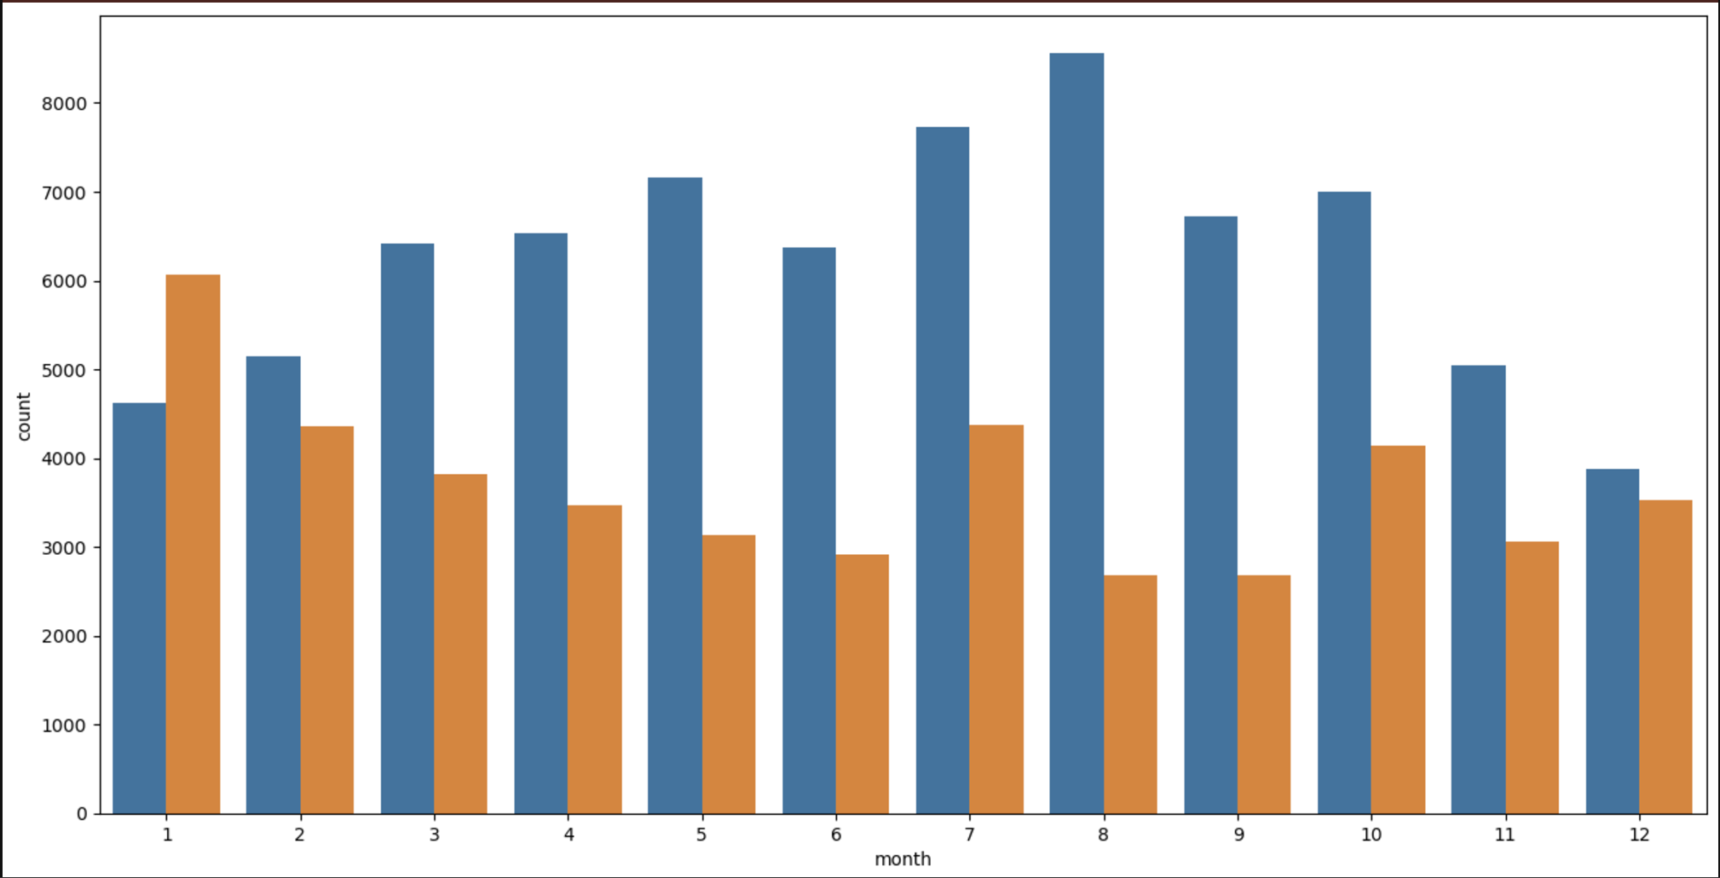
Booking based on months
We have developed the grouped bar graph to analyse the months with the highest and lowest reservation levels according to reservation status.
As can be seen, both the number
of confirmed reservations and the number of cancelled reservations are largest in the month of August. Whereas January is the month with the most cancelled reservations.
Reasons could be:
Peak travel season in many parts of the world due to summer vacations, especially in Europe and North America. Families and individuals often plan leisure trips during this time, resulting in a high volume of bookings.

Slide 11
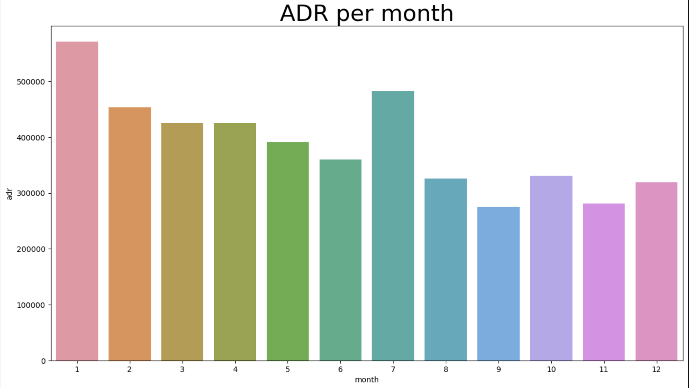
Adr per month
This bar graph demonstrates that cancellations are most common when prices are greatest and are least common when they are lowest. Therefore, the cost of the accommodation is solely responsible for the cancellation.
Reasons could be:
High prices without corresponding benefits can lead to cancellations, especially if reviews highlight a poor experience.
Customers might switch to cheaper alternatives or wait for discounts, increasing cancellation rates during peak price periods.

Slide 12
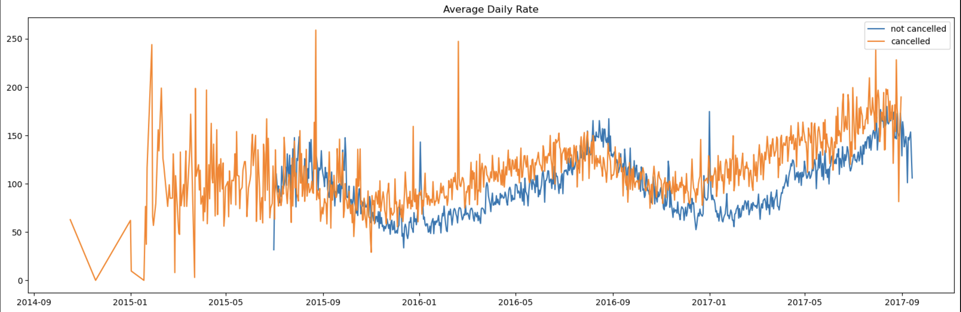
How adr affects the cancellation rates
As seen in the graph, reservations are cancelled when the average daily rate is higher than when it is not cancelled. It clearly proves all the above analysis, that the higher price leads to higher cancellation

Slide 13
Suggestions :
1. Cancellation rates rise as the price does. To prevent cancellations of reservations, hotels could work on their pricing strategies and try to lower the rates for specific hotels based on locations. they can also provide some discounts to the consumers.
2. as the ratio of the cancellation and not cancellation of the resort hotel is higher in the resort hotel than the city hotels. so, the hotels should provide a reasonable discount on the room prices on weekends or on holidays.
3. in the month of January, hotels can start campaigns or marketing with a reasonable amount to increase their revenue as the cancellation is the highest in this month.
4. they can also increase the quality of their hotels and their services mainly in Portugal to reduce the cancellation rate.

Slide 14
THANK YOU

