Slide 1
INTERNSHIP PROJECT · AI / ML TRAINING
Big Mart
Sales Prediction
Using XGBoost Regression
Prathna Parmar · AI ML Training · Thakur Shyamnarayan Degree College
Internship Project: Naviotech Solution

Slide 2



THE QUESTION
Big Mart sales can be estimated from product and outlet signals
Product signals
Outlet signals
Sales target
Predict product sales at Big Mart outlets.
Use product-related and outlet-related information as model inputs.
Predict the target variable Item_Outlet_Sales with machine learning regression.

Slide 3
PROJECT ARC
The project turns raw sales data into a measurable prediction
01
02
03
04
Prepare
Clean
Model
Evaluate
Prepare and analyze the sales dataset.
Handle missing values and categorical data.
Build an XGBoost regression model.
Measure performance with the R² score.

Slide 4
THE DATASET
The dataset combines 8,523 records with 11 input features
8,523
11
Target
Feature types
Item_Outlet_Sales
Numerical and categorical product and outlet information.
Training records
Input features
The value the model learns to predict.

Slide 5

PREPROCESSING
Preprocessing makes incomplete and categorical data model-ready
Check the dataset for missing values.
1
Impute Item_Weight with the mean.
2
Fill Outlet_Size based on Outlet_Type.
3
Encode categorical features with label encoding.
4
Prepare the cleaned data for model training.
5

Slide 6
ANALYSIS DESIGN
The analysis separates learning data from unseen test data
Before modeling, explore product and outlet features. Then define X as the features and Y as the target.
LEARNING DATA
UNSEEN DATA
80%
20%
Training
Testing
Used to learn the relationship between inputs and sales.
Held back to assess performance on new cases.
Random state: 2 · Reserve the notebook’s actual analysis graph here when supplied.

Slide 7
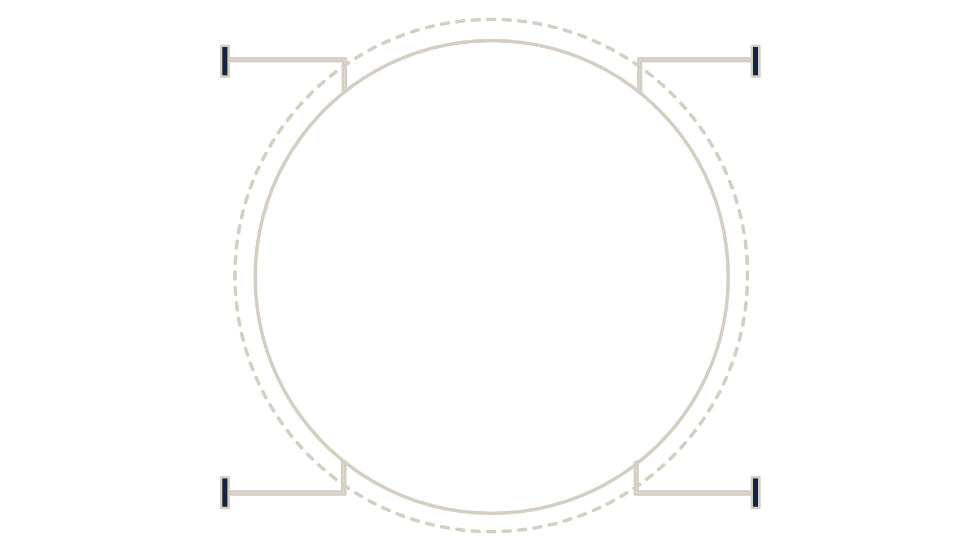
THE MODEL
XGBRegressor learns the relationship between outlet context and sales
It predicts numerical sales by learning relationships between product and outlet features.
Product
Outlet
Item features input
Store/location features
Training
Prediction
Cleaned historical data
Sales (numeric)
Evaluation metric: R² score.

Slide 8

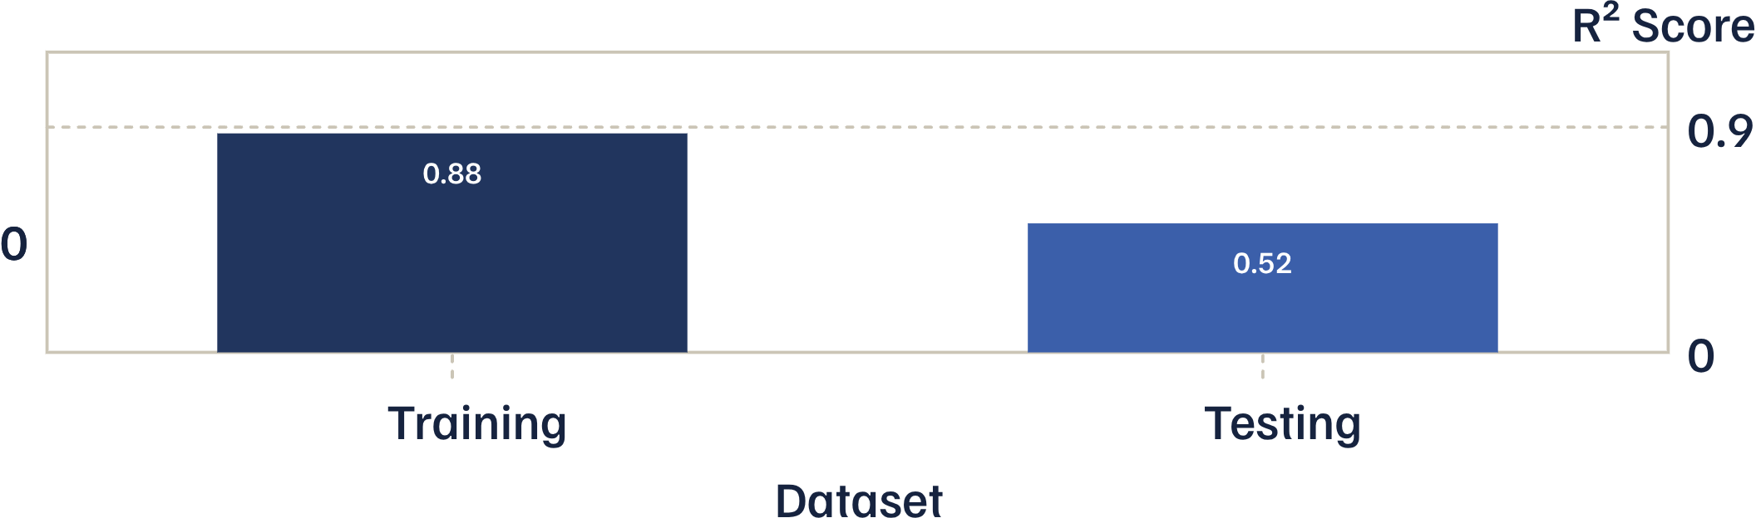
MODEL EVALUATION
Training fit is strong, while test performance is more modest
The gap between training and testing performance matters: unseen-data performance is the more cautious read.
Training fit and unseen-data performance do not tell the same story.
Model evaluation · R² score

Slide 9

RESULTS VIEW
Predictions are compared with actual test-set sales
The trained model generates sales predictions for the test data. The next comparison should place predicted values beside actual sales values.
MODEL OUTPUT
REFERENCE
Predicted values
Actual sales
Use the notebook’s prediction graph or results view.
Compare against the corresponding test-set sales values.
NOTEBOOK GRAPH SLOT — Replace this guidance with the appropriate prediction or results graph from the notebook. Do not show a specific sales prediction unless it appears in the notebook.

Slide 10
CLOSING READ
✓
Processed the dataset successfully.
The project demonstrates a complete sales-prediction workflow
✓
Handled missing and categorical data.
From raw records to evaluated predictions, each stage prepares the next.
✓
Implemented XGBoost regression.
Testing R² score: 0.5156
✓
Measured performance with R².
Educational project; results depend on the dataset and preprocessing used.

