Slide 1
Breast Cancer Classification Using Neural Network
Name :Prathna Parmar
Course: AI ML Training
College Name :Thakur shamnarayan degree college
Organization:Naviotech solution
Internship Project

Slide 2
INTRODUCTION
Introduction
Breast cancer is one of the important health problems.
This project uses machine learning to classify breast-tumor cases.
The model predicts whether a tumor is Malignant or Benign.
Project Objective
Main objective:
To build a neural-network model that can classify breast-tumor data into malignant and benign categories.

Slide 3
DATASET
Dataset
569
30
DATASET
Breast Cancer Wisconsin (Diagnostic)
cases
features used for prediction
Two categories: Malignant and Benign
The dataset has no missing values.

Slide 4







TOOLS USED
Tools Used
Python
Google Colab
NumPy
Pandas
TensorFlow / Keras
Scikit-learn
Matplotlib

Slide 5
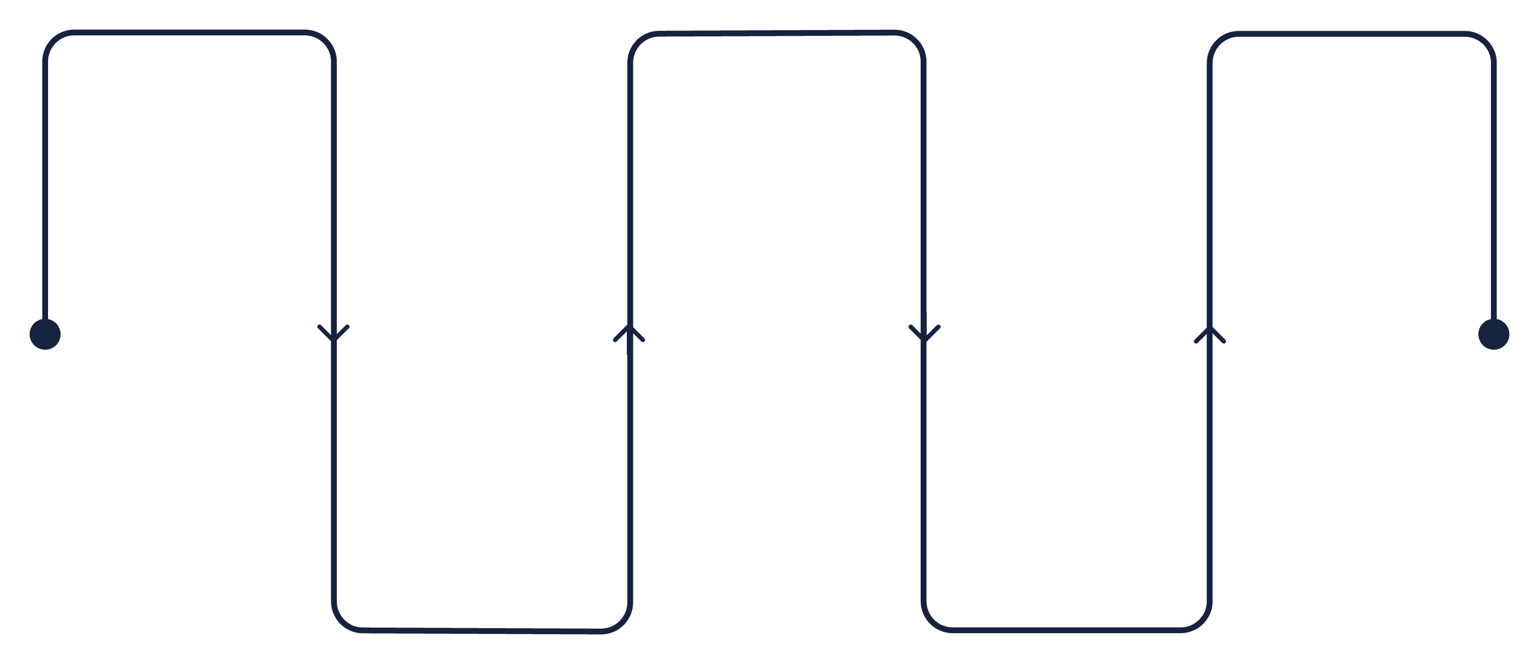
PROJECT FLOW
How the Project Works
Dataset
Split into training & testing
Train Neural Network
Collect raw data
Fit model to training data
Create train and test sets
Prepare the data
Scale the data
Clean and format records
Normalize features

Slide 6
DATA PREPARATION
Data Preparation
80%
20%
The data was divided into training data and testing data.
80% was used for training.
was used for testing.
The numbers were scaled before training.

Slide 7
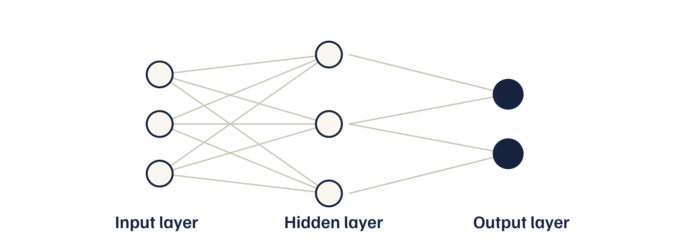
MODEL ARCHITECTURE
Neural Network
The project uses a simple neural network with an input layer, a hidden layer and an output layer.
30 input features
20 neurons in the hidden layer
2 output values for the two classes

Slide 8
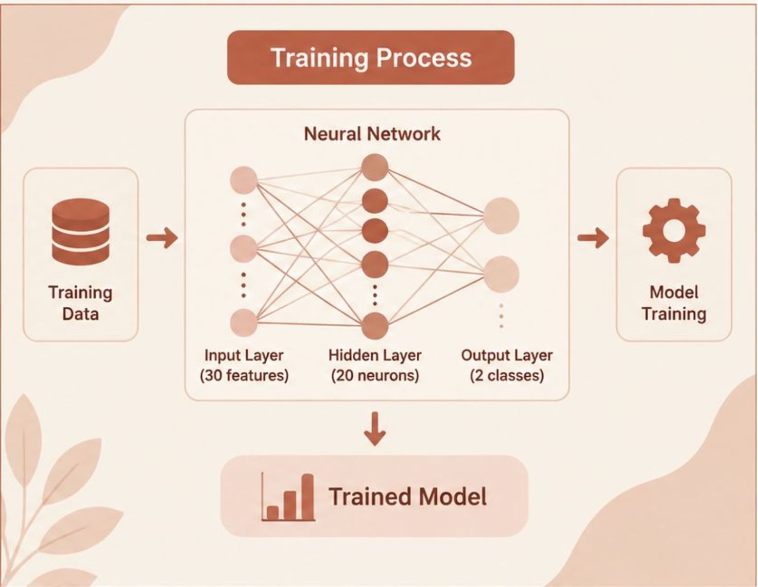
MODEL TRAINING
Training
The model was trained for 10 rounds (epochs).
During training, the model learned patterns from the training data.
Accuracy and loss were monitored during training.

Slide 9
EVALUATION
Results
TEST ACCURACY
Prediction Example
96.49%
The trained model was also used to predict an individual sample.
Prediction: Benign
The notebook's example produced a benign prediction.
Test Accuracy: 96.49%
The model was tested using separate test data.
The final test accuracy was 96.49%.

Slide 10
CONCLUSION
Conclusion
A neural-network model was successfully implemented.
The model classified the test data with 96.49% accuracy.
The project demonstrates how machine learning can be used for classification.
This project is for educational purposes and is not a medical diagnostic system.
96.49%
accuracy

