Slide 1

JOBINTERNDESK
Search your job with us!

Slide 2

DESK INTERNS 1. A E YOGITA 2. DISHA BHARGAVI B S 3. H L SRILAXMI 4. HARITHA T 5. NEHA ACHARYA 6. PRATHUASHA K B 7. VINAYAKA M DODMANI

Slide 3

OBJECTIVES
JobInternDesk is the website that contain a wide range of job and internship opportunities.
It is to provide the users with jobs information, online applying for jobs and other facilities.
A chatbot interface for a quick Q&A to resolve queries.

Slide 4

WHY WE CHOSE THIS PROJECT ?
Our main emphasis lies in front-end web designing, and we believe that incorporating additional front-end features can greatly enhance the experience of this JobInternDesk website. Therefore, we have selected this website allowing us to dedicate our efforts to create a captivating and visually appealing front-end design.

Slide 5

FEATURES OF WEBSITE
Landing page consists of Job search and internships search sections where users can search for desired jobs.
It also contains a section to explore Jobs/Internships based on category.
Users can find the reviews of our clients/users.
An interactive chatbot to resolve queries.

Slide 6
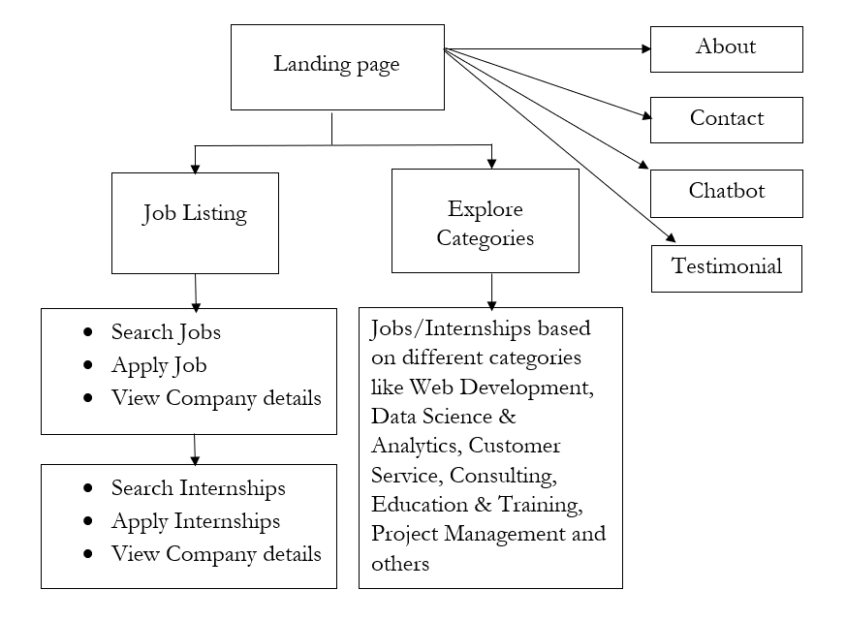
SITEMAP

Slide 7
TECHNOLOGIES USED
HTML
CSS
JAVASCRIPT
BOOTSTRAP
JQUERY

Slide 8

THANK YOU
VISIT OUR SITE HERE : https://jobinterndesk7internship.on.drv.tw/www.JobInternDesk.com/JobInternDesk%20Website/

