Slide 1
Water Potability assessment Using Machine Learning Techniques
Digital technology for Agriculture and Natural Resources
702706968
Prathyush KVSS
UNIVERSITY OF DELAWARE

Slide 2
Problem Statement:
Access to safe and potable water is a necessity for human health and well-being. However, many regions face contaminated or quality-compromised water sources, posing public health risks. There is a need for an automated, scalable approach leveraging sensor data and machine learning techniques to classify water quality and determine potability.

Slide 3
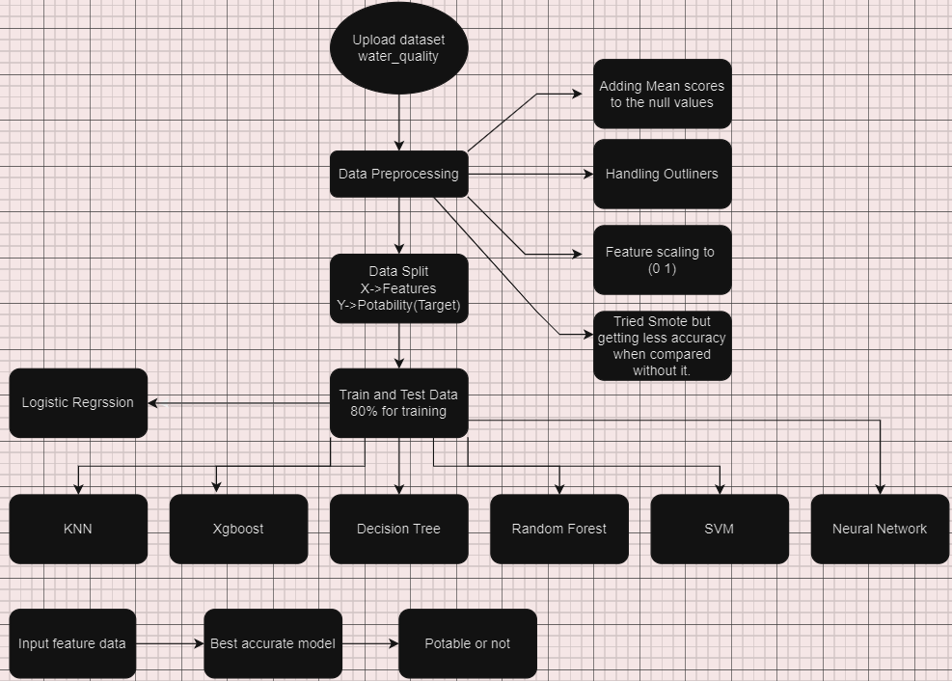
Over all WorkFLOW

Slide 4
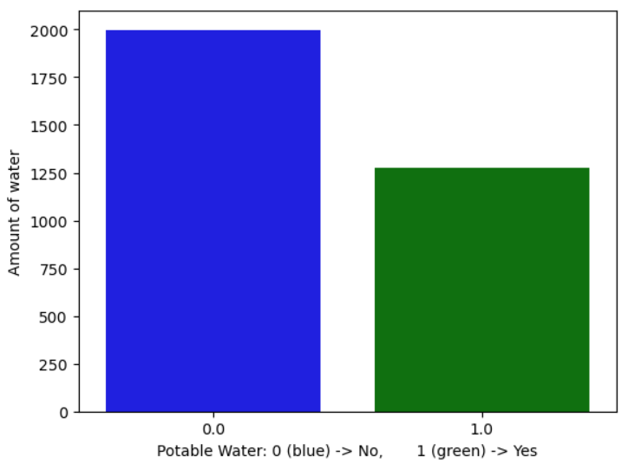
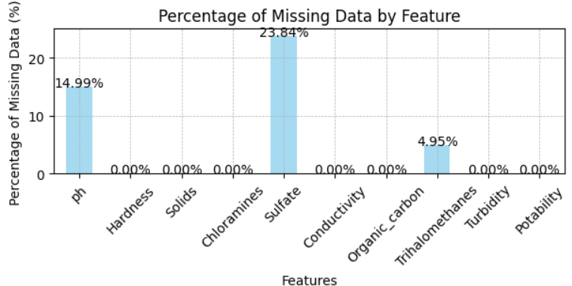
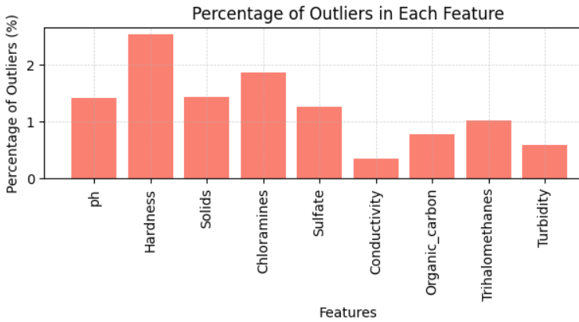
DATA PREPROCESSING
Analyze Data: Features like ‘ph’ , ‘Sulphate’ and ‘Organic_carbon’ show higher counts of missing data, while all other shows no missing entries.
Handling missing values: Fill missing values in specific columns with the mean of their non-null entries.
Handling Outliners: Apply Winsorization to the water dataset by capping outliers below the 5th percentile and above the 85th percentile as threshold values.
Featured Scaling: Feature scaling is crucial for this dataset to standardize variables like Solids, sulphates which vary widely in their ranges and units. I rescaled features with standardization , so that they have a mean of 0 and a standard deviation of 1.
Have got score 39% of data showing potable water, data has output imbalance.

Slide 5
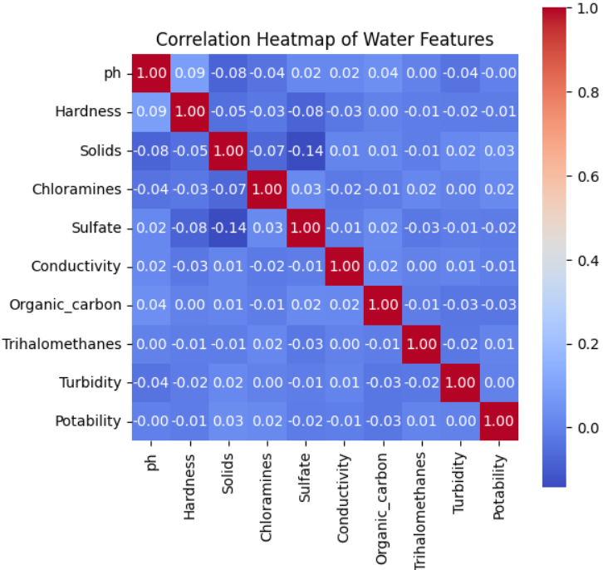
Correlation:
Most of the cells show values close to zero, indicating little
to no linear correlation between the features.
For example, the correlation between pH and Hardness is 0.09,
suggesting a very weak positive linear relationship, Sulphates
and Solids have a correlation coefficient of -0.14, indicating a
negligible negative relationship.
Co-relation matrix says that there is no linear relationship
between the features that can explain the target variable.
So, Linear model may not work on this problem. we need to
try with probability based models.

Slide 6
Machine Learning Models
Considering the following models for the best accuracy of potability.
Linear Model
Logistic Regression
Non Linear Model
Xgboost
Random Forest
KNN
Decision Tree
SVM
Neural network

Slide 7
Model Training and validation
X = water.drop(['Potability'],axis=1)
Y = water['Potability’]
Split data train 80% and test 20%
Use different algorithms with their respective parameters and tune them for better accuracy.

Slide 8
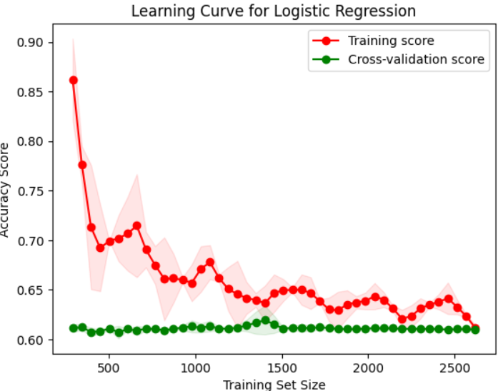
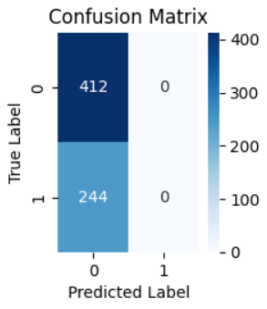
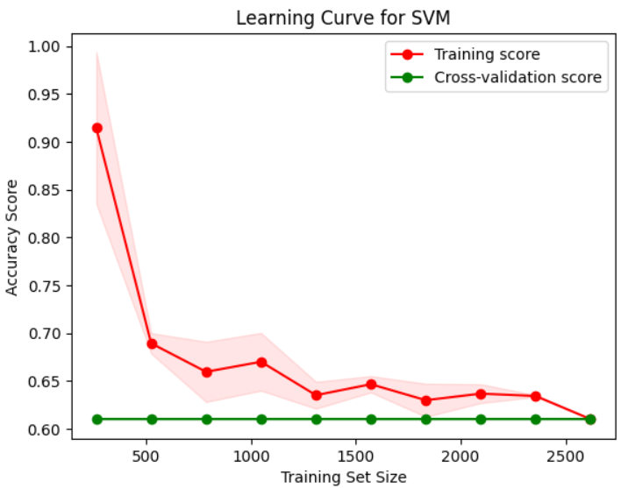
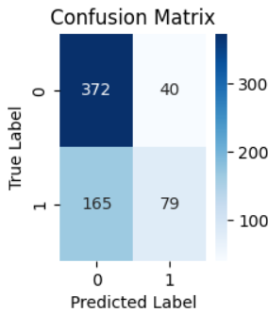
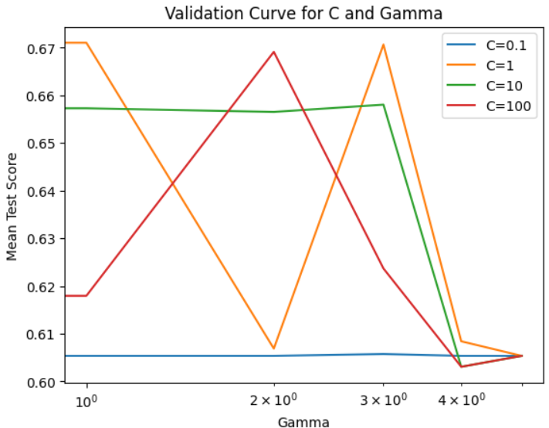
Logistic Regression
SVM (Tuned parameters: C =1,gamma =‘scale’)
Model | Size | Rmse | Mae | F1 Score | Variance | CV Score | Accuracy
Logist | 80:20 | 0.609 | 0.372 | 0.48 | 0.1 | 0.61 | 0.62
Model | Size | Rmse | Mae | F1 Score | Variance | CV Score | Accuracy
SVM | 80:20 | 0.559 | 0.3125 | 0.6542 | 0.14 | 0.61 | 0.67

Slide 9
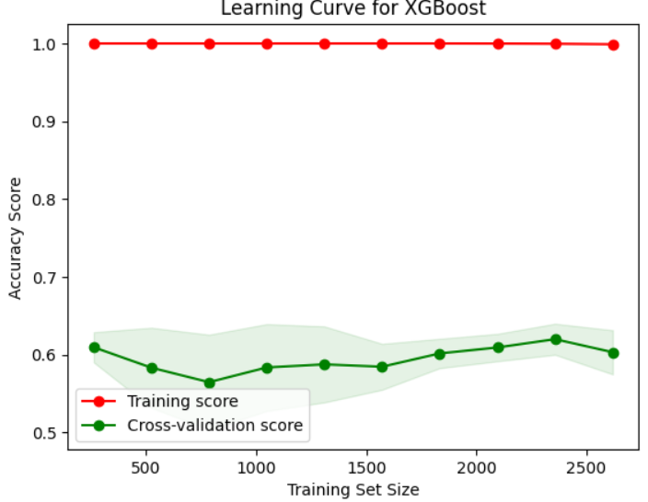
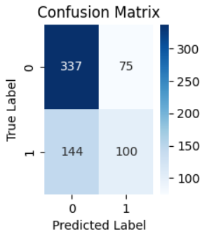
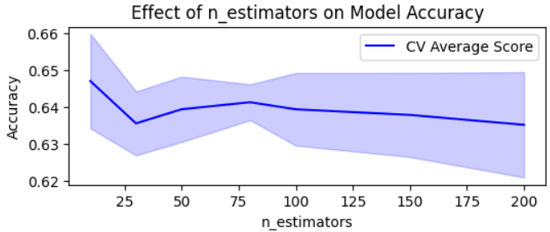
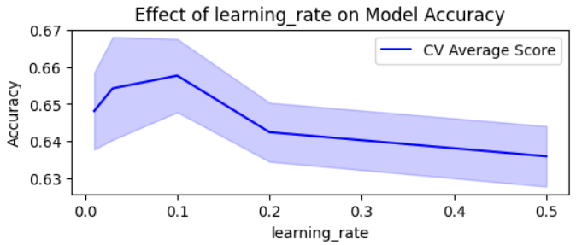
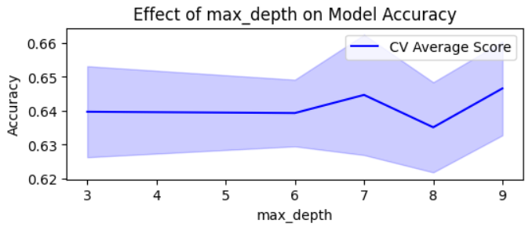
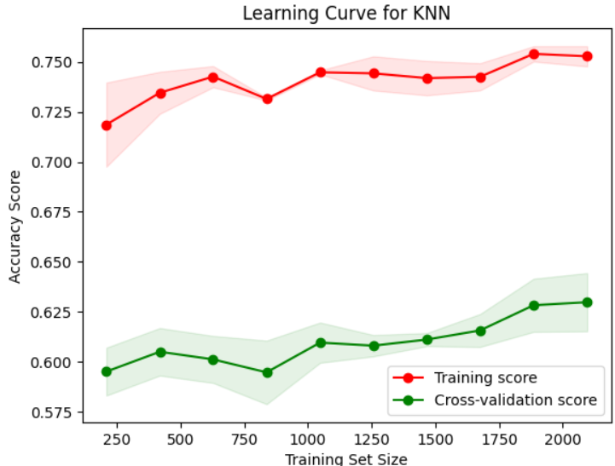
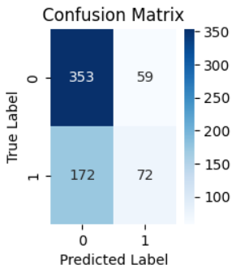
Xgboost (tuning no.of estimators, max_depth,learning rate)
KNN (metric: manhattan,n_neighbors: 15,weights: distance)
Model | Size | Rmse | Mae | F1 Score | Variance | CV Score | Accuracy
Xgboost | 80:20 | 0.58 | 0.63 | 0.65 | 0.11 | 0.65 | 0.66
Model | Size | Rmse | Mae | F1 Score | Variance | CV Score | Accuracy
KNN | 80:20 | 0.59 | 0.35 | 0.61 | 0.15 | 0.63 | 0.64

Slide 10
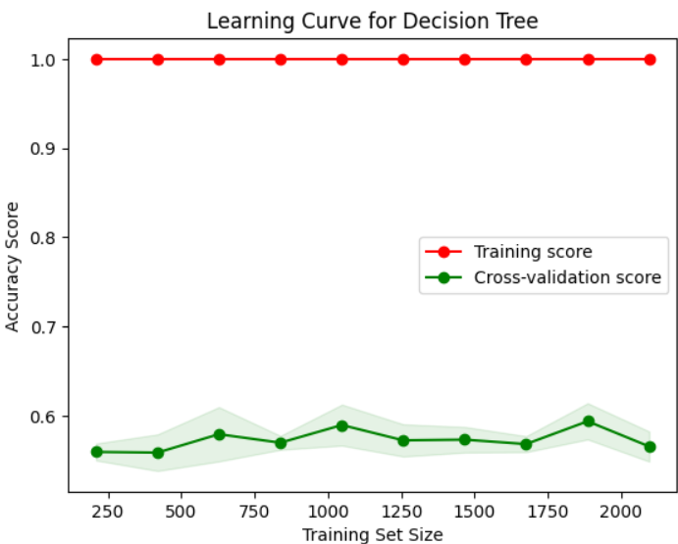
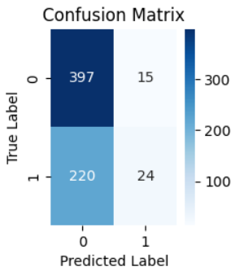
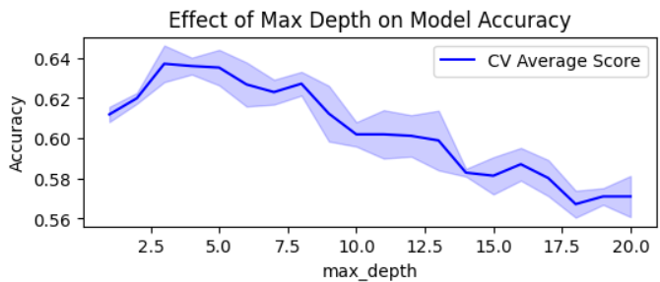
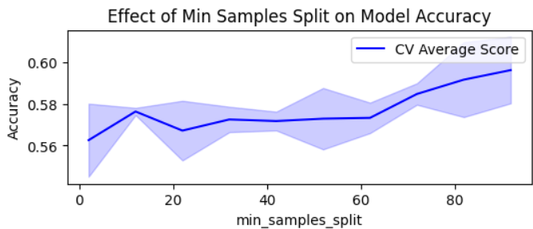
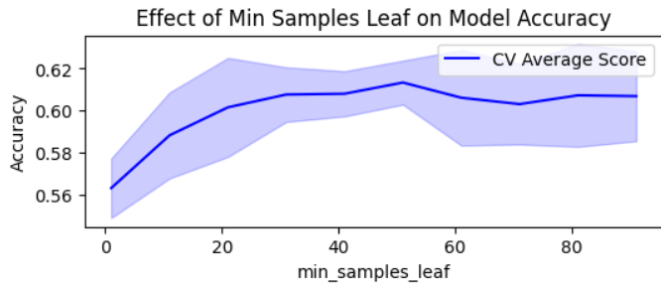
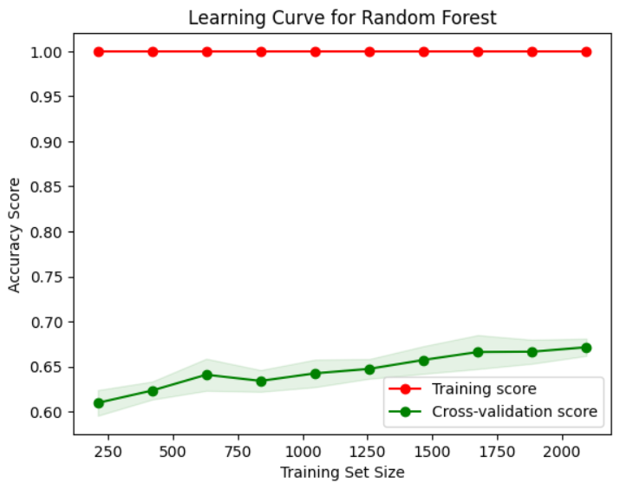
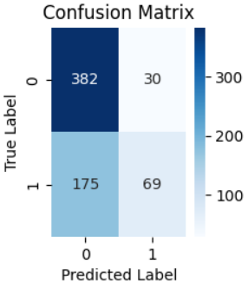
Decision Tree (max_depth,min_samples_leaf,min_split_samples)
Random Forest (estimators, max_depth,min_leaf_split)
Model | Size | Rmse | Mae | F1 Score | Variance | CV Score | Accuracy
DecisionT | 80:20 | 0.59 | 0.35 | 0.54 | 0.05 | 0.62 | 0.64
Model | Size | Rmse | Mae | F1 Score | Variance | CV Score | Accuracy
Rand F | 80:20 | 0.559 | 0.312 | 0.64 | 0.12 | 0.67 | 0.68

Slide 11
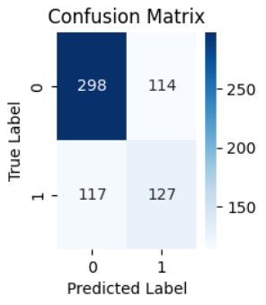
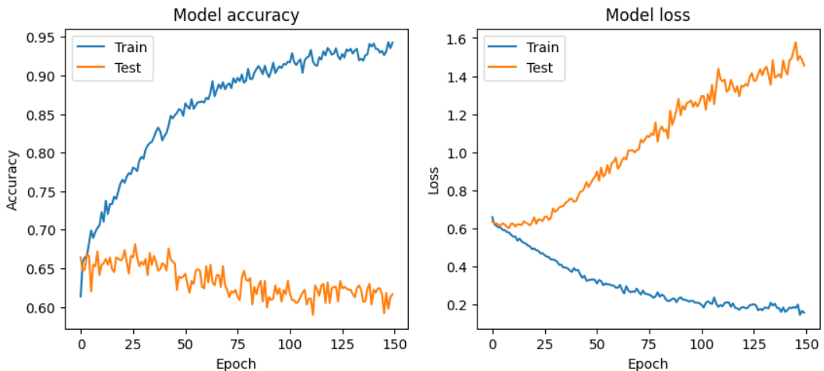
Neural Network
Model | Size | Rmse | Mae | F1 Score | Variance | CV Score | Accuracy
Neural network | 80:20 | 0.59 | 0.35 | 0.64 | 0.23 | 0.66 | 0.68

Slide 12
Compare models
Model | Size | Rmse | Mae | F1 Score(P&R) | Variance | CV Score | Accuracy
Logistic Regression | 80:20 | 0.609 | 0.372 | 0.48 | 0.01 | 0.61 | 0.62
SVM | 80:20 | 0.559 | 0.3125 | 0.6542 | 0.14 | 0.61 | 0.67
Xgboost | 80:20 | 0.58 | 0.63 | 0.65 | 0.11 | 0.65 | 0.66
KNN | 80:20 | 0.59 | 0.35 | 0.61 | 0.15 | 0.63 | 0.64
Decision Tree | 80:20 | 0.59 | 0.35 | 0.54 | 0.05 | 0.62 | 0.64
Random Forest | 80:20 | 0.56 | 0.312 | 0.64 | 0.12 | 0.67 | 0.68
Neural network | 80:20 | 0.59 | 0.35 | 0.64 | 0.23 | 0.66 | 0.67

Slide 13
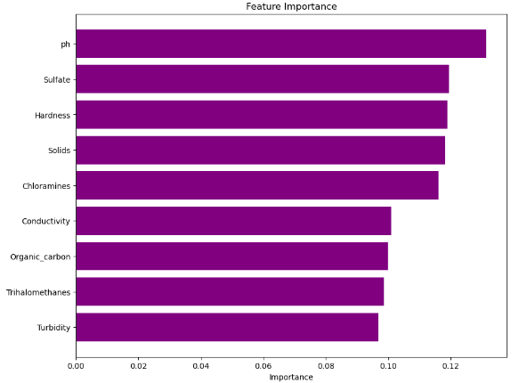
Feature Importance
Feature importance is done with the best model.(Random Forest)
Results:
Found out that PH is more effecting the output parameter Potability.

Slide 14
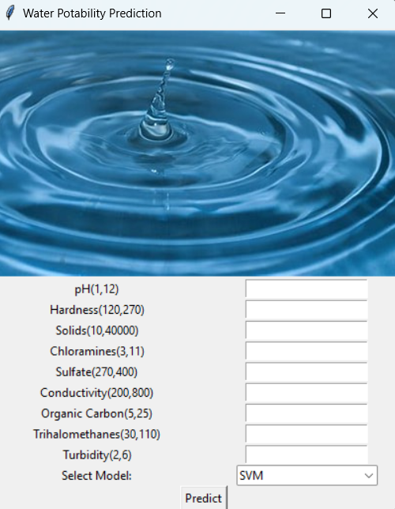
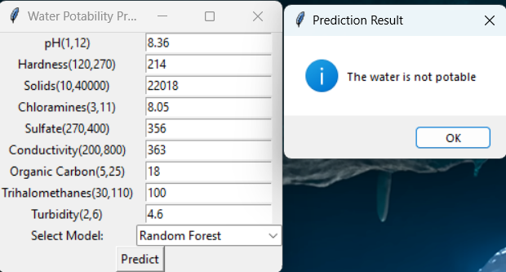
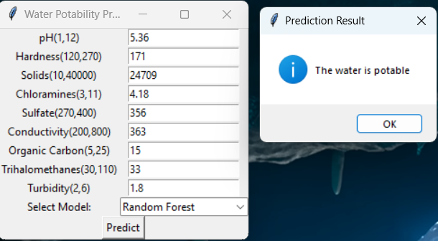
Application
ph | Hardness | Solids | Chloramines | Sulfate | Conductivity | Organic_carbon | Trihalomethanes | Turbidity | Potability
5.361211666 | 171.315543 | 24709.72886 | 4.184890692 | 366.8149789 | 490.658747 | 15.12267225 | 33.1196126 | 1.81252894 | 1
8.316765884 | 214.3733941 | 22018.41744 | 8.059332377 | 356.8861356 | 363.2665162 | 18.4365245 | 100.3416744 | 4.628770537 | 0
Tkinter

Slide 15
Conclusion
Best model: Random Forest
Models overfit: Data imbalance, need more data of positive results.
Feature importance: chemical properties like pH and sulfate levels play a critical role, but factors like hardness, solids, and disinfection also contribute significantly.

