Slide 1
HTML
HTML-hypertext markup language
Author of HTML(Time Berners lee)
Initiaaly HTML was developed to represent document content.
It is used to design webpages using markup.
Its elements are represented by tags.
Extension of HTML file:
html, .htm

Slide 2
Structure of HTML
<!DOCTYPE html>
<html>
<body>
The content of the body element is displayed in your browser.
</body>
</html>
0utput:
The content of the body element is displayed in your browser.

Slide 3
Components of HTML
Elements
Tags
Attributes
1. Elements: Elements represent the content and display.
2.Tags:Tag represents the element.
3.Attribute: Attribute gives additional information.
Types of elements
Block level elements
Inline elements
Empty elements

Slide 4
1.Block level element: Element taking end to end screen width (left to right) is called block level element.
EX: div,table,ui,oi,p…
2.Inline elements: Elements taking width as per the content is called inline element.
EX: <img>,<strong>,<mark>
3.Empty elements: Element represent any content.
Empty elements having only starting tag and no ending tag.
EX: br,hr,img,all input tags

Slide 5
Styles of an elements
Inline style
Internal style
External style
1.Inline style: Adding styles to an element with in the element.
EX: <table =“width:100%”>
2.Internal style: Creating a styles with in the file under by using
internal styles ,we can apply style to an element with in the file.
EX: <style>
Td {
border:ipx solid blue;
}
</style>
3.External style: Creating a separate css file and use/import that

Slide 6
file in the HTML document and using styles.
EX: <link rel =“style sheet” href=“%basic ex.css”>
Web Application
A web application is a software component/program developed
by using web technologies and run on web browser.
Types of Web Application
1. Static web application-HTML,CSS
2. Dynamic web application-HTML,CSS,JS
3. Tier architecture

Slide 7
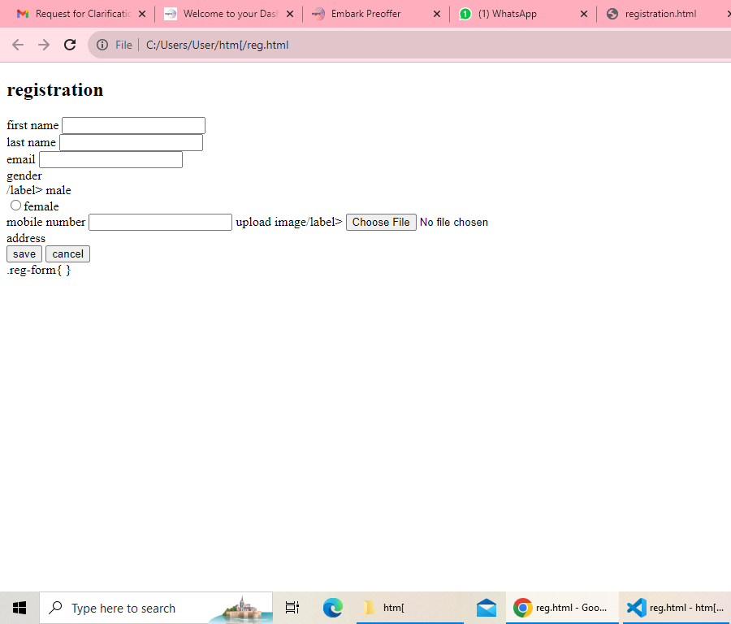
Registration page

Slide 8
Thank you

