Slide 1
Pixelwise Instance Segmentation with Dynamically Instantiated Network
PRATHYUSH AKUNDI (2018701014)
SOWMYA AITHA (2018702007)
TANU SHARMA (2018702012)

Slide 2
Abstract
Instance segmentation system produces a segmentation map where each pixel is assigned an object class and instance identity label using object detector and end-to-end CRF to predict instances.
This is dynamically instantiated to produce variable number of instances per image.

Slide 3
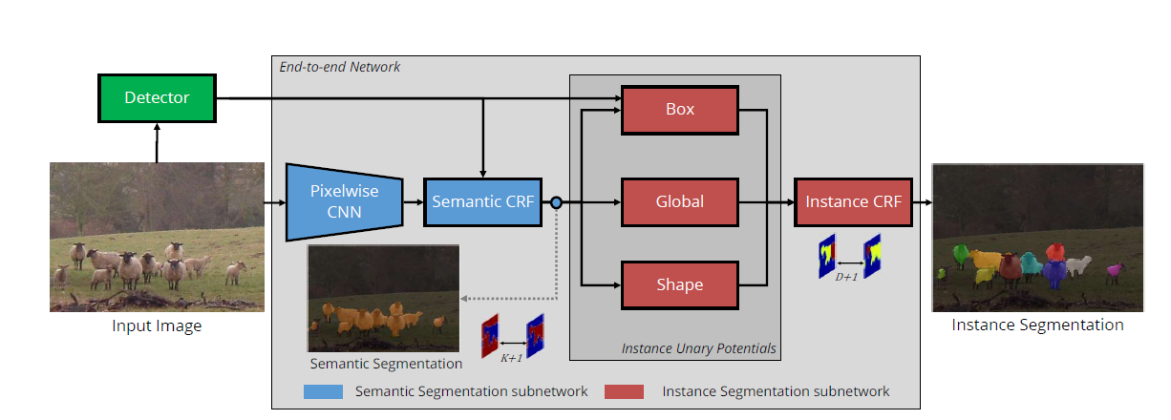
Architecture

Slide 4
TASK DONE
OBJECT DETECTOR
SEMANTIC SEGMENTATION
SHAPE PRIORS(work in progress)

Slide 5
OBJECT DETECTION
Tensorflow Object Detection API
Dataset used for training: MS COCO 2017
Pre-trained MobileNet model
Configurations:
Dropout = 0.8
Regularizer = L2
IOU Threshold = 0.6
Learning rate = 0.004
Momentum = 0.9

Slide 6
SEMANTIC SEGMENTATION
FCN-8 Architecture
Dataset used for training: PASCAL VOC 2011
Used pre-trained weights for the network
Network has 46 layers

Slide 7
SHAPE PRIORS
Dataset used: PASCAL VOC 2011
Generated aspect ratio clusters
Extracted masks for bounding boxes

Slide 8
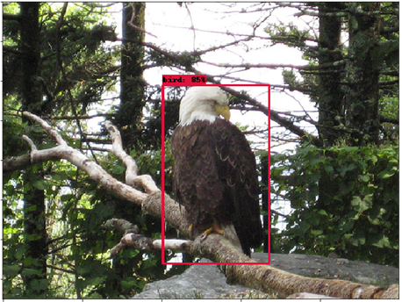
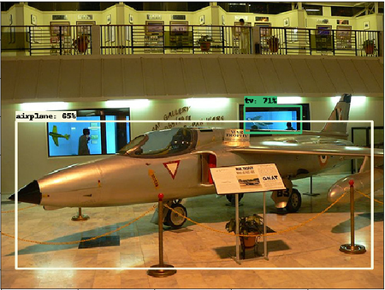
RESULTS (Object Detection)

Slide 9
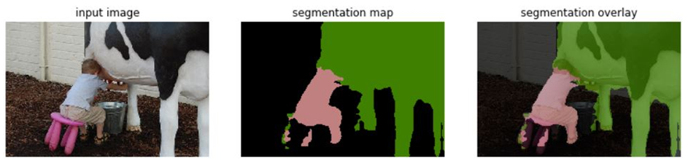
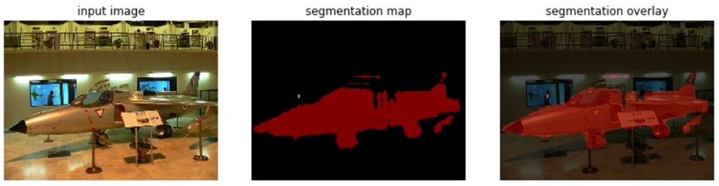
RESULTS(Semantic Segmentation)

Slide 10
TASKS TO BE DONE
Post processing semantic segmentation network with CRFs using CRF as RNN paper
Completing generation of shape priors
Final CRF for instance segmentation subnetwork combining:
Box information
Global information
Shape information

Slide 11
GITHUB LINK
https://github.com/Prathyusha-Akundi/Pixelwise_Instance_Segmentation.git

Slide 12
REFERENCES
A. Arnab and P. H. S. Torr. Pixelwise instance segmentation with a dynamically instantiated network. In CVPR, 2017
S. Zheng, S. Jayasumana, B. Romera-Paredes, V. Vineet, Z. Su, D. Du, C. Huang, and P. Torr. Conditional random fields as recurrent neural networks
D. Weiss and B. Taskar. Scalpel: Segmentation cascades with localized priors and efficient learning

