Slide 1
“DEtection of Dysgraphia and its Severity Assessment in preadolescents using Machine Learning”
BATCH :A-6
INTERNAL GUIDE:
Dr . M. Seetha
Professor in CSE and Dean of R&D cell
V. Rakshitha Reddy --- 20251A0527
G.Prathyusha --- 20251A0540
G.Charishma --- 20251A0541
G.Tharunya varma --- 20251A0542

Slide 2
AGENDA
Introduction
Existing system
Proposed System
Objectives
Methodology
Conclusion

Slide 3
Introduction --What is DYSGRAPHIA??
Dysgraphia is a learning difficulty that affects a person's ability to write.
It is a neurological condition that can impact a person's handwriting, spelling, and ability to put their thoughts on paper and may struggle with organizing their thoughts.
If it can be identified at an early stage, parents and teachers will be able to identify the problem with the child.
The automation can help in recognizing writing by parents and teachers without the help of clinical psychologists.

Slide 4
Characteristics of abnormal handwriting
Poor Handwriting
Slow writing speed
Poor motor skills
Difficulty with spelling and Trouble with grammar.
Inconsistent Spacing
Difficulty with organizing thoughts

Slide 5
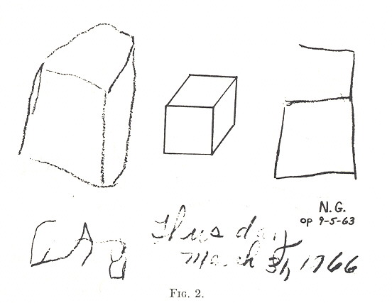
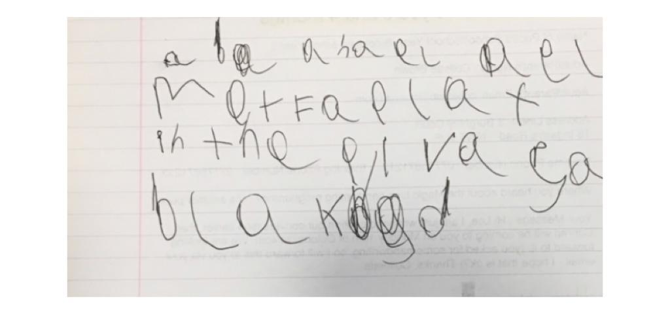
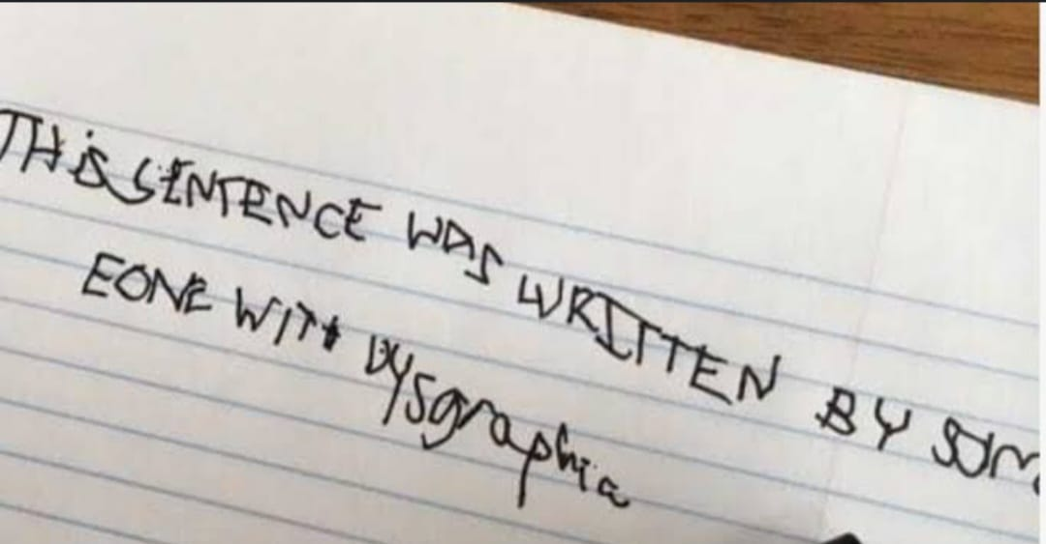
Handwriting Samples to show signs of Dysgraphia

Slide 6
EXISTING SYSTEM
1.Parent and teacher questionnaires: Parent and teacher questionnaires are often used to identify signs of dysgraphia in children. These questionnaires may ask about a child's writing abilities, fine motor skills.
2. Consulting Clinical Psychologists: Psychologists with the help of clinical tests identify whether the child is dysgraphic or non- dysgraphic
3. There are some Machine learning models to detect dysgraphia but those ML models considered the age groups of 7 to 15. During this period there will be drastic change in the development of handwriting, which may not give accurate results.
4. Level of severity of dysgraphia is not concentrated.
5. Limited data samples are available where the dataset is not balanced.

Slide 7
Proposed System
Expansion of dataset for accurate and diverse analysis.
Building the Feature-extraction model.
Using Machine Learning algorithms to analyze large amounts of data by collecting handwriting samples to predict the likelihood of dysgraphia.
Build a user-friendly model to identify dysgraphia in children and also to assess the severity level of dysgraphia.

Slide 8
Objectives
To build standardized dataset to classify abnormal and normal children.
To build feature extraction model to extract significant features .
3. To develop a user friendly interface that can detect dysgraphia and its severity level in children through handwriting analysis using machine learning techniques .
4. To evaluate the performance of the model using suitable metrics in classifying dysgraphic and non dysgraphic.

Slide 9
Literature Survey
Title of the paper | Technology/ Algorithms Used | WorkDone | Limitations
Identification and characterization of learning weakness from drawing analysis at the pre-literacy stage By Linda Greta Dui,Eugenio Lomurno , Cristiano Termine(2022) | Deep learning Models | Comparing several ML algorithms discovered that the best results were achieved by the adaptive boosting algorithm with 80% accuracy. | Focused solely on analyzing children’s drawings,which may not provide a comprehensive picture of their learning weakness.
Acquisition of handwriting in children with and without dysgraphia: A Computational approach by Gargot T,Asselborn T, Pellerin (2020) | Clinical gold standard methods ,Statistical models ,K-means clustering algorithm,elbow method | Identified the best Features ,to diagnose the children with Dysgraphia using BHK,BHK for teenagers, DASH and many other tests. | Didn’t relate Tilt and Pressure digital features to BHK Scores(Quality and Speed)
Automated human level diagnosis of dysgraphia using a consumer tablet by Thibault Asselborn,Thomas Gargot , Wafa Johal (2018) | Ajuriaguerra, BHK tests. Random Forest Algorithm . | Digitilized tablets are used to collect handwriting samples and With the help of Gini importance, 8 most important features seemed to be most important | Used very Limited sample size
Dysgraphia detection through Machine Learning by Peter Drotar and Marek Dobes (2020) | Convolutional Neural Networks (CNN), SVM | Speed, accuracy, quality of their writing features drawn, play write draw app is used | Could not pin point differences between children of different ages

Slide 10
METHODOLOGY
Data preprocessing
Feature Extraction
Handwriting dataset
Prediction Model
Test Sample
Data preprocessing
Writing Disability
And its severity level
Normal

Slide 11
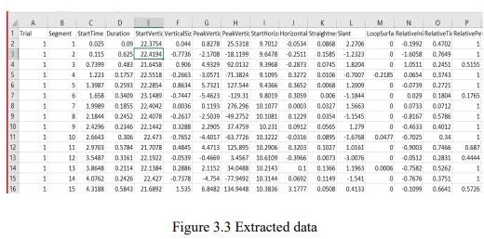
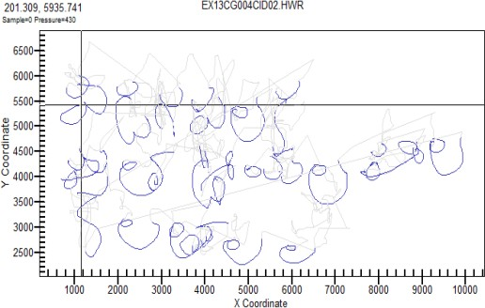
Before Data Preprocessing
Data is collected using the graphical tablet and processed it to extract various features from the handwriting data. Extracted data is numerical data in tabular form which has various features extracted by from the handwriting that counts down to 32 features.

Slide 12
Data Preprocessing
Preprocessing of time-series data to discrete data is done through technique called equal frequency distribution to make the data suitable to apply machine learning algorithms.
Equal frequency discretization divides the data into intervals with an equal number of observations, which can be useful when the data is skewed or has outliers.
This technique ensures that each bin contains approximately the same number of observations, which can help to minimize the impact of outliers or unusual datapoints.

Slide 13
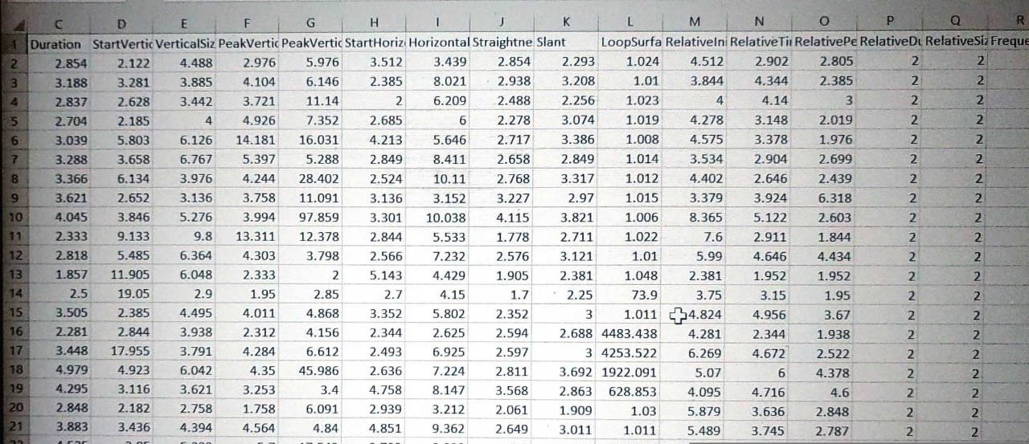
After Preprocessing

Slide 14
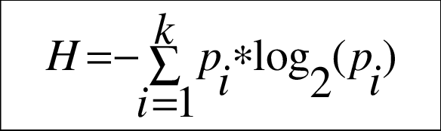
Feature Extraction Model
Information Gain – It is the amount of information provided by the feature for identifying the target value and measures reduction in the entropy values. Information gain of each attribute is calculated considering the target values for feature selection.
Features with higher Information Gain are considered more important and are often selected for use in classification tasks.
Information Gain provides a ranking of features based on their relevance to the target variable.
This ranking can be useful for selecting a subset of the most informative features where this method is considered as appropriate and effective in the case of handwriting analysis.

Slide 15
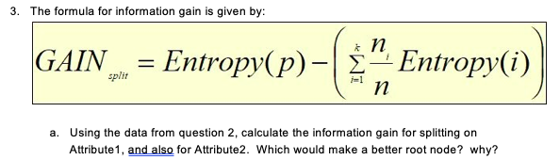
Information Gain is calculated by the following formula:

Slide 16
Significant Features
StartTime
Duration
StartVerticalPosition
VerticalSize
PeakVerticalVelocity
PeakVerticalAcceleration
StartHorizontalPosition
HorizontalSize
StraightnessError
Slant
LoopSurface

Slide 17
Results
Raw data is processed and features are extracted using movalyzer software.
Data is pre-processed so that it is suitable to build the machine learning model.
Features are reduced by analysing and understanding the significance of each of them in detecting the dysgraphia using information gain technique.
Machine learning techniques are applied to classify normal and abnormal handwriting.

Slide 18
conclusion
In conclusion, the development of a dysgraphia detection system is a significant step towards early diagnosis and intervention for individuals with writing difficulties.
This developed system can aid the educators and healthcare professionals in identifying dysgraphia, leading to timely support and improved learning outcomes for affected individuals.

Slide 19

Thank you

