Slide 1
Lightweight CNN for Image Classification with Preprocessing, Augmentation, and Feature Visualization
Presented by:
Bala Nithin Chennarapu ( A04342051)
Prathyusha Pentam (A04342934)
Madhusudhan poduturu (A04346304)

Slide 2
scheme
Introduction & Problem Statement
Motivation and Real-World Relevance
Objectives and Scope of the Project
Dataset Overview (CIFAR-10 Subset)
Data Split & Folder Structure
Preprocessing: CLAHE and Normalization
Data Augmentation Pipeline
Proposed Lightweight CNN Architecture
Implementation Flow (End-to-End Pipeline)
Training Setup & Hyperparameters
Callbacks & Regularization Strategy
Results: Training & Validation Curves
Results: Test Metrics (Accuracy, Precision, Recall, F1)
Confusion Matrix & Class-wise Performance
Feature Map Visualizations & Interpretability
Discussion: Insights & Observations
Challenges & Limitations
Future Work & Conclusion

Slide 3
Introduction
In this project, we work with small color images of everyday objects like cars, planes, animals, etc.
These images are very small (32×32 pixels), so the details are not very clear.
Some images also have low contrast or poor lighting, which makes them harder to recognize.
We use a 10,000-image subset instead of the full dataset, so we have limited data to train on.
With fewer images and low-quality visuals, it becomes difficult to correctly classify all objects.
Our main idea is to improve the image quality first and then use a simple, lightweight model to classify them into 10 classes.
To do this, we
Enhance contrast using CLAHE,
Normalize the images,
Apply data augmentation to create more variations,
And then train a compact CNN model for classification.

Slide 4
Why did we choose this project?
real world
Motivation
In real life, we usually don’t have very large datasets or powerful GPUs. Instead, we often work with small, low-quality images that have low contrast, noise, and poor lighting. When we directly use a regular deep CNN on this type of data, the model can easily overfit, training becomes unstable, and test accuracy remains low, even if we spend a long time training.
In a classroom or lab environment, we therefore need a method that is simple to understand, fast to train, and still able to give reasonable accuracy. This motivates us to design a lightweight and practical pipeline that can handle limited data and limited resources effectively.
Many small companies, colleges, and research groups usually work with limited data, limited hardware, and simple image collections that are not very high quality. They cannot always use very deep or heavy models that need a lot of memory and powerful GPUs.
Our pipeline gives a practical way to handle this situation. We first improve image quality using CLAHE and normalization, then increase data variety using data augmentation, and finally use a CNN that can run on normal machines. The same idea can be applied to other small or noisy datasets, such as basic medical images, simple CCTV footage, or student/lab projects, making this project a realistic model.

Slide 5
Objectives of the
Project
Design a lightweight CNN
Create a compact CNN architecture with fewer parameters so that it trains quickly but can still handle CIFAR-10 style images.
Improve image quality before training
Use CLAHE and normalization to enhance contrast and make important structures in the images more visible to the network.
Increase data diversity
Apply data augmentation (random flips, small rotations, translations, zooms) to reduce overfitting and make the model more robust.
Evaluate and understand the model
Test the model on a separate test set and measure accuracy, precision, recall, and F1-score, and visualize feature maps to see what the CNN is learning.
Our goal is to build a simple, complete pipeline that can classify CIFAR-10 images effectively using limited data and limited resources.

Slide 6
Dataset Overview
We use the CIFAR-10 image dataset.
It contains small color images of everyday objects like
airplane, car, bird, cat, dog, frog, horse, ship, truck, deer.
Each image is 32 × 32 pixels, with 3 color channels (RGB).
For our project, we do not use the full dataset.
We work with a subset of 10,000 images.
All 10 classes are included and balanced.
We split this subset into:
7,000 images for training
1,500 images for validation
1,500 images for testing
This setup keeps training manageable,
while still making the classification task challenging because of
the small size and quality of the images.

Slide 7
Preprocessing
In this project, every image in the CIFAR-10 subset is passed through a preprocessing pipeline before being used for training. The main goal of this step is to improve the visual quality of the images so that the CNN can learn more meaningful patterns from them.
First, we apply CLAHE (Contrast Limited Adaptive Histogram Equalization) to each image. CLAHE enhances local contrast in small regions of the image, which helps to bring out important edges, textures and object details, especially in low-contrast or unevenly lit areas. This makes features like boundaries and shapes more visible to the model.
After contrast enhancement, we perform normalization on the pixel values. The images are scaled to a suitable numerical range (for example [0, 1] or standardized using mean and standard deviation), so that all channels are on a similar scale. This step stabilizes training, helps the optimizer converge faster, and generally improves the overall performance of the CNN.

Slide 8
Data Augmentation Pipeline
In our project, we apply data augmentation only to the training images after preprocessing. The main idea is to show the model slightly different versions of the same image in each epoch so that it does not simply memorize them. We use random horizontal flips, small rotations, shifts and zooms to change the position, angle and scale of the images while keeping the same class label.
By doing this, we increase the effective size and diversity of our 10,000-image dataset and make the CNN more robust. As a result, the model learns more general patterns and shows better performance on the validation and test sets, with reduced overfitting.

Slide 9
CNN Architecture
Layer-wise Summary
Block 1
Conv2D (e.g., 32 filters, 3×3, ReLU)
Batch Normalization
MaxPooling2D
Block 2
Conv2D (e.g., 64 filters, 3×3, ReLU)
Batch Normalization
MaxPooling2D
Block 3
Conv2D (e.g., 128 filters, 3×3, ReLU)
Batch Normalization
GlobalAveragePooling2D
Classifier Head
Dense (e.g., 128 units, ReLU) + Dropout
Dense (10 units, softmax) → class probabilities
Block 1 learns very low-level features such as edges and simple textures using a Conv2D layer, Batch Normalization and MaxPooling2D.
Block 2 builds on this and captures mid-level patterns (corners, small parts of objects) with more filters, again followed by Batch Normalization and MaxPooling2D.
Block 3 extracts higher-level features and shapes using even more filters,and then applies GlobalAveragePooling2D to compress each feature map into a single value, reducing parameters.
The Classifier Head takes these compressed features, passes them through a Dense + ReLU + Dropout layer for regularization, and finally a Dense (10, softmax) layer that outputs the probabilities for the 10 CIFAR-10 classes.

Slide 10
Training Setup & Hyperparameters
Training Data
Model is trained on the preprocessed + augmented CIFAR-10 subset.
Train: 7,000 images Validation: 1,500 images
Loss Function
Categorical Cross-Entropy
Used for multi-class classification with 10 classes.
Measures how well the predicted probability distribution matches the true labels.
Optimizer
Adam optimizer
Learning rate 0.001
Adaptive updates for each parameter → faster and smoother convergence than plain SGD.
Epochs and Batch Size
Batch size: 32 images per update
Maximum epochs: 30
Model can stop earlier if validation performance stops improving.
Learning Rate Scheduler
ReduceLROnPlateau
Monitors validation loss.
If it does not improve for a few epochs, the learning rate is reduced to allow finer updates.
Early Stopping & Best Model
EarlyStopping
Stops training when validation loss stops improving for several epochs.
Helps to avoid overfitting.
ModelCheckpoint
Saves the best model weights based on validation loss.

Slide 11
Training & Validation Curves
Training loss decreases steadily across epochs, showing that the model is learning patterns from the training data.
Validation loss is higher than training loss and shows small fluctuations after some point, which indicates mild overfitting but still stable learning.
At the beginning, both training and validation accuracy are low, close to random.
As epochs increase, training accuracy keeps rising and reaches around 60%, while validation accuracy increases and stabilizes around ~45–50%.
After a certain number of epochs, validation accuracy does not improve much, meaning the model has reached its current capacity with this data and setup.
Graph Analysis
The curves show that the model is well-fitted to the training data, but its generalization on unseen data is limited because of the small dataset size and lightweight architecture.
Performance could be improved by more data, stronger regularization, or further tuning of hyperparameters (e.g., learning rate, augmentation strength, extra dropout).
The loss and accuracy graphs are generated in our training code using Matplotlib and saved as an image (e.g., training_metrics.png) and then added to the PPT.

Slide 12
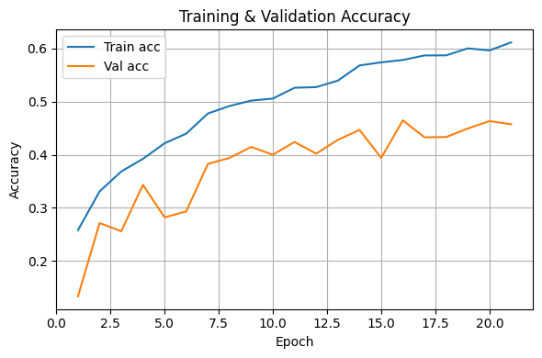
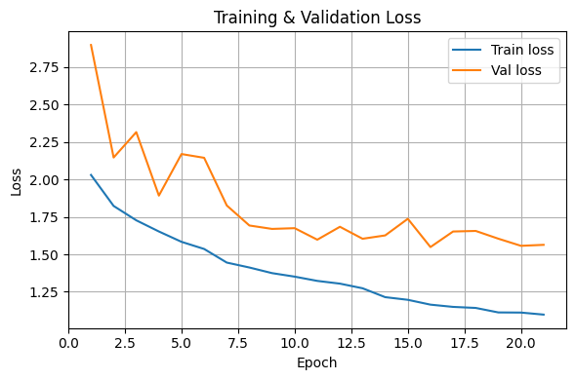

Slide 13
Test Performance
On the held-out test set of 1,500 images, our lightweight CNN achieves a test loss of about 1.48 and a test accuracy of around 48.9%.
This means the model correctly classifies roughly half of the test images, which is reasonable for a small, noisy dataset and a compact architecture.
The macro precision is about 53.9%, showing that when the model predicts a class, it is correct a little more than half the time on average.
The macro recall is about 48.9% and the macro F1-score is around 48.0%, indicating that the model detects roughly half of the samples in each class correctly.
The gap between training and test performance suggests that there is still some overfitting and that the model’s generalization ability is limited by dataset size and image quality.
These results could be improved further by using more data, adding stronger regularization, or fine-tuning the architecture and hyperparameters.

Slide 14
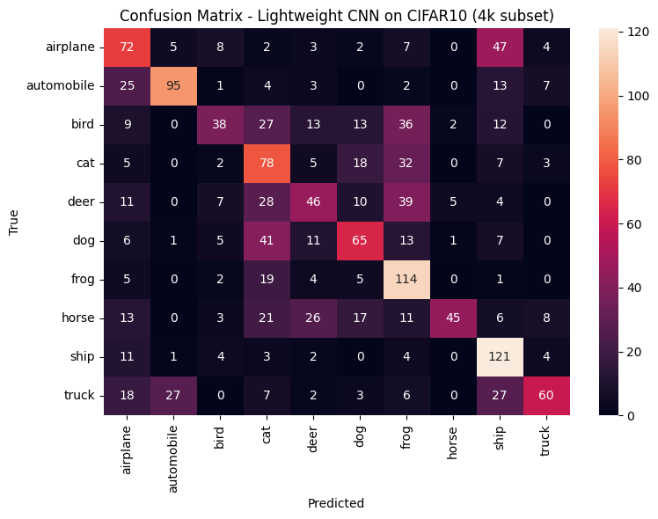
Class-wise Performance & Confusion Matrix
Automobile has strong performance with high precision and good recall, meaning the model predicts this class reliably.
Ship shows very high recall but moderate precision, so the model detects most ships but sometimes labels other objects as ships.
Truck also has high precision, indicating that when the model predicts truck, it is usually correct.
Frog has high recall but only moderate precision, so the model rarely misses frogs but wrongly calls some other images frog.
Bird is difficult for the model, with low recall, meaning many bird images are misclassified as other classes.
Cat has moderate precision and recall,and is often confused with dog and other animal classes.
Horse shows very high precision but low recall, so predicted horses are mostly correct, but many real horse images are missed.
The confusion matrix reveals typical mistakes such as airplanes being confused with ships and animals (cat, dog, deer, bird) being confused with each other.
Overall, the model classifies vehicle classes better than animal classes, showing that small, low-resolution animal images are more challenging for this lightweight CNN.

Slide 15
Feature Map Visualization & Interpretability
We visualized feature maps from different convolutional layers to understand what the CNN is learning at each stage.
In the first convolutional layer, the feature maps mostly highlight simple edges, color changes and basic textures, showing that the network is focusing on low-level patterns.
In the middle layers, the feature maps start to capture more complex shapes and parts of objects, such as curves, corners and small regions of animals or vehicles.
In the deeper convolutional layers, the activations become more abstract, responding to larger object parts or combined patterns, although some maps look sparse because the images are small and the model is lightweight.
These visualizations help us “open the black box” and check whether the network is focusing on meaningful structures (like object regions) or just background noise.
Overall, the feature maps confirm that our model is learning a hierarchy of features from simple edges to more complex patterns, which supports the interpretability aspect of the project.

Slide 16
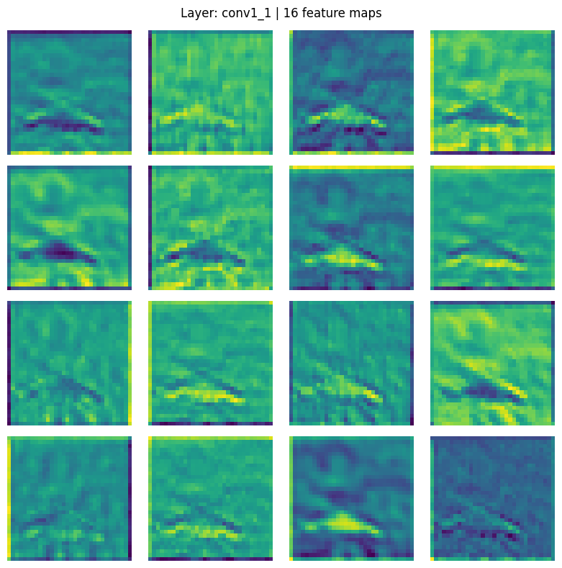
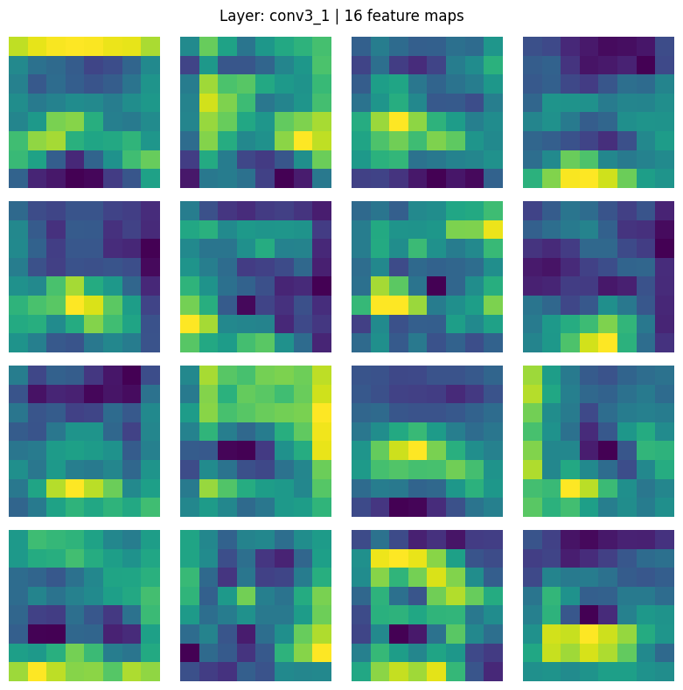
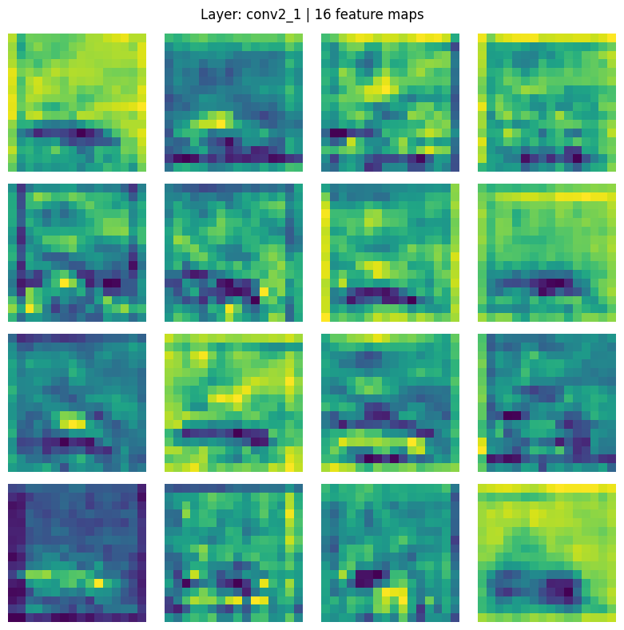

Slide 17
Insights
Observations
Preprocessing helps: CLAHE + normalization made small 32×32 images clearer, so the CNN could learn better edges and structures.
Augmentation is important: Flips, rotations, shifts and zooms reduced overfitting and improved robustness with only 10,000 images.
Lightweight CNN is enough: A small CNN with few blocks and global average pooling gave reasonable performance without heavy models.
Vehicles vs. animals: Vehicle classes (car, truck, ship) were easier to classify than animal classes, which are low-resolution and look similar.
Limited generalization: The gap between training and test results shows that small dataset size and low resolution still restrict generalization.
More interpretable: Feature map visualizations showed a clear hierarchy from edges to shapes, making the model easier to understand.
Training loss goes down smoothly, but validation loss stays higher and wiggles a bit → mild overfitting.
Training accuracy reaches ~60%, while validation/test stay ~45–49% → clear gap between seen and unseen data.
The model classifies vehicles better than animals; animal classes (cat, dog, bird, deer) are often confused due to low-res, similar images.
Frog and ship have high recall but lower precision, so they are found often but also over-predicted.
Feature maps show a clear hierarchy: early layers learn edges, deeper layers learn larger shapes, even in this lightweight CNN.

Slide 18
Challenges & Limitations
We worked with a small subset of 10,000 images instead of the full 60,000 CIFAR-10 images, which limits how well the model can learn and generalize.
CIFAR-10 images are very low resolution (32×32), so many fine details of objects and animals are lost, making classification harder.
Some classes, especially animals (cat, dog, bird, deer), are visually similar and noisy, which leads to more confusion and misclassifications.
Our model is a lightweight CNN, so it has fewer parameters and less capacity compared to deeper architectures; this restricts the maximum achievable accuracy.
Due to time and resource limits, we could not perform extensive hyperparameter tuning (e.g., many different learning rates, architectures, or regularization settings).
We only trained and evaluated one main pipeline (CLAHE + augmentation + single CNN); we did not compare against other models or preprocessing methods as baselines.

Slide 19
Try
Try a slightly deeper / improved CNN while keeping it lightweight.
Do
Do more hyperparameter tuning (learning rate, dropout, augmentation).
Use
Use a larger subset or full CIFAR-10 to reduce overfitting.
Compare
Compare with other models as baselines in future.
Future Work
We built a complete pipeline for CIFAR-10 subset classification using CLAHE, normalization, data augmentation, and a lightweight CNN.
The model achieved around 49% test accuracy on a 10,000-image subset, which is reasonable for low-resolution and noisy images with limited data.
Results show that preprocessing and augmentation are crucial when working with small datasets and simple models.
Overall, the project demonstrates that a simple, interpretable and efficient CNN pipeline can still perform well in resource-constrained, small-data scenarios, and can be extended or improved in future work.
Conclusion

Slide 20
THANK YOU

