Slide 1

Risk Prediction Following Surgery Using Machine Learning Algorithms
By
Prathyusha Mandagani
Chair of the Supervisory Committee
Professor Martine De Cock
Professor Senjuti Basu Roy
Professor Ankur Teredesai

Slide 2
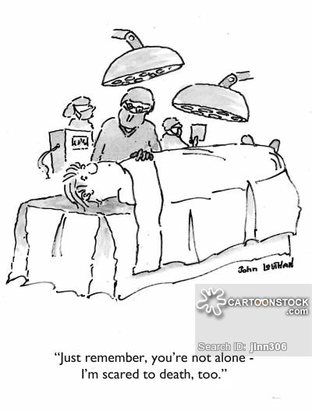
Surgical Complications Introduction:
Surgical complications are associated with excess cost and ultimately lower profit margins for hospitals­.
The surgical complications are the most common reason for the patient’s readmissions to the hospitals.
Objective:
Using machine learning, to construct a predictive model for identification of high-risk patients susceptible to Surgical complications following surgery, based on patients medical information provided.

Slide 3
Summary
 | SORCE Project from UW Medicine | AMIA KDDM 2016 Competition
Goal | Predicting the risk of adverse events following a surgery in patients with multiple chronic conditions | Predicting the risk of surgical site infections following a surgery based on patients blood tests results history
Dataset | Truven Health MarketScan Research Database | a benchmark patient dataset of the University Hospital of North Norway
Models Applied | Naïve Bayes, Ada boost | Logistic regression, Decision trees, Ada boost
Best Results | AUC: 79% (Naïve Bayes) | AUC: 86% (Ada boost)
Papers (Under review) | Improved Risk Prediction Following Surgery Using Machine Learning Algorithms, by Anne P. Ehlers, MD MPH; Senjuti Basu Roy, PhD; Sara Khor, MS; Prathyusha Mandagani; Moushumi Maria; Rafael Alfonso-Cristancho, MD MSc PhD; David R Flum, MD MPH | Machine Learning Models for Surgical Site Infection Prediction, by Prathyusha Mandagani, Shaun Coleman, Anam Zahid Annie Pugel Ehlers, Senjuti Basu Roy, Martine De Cock (Stood 2nd in the competition)

Slide 4
Demo (Built on the SORCE project)
http://mcs1.insttech.washington.edu:8888/

Slide 5
Acknowledgement
I would like to express gratitude to Prof.Martine, my capstone committee chair, for the immense help and guidance through out the project.
I would like to acknowledge Prof.Senjuti Basu Roy, Prof.Ankur Teredesai, Committee members, for the encouragement and guidance.
I THANK YOU ALL

