Slide 1
Building Machine Learning Models to Predict Future Frequent Users of Emergency Departments
By
Vikhyati Singh
Committee Members
Professor Martine De Cock (Chair )
Professor Ankur Teredesai
David Hazel
Dr Shanu Sushmita

Slide 2
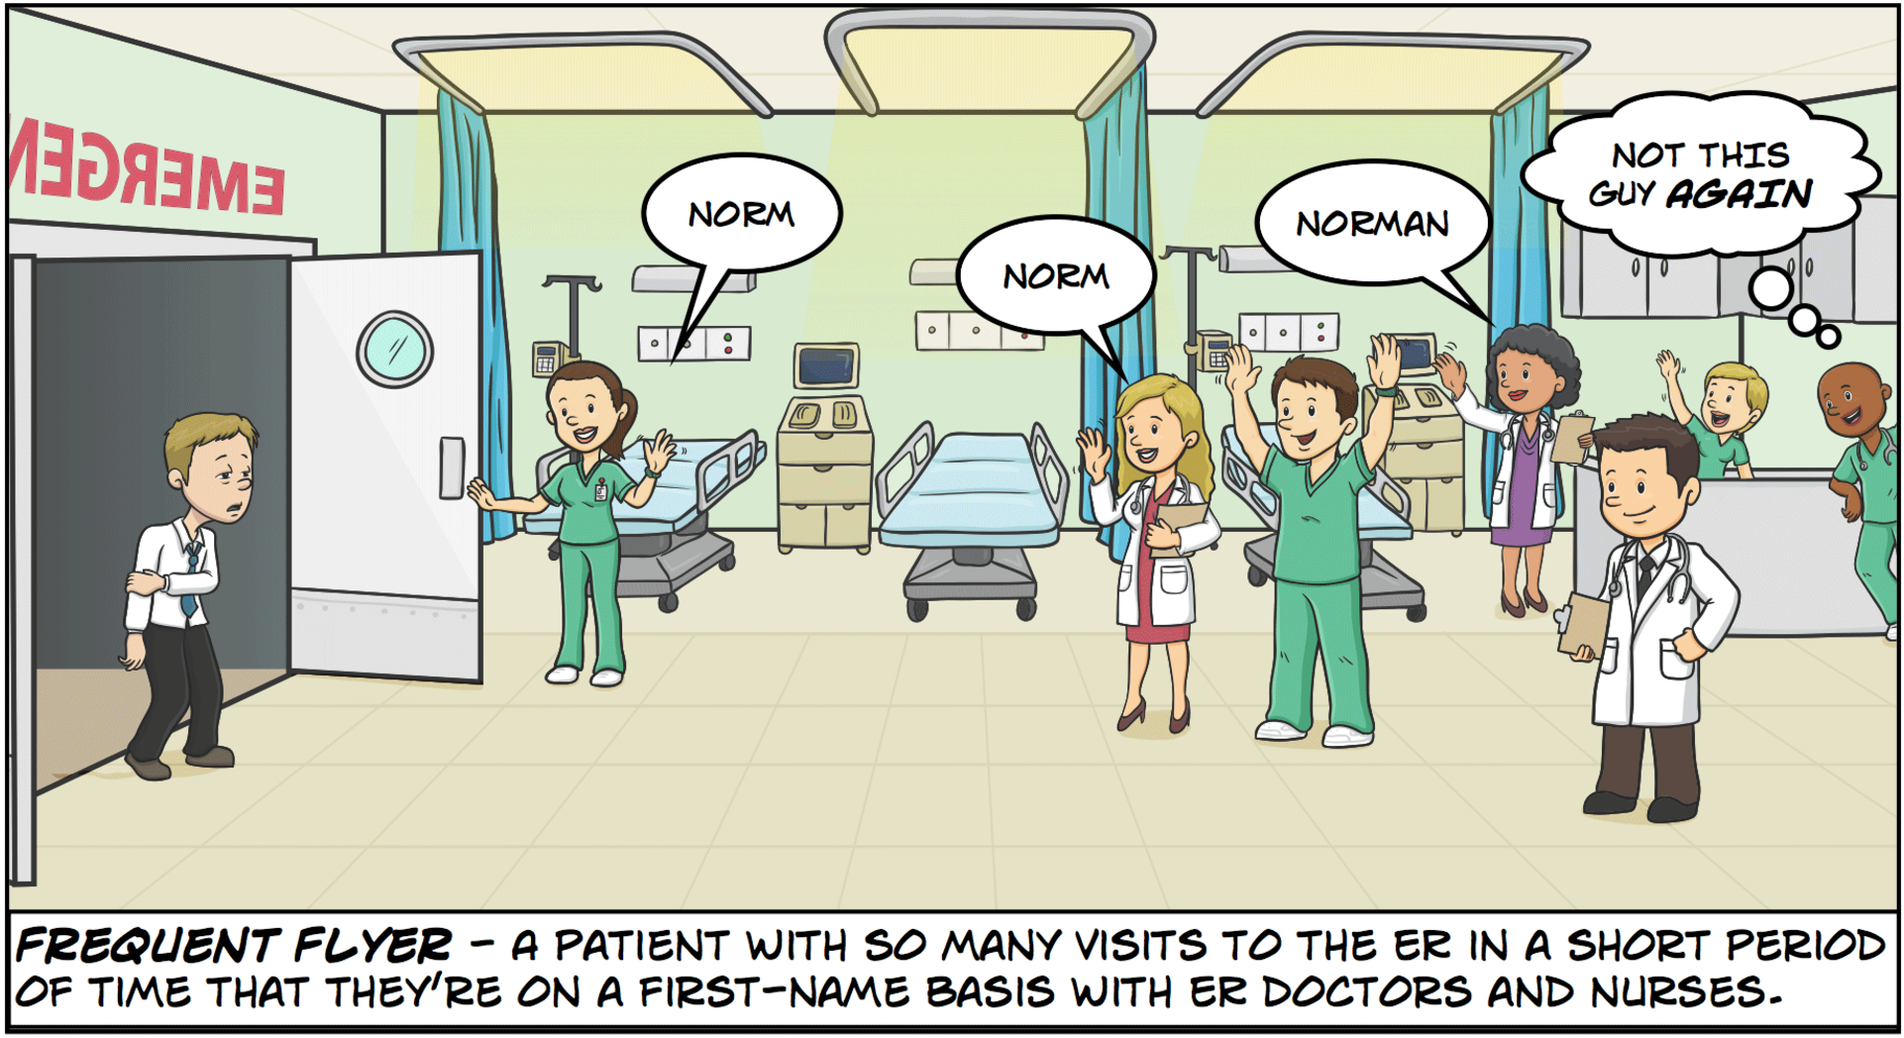
Introduction:

Slide 3
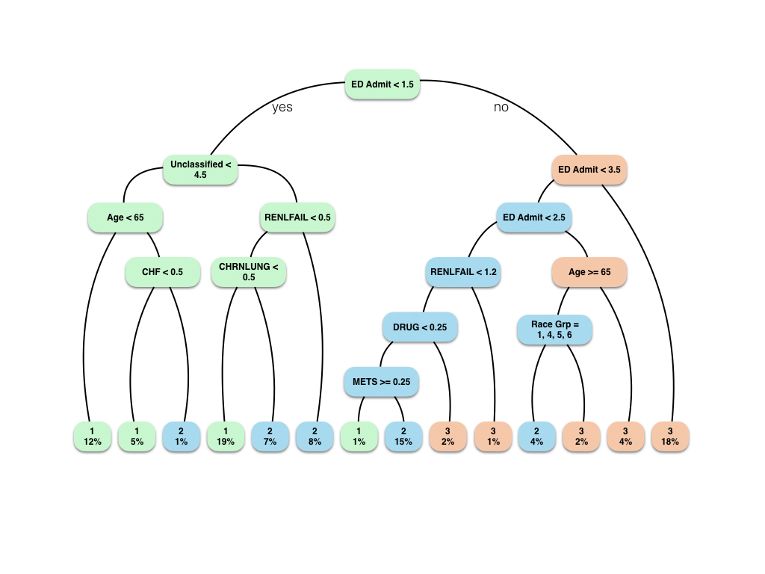
Methods:
Decision Trees, Logistic regression, AdaBoost

Slide 4
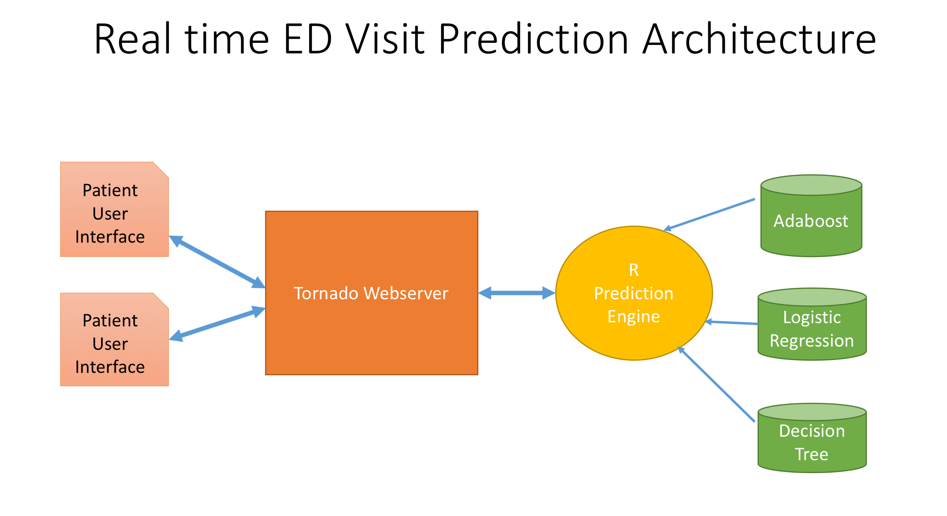
Deliverables:
We also published a paper at the ACM BCB Workshop on Methods and Applications in Healthcare Analytics, 2016.
https://sites.google.com/site/feiwang03/acm-bcb-workshop-on-healthcare-analytics
Demo
http://mcs1.insttech.washington.edu:8888/

Slide 5
THANK YOU

