Slide 1
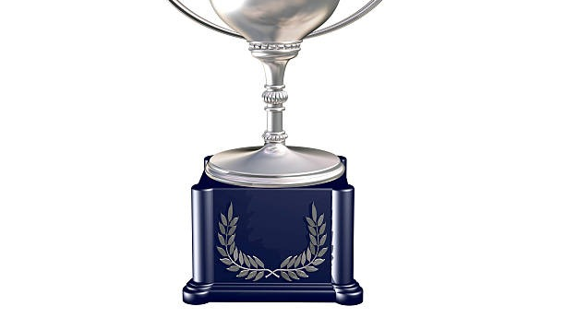
Award PREDICTION WITH NEURAL NETWORKS USING PYSPARK

Slide 2
GROUP 12 TEAM MEMBERS
Jasvitha Allamsetty 11556820
Ram Prathyusha Gangisetty 11709718
Nikhitha Thakur 11711027
Alivene Satholu 11626247
Sai nikitha ponnathota 11645469

Slide 3
Motivation
Introduction
Technical part
PySpark
Workflow of the approach
Methodologies used
Challenges encountered
Analysis on the results
Advantages and disadvantages
Applications
Conclusion
OUTLINE

Slide 4
Motivation
Problem statement
We examine the connection between industry trends, awards recognition, and critical acclaim using a condensed dataset in this study. In addition to offering insightful commentary to conversations about inclusivity, diversity, and representation in the film business, our goal is to create predictive models for Oscar winners.

Slide 5


Motivation
Problem statement
We examine the connection between industry trends, awards recognition, and critical acclaim using a condensed dataset in this study. In addition to offering insightful commentary to conversations about inclusivity, diversity, and representation in the film business, our goal is to create predictive models for Oscar winners.

Slide 6

Introduction
The Oscars, also known as the Academy Awards, represent the pinnacle of achievement in the film industry, covering prestigious categories such as Best Picture, Best Director, and Best Actor/Actress. With an extensive history spanning nearly a century, these awards have evolved into a cultural phenomenon, captivating millions of viewers annually. Administered by the Academy of Motion Picture Arts and Sciences (AMPAS), the Oscars celebrate excellence in filmmaking on a global scale.
Despite conducting an exhaustive search, we were unable to locate a comprehensive dataset encompassing nominees and winners from 1927 to 2020, inclusive of gender and ethnicity data. In order to explore diversity within the Academy Awards, we have compiled a simplified dataset from Kaggle, although it lacks racial and gender information. Nevertheless, this dataset still offers valuable insights into the diverse landscape of the Oscars.
Our study aims to delve into the relationship between critical acclaim, awards recognition, and industry trends. To achieve this, we employ predictive models to forecast award winners. By doing so, we seek to enhance our understanding of the dynamic factors that shape cinematic recognition.

Slide 7
Technical Part
Approach
Data Ingestion
Managing Missing Values
Feature Development
Neural Network Model Definition
Model Instruction
Model Assessment
Contribution
Working on a new dataset – The dataset is downloaded from Kaggle and the accuracy of the model is evaluated based on the metrics.

Slide 8
PySpark
Apache PySpark is an open-source distributed computing framework.
It's built on Apache Spark and designed for efficient big data processing.
PySpark leverages the Python programming language and offers a high-level API.
This high-level API seamlessly integrates with Spark's distributed computing capabilities.
It's particularly well-suited for parallel and distributed tasks, such as data cleaning and analysis.
Developers find it convenient for handling large-scale datasets.
PySpark supports various data sources, including Hadoop Distributed File System (HDFS) and Apache Hive.
As a result, it's a popular choice among organizations seeking scalable solutions for big data processing.

Slide 9
Workflow of the approach
Data Ingestion: We read data from the CSV file "/content/FinalDS.csv“ using SparkSession.builder.findOrCreate, creating a Spark DataFrame.
Managing Missing Values: The 'Winner' column is addressed by filling in missing values with 0, ensuring data completeness.
Feature Development: Categorical columns ('Award,' 'Name,' 'Film') undergo indexing and one-hot encoding using Spark ML transformers. Numeric columns ('Year' and 'Ceremony') remain unaltered. VectorAssembler combines features into a vector, and StandardScaler standardizes them.

Slide 10
Workflow of the approach - Contd
Neural Network Model Definition: We define a Multilayer Perceptron with a specific architecture (four layers: input, two hidden, and output) and set up a Spark ML pipeline for feature modifications.
Model Instruction: The Multilayer Perceptron serves as the classifier, fitting the model to the training data.
Model Assessment: Predictions are generated for the test data, and a multiclass classification evaluator is employed to assess model precision on the test dataset.

Slide 11
Methodologies Used
Neural Network Model with Pyspark
Data Loading and Preprocessing
StringIndexer and OneHotEncoder
VectorAssembler
StandardScaler
Neural Network Classification
MultilayerPerceptronClassifier
MulticlassClassificationEvaluator
Hyperparameter Tuning
ParamGridBuilder
Final Model Evaluation

Slide 12
Methodologies Used
Neural Network Model with Pyspark
Data Loading and Preprocessing
StringIndexer and OneHotEncoder
VectorAssembler
StandardScaler
Neural Network Classification
MultilayerPerceptronClassifier
MulticlassClassificationEvaluator
Hyperparameter Tuning
ParamGridBuilder
Final Model Evaluation

Slide 13
Methodologies Used - Contd
Data Loading and Preprocessing: Data is loaded and preprocessed, including steps like StringIndexer and OneHotEncoder for categorical variables, VectorAssembler for feature combination, and StandardScaler for feature scaling.
Neural Network Classification: A Multilayer Perceptron Classifier is used for classification tasks.
Multiclass Classification Evaluator: A MulticlassClassificationEvaluator is employed to assess model performance.

Slide 14
Methodologies Used- Contd
Hyperparameter Tuning: Hyperparameter tuning is conducted using ParamGridBuilder.
Cross-Validation: k-fold cross-validation is performed to evaluate model performance across different data subsets.
Final Model Evaluation: The final neural network model's performance using PySpark is assessed.

Slide 15

Challenges encountered
Data Gaps: Incomplete or inconsistent historical match data can hinder model training.
Overfitting: Models may perform well on training data but poorly on unseen data.
Many Features: Processing numerous features stats can complicate computations.
Feature Selection: Deciding on the most predictive stats can be challenging.
Model Interpretability: Complex models may be hard to understand or justify.
Data Bias: Skewed data can lead to biased predictions.

Slide 16

Analysis on the results:
Accuracy: Compare the accuracy scores. Higher accuracy indicates better general performance.
Precision, Recall, F1 Score: In scenarios where one class is more important (e.g., predicting a win for a team), these metrics might be more informative than mere accuracy.

Slide 17

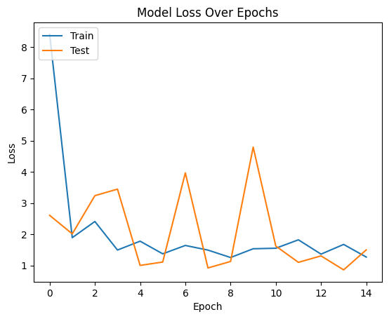
Analysis on the results- Contd

Slide 18
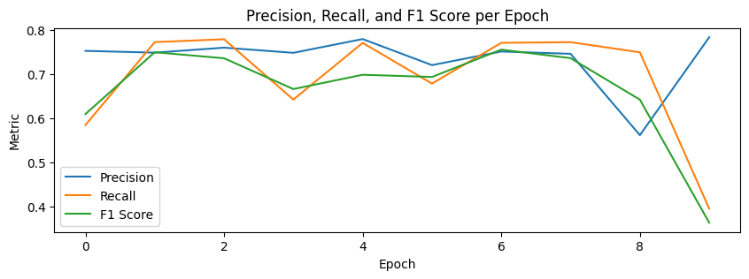

Slide 19
Advantages
Diverse Dimensions of Academy Awards Dataset:Abundant opportunities for diverse research on gender, color, and ethnicity.Tailored analysis of various characteristics beyond prize prediction.
Feature Analysis:Identifying primary demographic variables impacting nominations and wins.Examining the influence of race or gender on award outcomes.
Efficient Data Execution:Well-organized dataset with defined variables.Supports complex analyses and longitudinal studies due to extensive time span.

Slide 20
DISADVANTAGES
Restricted Dataset:The dataset's limits are its main drawback.Lack of gender and race information for nominations and winners.Limits the depth of diversity analysis within the Academy Awards.
Data Collection Challenges:Complex and time-consuming data compilation from 1927 to 2015.Potential gaps and errors in the dataset may compromise analysis validity.
Partial Diversity Picture:Exclusion of gender and race data limits comprehensive insights.Difficulty drawing significant conclusions about equity and representation.

Slide 21
Applications
Natural Language Processing:Language processing is a subset of artificial intelligence that focuses on the interaction between computers and human languages.
Image Recognition:The ability of computers to detect and categorize items inside digital photos is known as image recognition.
Clinical Diagnostics:Medical diagnostics is the process of identifying and diagnosing diseases or problems in patients using medical data.

Slide 22

Conclusion
Techniques Used: We employed classification methods, including Multilayer Perceptron, OneHotEncoder, Standard Scaler, and StringIndexer.
Optimization: We optimized a PySpark MLP classifier using cross-validation, achieving an impressive 81.78% test set accuracy.
Training Progress: The model continuously improved during training, with decreasing loss and stable precision, recall, and F1 score (72-75%) around the sixth epoch.
Methodology Summary: Our systematic approach, involving advanced algorithms, preprocessing, and hyperparameter tuning, resulted in a reliable prediction model.
Validation: High test set accuracy validates our methodology, providing a strong foundation for future research in advanced machine learning applications.

