Slide 1

LOAN APPROVAL PREDICTION
Team 12
Prathyusha Gangisetty
Siri Ranabothu
Kusuma Kumari Dama
Dharam Singh Vislavath
Divya Sai Sri Murugudu
Manoj Kumar Unnam

Slide 2

AGENDA
Motivation
Challenges
Technical Part
Experimental Results
Conclusion

Slide 3

MOTIVATION
Problem:
Banks need to make quick accurate fair loan approval decisions. Traditional models like Logistic Regression Random Forest followed by SVM can handle structured data but often overlook complex relationships among variables.
This can result in increase in approval of loans that later default or unnecessary rejections of potentially good loans. Accurately predicting loan approvals was essential to reduce risk enhance profitability improve customer satisfaction.
It’s Importance:
Improving accuracy of loan approval predictions was crucial because it impacts bank’s profitability followed by risk management. more accurate prediction model reduces likelihood of default thus saving banks from potential losses.
Additionally reliable prediction system can streamline loan process providing customers with quicker responses enhancing their experience.

Slide 4
MOTIVATION(contd.)
Existing Research:
Previous studies have applied traditional machine learning algorithms such as Logistic Regression ;SVM to predict loan approvals.
These models perform reasonably well with structured data but struggle with complex relationships between variables.
More recent research has explored XGBoost classifier; Graph Neural Networks (GNNs) for loan prediction.
XGBoost known for handling structured data with imbalanced classes then GNNs which capture relational data patterns have shown promise in achieving higher accuracy.

Slide 5
MOTIVATION(contd.)
Challenge:
Despite advancements challenges remain in creating loan approval model that can both accurately predict outcomes interpret complex relational data.
Traditional models lack transparency making it difficult for banks to trust predictions. Furthermore dealing with imbalanced data where approved loans outnumber rejections poses additional challenges.
This project aims to overcome these obstacles by integrating advanced machine learning techniques including XGBoost ;GNNs to capture both individual relational data patterns effectively.
Additionally using Orange tool will enable easy data processing involving model visualization making prediction process more intuitive accessible for non-technical stakeholders.

Slide 6
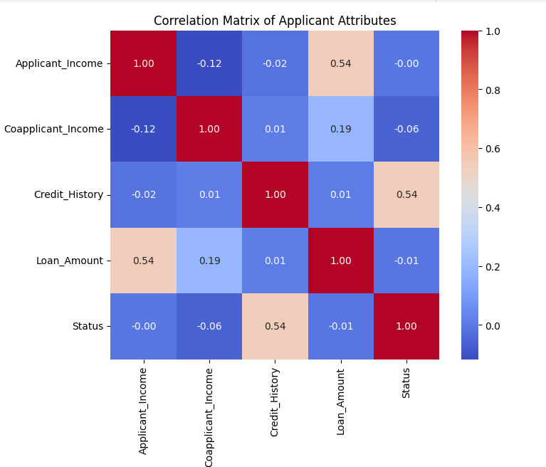
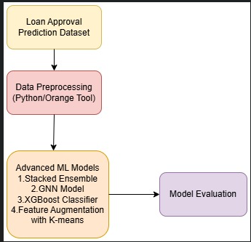
Motivation Illustration

Slide 7
CHALLENGES
Literature Review:
Traditional machine learning models like Logistic Regression SVM ; Random Forest were widely used for loan approval prediction.
Limitations: While effective on structured data these models fall short in capturing complex relationships between applicants co-applicants financial indicators.
Examples: Logistic Regression assumes linear relationships; Random Forest struggles with feature interactions.
Loan approval prediction based on machine learning approach
This paper proposes applied traditional machine learning models (Logistic Regression, Random Forest, SVM) for structured loan data by showing reasonable accuracy.
Prediction of loan approval using machine learning
This paper demonstrated effectiveness of XGBoost for handling structured; imbalanced data in loan predictions; outperforming conventional models.

Slide 8
CHALLENGES(contd.)
Why Traditional Methodologies Don’t Work
Complex Relationships: Standard models can’t capture dependencies between applicants such as co-applicant’s influence on credit risk.
Overfitting Risks: These models overfit structured data reducing generalization on new varied applicant profiles.
Imbalanced Data Challenge: Loan datasets were often approval-heavy leading to biased predictions for minority classes (denied loans).
Advanced Techniques to Address Challenges
XGBoost Classifier : Effective for structured data; handles missing values; complex decision boundaries offering robust performance.
Graph Neural Networks (GNNs): Models relationships among features capturing dependencies between applicants and financial activities.
Orange Tool: Provides visual tools for data preprocessing; feature engineering streamlining model experimentation.

Slide 9
TECHNICAL PART
Structured Workflow for Model Development
Data Preprocessing: For handling missing values ; apply label encoding ; engineer features for more informative inputs.
Model Selection & Evaluation: Evaluate multiple models including XGBoost ;Stacked Ensemble of tree-based models Graph Neural Networks (GNN) to determine optimal performance.
Deployment: Build user-friendly app using Streamlit; deploy with Ngrok to provide real-time loan approval predictions.
Integration of Orange Tool: Leverage Orange data mining tool for visual intuitive implementation of XGBoost facilitating model testing feature analysis

Slide 10
TECHNICAL PART(contd.)
Unique Combination of Techniques
Stacked Ensemble: Combines various tree-based models that increasing accuracy and robustness by leveraging strengths across models.
Feature Augmentation with K-Means: Incorporates clustering to create new features that capture hidden data patterns enhancing predictive power of XGBoost.
Graph Neural Networks (GNN): Captures complex relationships between features then provide versatile solution for structured data with relational dependencies.

Slide 11
TECHNICAL PART(contd.)
Implementation of XGBoost Using Orange Tool:
Overview: Orange data mining tool was utilized to implement evaluate XGBoost classifier for loan approval prediction. This visual tool enables efficient data preprocessing;model testing and analysis through intuitive drag-and-drop interface.
Data Preprocessing: Missing values were handled and relevant features were selected for training. This process ensures that dataset was prepared for robust modeling.
Model Configuration: Gradient Boosting widget in Orange was configured with 100 trees learning rate of 0.01 to optimize performance. This setup harnesses power of XGBoost to handle structured data with complex decision boundaries.
Evaluation: Model was evaluated based on metrics like AUC, precision, recall and F1 score. Results indicated high-performance level with AUC score of 0.835 showcasing model's effectiveness in predicting loan approvals accurately.
Benefits: Using Orange provides user-friendly environment for non-technical users to understand interact with machine learning models;making model testing feature analysis more accessible.

Slide 12
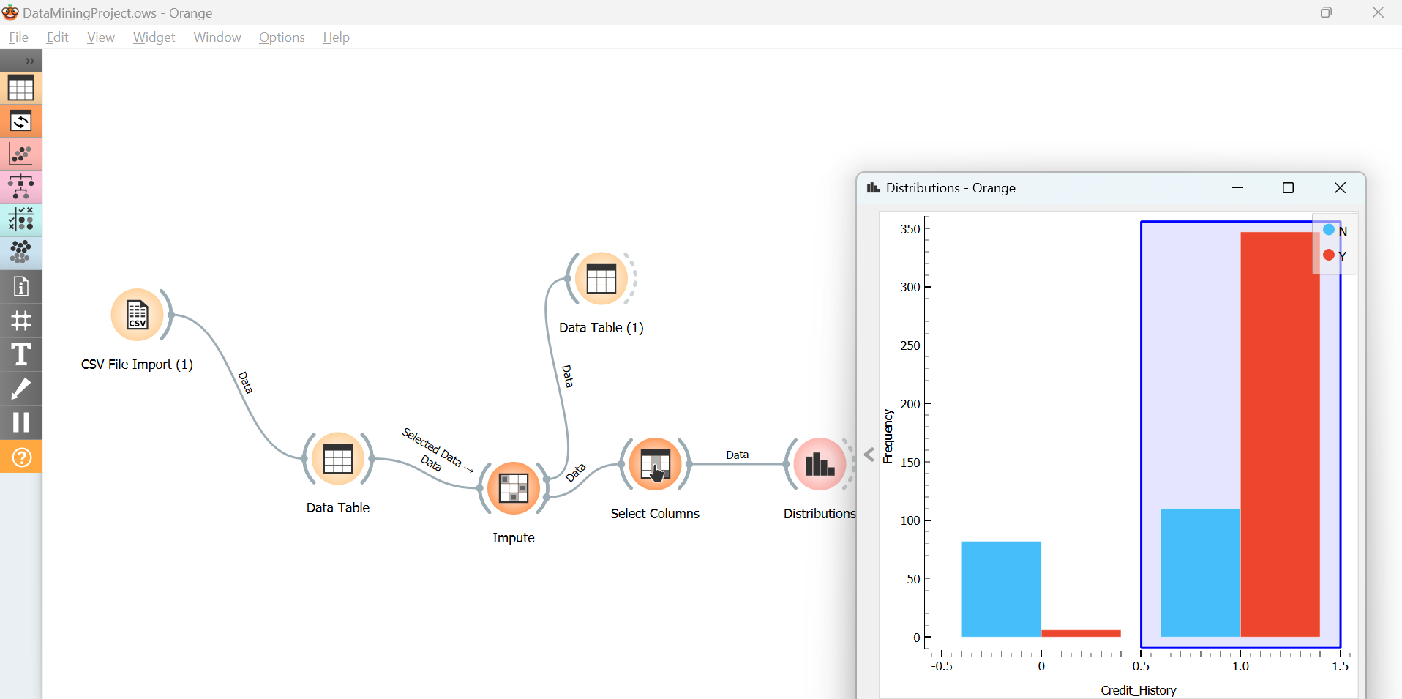
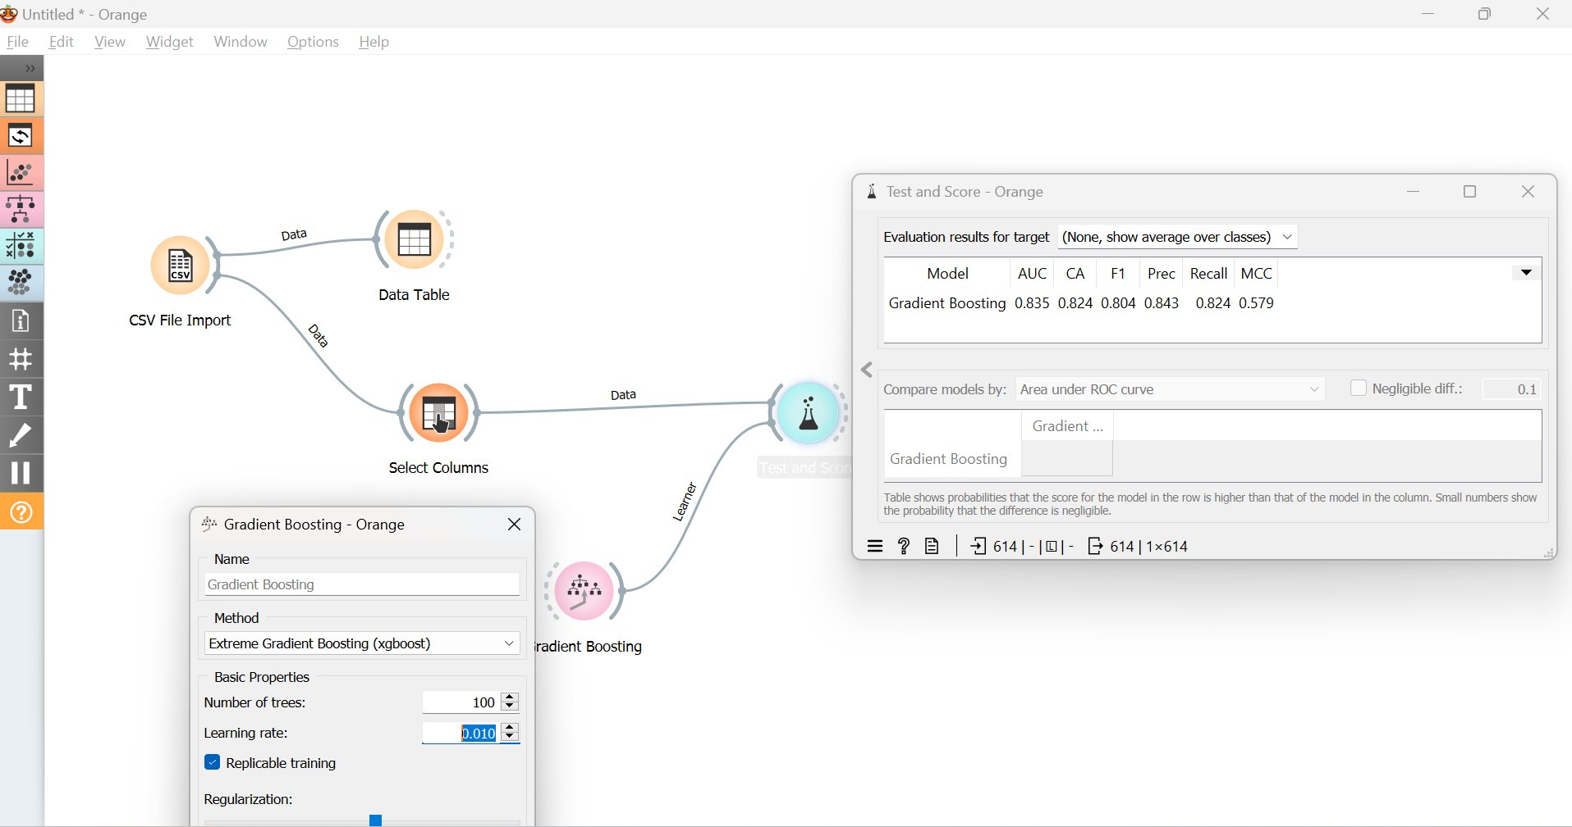
Illustrations on the Approach

Slide 13
EXPERIMENTAL RESULTS
XGBoost Algorithm: Robust gradient-boosting algorithm that builds ensemble of decision trees to enhance prediction accuracy minimize overfitting.
Performance: Achieved accuracy of 0.7901 with balanced precision of 0.8364 recall of 0.8683 demonstrating its effectiveness for loan approval prediction.
Advantage: XGBoost's ability to handle complex decision boundaries missing data makes it suitable for structured loan datasets improving overall model reliability.
GNN Model: Designed for graph-based data GNNs capture dependencies relationships ideal for structured relational data like loan applications with multiple applicants financial ties.
Performance:Accuracy of 0.8130 slightly outperforming XGBoost highlighting its strength in understanding relational patterns complex interactions among applicant features.
Insight: GNN’s capacity to model interconnected data offers valuable advantage in predicting loan approvals with intricate dependencies.

Slide 14
EXPERIMENTAL RESULTS(contd.)
Stacked Ensemble & Feature Augmentation:
Stacked Ensemble: Combines Decision Trees Random Forest XGBoost enhancing accuracy robustness. Performance metrics: Accuracy of 0.8455 followed by ROC AUC of 0.8517
Feature Augmentation with K-Means: Clusters applicants into groups adding these as new features to XGBoost resulting in highest ROC AUC of 0.8588 followed by Accuracy of 0.8455.

Slide 15
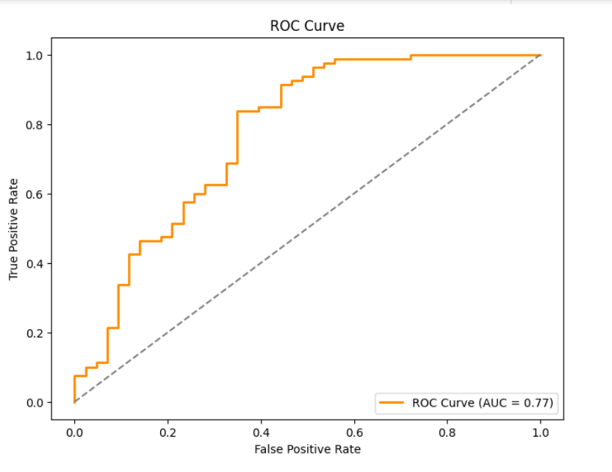
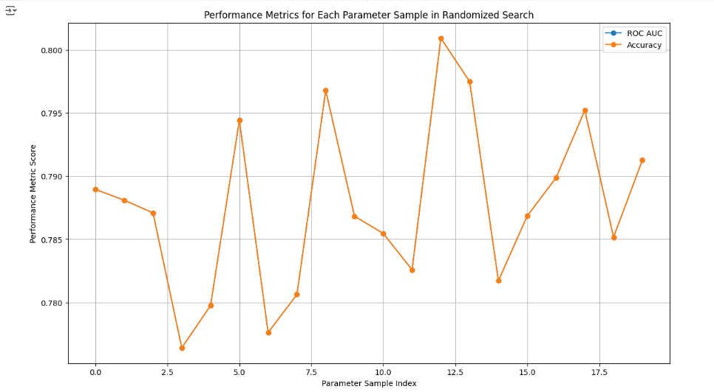
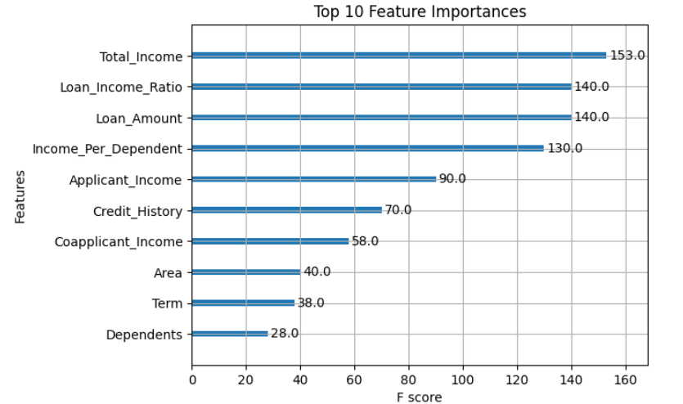
EXPERIMENTAL RESULTS(contd.)

Slide 16
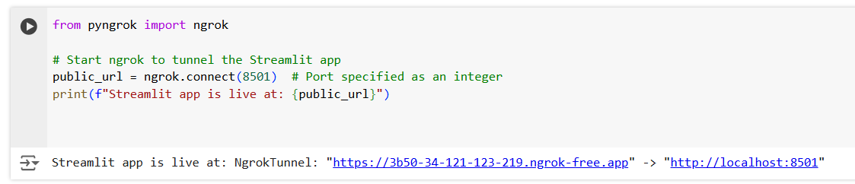
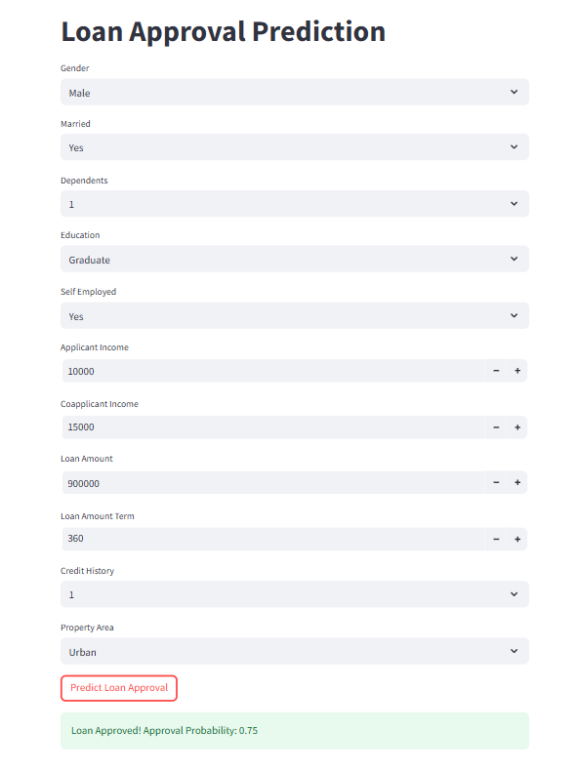
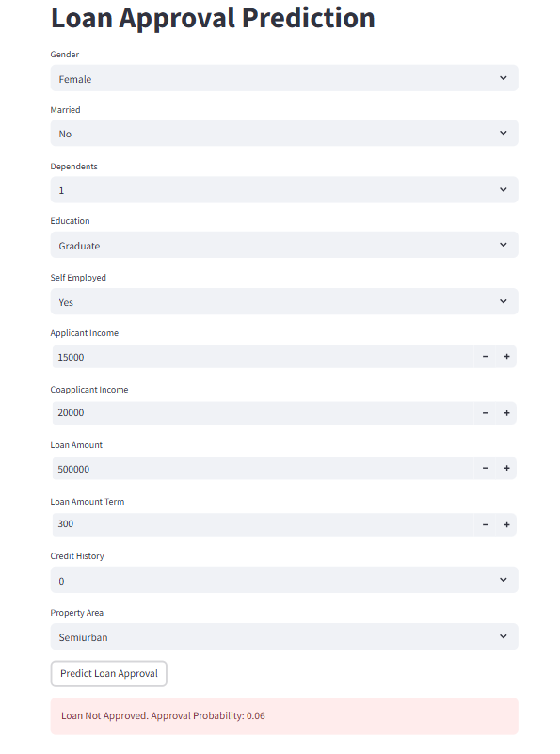
EXPERIMENTAL RESULTS(contd.)

Slide 17
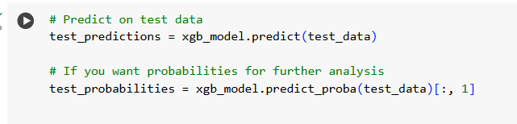
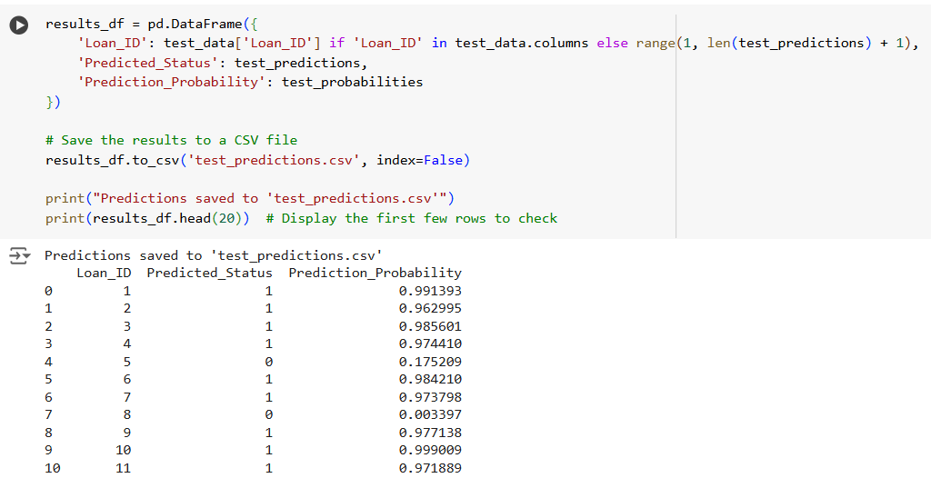
EXPERIMENTAL RESULTS(contd.)

Slide 18
CONCLUSION
Main Takeaways
Advanced machine learning techniques such as XGBoost feature augmentation; integration of Orange data mining tool significantly improve accuracy of loan approval predictions.
Using model combinations like stacked ensembles alongside clustering-based feature engineering enhances predictive power model robustness making predictions more reliable.
Key Insights
Proper data preprocessing and thoughtful feature engineering were essential to achieve accurate dependable predictions in loan approval scenarios.
Orange data mining tool offers intuitive visual interface that simplifies implementation evaluation of complex machine learning models making advanced analysis accessible to users with varying technical backgrounds.
User-friendly real-time application for loan approvals demonstrates practical value of machine learning in finance facilitating quicker data-driven decisions that benefit both institutions applicants.

Slide 19
Team Member Roles and Contributions
Member Name | Role | Contribution
Prathyusha Gangisetty | ML Engineer | Training ML Models, Documentation
Siri Ranabothu | Data Engineer | Data Preprocessing
Kusuma Kumari Dama | Data Engineer | Orange tool Integration
Dharam Singh Vislavath | ML Engineer | Visualization
Divya Sai Sri Murugudu | ML Engineer | Training ML models
Manoj Kumar Unnam | ML Engineer | Documentation

Slide 20

THANK YOU…

