Slide 1
“PREDICTION OF CHRONIC KIDNEY DISEASE-A MACHINE LEARNING PERSPECTIVE”
D.SOWMYA(18121A1521)
G.RAM PRATHYUSHA(18121A1530)
K.SUMITHRA BHARADWAJ(18121A1540)
Under the Guidance of
DR. A.BALASUBRAMANI,
Professor & Head Dept. of CSSE, SVEC
Problem Statement:
To predict the CKD using ML algorithms-LSVM ,Deep Neural Network with SMOTE feature selection technique.

Slide 2
ABSTRACT
A Chronic Kidney Disease(CKD) is a disease that is persistent.Machine learning technique has become reliable for medical treatment with which the doctor can detect the disease on time.For the process of CKD prediction, a few classifier algorithms have been applied on the dataset such as ANN, logistic regression, linear support vector machine with penalty L1& L2 and random tree. In order to make correct predictions whether it is CKD or not CKD, the proposed work considers the most accuracy rate outcome algorithm computed based on SMOTE with full features.In company with machine learning models one deep neural network has been applied on the same dataset and it has been noticed that deep neural network gives better accuracy.From the extracted results, it is also marked that even LSVM is giving better accuracy in synthetic minority over-sampling technique with full features. In this proposed work, out of all the classifier algorithms, the deep neural network and support vector machine with SMOTE technique are considered and will be implemented to predict the CKD.

Slide 3
LITERATURE SURVEY
“Detection of Chronic Kidney Disease Using Machine Learning Algorithms with Least Number of Predictors “
In this work, the aim is to test the ability of machine learning algorithms for the prediction of chronic kidney disease using the smallest subset of features.
Several statistical tests have been done to remove redundant features such as the ANOVA test, the Pearson’s correlation, and the Cramer’s V test.
Logistic regression, support vector machines, random forest, and gradient boosting algorithms have been trained and tested using 10-fold cross-validation.

Slide 4
“Analysis and Prediction of Chronic Kidney Disease”
Classification algorithms are provided with the ability to manage missing and noisy values.
To find a suitable response for this problem, we tested other classification algorithms, such as Logistic Regression, Random Forest and Neural Networks.
We used two methods to conduct feature reduction,Wrapper Method and LASSO Regularisation, they helped in removing over fitting as well as to identify the most significant predictive attributes for CKD.

Slide 5
“Chronic Kidney Disease Analysis is Using Data Mining Classification Techniques”.
Data mining is the process of extracting hidden information from massive dataset, categorizing valid and unique patterns in data.
There are many data mining techniques like clustering, classification, association analysis, regression etc.
The objective of the paper is to predict Chronic Kidney Disease (CKD) using classification techniques like Naive Bayes and Artificial Neural Network (ANN).

Slide 6
“Comparative Study of Classifier for Chronic Kidney Disease Prediction Using Naive Bayes, KNN and Random Forest”
Chronic Kidney disease defines constrains which affects your kidneys and reduces your potential to stay healthy.
Machine learning is an important task as it benefits many applications, varied knowledge mining classification approaches and machine learning algorithms are applied for prediction of chronic diseases.
Therefore, this paper examines the performance of Naive Bayes, K-Nearest Neighbor (KNN) and Random Forest classifier on the basis of its accuracy, preciseness and execution time for CKD prediction.
Finally, the outcome after conducted research is that the performance of Random Forest classifier is finest than Naive Bayes and KNN

Slide 7
EXISTING SYSTEM
Machine Learning algorithms like Random forest, SVM,naïve bayes classifier,K-nearest neighbour were performed on the CKD dataset.
Different feature selection techniques are used on the dataset.
They are : 1.Wrapper method.
2.Pearson Correlation method.
3.LASSO regression.

Slide 8
LIMITATIONS
Wrapper method:
1.High computational cost.
2.Risk of overfitting more computationally increased with increased number of features.
Pearson Correlation:
1.Correlation doesn’t demonstrate cause-and effect
2.Time consuming and don’t determine what variables have the most influence.
LASSO Regression:
1. If there are two or more highly collinear variables then lasso regression will select one of them randomly which is not a good technique in data interpretation.

Slide 9
PROPOSED SYSTEM
ML algorithms shows better results with SMOTE feature selecting technique.
In those algorithm SVM and deep neural network gave the highest accuracy.
SMOTE:[Synthetic Minority Over Sampling Technique]
The SMOTE algorithm works as follows:
Draw a random sample from the minority class.For the observations in the sample,identify the k nearest neighbors.
Then take one of those neighbors and identify the vector between the current data point and the selected neighbor.
Multiply the vector by a random number between 0 and 1.
To obtain the synthetic data point, add this to the current data point.
Make sure that synthetic data point is not an exact copy of an existing data point while making sure that it is also not too different from the known observations in minority class.

Slide 10
The confusion matrix is a machine learning metric that shows the number of:
True positives (the model correctly predicted true)
False positives (the model incorrectly predicted true)
True negatives (the model correctly predicted false)
False negatives (the model incorrectly predicted false)
Precision vs. Recall:
Precision means how well a model succeeds in identifying ONLY positive cases. Recall means how well a model succeeds in identifying ALL the positive cases within the data.
When machine learning is used for automating business processes, false negatives (positives that are predicted as negative) will not show up anywhere and will probably never be detected, whereas false positives (negatives that are wrongly predicted as positive) will generally be filtered out quite easily in later manual checks that many businesses have in place.

Slide 11
MODULE DESCRIPTION
NumPy:
NumPy is a Python package. It stands for 'Numerical Python'.
A library consisting of multidimensional array objects and a collection of routines for processing those arrays
Pandas:
Pandas Functions for Data Analysis and Manipulation.
It provides many functions and methods to speed up the data analysis.
Matplotlib:
It helps to understand the huge amount of data through different visualisations

Slide 12
Tensor Flow :
An open-source end-to-end platform for creating Machine Learning applications.
A symbolic math library that uses dataflow and differentiable programming to perform various tasks focused on inference of deep neural networks.
Keras :
A deep learning API written in Python, running on top of the machine learning platform TensorFlow.
It was developed with a focus on enabling fast experimentation.
Optimizer :
A function or an algorithm that modifies the attributes of the neural network, such as weights and learning rate.
It helps in reducing the overall loss and improve the accuracy.

Slide 13
Sequencial model
The core idea of Sequential API is simply arranging the Keras layers in a sequential order .
Most of the ANN also has layers in sequential order and the data flows from one layer to another layer in the given order until the data finally reaches the output layer.
Dense layers
The dense layer is a neural network layer that is connected deeply, which means each neuron in the dense layer receives input from all neurons of its previous layer. The dense layer is found to be the most commonly used layer in the models.
Scikit-Learn
A python library to implement machine learning models and statistical modeling.
Various machine learning models for regression, classification, clustering, and statistical tools for analyzing these models.

Slide 14
KNN Imputation:
The idea in KNN methods is to identify 'k' samples in the dataset that are similar or close in the space.
Then use these 'k' samples to estimate the value of the missing data points. Each sample's missing values are imputed using the mean value of the 'k'-neighbors found in the dataset.
Prepocessing:
Standard Scaler:
Standard Scaler is used to resize the distribution of values ​​so that mean of the observed values ​​is 0 and the standard deviation is 1.
Goal to perform standardization is to bring down all the features to a common scale without distorting the differences in the range of the values.
Label Encoding:
Features can be encoded as integers for machines to process them.

Slide 15
Coding And Implementation
The below function is used to check if there are null values in the dataset.
Support Vector Machine
def null_values_check(df):
if(df.isnull().values.any() == True) :
print('Number of null records within each column:\n‘ + str(df.isnull().sum()))
else:
print('There is no missing values in the dataset.')
The below line is used to fill the null values int the dataset
knn_missing_values_imputer = KNNImputer(n_neighbors=5) feature_classes=pd.DataFrame(knn_missing_values_imputer.fit_transform
(feature_classes),columns = feature_classes.columns)

Slide 16
The StandardScaler() method is to perform standardization on all the features in the set.
standard_feature_scaler = StandardScaler() feature_classes = standard_feature_scaler.fit_transform(feature_classes)
The below block of code shows how SMOTE technique performed on the training dataset to balance minority samples count with majority samples.
from collections import Counter
from imblearn.over_sampling import SMOTE
counter=Counter(train_target)
print('before',counter)
smt=SMOTE()
x_train_sm,y_train_sm=smt.fit_resample(train_features,train_target)
counter=Counter(y_train_sm)
print('after',counter)
Output:
before Counter({0: 125, 1: 75})
after Counter({1: 125, 0: 125})

Slide 17
The below code is to split the data into training(70%) and testing data(30%)
train_features,test_features,train_target,test_target=train_test_split(feature_classes,target_class,train_size=0.7,test_size=0.3
The below block of code is to apply Support Vector Machine classification algorithm on the training dataset.
linear_svm=SVC(C=1.0,kernel='linear',random_state=0)
linear_svm=linear_svm.fit(x_train_sm,y_train_sm)
print(linear_svm.score(x_train_sm,y_train_sm))
print(linear_svm.score(test_features,test_target))
“C” parameter in SVM is Penalty parameter of the error term and it consider as the degree of correct classification.
Linear Kernel is used when the data is Linearly separable, that is, it can be separated using a single Line.

Slide 18
SVM WITH SMOTE FEATURE SELECTION:
predicted =linear_svm.predict(test_features)
report = classification_report(test_target, predicted)
print(report)
 | Precision | Recall | f1-score | support
0 | 1.00 | 0.97 | 0.99 | 70
1 | 0.96 | 1.00 | 0.98 | 50
Accuracy |  |  | 0.98 | 120
Macro avg | 0.98 | 0.99 | 0.98 | 120
Weighted avg | 0.98 | 0.98 | 0.98 | 120

Slide 19
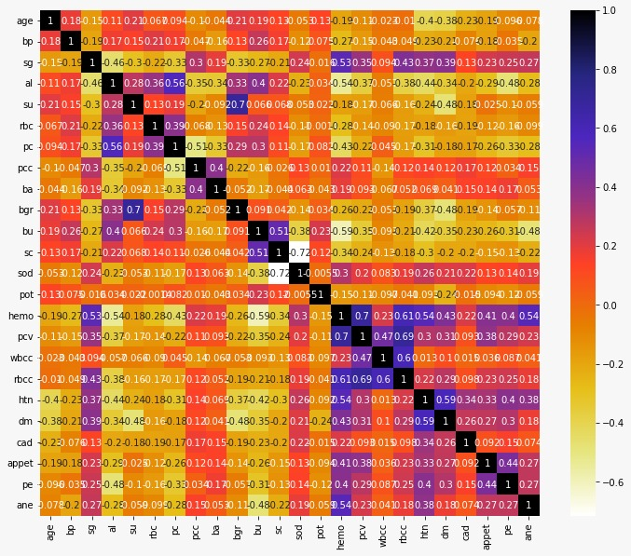
Pearson Correlation Method:
Pearson's Correlation method is used for finding the association between the continuous features and the class feature

Slide 20
The below block of code is about to check correlation between the features so that if any two features are highly correlated one must be taken from that.(Dimensionality Reduction)
def correlate(dataset,threshold):
col_corr=set()
corr_matrix=dataset.corr()
for i in range(len(corr_matrix.columns)):
for j in range(i):
if abs(corr_matrix.iloc[i,j])>threshold: colname=corr_matrix.columns[i]
col_corr.add(colname)
return col_corr
The below block shows which are correlated features with threshold 0.6.
corr_features=correlate(X_train,0.6)
print(corr_features)
Output:{'rbcc', 'pcv', 'sod', 'bgr'}

Slide 21
After applying correlation feature selection on the dataset, correlation features are obtained that are dropped out of the dataset on which the algorithm is used.
After dropping out features SVM applied on the training and testing data.
print(linear_svm.score(X_train,Y_train))
print(linear_svm.score(X_test,Y_test))
Output:
1.0
0.975

Slide 22
ARTIFICIAL NEURAL NETWORK[ANN]
model = Sequential()
#first layer
model.add(Dense(32,input_dim= 24,kernel_initializer= k.initializers.random_normal(seed= 13),activation= 'relu'))
#second layer
model.add(Dense(32,input_dim= 24,kernel_initializer= k.initializers.random_normal(seed= 13),activation= 'relu'))
#final layer
model.add(Dense (1, activation = 'hard_sigmoid'))
The rectified linear activation function or ReLU for short is a piecewise linear function that will output the input directly if it is positive, otherwise, it will output zero.

Slide 23
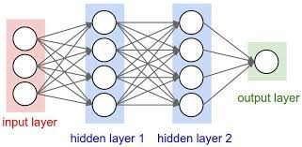
ANN [continued]

Slide 24
ANN [continued]
ReLU:
Function(z)={z z>0 Derivative :R′(z)={1 z>0
0 z<=0} 0 z<0}
Hard Sigmoid:
f(x)=max(0,min(1,(x+1)/2))
This function is piece-wise linear approximation of the sigmoid function. It is equal to 0 on the range [-Inf; -2.5), then linearly increases from 0 to 1 on the range [-2.5; +2.5] and stays equal to 1 on the range (+2.5; +Inf] (Source).
Computing Hard Sigmoid is considered to be faster than computing regular Sigmoid, because calculating the exponent is not necessary.

Slide 25
ANN [continued]
model. compile(loss = 'binary_crossentropy', optimizer = 'adam', metrics = ['accuracy'])
Binary Cross Entropy also known as Log loss,is the most common loss function used for binary classification problems.
Adam is an optimization algorithm that can be used instead of the classical stochastic gradient descent procedure to update network weights iterative based in training data.
history = model.fit(x_train_sm, y_train_sm, epochs =150, batch_size =x_train_sm.shape[0])

Slide 26
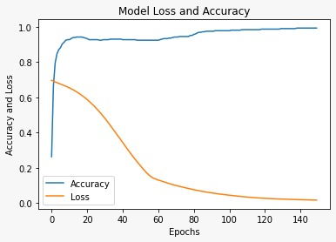
ANN [continued]
plt.plot(history.history['accuracy'],label='Accuracy')
plt.plot(history.history['loss'],label='Loss')
plt.title('Model Loss and Accuracy')
plt.ylabel('Accuracy and Loss')
plt.xlabel('Epochs')
plt.legend();

Slide 27
CLASSIFICATION REPORT
 | precision | recall | f1-score | Support
0 | 0.96 | 0.98 | 0.97 | 83
1 | 0.94 | 0.92 | 0.93 | 37
Accuracy |  |  | 0.96 | 120
Macro avg | 0.95 | 0.95 | 0.95 | 120
Weighted avg | 0.96 | 0.96 | 0.96 | 120

Slide 28
REFERENCES
[1] W.Gunarathne, K.D.MPerera, and K.A.D.C.PKahandawaarachchi, ‘‘Performance evaluation on machine learning classification techniques for disease classification and forecasting through data analytics for chronic kidney disease (CKD),’’ in Proc. IEEE 17th Int. Conf. Bioinf. Bioeng. (BIBE), Oct. 2017, pp. 291–296..
[2] M.Almasoud and T.E. Ward, ‘‘Detection of chronic kidney disease using machine learning algorithms with least number of predictors,’’ Int. J. Adv. Comput. Sci. Appl., vol. 10, no. 8, pp. 89–96, 2019.
[3] S.Shankar, S.Verma, S.Elavarthy, T.Kiran, and P.Ghuli, ‘‘Analysis and prediction of chronic kidney disease,’’ Int. Res. J. Eng. Technol., vol. 7, no. 5, May 2020, pp. 4536–4541.

