Slide 1
Does Ownly's Bengaluru proposition transfer to Gachibowli?
Early market-fit validation among 20–30-year-old students and working professionals
[Team names] · [Course] · 17 September 2026
One-line answer: [TO FILL on 17 Sep — SCALE / ADAPT / TARGET SELECTIVELY, with confidence level]

Slide 2
WHY THIS QUESTION
A proposition that works in one city is not proof it works in the next
Starbucks Australia (analogy only): it closed about three-quarters of its Australian stores in 2008 after overestimating its differentiation and expanding too fast into an established local coffee culture (Patterson, Scott & Uncles, 2010).
Ownly (Rapido's food-delivery app) grew fast in Bengaluru with a zero-commission, low-fee proposition, and now says it is live in Hyderabad.
Our question: are the conditions behind Bengaluru's traction present in Gachibowli — for whom, and at what trade-offs?
Decision options
SCALE — proposition transfers as is
ADAPT — need exists, but price or experience must change
TARGET SELECTIVELY — works for one segment
RETHINK — need or switching potential absent
DRAFT — 14 Sep 2026
Notes:
Starbucks Australia lesson sourced in 01_secondary_research/secondary_research_report.md §12. Use as analogy only.

Slide 3
WHAT IS CLAIMED VS WHAT IS VERIFIED
Several widely repeated Ownly 'facts' are unverified or contradicted
Claim | What we found | Evidence label
50,000 orders/day, ~10% Bengaluru share | Traces to a single upstream media report copied by others | MEDIA REPORT (single source)
₹30 flat delivery fee | Contradicted: App Store says 'Free delivery'; users report ₹0/₹15; a blog says distance-based | CONTESTED
~15% cheaper than Swiggy/Zomato | Pilot-era (Aug 2025) positioning, not a measured saving | COMPANY CLAIM
20,000 / 22,000 / 25,000 restaurants | Sources disagree; the company's own site says 22,000 | COMPANY CLAIM / MEDIA
Ownly is live in Hyderabad | Ownly's site says so; no dated independent report; posts suggest launch late Aug – ~11 Sep 2026 | COMPANY CLAIM + INTERPRETATION
Incumbent fees | Platform fee ₹17.58 incl. GST (Swiggy & Zomato, national, Mar 2026); 18% GST on delivery | MEDIA REPORT (national, not Hyderabad)
New affordability rival | Swiggy's budget app Toing targets students/young professionals; Hyderabad availability unknown | MEDIA REPORT
DRAFT — 14 Sep 2026
Notes:
Full evidence table with URLs and dates: 01_secondary_research/evidence_table.csv (68 claims).

Slide 4
WHO OWNLY TARGETS (SECONDARY RESEARCH)
Ownly pitches local eateries and first-time online orderers, but showcases popular regional chains
Restaurants | Evidence (label)
Stated target: local/regional eateries incumbents 'aren't built for' | CEO interview, Jul 2026 (COMPANY CLAIM, verified)
~70,000 unlisted Bengaluru outlets: thaali places, tiffin centres, dhabas; 15% of onboarded were new to delivery | Inc42, 25 Mar 2026 (MEDIA REPORT, verified)
Pilot rules: ≥4 'Meals for One' under ₹150; dine-in prices; no packaging fee | Storyboard18, Aug 2025 (MEDIA REPORT, verified)
Showcase partners are well-known regional chains: Empire, Vidyarthi Bhavan (BLR); Paradise, Bawarchi, Cream Stone (HYD) | Press release; ownly.food/hyd (COMPANY CLAIM)
KFC & McDonald's (via magicpin) went offline in May 2026 | Financial Express (MEDIA REPORT, snippet)
Customers | Evidence (label)
Price-sensitive diners; 'affordability is the biggest deterrent' | CEO interview (COMPANY CLAIM, verified)
Rapido riders who have never ordered food online; goal of 100M online orderers | Company statements (COMPANY CLAIM)
Everyday low prices, not coupons; 'pay for Food + Delivery' | Launch coverage, Instagram (COMPANY CLAIM)
No stated age or occupation target; no data on actual users | UNKNOWN
Analysts group budget apps with 'students and younger users'; say Toing leads | JP Morgan via Storyboard18 (MEDIA REPORT, no metrics)
So what (INTERPRETATION): our 20–30 Gachibowli users fit Ownly's price point, but most already use Swiggy/Zomato. For Ownly they are a switching segment, not the first-time orderers it says it is chasing. The audit therefore samples showcase chains, local budget eateries and national QSRs.
DRAFT — 14 Sep 2026
Notes:
Sources and verification status: 01_secondary_research/ownly_restaurant_and_user_segments.md and ownly_segments_evidence.csv.

Slide 5
METHOD
What we could collect in 3 days, ethically, with ₹900
Evidence | Size | What it answers | Limits
Secondary research | 68 sourced claims | Claims vs facts; market context | Mostly national/Bengaluru
Public customer voice (app stores, Reddit, LinkedIn, X) | 37 reviews + 524 posts (108 first-hand) | Bengaluru benchmark: what drives use and churn | Self-selected; not prevalence
Competitor price audit, Gachibowli | [n] captures, [n] matched comparisons | Is Ownly actually cheaper at checkout, after coupons? | Team accounts; 3 slots
Test orders | 3 orders (₹900) | Promised vs actual delivery time, fees charged | Anecdotal
Short survey (7 min) | [n] valid, 20–30, Gachibowli area | Fee pain, switching threshold, trade-offs, Ownly funnel | Convenience sample
Short interviews | [n] (students / professionals) | Why behind the numbers | Not prevalence
All activities approved by [instructor] on [date]. No incentives, no deception, no personal identifiers stored.
Dropped for time/ethics: Bengaluru survey, fake-door landing page, full choice experiment (designs retained as next-phase appendix).
DRAFT — 14 Sep 2026

Slide 6
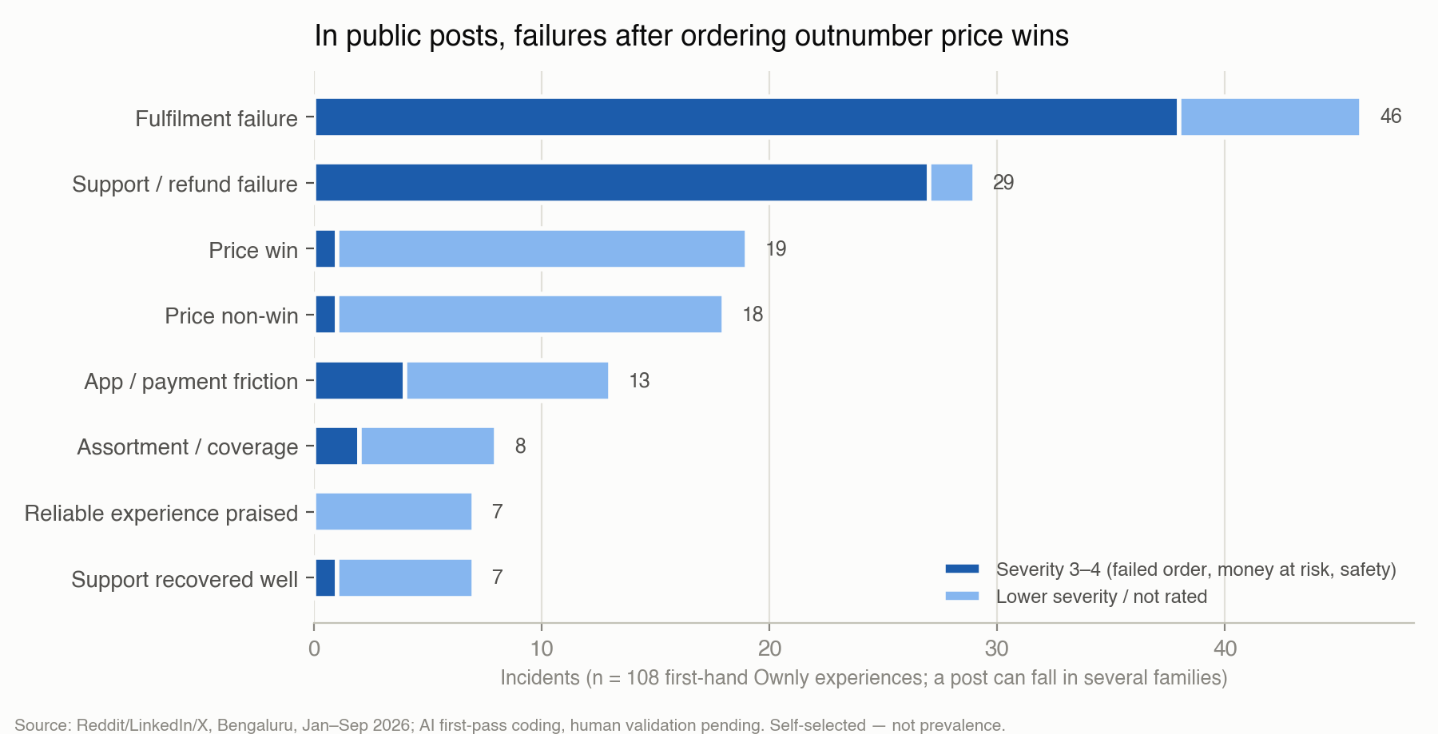
PUBLIC CUSTOMER VOICE
Bengaluru benchmark: price attracts, but failures after ordering drive the loudest complaints
Price is praised before ordering; harm happens after dispatch (non-delivery, rider issues, support).
Savings are contested: all 6 user-posted bill comparisons favour Ownly, but 18 posts say coupons/card offers erased the gap.
37 posts expect prices or fees to rise later ('enjoy while it lasts').
Payment gaps noticed: no cash on delivery, no meal cards (Pluxee).
Label: CONSUMER-GENERATED signals — they tell us what to measure, not how common it is.
DRAFT — 14 Sep 2026

Slide 7
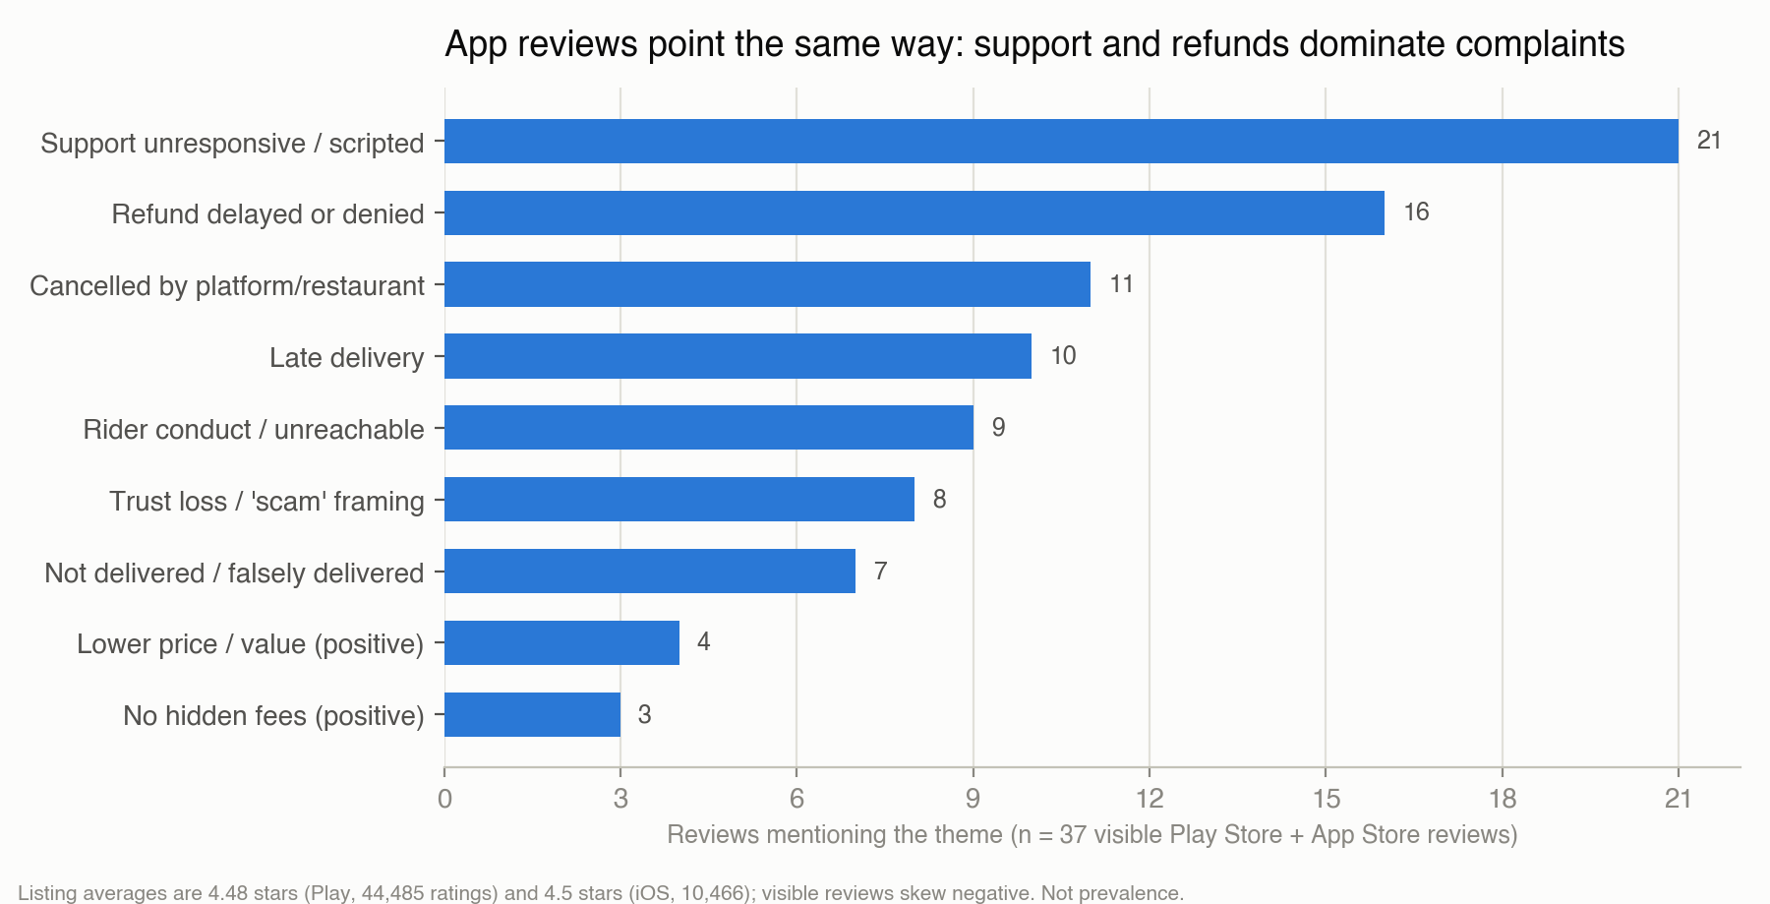
PUBLIC CUSTOMER VOICE
App-store reviews independently show the same failure pattern
Two independent public sources converge: support, refunds, cancellations and lateness.
Positive reviews praise price and 'no hidden fees'.
Caution: only 37 reviews were accessible within the stores' crawling rules, and they skew negative versus the 4.5★ averages.
Implication to test in Gachibowli: does reliability outweigh a ₹30 saving? (slide 9)
DRAFT — 14 Sep 2026

Slide 8
MARKET REALITY: COMPETITOR PRICE AUDIT
[Insight title after audit] — Is Ownly cheaper at checkout in Gachibowli?
TO FILL AFTER DATA COLLECTION (15–16 Sep) — do not present until real numbers are in
• Price per basket (median final payable) per app — from audit_report.md
• Median gap Ownly − Swiggy and Ownly − Zomato with 95% CI: (a) without coupons, (b) after coupons
• Win rate (Ownly cheapest, tie ≤ ₹5) and fee share of bill per app
• Coverage: share of 10 popular restaurants listed & open on Ownly; ETA gap (minutes)
• Test orders: promised vs actual delivery time; fee actually charged (n = 3, anecdotal)
• Chart: dot-plot of gaps per restaurant with median line; title states the finding only if CI excludes 0
DRAFT — 14 Sep 2026

Slide 9
GACHIBOWLI SURVEY
[Insight title after survey] — How painful are fees, and what saving makes people switch?
TO FILL AFTER DATA COLLECTION (15–16 Sep) — do not present until real numbers are in
• Price Pain Index median (0–100) with CI; % whose checkout charges made them reconsider (H1.1); cart abandonment (H1.4)
• Top-3 frustrations: price/fee vs late/cancel (H1.2) — sorted bar with n
• Required saving to switch (median ₹) vs audit median saving (H2.3) — the key economic test
• Transparency: simple vs itemised bill at equal ₹245 (H2.2)
• Students vs working professionals side by side (only if each n ≥ 20; else note 'directional')
DRAFT — 14 Sep 2026

Slide 10
TRADE-OFFS
[Insight title after survey] — What will people give up for ₹30 less?
TO FILL AFTER DATA COLLECTION (15–16 Sep) — do not present until real numbers are in
• % choosing ₹30 cheaper but 15 min slower (H3)
• % choosing ₹30 cheaper but late 3 in 10 vs 1 in 10 (H4)
• % choosing ₹30 cheaper but only a few usual restaurants (H5)
• Rule: '₹30 buys the compromise' only if the CI lower bound > 50% (stated, hypothetical preference)
• Max acceptable dinner ETA (median); delivery-fee acceptance curve from the max-fee question (H8)
DRAFT — 14 Sep 2026

Slide 11
ADOPTION & COURSE KPIS
[Insight title after survey] — Ownly's early funnel in Gachibowli
TO FILL AFTER DATA COLLECTION (15–16 Sep) — do not present until real numbers are in
• Aided awareness → tried → repeat (≥2 orders in 4 weeks) with n at each step; aware→tried conversion (say–do gap)
• Penetration share = tried ÷ delivery users; brand development index students vs professionals
• Share of requirements & heavy-usage index → market-share decomposition (only if ≥10 Ownly triers)
• Trial intent before vs after revealing 'Ownly by Rapido' (brand effect, within-subject)
• Top reasons for not trying (incl. payment method not accepted)
DRAFT — 14 Sep 2026

Slide 12
MARKET-TRANSFER TEST
Bengaluru assumption → Gachibowli evidence → does it transfer?
Bengaluru assumption | Bengaluru evidence (public, labelled) | Gachibowli evidence | Verdict
Lower total price triggers trial | 6/6 user bill comparisons favour Ownly; 18 posts report no win after coupons (CONSUMER-GENERATED) | [Audit gap after coupons; required saving] | [TRANSFERABLE / ADAPT / NOT / UNKNOWN]
Delivery fee is acceptable | Fee contested (₹0 / ₹15 / ₹30) | [Observed fee; % accepting that fee] | [ ]
Reliability good enough to repeat | 46 fulfilment + 29 support/refund failures in first-hand posts | [Trade-off H4; test orders; Ownly users' on-time rating] | [ ]
Restaurant coverage sufficient | 'Limited restaurants' 8 incidents | [Audit coverage; % needing most usual restaurants] | [ ]
Rapido brand builds trust | Two-sided mentions | [Intent before vs after reveal] | [ ]
Users switch easily (multi-home) | 'Just keep switching' posts; coupons pull users back | [% using ≥2 apps; memberships] | [ ]
Verdict rules (pre-registered): TRANSFERABLE = need present and not weaker; ADAPT = need present but a condition is worse; NOT = need absent; UNKNOWN = not enough data.
DRAFT — 14 Sep 2026

Slide 13
DECISION
Recommendation
Working position going into data collection (HYPOTHESIS, to be confirmed or rejected by slides 7–11):
ADAPT rather than copy Bengaluru: lead with a fair total price you can rely on, not 'cheapest'.
Guardrail before scaling: support and refund resolution; delivery-time parity at dinner peak.
Start with small, frequent solo orders from students and young professionals; add payment options (COD / meal cards).
Don't compete on coupons against Swiggy/Zomato.
TO FILL AFTER DATA COLLECTION (15–16 Sep) — do not present until real numbers are in
• Final recommendation (SCALE / ADAPT / TARGET SELECTIVELY / RETHINK) with confidence level and the evidence that decided it
• What would change our mind; next experiment (the full 5-week design in the appendix)
DRAFT — 14 Sep 2026

Slide 14
HONESTY SLIDE
Limitations and next research
3-day window, convenience sample around Gachibowli — results describe our respondents, not Hyderabad.
No Bengaluru survey: the Bengaluru benchmark relies on self-selected public posts and reviews.
Survey trade-offs and intent are stated preferences; the price audit reflects the team's own accounts and 3 time slots.
Scenario KPIs (growth rate, contribution per order, CLV) use media figures and assumptions, not company data.
Next phase (designed, in appendix): 220-person Hyderabad survey with a choice experiment and randomised brand test; 150-person Bengaluru Ownly-user survey; 2-week audit; 16 interviews; value-proposition landing-page test.
DRAFT — 14 Sep 2026

Slide 15
APPENDIX A
Appendix: course KPIs we can compute now (scenarios, clearly labelled)
KPI (course formula) | Calculation | Result | Label
Compound monthly growth (CAGR) | (50,000 ÷ 5,000)^(1/5) − 1, Bengaluru daily orders Mar→Aug 2026 | ≈ 58.5% per month | MEDIA REPORT inputs
Contribution per order | Delivery fee − rider payout − ₹5 other; fee ₹0–30 vs payout ₹30–60 | −₹65 to −₹5 per order (positive only if payout < fee − ₹5) | ASSUMPTION scenario
Break-even volume | Fixed costs ÷ contribution per order | Not reachable while contribution ≤ 0 | ASSUMPTION scenario
Customer lifetime value | Margin × r ÷ (1 + d − r), d = 1%/month | ₹50 margin: ₹73 at 60% retention vs ₹409 at 90% | ASSUMPTION scenario
Takeaway (INTERPRETATION): retention multiplies value far more than margin, so reliability that keeps users is worth more than deeper discounts.
Full working: 09_analysis/short_plan/scenario_kpis.md
DRAFT — 14 Sep 2026

Slide 16
APPENDIX B
Appendix: digital-funnel KPIs (practice dataset, not Ownly data)
Marketing Metrics 1000 Records.csv: generic 2024–25 USD campaign data (8 channels). Formulas check out (CTR, conversion rate, ROAS, CPA reproduce in 1000/1000 rows).
Data-quality flag: conversions exceed qualified leads in 325/1000 rows; near-identical ROAS across channels suggests synthetic data.
How these KPIs would apply to Ownly's Gachibowli launch: CTR and conversion rate of launch ads; CPA (= average acquisition cost) compared with CLV (Appendix A).
Applied to our own survey recruitment: completes ÷ starts by channel; cost per valid response = ₹0.
DRAFT — 14 Sep 2026

