Slide 1
Walchand College of Engineering, Sangli
Presented By:
Presented By:
Pratibha Ambadas Garje – 2017BTECS00108
08
Under the Guidance of: Prof. Kiran. P. Kamble.

Slide 2
Metal Surface Defect Detection using Convolutional Neural Netwok
Problem Statement
Objective
To locate various metallic defects in an image using Deep Convolutional Neural Netwok

Slide 3
Dataset
Dataset is taken from NEU database.
Dataset consists of 6 types of metallic defects like crazing ,inclusion,patches,pitted surface,rolled in scale ,scratches with annotations for every class.

Slide 4
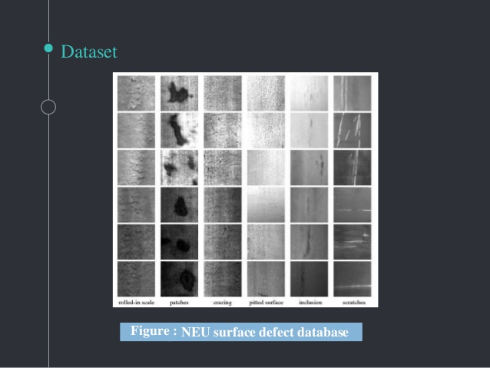
Dataset

Slide 5
Proposed Technology
Training model
Deep Learning
CNN

Slide 6
Algorithm and Techniques
Neural networks perform very well for image recognition. In particular, a specific type of neural networks called Convolutional Neural Networks (CNNs) are best suited for the task of image recognition..

Slide 7
Model Parameters
➢ filters - Number of feature maps required as the output of that convolutional layer.
➢ kernel_size - The size of the window that will get convolved along all the axes of the input data to produce a single feature map.
➢ Padding - To decide what happens on the edges - either the input gets cropped (valid) or the input is

Slide 8
➢Activation - The activation function to be used for that layer. For each pooling layer, we have to configure the following parameters:
➢ Pool_size - The size of the window.
➢ Strides - The number of pixels by which the pooling window should shift by.

Slide 9
Architecture
Architecture
Convolutional layer
Input: image matrix and kernel
Output: Feature map
Filters: sharpening, blurring, edge detection
Strides
Padding
f (x_{i}, W, b) = W ∗ x_{i} + b
Where x is filter matrix.W is the weight matrix
b is bias vector.

Slide 10
ReLu layer
Non-linear activation
Updates parameters of model
Negative activations are converted to zero
Not technically layer
Pooling layer
Downsampling
Controls overfitting
Types:
Max pooling
Average pooling

Slide 11
Dropout Layer
Reduces overfitting
Improves accuracy
Fully connected layer
Neurons are fully connected
Combine features together to create a model
Can be replaced by average pooling layer
Output the probabilities

Slide 12
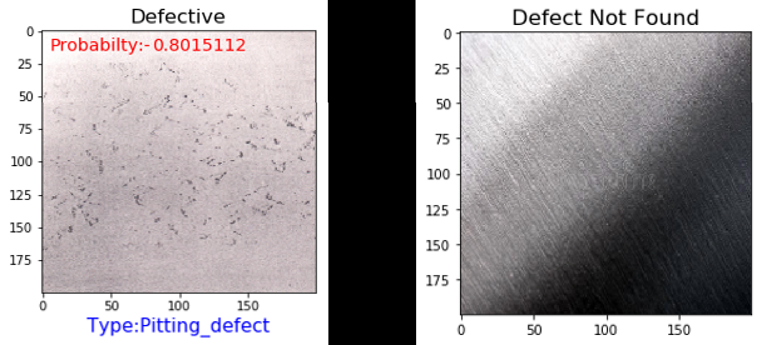
Results

Slide 13
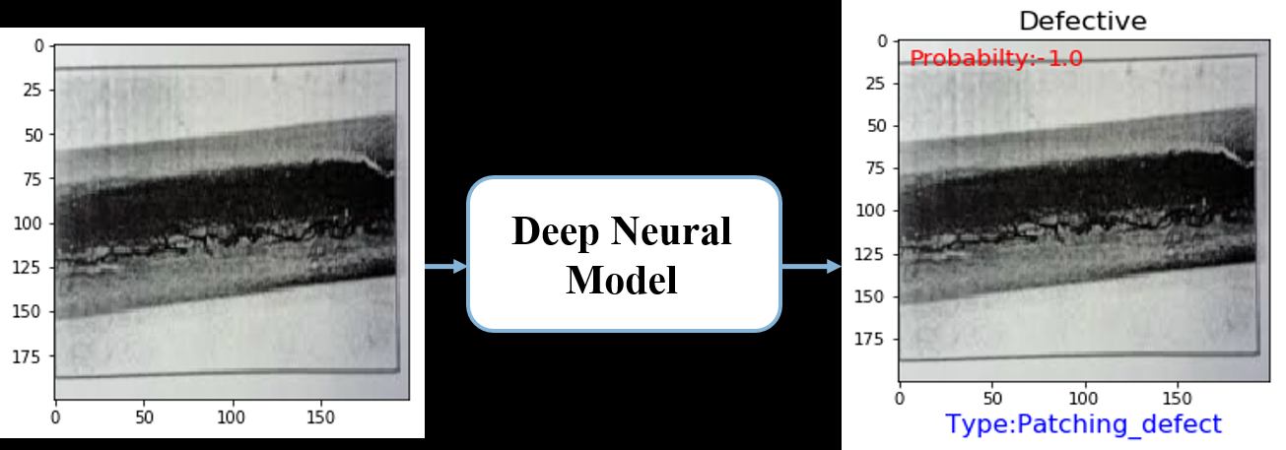

Slide 14
References
https://www.mdpi.com/2076-3417/8/9/1575
https://medium.com/@abhimanyu.contact/metal-surface-defect-detection-4e4c8c79bb6b

Slide 15
Thank You☺

