Slide 1

A Presentation on
Sanjivani Rural Education Society’s,
Sanjivani College of Engineering, Kopargaon
Secret data Encryption, Decryption & Digital Signature Tool
Group ID : 19
78. Avanti Joshi
95. Divyani Nale
100. Pratibha Pagar
107. Dnyaneshwar Raundal
Guide: Prof. P.M. Dhanrao

Slide 2
Contents
1. | Introduction
2. | Objective
3. | Flowchart
4. | Technology Used
5. | Results
6. | Applications
7. | Conclusion
8. | References
2.

Slide 3

Introduction
In today's digital age, data security is a critical concern for individuals and organizations.
Cryptography, particularly encryption, plays a vital role in protecting sensitive information from unauthorized access. This tool simplifies the encryption process, making it accessible to users with a user-friendly interface, while also ensuring the highest levels of data security.
This system aimed at providing a simple yet effective way to securely encrypt and decrypt sensitive data, including text, files, and images.
3.

Slide 4
Objectives
Objective 1
Objective 2
To provide an understanding of symmetric encryption (Fernet algorithm) and its role in data security.
To develop a tool that encrypts and decrypts text, files, and images, ensuring confidentiality of secret information.
Objective 3
Objective 4
To showcase how plaintext can be encrypted into ciphertext and decrypted back into readable data using a secret key.
To implement encryption and decryption functionalities with user-friendly interfaces for text, files, and images.
5.

Slide 5
Technologies Used
Python:
The core programming language used to develop the application. Python's simplicity and extensive library support make it ideal for cryptographic operations and GUI development.
Tkinter:
A standard Python library used to create the graphical user interface (GUI) for the application. Tkinter makes it easy to build user-friendly interfaces for desktop applications.
4.

Slide 6
Technologies Used
Cryptography (Fernet):
A Python library for secure encryption and decryption. It uses the Fernet symmetric encryption algorithm, which ensures both confidentiality and message integrity by encrypting the data with a key that is both generated and stored securely.
Base64:
This is used for encoding the encryption key to make it safe for storing and transmission. Base64 ensures that the encryption key is compatible with different systems and remains in a readable format.
4.

Slide 7
Symmetric Encryption: Fernet Algorithm
Symmetric Key Encryption: Uses the same key for both encryption and decryption, ensuring secure data transformation.
Fernet Algorithm: A part of Python’s cryptography library, it provides easy-to-use, strong encryption:
AES-128 Encryption: For data confidentiality.
HMAC with SHA256: Ensures data integrity and authenticity.
12.

Slide 8
Symmetric Encryption: Fernet Algorithm
Process:
Key Generation: A 32-byte base64-encoded key is generated.
Encryption: Plaintext is converted into unreadable ciphertext using the key.
Decryption: The ciphertext is decrypted back to plaintext using the same key
12.

Slide 9
RSA
RSA is a widely-used asymmetric encryption algorithm, which means it utilizes a pair of keys: a public key for encryption and a private key for decryption.
It provides a secure way to encrypt sensitive data and is foundational for secure communications, digital signatures, and authentication mechanisms.
Public Key: This key is publicly shared and used for encryption.
Private Key: This key is kept secret by the owner and used for decryption.
12.

Slide 10
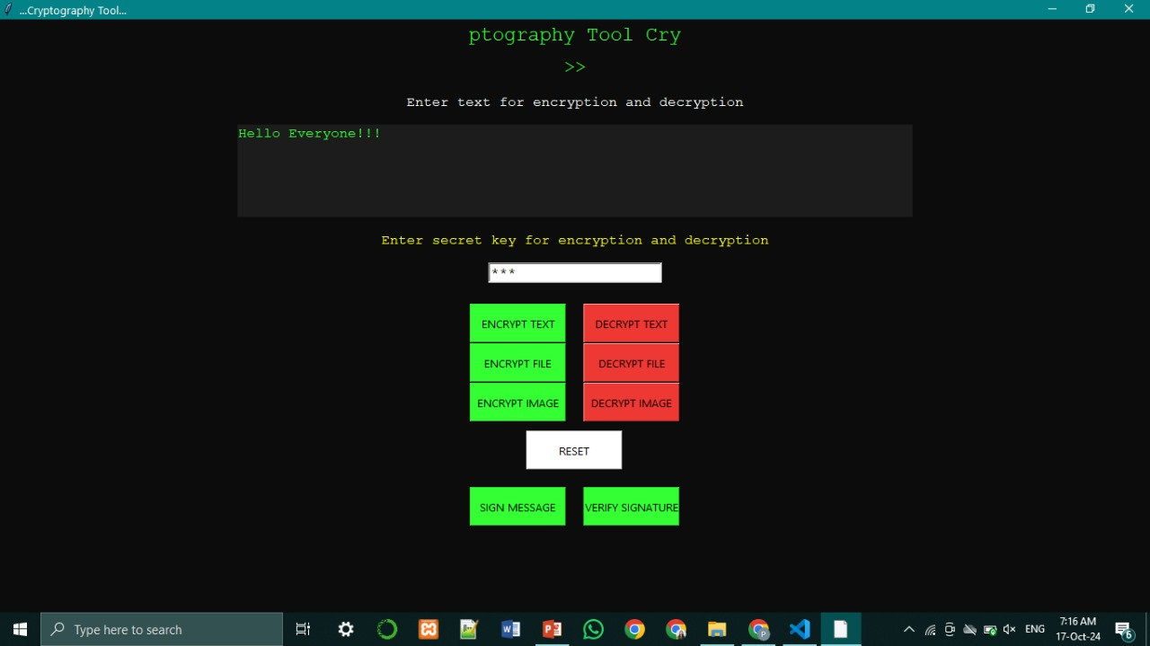
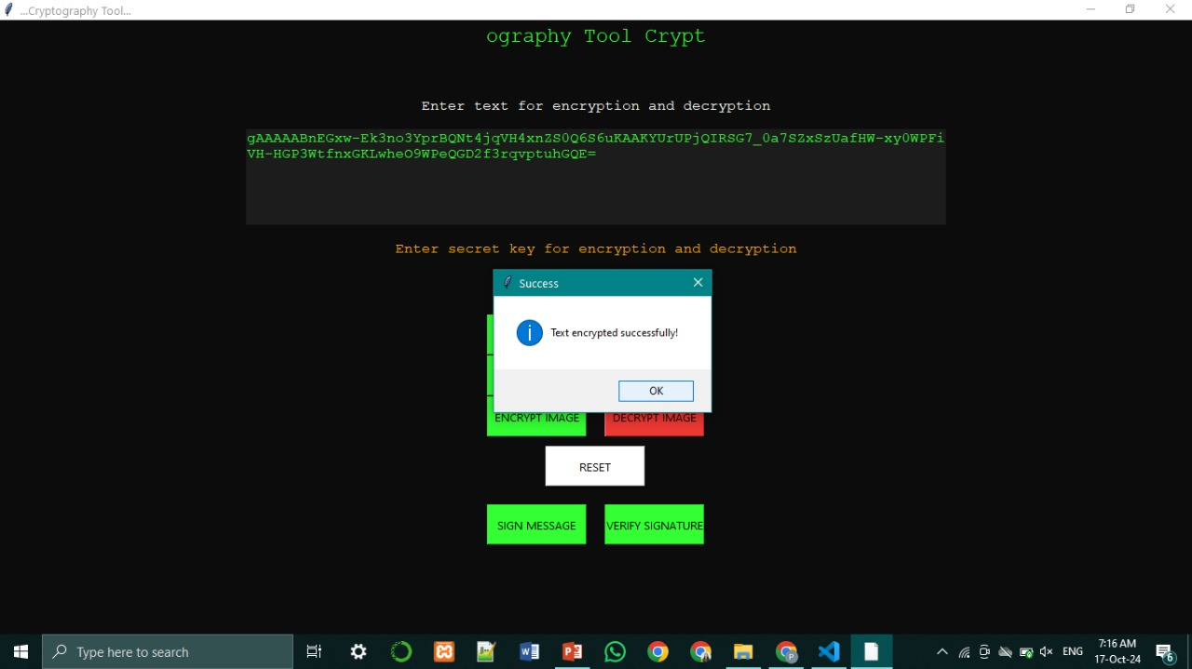
Results
12.

Slide 11
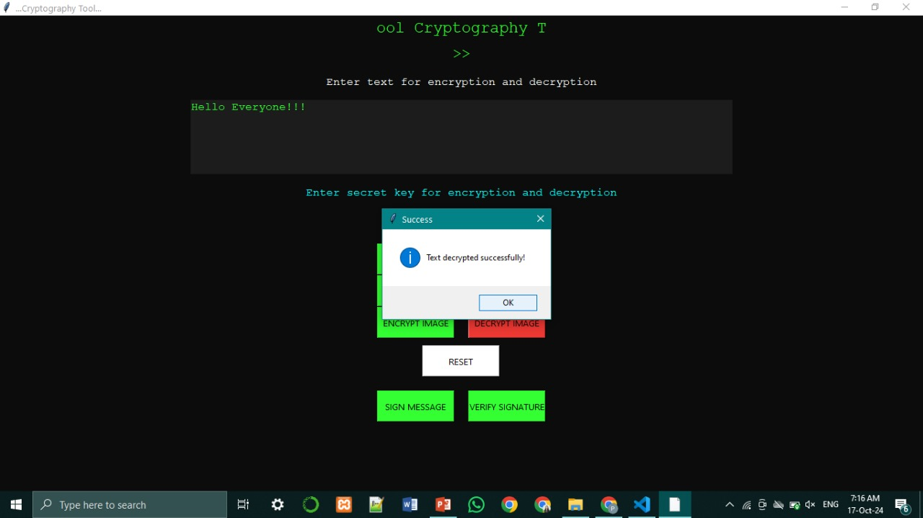
Results
12.

Slide 12
Applications
Secure Messaging: Encrypt sensitive messages to ensure confidential communication between individuals or organizations.
File and Document Protection: Safeguard personal, financial, and business documents by encrypting files, preventing unauthorized access.
Data Privacy in Cloud Storage: Protect files stored in cloud environments by encrypting them before uploadconfidential media exchanges.ing, ensuring data privacy even if the cloud is compromised.
Image Security: Encrypt images to secure visual data, useful for sectors like healthcare (medical images) and
12.

Slide 13
Conclusion
The Secret Message Encryption Tool enhances data security by enabling users to encrypt and decrypt sensitive information easily.
Its user-friendly interface supports text, file, and image encryption, making secure communication accessible for everyone.
Future enhancements, such as multi-factor authentication and mobile application support, can further strengthen its capabilities.
As data breaches become more prevalent, this tool empowers users to protect their information, ensuring that they can communicate with confidence in an increasingly digital world.
12.

Slide 14
References
https://www.geeksforgeeks.org/cryptography-with-python/
https://cryptography.io/en/latest/fernet/
https://www.geeksforgeeks.org/python-gui-tkinter/
https://docs.python.org/3/library/base64.html
https://realpython.com/python-encryption-programming/
13.

Slide 15
Thank You!
Do you have any questions?
14.

