Slide 1

Project Phase –I “Multi-Objective Optimization for the Design of Neural Networks”
Presenter :
Pratibha M Goudar
[01FE20MCS010]
Under the Guidance of:
Dr. Meena S .M and Prof. Sunil V. Gurlahosur
PG Coordinator:
Dr. Vishwanath P. Baligar

Slide 2
Domain
AutoML – Neural Architecture Search (NAS).
NAS is subdomain of Automatic Machine Learning (AutoML), where the search for the best architectutre for the neural network is automated.

Slide 3
Structure of presentation
Introduction
Literature Survey
Motivation
Problem Statement
Objectives
System Architecture
Methodology
Results
Conclusion
References

Slide 4
Introduction
Neural networks are computing systems with interconnected nodes that work much like neurons in the human brain.
Multiobjective optimization has been applied to many fields of science, including engineering.
Multi-objective optimization is an area of multiple-criteria decision-making, concerning mathematical optimization problems.
Multi-objective involving more than one objective function to be optimized simultaneously.
Optimal decisions need to be taken in the presence of trade-offs between two or more objectives that may be in conflict.

Slide 5
Introduction
Multi-objective algorithms have become popular in the last years to solve the problem of the simultaneous training and topology optimization of neural networks.
Optimizers are algorithms or methods used to change the attributes of neural network such as weights and learning rate in order to reduce the losses.

Slide 6
Literature survey
The deep convolutional neural network (CNN) is the state-of-the-art solution for large-scale visual recognition.
The core idea is to propose an encoding method[1]to represent each network structure in a fixed-length binary string.
Based on this framework, design some genetic operations, such as mutation and crossover for explore the search space efficiently.
The genetic algorithm[1] is only used to explore the network structure, where as the network training process is performed separately.
The NSGA-Net[2], a multi-objective evolutionary approach for neural architecture search is used to overcome this drawback.
NSGA-Net is population based search algorithm that explores a space of potential neural network architectures.

Slide 7
Literature survey
NSGA-Net finds a set of network architectures containing solutions that are significantly better than hand-crafted methods in both objectives i.e. classification error and computational complexity.
Networks are represented as bit strings, and trained through gradient descent, ranking and selection by NSGA-II, the search history exploitation through Bayesian Optimization Algorithm(BOA).
One more, evolutionary multiobjective algorithm NSGA-NetV1[3] for Neural Architecture Search (NAS)[2][3]. It explores the design space of architectures through recombining and mutating architectural components.
NSGA-NetV1 further improves the search efficiency by exploiting the patterns among the past successful architectures via distribution estimation through a Bayesian Network model(BN).

Slide 8
Literature survey
Further analysis towards validating the generalization and robustness aspects of the obtained architectures.
Another multi-objective algorithm NSGA-NetV2[4], it comprises of two surrogates, one at the architecture level to improve sample efficiency and one at the weights level, through a supernet, to improve gradient descent training efficiency.
The multi-objective model optimization which allows training the multi-layer perceptron neural network (MLPNN) and optimizing its architecture[5].
More precisely, the model aims to satisfy two objectives: the first one is minimizing the perceptron error (training objective) and the second one is minimizing the sum of the absolute weights (optimizing architecture objective).

Slide 9
Literature survey
The NSGA II algorithm (Non-Dominated Sorting Genetic Algorithm II)[5]. also solve the proposed model. It is very powerful for multiobjective optimization.
The proposed NSGA-II is able to maintain a better spread of solutions and converge better in the obtained nondominated front [6]. It includes a set of Pareto-optimal points, instead of a single point.
By optimizing model for multiple objectives, NAS method to perform in terms of accuracy, latency, power usage, FLOPS etc. due to which, model will be the best choice to run on resource constrained embedded devices.

Slide 10
Motivation
Currently, building efficient neural networks is time consuming, error prone computationally expensive, there is a need to democratize the development of neural networks for its wider use .
NAS allows for the automated search of the best architecture.
Methods for NAS can be categorized according to the search space, search strategy and performance estimation strategy .
The search space defines the type of neural networks that can be designed and optimized.
The search strategy defines the approach used to explore the search space.
The performance estimation strategy evaluates the performance of a possible neural network from its design.

Slide 11
Problem Statement
Design and development of neural networks using multiobjective optimization by considering the latency, accuracy and power usage to classify images using Neural Architecture Search method.

Slide 12
Objectives
The goal is to implement a multi-objective optimization technique that is based on the NSGA-II evolutionary algorithm.
To improve accuracy of the model.
To reduce latency in performing operations.
To have minimum FLOPS and power usage.

Slide 13
System Architecture
Apply NAS on Search Space
Save optimized Architecture
Binarized the model
Multi-objective optimization of the model
Compare our model with other state of art models
Figure 1 : System Architecture

Slide 14
Methodology
Search for the optimal architecture for a given dataset using Evolutionary algorithm using the models for the architecture and for the weights– Neural Architecture Search.
Perform a evolution search optimization for obtaining the non-dominating solutions on the pareto-front. (with respect to accuracy plus an additional objective) – Muiltiobjective Optimization.
Fine tune the obtained model and re-train it to optimize it for a specific dataset and a specific device using the device look-up table parameters.
Figure 2 : Methodology

Slide 15
Dataset Description
CIFAR-10
The CIFAR-10 dataset is a collection of images that are commonly used to train Machine learning and Computer Vision algorithms.
It has 60000 32*32 color images in 10 different classes. 6000 images of each class. i.e. airplanes , cars, birds , cats , deer , dogs , frogs , horses , ships and trucks.

Slide 16
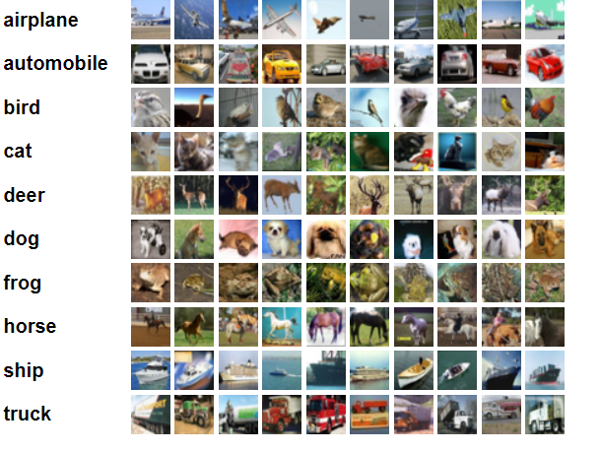
Sample Dataset
Figure 3: Sample Dataset with each classes

Slide 17
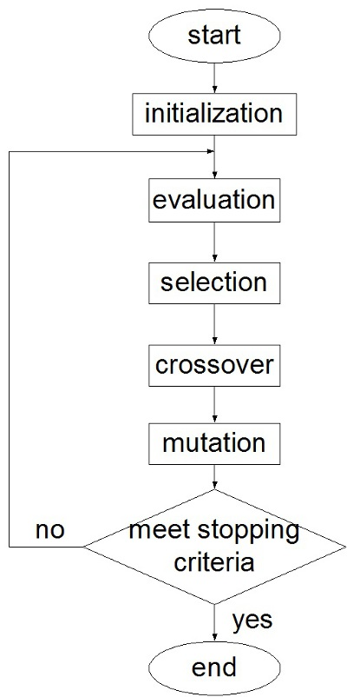
Genetic Algorithm Flowchart
Figure 4 : Genetic Algorithm Flow Diagram

Slide 18
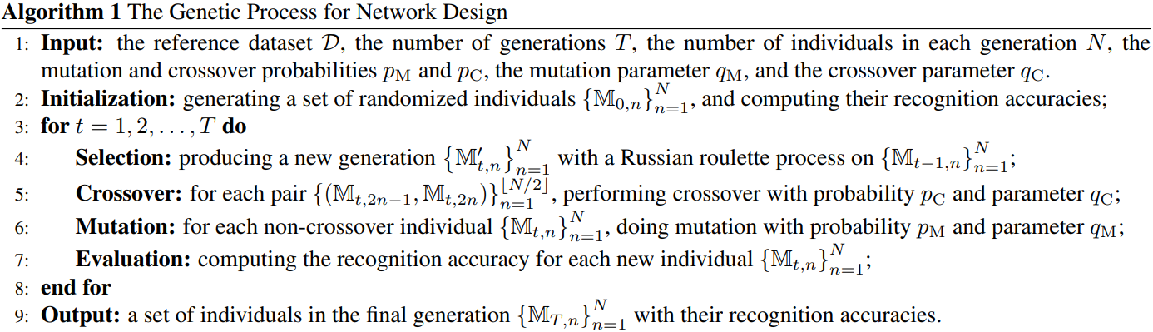
Genetic Algorithm

Slide 19
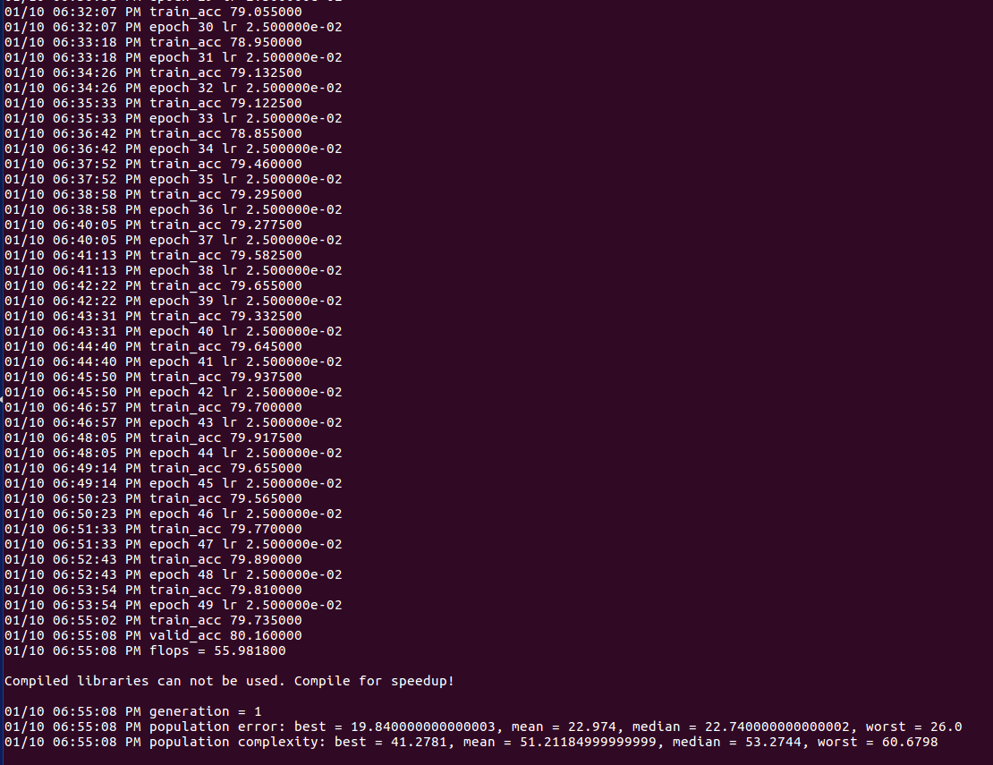
Results
Epochs: 25
No.of Generations: 2
Evolutionary Algorithm: NSGA-NET
Figure 6: Multi Objective Search Accuracy with Flops [Macro Search Space]

Slide 20
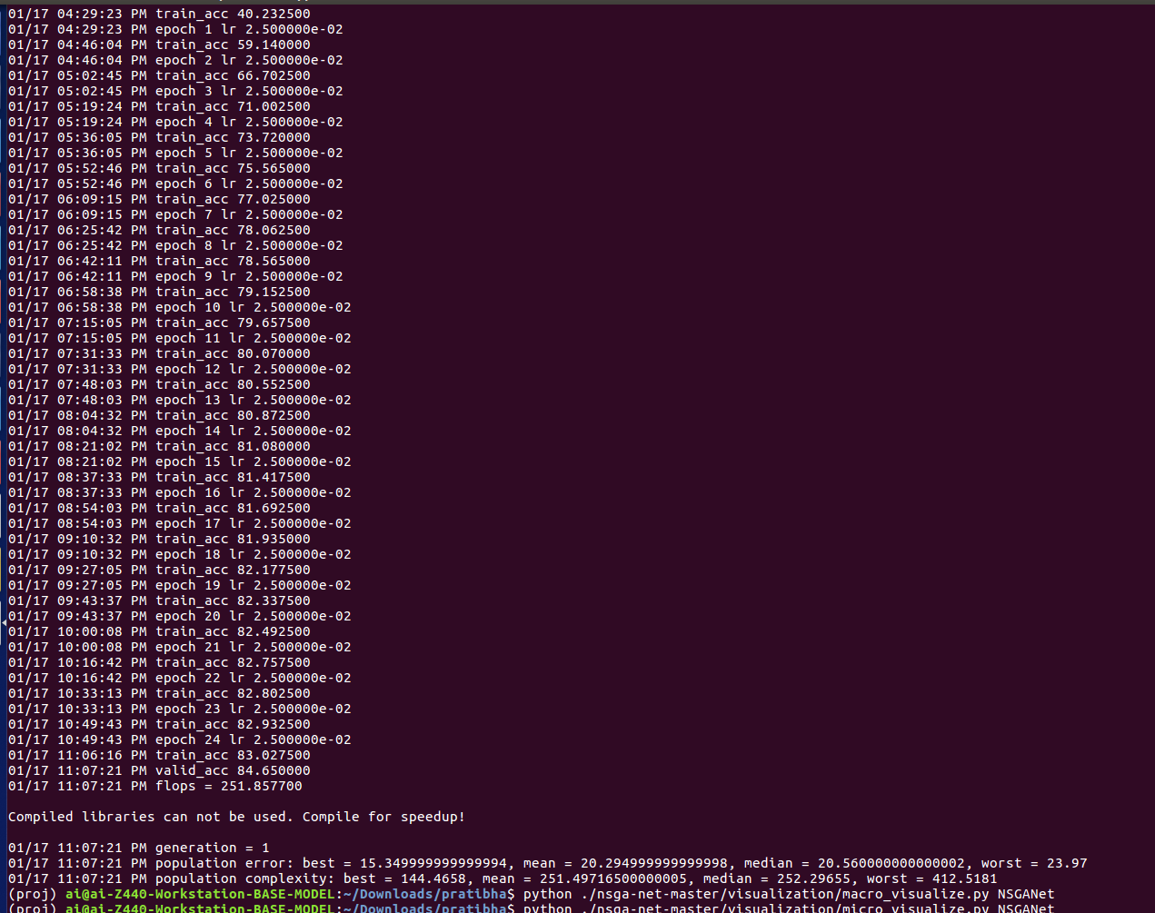
Results
Epochs: 50
No.of Generations: 1
Evolutionary Algorithm: NSGA-NET
Figure 7: Multi Objective Search Accuracy with Flops [Micro Search Space]

Slide 21
Conclusion
Search a model using NAS Evolutionary Algorithm for multiple-objectives.
We obtained a set of weights so that we can train model.
We obtained a better model which has higher chance of predicting accurate results.
We obtained a model which is satisfying multiple objective.

Slide 22
References
[1]Xie, Lingxi, and Alan Yuille. "Genetic cnn." In Proceedings of the IEEE international conference on computer vision, pp. 1379-1388. 2017.
[2]Lu, Zhichao, Ian Whalen, Vishnu Boddeti, Yashesh Dhebar, Kalyanmoy Deb, Erik Goodman, and Wolfgang Banzhaf. "Nsga-net: neural architecture search using multi-objective genetic algorithm." In Proceedings of the Genetic and Evolutionary Computation Conference, pp. 419-427. 2019.
[3] Lu, Zhichao, Ian Whalen, Yashesh Dhebar, Kalyanmoy Deb, Erik D. Goodman, Wolfgang Banzhaf, and Vishnu Naresh Boddeti. "Multiobjective Evolutionary Design of Deep Convolutional Neural Networks for Image Classification." IEEE Transactions on Evolutionary Computation 25, no. 2 (2020): 277-291.
[4] Lu, Zhichao, Kalyanmoy Deb, Erik Goodman, Wolfgang Banzhaf, and Vishnu Naresh Boddeti. "Nsganetv2: Evolutionary multi-objective surrogate-assisted neural architecture search." In European Conference on Computer Vision, pp. 35-51. Springer, Cham, 2020.

Slide 23
References
[5] Kaoutar, Sinai, and Ettaouil Mohamed. "Multi-criteria optimization of neural networks using multi-objective genetic algorithm." In 2017 Intelligent Systems and Computer Vision (ISCV), pp. 1-4. IEEE, 2017.
[6] Deb, Kalyanmoy, Amrit Pratap, Sameer Agarwal, and T. A. M. T. Meyarivan. "A fast and elitist multiobjective genetic algorithm: NSGA-II." IEEE transactions on evolutionary computation 6, no. 2 (2002): 182-197.
[7] Srinivas, Nidamarthi, and Kalyanmoy Deb. "Muiltiobjective optimization using nondominated sorting in genetic algorithms." Evolutionary computation 2, no. 3 (1994): 221-248.
[8]J. Blank and K. Deb, "Pymoo: Multi-Objective Optimization in Python," in IEEE Access, vol. 8, pp. 89497-89509, 2020,doi: 10.1109/ACCESS.2020.2990567.
[9] Shuchang Zhou, Yuxin Wu, Zekun Ni, Xinyu Zhou, He Wen, and Yuheng Zou. Dorefanet: Training low bitwidth convolutional neural networks with low bitwidth gradients. arXiv preprint arXiv:1606.06160, 2016.

Slide 24
References
[10] Bhandare, Ashray, and Devinder Kaur. "Designing convolutional neural network architecture using genetic algorithms." In Proceedings on the International Conference on Artificial Intelligence (ICAI), pp. 150-156. The Steering Committee of The World Congress in Computer Science, Computer Engineering and Applied Computing (WorldComp), 2018.
[11] Baozhou Zhu, Zaid Al- Ars, and H Peter Hofstee. Nasb: Neural architecture search for binary convolutional neural networks. In 2020 International Joint Conference on Neural Networks (IJCNN), pages 1–8. IEEE, 2020.
[12]Adrian Bulat, Brais Martinez, and Georgios Tzimiropoulos. Bats: Binary architecture search. In Computer Vision–ECCV 2020: 16th European Conference, Glasgow, UK, August 23–28, 2020, Proceedings, Part XXIII 16, pages 309–325. Springer, 2020.
[13]Adrian Bulat, Brais Martinez, and Georgios Tzimiropoulos. High-capacity expert binary networks. arXiv preprint arXiv:2010.03558, 2020.

Slide 25
THANK YOU

