Slide 1

Preventing Adversarial Attacks on Neural Network
Presenter :
Pratibha M Goudar
[01FE20MCS010]
Under the Guidance of:
Dr. Meena S .M and Prof. Sunil V. Gurlahosur
PG Coordinator:
Dr. Vishwanath P. Baligar

Slide 2
Structure of presentation
Introduction
Literature Survey
Problem Statement
Objectives
Requirements
High Level Design
Low Level Design
Implementation
Results
Conclusion
References

Slide 3
Introduction
Adversarial machine learning is a technique used in machine learning to fool or misguide a model with malicious input.
An adversarial attack is a method to generate adversarial examples.
An adversarial example is an input to a machine learning model that is purposely designed to cause a model to make a mistake in its predictions despite resembling a valid input to a human.

Slide 4
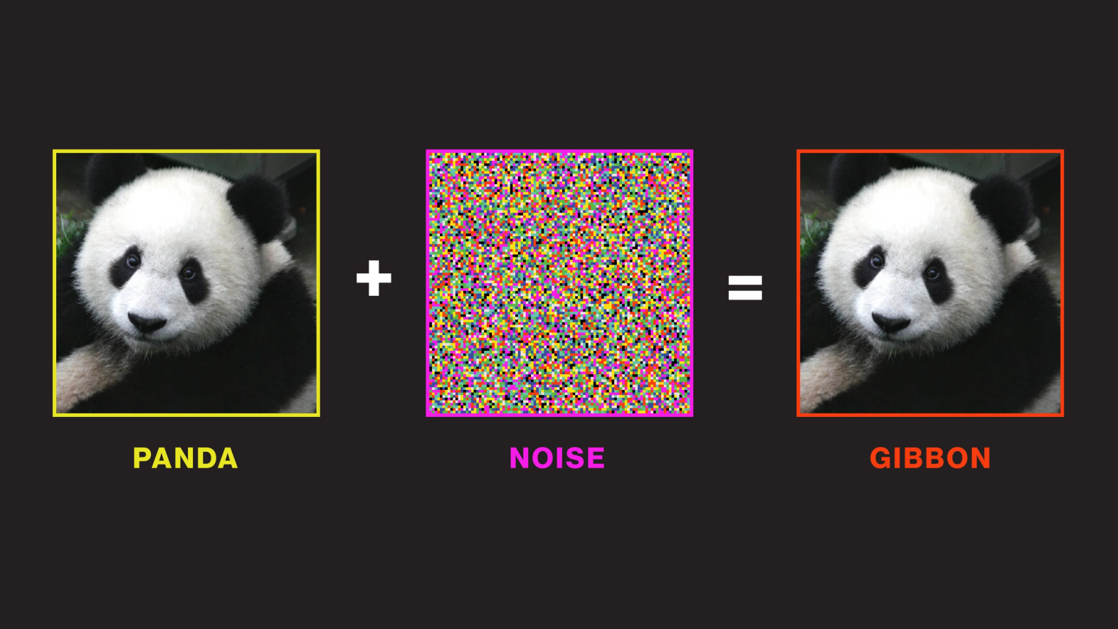
Adversarial attack example

Slide 5
Types of attacks
A white box attack is a scenario where the attacker has complete access to the target model, including the model’s architecture and its parameters.
A black box attack is a scenario where an attacker has no access to the model and can only observe the outputs of the targeted model.

Slide 6
Literature survey
The fast developments of artificial intelligence (AI) and deep learning (DL) techniques, it is critical to ensure the security and robustness of the deployed algorithms.
According to the threat model[1][8], existing adversarial attacks can be categorized into white-box, and black-box attacks.
The threat model of white-box attacks, the adversaries are assumed to have full knowledge of their target model, including model architecture and parameters.
In the black-box threat model, the adversaries can only observe to the output of the target model .

Slide 7
Literature survey
In the frameworks of these threat models, a number of attack algorithms for adversarial sample generation have been proposed such as fast gradient sign method (FGSM), the basic iterative method(BIM),projected gradient descent (PGD) , distributionally adversarial attack etc.[2]
An Adversarial Attack is a technique to find a perturbation that changes the prediction of a machine learning model. The perturbation can be very small and imperceptible to human eyes..
torch attacks supports MultiAttack for combining multiple adversarial attacks. By using MultiAttack, more powerful adversarial adversarial example can be generated[2].

Slide 8
Literature survey
In the frameworks of these threat models, a number of attack algorithms for adversarial sample generation have been proposed such as fast gradient sign method (FGSM), the basic iterative method(BIM),projected gradient descent (PGD) , distributionally adversarial attack etc.[2]
An Adversarial Attack is a technique to find a perturbation that changes the prediction of a machine learning model. The perturbation can be very small and imperceptible to human eyes..
torch attacks supports MultiAttack for combining multiple adversarial attacks. By using MultiAttack, more powerful adversarial adversarial example can be generated[2].

Slide 9
Literature survey
Introduced a family of fast methods for generating adversarial examples. And these can be explained as a property of high-dimensional dot products[3].
demonstrated that adversarial training can result in regularization; even further regularization than dropout. So that Models that are easy to optimize are easy to perturb[3]
Based on the methods of generating adversarial examples, it can be divided into optimization based network and forward derivative based attack [4]
And further defense methods can be categories into proactive defense and reactive defense .[4]

Slide 10
Literature survey
In proactive defense the model is trained to be robust towards the adversarial examples i.e defensive distillation.[7]
In the reactive defense method , a second model is adopted to detect the adversarial examples .i.e safety net[6]
The safety net is robust to adversarial examples[8] built from currently known attacking approaches.[6] This is able to reject adversarial examples that come from attacking methods not seen in training data.
And one more defense method is Defense-GAN, a novel defense strategy utilizing GANs to enhance the robustness of classification models against black-box and white-box adversarial attacks.[9]
DL has been extensively applied in a variety of application domains such as speech recognition, medical diagnosis [16]

Slide 11
Few general adversarial attacks
Fast gradient sign method (FGSM)
Iterative fast gradient sign method(IFGSM)
Deep-fool
Carlin and Wagner L2
Projected gradient descent
Apart from these , there are many other attacks as well.

Slide 12
Problem Statement
To classify the images using AlexNet neural network architecture and improve the architecture performance using adversarial attacks.

Slide 13
Defense Against Adversarial Attacks
Adversarial training.
Create a safety net.
Train on correctly labeled adversarial examples.

Slide 14
Objectives
To find strong adversarial examples from Torch Attacks and see which one is best suited for adversarial training.
To test the strongest attack against the CIFAR-10 datasets.
To make the model more robust.

Slide 15
High Level Design
Applying
Adversarial
Attack
Trained
Model
Obtain
Accuracy
Input data

Slide 16
Low Level Design
Trained Model
Applying Adversarial Attacks
Obtained Accuarcy
Input Data
Pre-Processed Data
Evaluateaccuarcy on adversarial attacks
Compare the accuracy
Building Neural Network
Evaluate the accuracy on clean data vs. adversarial training data
Evaluating on th
Apply adversarial training as defense method e accuracy on the clean data
Train model on cifar10 dataset
Evaluate accuracy on clean data

Slide 17
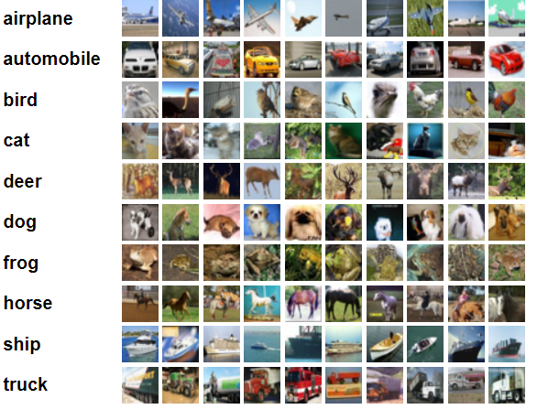
Dataset Description-CIFAR-10
The CIFAR-10 dataset is a collection of images that are commonly used to train Machine learning and Computer Vision algorithms.
It has 60000 32*32 color images in 10 different classes. 6000 images of each class. i.e. airplanes , cars, birds , cats , deer , dogs , frogs , horses , ships and trucks.

Slide 18
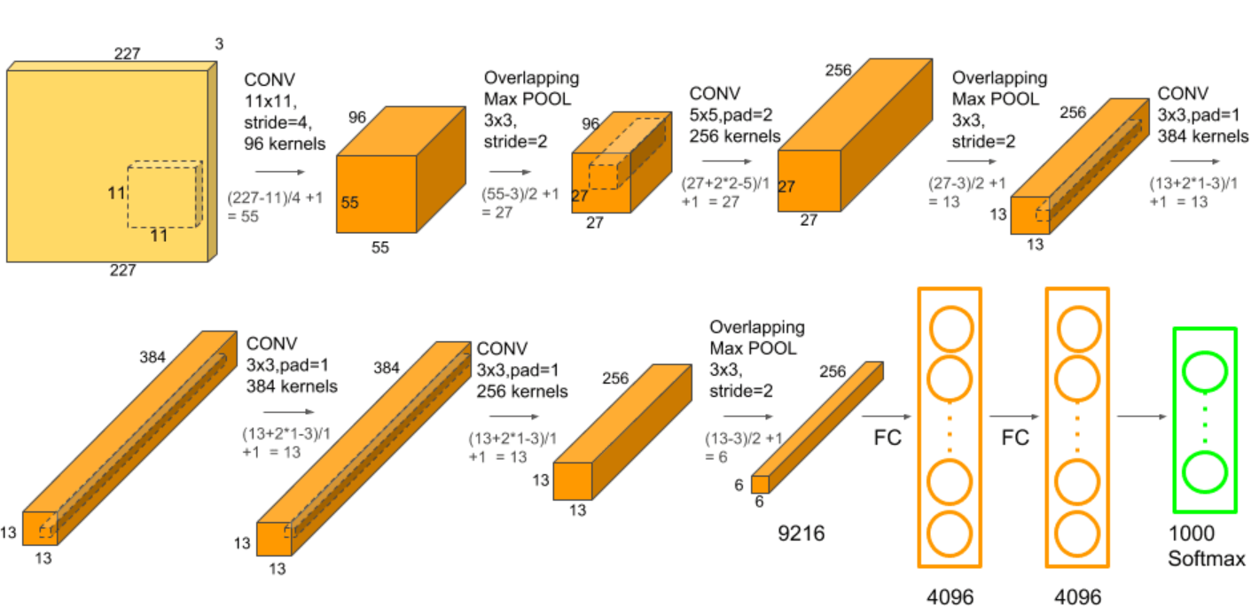
AlexNet Architecture

Slide 19
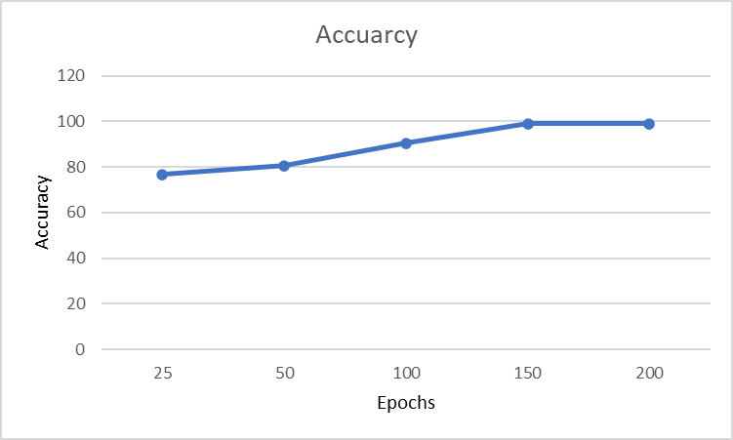
Accuracy Graph

Slide 20
Results
Total benign train accuracy :99.84%
Total benign test accuracy :86.38%
Total Adversarial training accuracy:78%
Total Adversarial test accuarcy:70%

Slide 21
Paper communication details
1. Classification of Kannada Character using Deep Learning – work in progress.
2. Preventing Adversarial Attacks on Neural Network – work in progress

Slide 22
Report Link
Project: Preventing Adversarial Attacks on Neural Network

Slide 23
References
1.Ren, Kui, Tianhang Zheng, Zhan Qin, and Xue Liu. "Adversarial attacks and defenses in deep learning." Engineering 6, no. 3 (2020): 346-360.
2.Kim, Hoki. "Torchattacks: A pytorch repository for adversarial attacks." arXiv preprint arXiv:2010.01950 (2020).
3.Goodfellow, Ian J., Jonathon Shlens, and Christian Szegedy. "Explaining and harnessing adversarial examples." arXiv preprint arXiv:1412.6572 (2014).
4.Wang, Derui, Chaoran Li, Sheng Wen, Surya Nepal, and Yang Xiang. "Defending against adversarial attack towards deep neural networks via collaborative multi-task training." IEEE Transactions on Dependable and Secure Computing (2020).
5.Liu, Ximeng, Lehui Xie, Yaopeng Wang, Jian Zou, Jinbo Xiong, Zuobin Ying, and Athanasios V. Vasilakos. "Privacy and security issues in deep learning: A survey." IEEE Access 9 (2020): 4566-4593.

Slide 24
References
6.Lu, Jiajun, Theerasit Issaranon, and David Forsyth. "Safetynet: Detecting and rejecting adversarial examples robustly." In Proceedings of the IEEE international conference on computer vision, pp. 446-454. 2017.
7.Papernot, Nicolas, Patrick McDaniel, Xi Wu, Somesh Jha, and Ananthram Swami. "Distillation as a defense to adversarial perturbations against deep neural networks." In 2016 IEEE symposium on security and privacy (SP), pp. 582-597. IEEE, 2016.
8.Yuan, Xiaoyong, Pan He, Qile Zhu, and Xiaolin Li. "Adversarial examples: Attacks and defenses for deep learning." IEEE transactions on neural networks and learning systems 30, no. 9 (2019): 2805-2824.
9.Samangouei, Pouya, Maya Kabkab, and Rama Chellappa. "Defense-gan: Protecting classifiers against adversarial attacks using generative models." arXiv preprint arXiv:1805.06605 (2018).

Slide 25
References
10.Huang, Ling, Anthony D. Joseph, Blaine Nelson, Benjamin IP Rubinstein, and J. Doug Tygar. "Adversarial machine learning." In Proceedings of the 4th ACM workshop on Security and artificial intelligence, pp. 43-58. 2011.
11.Yuan, Xiaoyong, Pan He, Qile Zhu, and Xiaolin Li. "Adversarial examples: Attacks and defenses for deep learning." IEEE transactions on neural networks and learning systems 30, no. 9 (2019): 2805-2824.
12.Chen, Hanjie, and Yangfeng Ji. "Adversarial Training for Improving Model Robustness? Look at Both Prediction and Interpretation." arXiv preprint arXiv:2203.12709 (2022).
13.Bai, Tao, Jinqi Luo, Jun Zhao, Bihan Wen, and Qian Wang. "Recent advances in adversarial training for adversarial robustness." arXiv preprint arXiv:2102.01356 (2021).

Slide 26
References
14.Ilyas, Andrew, Shibani Santurkar, Dimitris Tsipras, Logan Engstrom, Brandon Tran, and Aleksander Madry. "Adversarial examples are not bugs, they are features." Advances in neural information processing systems 32 (2019).
15., Yaxin, Wei Jin, Han Xu, and Jiliang Tang. "Deeprobust: A pytorch library for adversarial attacks and defenses." arXiv preprint arXiv:2005.06149 (2020).
16.Liu, Ximeng, Lehui Xie, Yaopeng Wang, Jian Zou, Jinbo Xiong, Zuobin Ying, and Athanasios V. Vasilakos. "Privacy and security issues in deep learning: A survey." IEEE Access 9 (2020): 4566-4593.

Slide 27
THANK YOU

