Slide 1

“Classification of Handwritten Bengali Alphabets and Kannada Digits”
Presenter :
Pratibha M Goudar [01FE20MCS010] II Sem MTech
Under the Guidance of: Dr. Meena S .M
Co-guide: Prof. Sunil V Gurlahosur
PG Coordinator: Dr. Vishwanath P . Baligar

Slide 2
Classification of Handwritten Bengali Alphabets and Kannada Digits
Structure of Presentation
Introduction
Literature Servey
Model details
Result Analysis
School of Computer Science and Engineering
1/31

Slide 3
Classification of Handwritten Bengali Alphabets and Kannada Digits
Introduction:
Bengali is the 5th most spoken language in the world with hundreds of million of speakers.
It’s the official language of Bangladesh and the second most spoken language in India.
Optical character recognition is particularly challenging for Bengali. While Bengali has 49 letters (to be more specific 11 vowels and 38 consonants) in its alphabet, there are also 18 potential diacritics, or accents.
School of Computer Science and Engineering
3/31

Slide 4
Classification of Handwritten Bengali Alphabets and Kannada Digits
This challenge hopes to improve on approaches to Bengali recognition.
Kannada is a language spoken predominantly by people of Karnataka in southwestern India.
The language has roughly 45 million native speakers and is written using the Kannada script.
Convolutional Neural Network with TensorFlow and keras more specifically, it is about a classification problem in regard to the recognition and prediction of the Bengali alphabets and kannada digits .
School of Computer Science and Engineering
4/31

Slide 5
Classification of Handwritten Bengali Alphabets and Kannada Digits
Problem Statement
Classification of Handwritten Bengali Alphabets and Kannada Digits using deep learning based convolutional neural network.
Objectives:
The image of a handwritten Bengali alphabets and are challenged to separately classify three constituent elements in the image: grapheme root, vowel diacritics, and consonant diacritics. And recognize the kannada digits we have to built model and get accuracy.
School of Computer Science and Engineering
<number>/31

Slide 6
Classification of Handwritten Bengali Alphabets and Kannada Digits
Literature Review
Paper title | dataset | Methodology | Result
A Large Multi-Target Dataset of Common Bengali Handwritten Graphemes published: 2020 | The dataset is open-sourced as a part of a public Handwritten Grapheme Classification | that deep learning methods can generalize to a large span of out of dictionary graphemes | CNN network used and get more Accurcy.
School of Computer Science and Engineering
<number>/31

Slide 7
Classification of Handwritten Bengali Alphabets and Kannada Digits
Literature Review
Paper title | dataset | Methodology | Result
Bengali Handwritten Character Classification using Transfer Learning on Deep Convolutional Neural Network Published: 16 June 2021 | Metadata information of training dataset and testing dataset | The model is a pre-trained Deep Convolutional Neural Network (CNN) called ResNet-50 . | to ensure that the model has not been overfitted or underfitted.
School of Computer Science and Engineering
<number>/31

Slide 8
Classification of Handwritten Bengali Alphabets and Kannada Digits
Literature Review
Paper title | dataset | Methodology | Result
A Hierarchical Method for Kannada-MNIST Classification Based on Convolutional Neural Networks "published in 2020 | Kannada MNIST | The two main methods for handwritten digit classification consist of learning-based methods and extraction of features approaches by traditional hand-crafted methods. | CNN models designed Kannada-MNIST dataset indicate its excellent performance because the accuracy on the training, validation, and test sets are 99.86%, 99.66%, and 99.80%.
School of Computer Science and Engineering
8/31

Slide 9
Classification of Handwritten Bengali Alphabets and Kannada Digits
Literature Review
Paper title | dataset | Methodology | Result
Kannada Mnist classification using CNN published in 2020 | Kannada MNIST | custom-built neural network using a skip connection after the Max pool layer. | Our main contribution is creating a model that achieves high accuracy by training on the Kannada-MNIST
School of Computer Science and Engineering
9/31

Slide 10
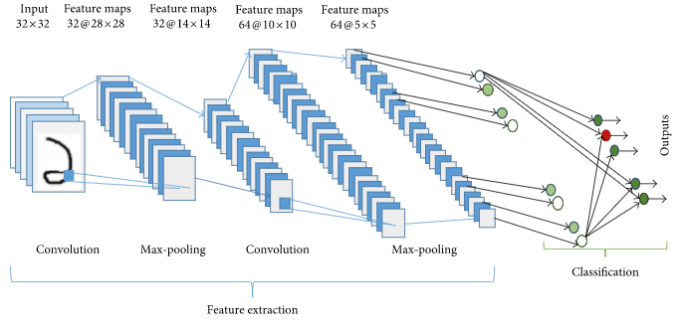
Classification of Handwritten Bengali Alphabets and Kannada Digits
.
Figure: Convolutional Neural Network
School of Computer Science and Engineering
<number>/31

Slide 11
Classification of Handwritten Bengali Alphabets and Kannada Digits
Import the libraries and load the datasets
Data Preprocessing and Normalize
Create model
Train the model
Evaluate the model
Figure: Blook diagram
School of Computer Science and Engineering
<number>/31

Slide 12
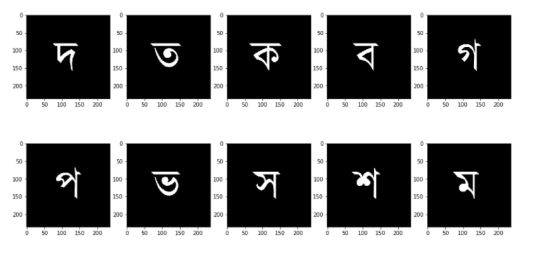
Classification of Handwritten Bengali Alphabets and Kannada Digits
Figure: Bengali Top 10 root images
School of Computer Science and Engineering
<number>/31

Slide 13
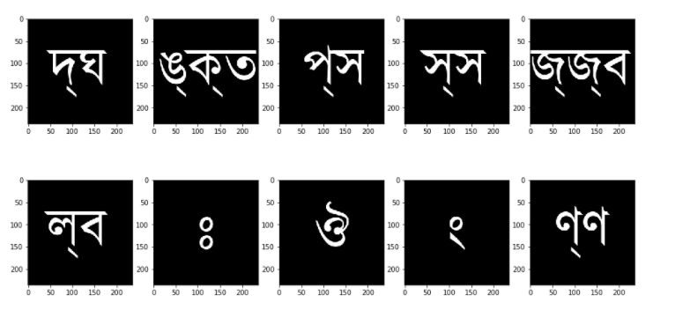
Classification of Handwritten Bengali Alphabets and Kannada Digits
Figure: Bengali Bottom 10 root images
School of Computer Science and Engineering
<number>/31

Slide 14
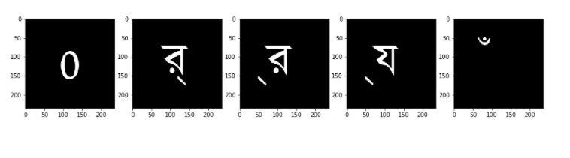
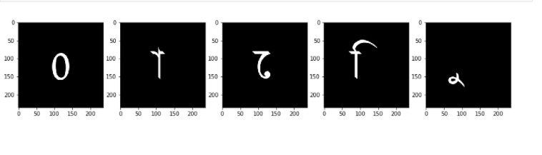
Classification of Handwritten Bengali Alphabets and Kannada Digits
Figure: Top 5 consonant images
Figure : Top 5 vowels images
School of Computer Science and Engineering
<number>//31

Slide 15
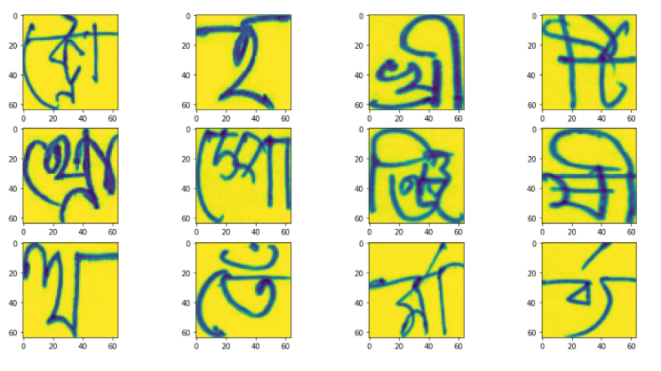
Classification of Handwritten Bengali Alphabets and Kannada Digits
Figure: Bengali Training sample images
School of Computer Science and Engineering
15/31

Slide 16
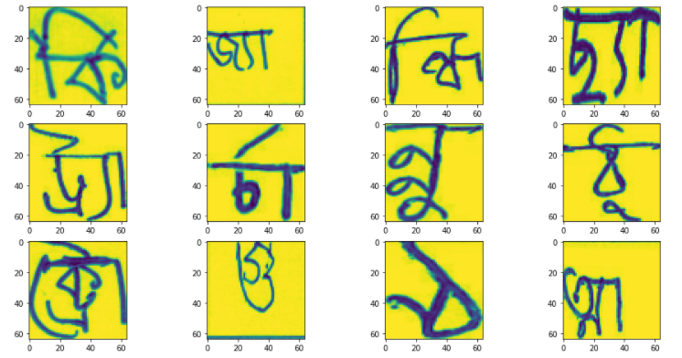
Classification of Handwritten Bengali Alphabets and Kannada Digits
Figure: Bengali Trained Consonant images
School of Computer Science and Engineering
<number>/31

Slide 17
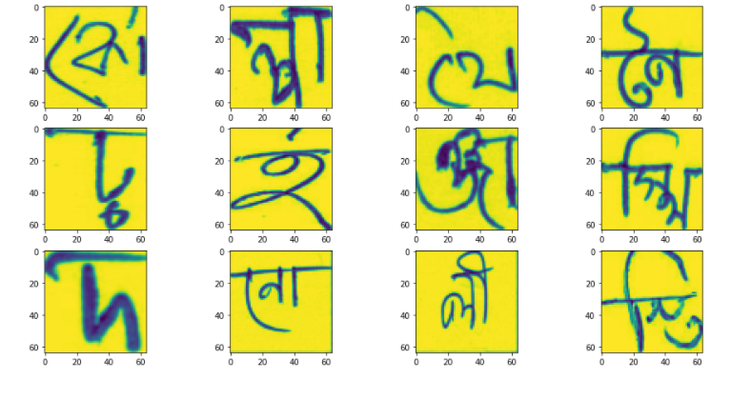
Classification of Handwritten Bengali Alphabets and Kannada Digits
Figure: Trained vowel images
School of Computer Science and Engineering
<number>/31

Slide 18
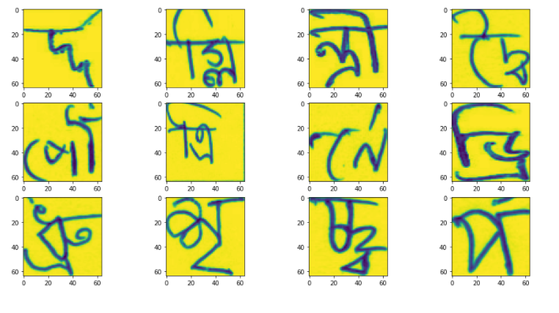
Classification of Handwritten Bengali Alphabets and Kannada Digits
Figure: trained root images
School of Computer Science and Engineering
<number>/31

Slide 19
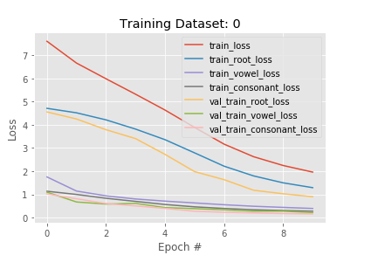
Classification of Handwritten Bengali Alphabets and Kannada Digits
Result Analysis
School of Computer Science and Engineering
<number>/31

Slide 20
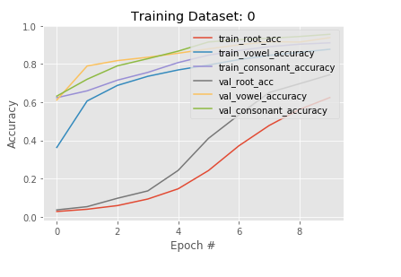
Classification of Handwritten Bengali Alphabets and Kannada Digits
School of Computer Science and Engineering
<number>/31

Slide 21
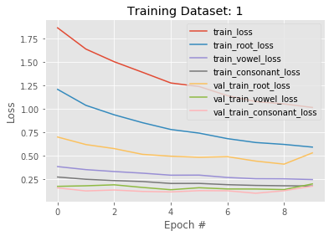
Classification of Handwritten Bengali Alphabets and Kannada Digits
School of Computer Science and Engineering
<number>/31

Slide 22
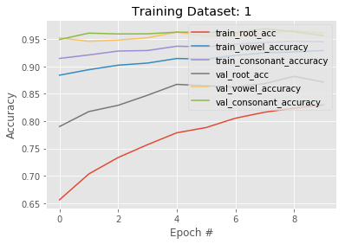
Classification of Handwritten Bengali Alphabets and Kannada Digits
School of Computer Science and Engineering
<number>/31

Slide 23
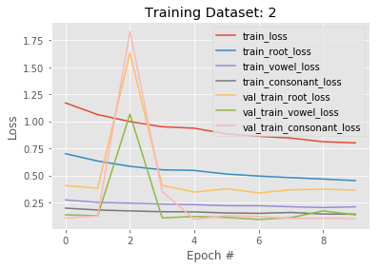
Classification of Handwritten Bengali Alphabets and Kannada Digits
School of Computer Science and Engineering
<number>/31

Slide 24
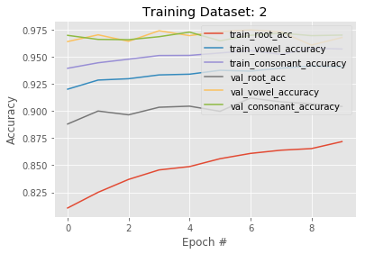
Classification of Handwritten Bengali Alphabets and Kannada Digits
School of Computer Science and Engineering
<number>/31

Slide 25
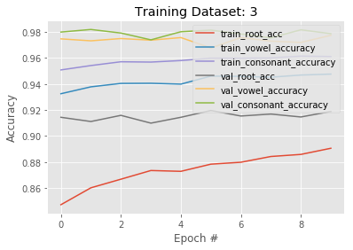
Classification of Handwritten Bengali Alphabets and Kannada Digits
School of Computer Science and Engineering
<number>/31

Slide 26
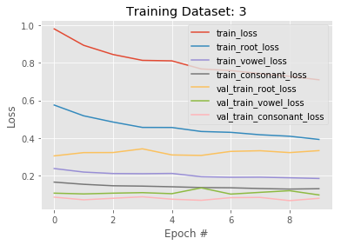
Classification of Handwritten Bengali Alphabets and Kannada Digits
School of Computer Science and Engineering
<number>/31

Slide 27
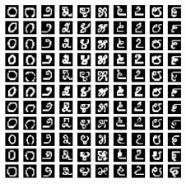
Classification of Handwritten Bengali Alphabets and Kannada Digits
Figure: Sample kannada digits
School of Computer Science and Engineering
<number>/31

Slide 28
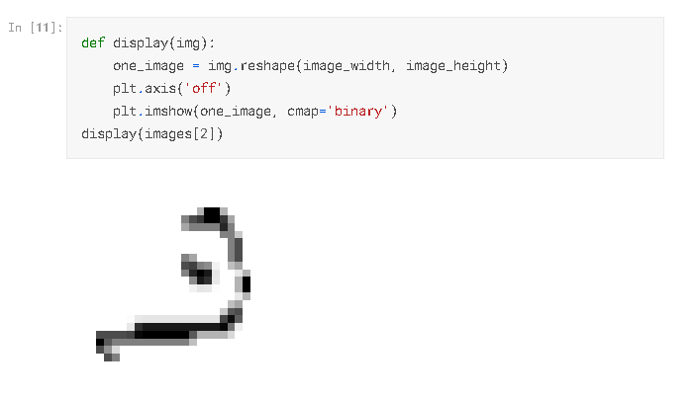
Classification of Handwritten Bengali Alphabets and Kannada Digits
Figure: kannada digit recognition
School of Computer Science and Engineering
<number>/31

Slide 29
Classification of Handwritten Bengali Alphabets and Kannada Digits
Conclusion
We have successfully built deep learning sequential model for Bengali Alphabets
With 96% accuracy and kannada digits with 99% accuracy.
We have built trained CNN which is very effective for image classification .
School of Computer Science and Engineering
<number>/31

Slide 30
Classification of Handwritten Bengali Alphabets and Kannada Digits
References:
[1] Hasan, Md Mahedi, Mahathir Mohammad Abir, Mohammad Ibrahim, Muhammad Sayem, and Sohaib Abdullah. "Aibangla: A benchmark dataset for isolated bangla handwritten basic and compound character recognition." In 2019 International Conference on Bangla Speech and Language Processing (ICBSLP), pp. 1-6. IEEE, 2019.
[2] Mamun, Mamunur Rahaman, Zabir Al Nazi, and Md Salah Uddin Yusuf. "Bangla handwritten digit recognition approach with an ensemble of deep residual networks." In 2018 International Conference on Bangla Speech and Language Processing (ICBSLP), pp. 1-4. IEEE, 2018.
[3]Beikmohammadi, Ali, and Najmeh Zahabi. "A Hierarchical Method for Kannada-MNIST Classification Based on Convolutional Neural Networks." In 2021 26th International Computer Conference, Computer Society of Iran (CSICC), pp. 1-6. IEEE, 2021.
[4]GATI, ELVIS S., BENJAMIN D. NIMO, and ELISHA K. ASIAMAH. "Kannada-Mnist Classification Using Skip CNN." In 2019 16th International Computer Conference on Wavelet Active Media Technology and Information Processing, pp. 245-248. IEEE, 2019.
[5]Aradhya, VN Manjunath, G. Hemantha Kumar, and S. Noushath. "Robust unconstrained handwritten digit recognition using radon transform." In 2007 International Conference on Signal Processing, Communications and Networking, pp. 626-629. IEEE, 2007.
School of Computer Science and Engineering
<number>/31

Slide 31
THANK YOU
School of Computer Science and Engineering
31/31

