Slide 1

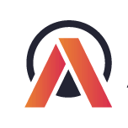

Generating Insights to solve a Supply chain issue in the FMCG Domain

Slide 2
Problem Statement AtliQ Mart is a growing FMCG manufacturer headquartered in Gujarat, India. It is currently operational in three cities Surat, Ahmedabad and Vadodara. They want to expand to other metros/Tier 1 cities in the next 2 years. AtliQ Mart is currently facing a problem where a few key customers did not extend their annual contracts due to service issues. It is speculated that some of the essential products were either not delivered on time or not delivered in full over a continued period, which could have resulted in bad customer service. Management wants to fix this issue before expanding to other cities and requested their supply chain analytics team to track the ’On time’ and ‘In Full’ delivery service level for all the customers daily basis so that they can respond swiftly to these issues. The Supply Chain team decided to use a standard approach to measure the service level in which they will measure ‘On-time delivery (OT) %’, ‘In-full delivery (IF) %’, and OnTime in full (OTIF) %’ of the customer orders daily basis against the target service level set for each customer.

Slide 3
Cities To Track For
VADODARA
AHMEDABAD
SURAT
Categories Present
DAIRY
BEVERAGES
FOOD

Slide 4
Key Metrics used to Track our project
On time delivery(OT)=All items delivered at the promised time
OT% =Number of orders delivered On Time / Total Number of Orders
In full delivery(IF)=Order quantity is delivered full as per the requested quantity
IF%=Number of orders delivered in Full quantity / Total Number of Orders
On time In full delivery(OTIF)=Order is delivered on time and in full quantity
OTIF%= Number of orders delivered both IN Full & On Time / Total Number of Orders
Line full rate (LIFR)=Line Fill Rate is an important metric for the supply planning team to understand how many lines they shipped out of the total lines ordered. This metric does not consider the delivery time of the order.
LIFR%=Number of order lines shipped In Full Quantity / Total Order Lines
Volume Fill Rate (VOFR)=Volume fill rate or case fill rate is a similar metric useful for the supply planning team to understand the total quantity they are able to ship for a customer per order or for a given period of time
VOFR%=Total Quantity shipped / Total Quantity Ordered

Slide 5
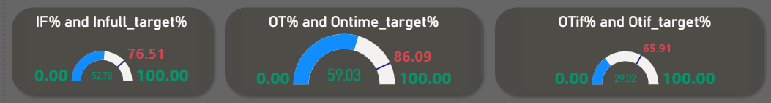
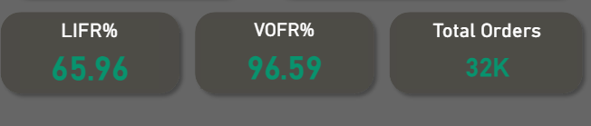
IF ,OT,OTIF WITH RESPECT TO THEIR TARGETS
We can clearly see the difference between the metrics and their respective targets.
LINE FILL RATE,VOLUME FILL RATE AND TOTAL ORDERS
Line fill rate is 65.96 %,Volume fill rate is 96.59% for a total orders of about 32k.

Slide 6
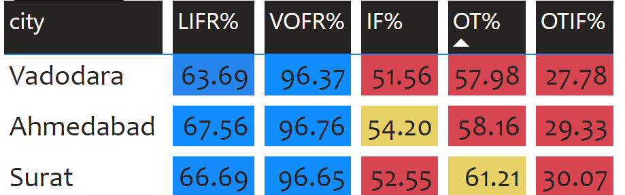
CITY WISE SPLIT OF METRICS
For Vadodara and Ahmedabad OT% and OTIF% is far from targets
For Surat IF% is far from Target.

Slide 7
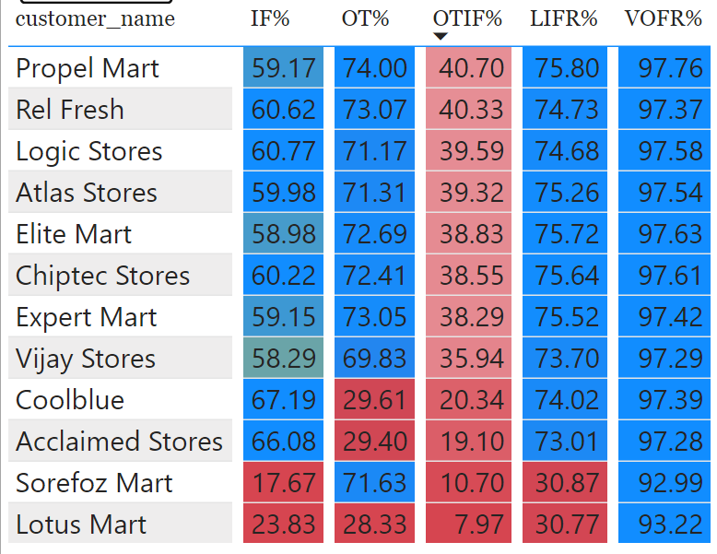
Checking for customers individually for each city
AHMEDABAD
Coolblue,acclaimed stores,sorefoz mart ,lotus mart have the values of metrics way less then targets,so we need to pay attention over these customers .

Slide 8
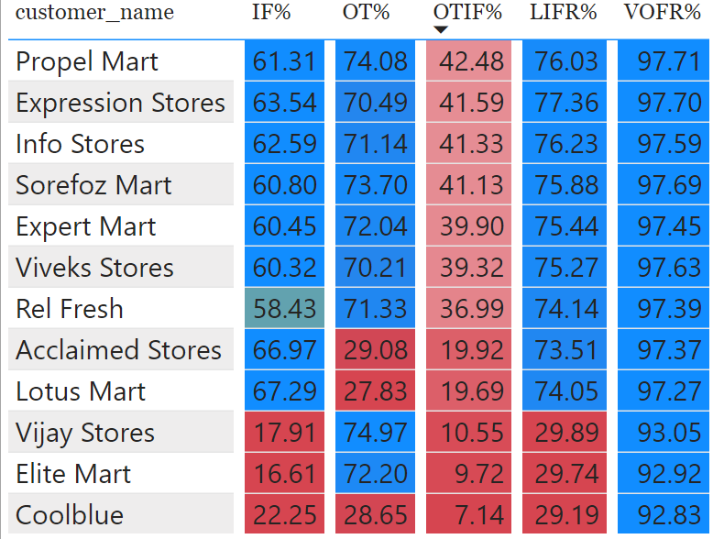
Vadodara
Coolblue,acclaimed stores,lotus mart have the values of OT metrics way less then targets,so we need to pay attention over these customers .
IF and LIFR is less for vijay stores,elite mart ,coolblue.

Slide 9
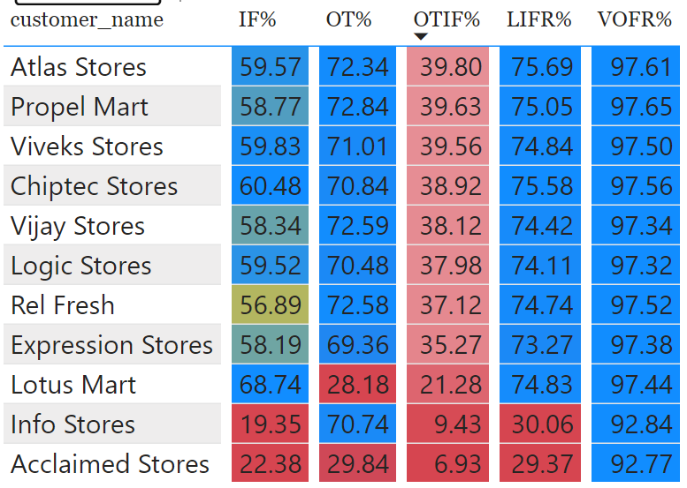
SURAT
Info Stores,acclaimed stores,lotus mart have the values of IF metrics way less then targets.
Lotus mart and acclaimed stores have way less OT and LIFR

Slide 10
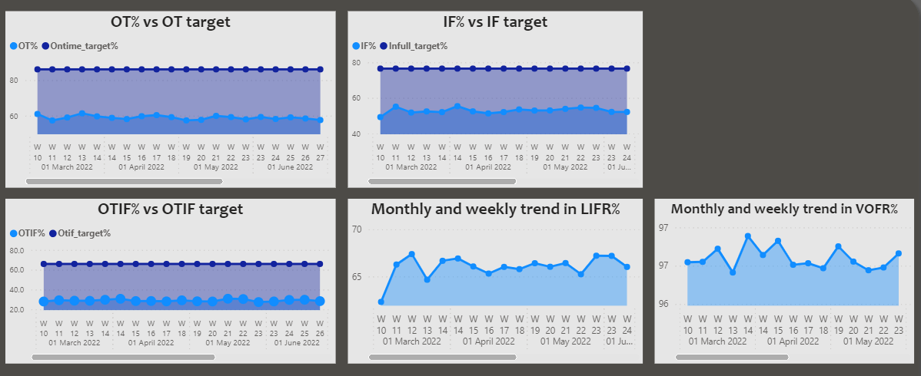
Targets of metrics and timely trend in LIFR and VOFR
Clearly,we can see that target value is never reached for any metrics
Mainly,customers such as coolBlue,AcclaimedStore,LotusMart generally have a low IF and OT values
OTIF values was never satisfying for any of the customers present

Slide 11
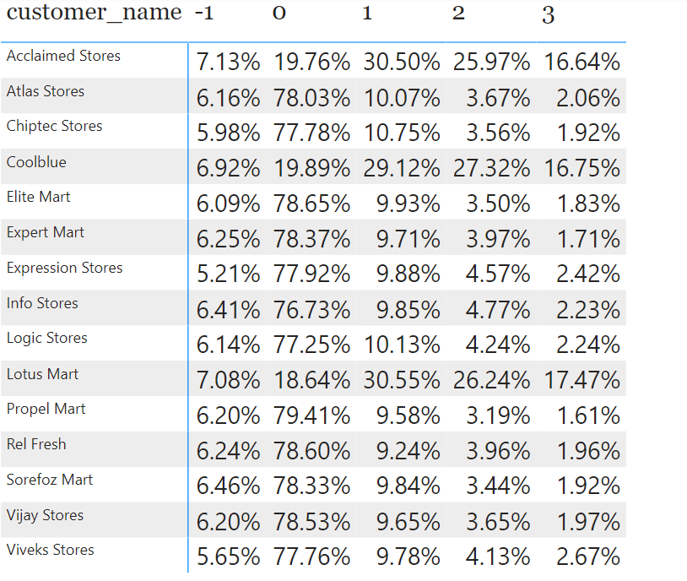
Delaying in days
Clearly,It can be observed that most of the delays are happening for either one or two days for most of the customers.

Slide 12
THANK YOU

