Slide 1
Chess boys
Brandyn fix me plz

Slide 2
The project
Chess
React
The code is complicated but the concept isn’t
Notes:
Prtiibh

Slide 3
The team
https://401-chess-team.github.io/Chess-react/
Notes:
All of us

Slide 4
Problem domain
Learning
Series of intense code challenges
e.g. : 2 dimensional array manipulation
board[0][0].move( [2,0] , board, arrOfPieces)
React routing
Notes:
AJ

Slide 5
Working application
Insert link here

Slide 6
How do knights move?
Notes:
Lee

Slide 7
Notes:
Lee

Slide 8
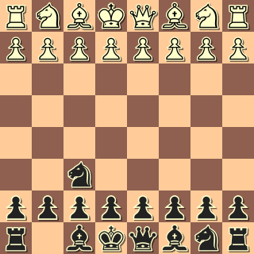
Notes:
lee

Slide 9
Can Move
Cannot Move
Notes:
lee

Slide 10
knightMoves = [
[2 , 1],
[-2, -1],
[2 , -1],
[-2, 1],
[1 , 2],
[1 , -2],
[-1, 2],
[-1, -2]
];
Notes:
lee

Slide 11
The magic part 1
let arrAdd = function(current, delta) {
let [cy, cx] = [...current];
let [dy, dx] = [...delta];
[cy, cx, dy, dx] = [
parseInt(cy),
parseInt(cx),
parseInt(dy),
parseInt(dx)
];
return [cy + dy, cx + dx];
};
Notes:
lee

Slide 12
The magic part 2
let possMoves = [];
knightmoves.forEach(move => {
possMoves.push(arrAdd(this.currentSpace, move));
});
possMoves = possMoves.filter(move => this.canMove(move, board));
newAvailableMoves = [...possMoves];
return newAvailableMoves;
Notes:
lee

Slide 13
The magic part 3
canMove(space, board) {
let [s, b] = [space, board];
if (
this.isOnBoard(space) &&
!this.isFriend(s, b) &&
(this.isEmpty(s, b) || this.isFoe(s, b))
) {
return true;
} else {
return false;
}
}
Notes:
lee

Slide 14
isFriend
isFriend(space, board) {
let [y, x] = [space[0], space[1]];
if (board[y][x] && board[y][x].color === this.color) {
return true;
} else {
return false;
}
}
Notes:
lee

Slide 15
isFoe
isFoe(space, board) {
if (
board[space[0]][space[1]] &&
board[space[0]][space[1]].color &&
board[space[0]][space[1]].color !== this.color
) {
return true;
} else {
return false;
}
}
Notes:
lee

Slide 16
isEmpty
isEmpty(space, board) {
if (board[space[0]][space[1]] && board[space[0]][space[1]].color) {
return false;
} else {
return true;
}
}
Notes:
lee

Slide 17
IsOnBoard
isOnBoard(space) {
let [y, x] = [...space];
if (y >= 0 && y <= 7 && x >= 0 && x <= 7) {
return true;
} else {
return false;
}
}
Notes:
lee

Slide 18
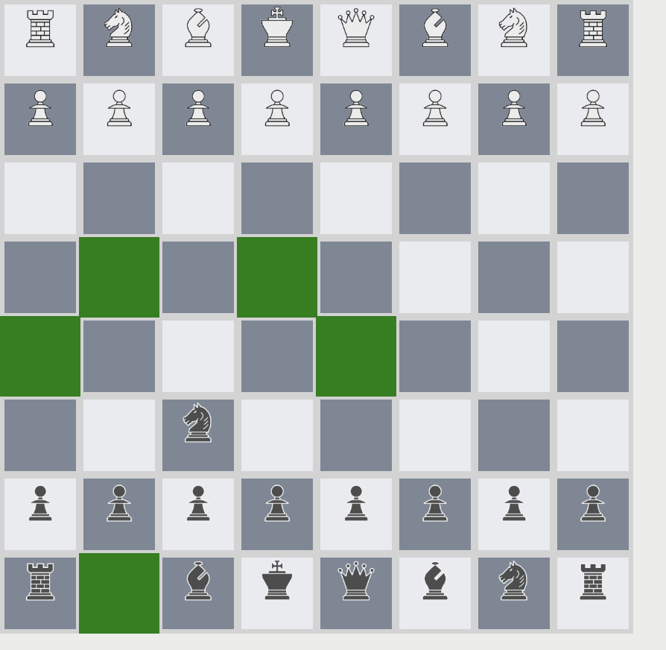
IRL how it looks
Notes:
lee

Slide 19
How do Queens, Rooks, and Bishops move?
Notes:
lee

Slide 20
Notes:
lee

Slide 21
Can Move
Cannot Move
Notes:
lee

Slide 22
It slides everywhere
howItMoves = (currentSpace, color, board) => {
let newAvailableMoves = [];
//left slide
this.slide([0, -1],
this.currentSpace, board).forEach(move =>
newAvailableMoves.push(move)
);
…. Also every other direction
But what is slide?
Notes:
lee

Slide 23
Slide
slide(direction, currentSpace, board) {
let newAvailableMoves = [];
let [y, x] = [currentSpace[0], currentSpace[1]];
let [dy, dx] = [direction[0], [direction[1]]];
let current = [y + parseInt(dy), x + parseInt(dx)];
while (this.canMove(current, board)) {
let [cy, cx] = [...current];
newAvailableMoves.push(current);
if (this.isFoe(current, board)) {
break;
}
current = [cy + parseInt(dy), cx + parseInt(dx)];
}
return newAvailableMoves;
}
Notes:
lee

Slide 24
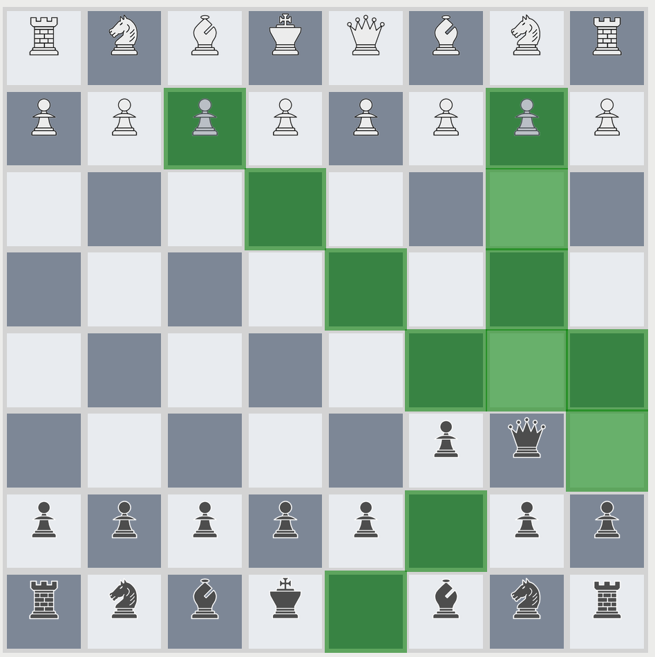
irl
Notes:
lee

Slide 25
Our solution
React
State management
DB handles minimum data
Tackle challenge without outside help
NO dependancies (outside react/ react-router)
Focus on Inheritance/ class structure
Notes:
Lee

Slide 26
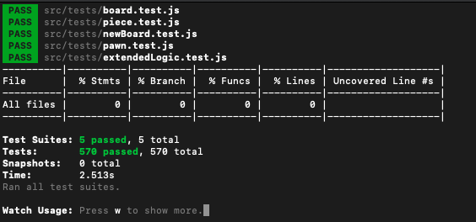
Show Your Tests
Show them
Notes:
lee

Slide 27
Workflow and process
Commit graph
Trello
Slack integrated with github
Time commitment in person
Notes:
brandyn

Slide 28
Slide: Highlight your wins
Available Moves
Check
Move logic
Do many moves
DB schema
Move list
Notes:
aj

Slide 29
Areas for growth
2d arrays are difficult to parse (for humans)
Socket.io
Checkmate
Castling
Notes:
pratiibh

Slide 30
Questions and Answers
Hit us, we are ready
Notes:
All of us

