Slide 1
CALIBO AI ACADEMY | MANTHAN HACKATHON | KLU + PATH3 | ML-01
DeliveryIQ
ETA + late risk, at checkout
customer
Quick-commerce delivery intelligence: predict the ETA, flag late orders, plan the riders.
“Know at checkout how long an order will take — and whether it will be late.”
store
TEAM GENESIS GRID · GROUP 4
01
02
03
04
05
Manda Lohitha
Pratik Jankiram Pattewar
K Bonishira Akshaya
Yatheesh Chandra Maram
Sanapalli Vikas
Notes:
SPEAKER: Manda Lohitha · ~35 s
Good morning. We are Team Genesis Grid, Group 4. I'm Lohitha, and with me are Pratik, Bonishira, Yatheesh and Vikas.
Our project is DeliveryIQ. The idea is simple: at the moment a customer places an order, we predict how long it will take and how likely it is to be late. Then we turn that into decisions an operations team can actually use.
TRANSITION: "Let me start with why this matters."

Slide 2
Late deliveries are expensive — and hard to see coming
29.8%
Why it hurts
A missed promise means a cancellation, refund or lost customer
The ETA the customer sees is often wrong
Ops learns an order is late only after it is already late
of 45,593 orders took more than 30 minutes
What we set out to do
“Late” = more than 30 min — our project benchmark. The dataset has no official SLA.
Predict the delivery time (ETA)
Flag late-risk orders at checkout
Find when and where delays concentrate
Turn the evidence into management actions
Order placed
ETA predicted
Late risk flagged
Ops acts early
Notes:
SPEAKER: Manda Lohitha · ~50 s
In quick commerce, a broken delivery promise can mean a cancellation, a refund or a lost customer. In our dataset, almost 3 in every 10 orders took more than 30 minutes. That 30-minute line is our own benchmark, because the data has no official SLA.
The real problem is timing: a late order is usually discovered only after it is already late. So we set four goals: predict the ETA, flag risky orders at checkout, understand where and when delays concentrate, and convert that into concrete actions.
[The four arrows at the bottom appear automatically.]
TRANSITION: "Bonishira will explain the data we worked with."

Slide 3
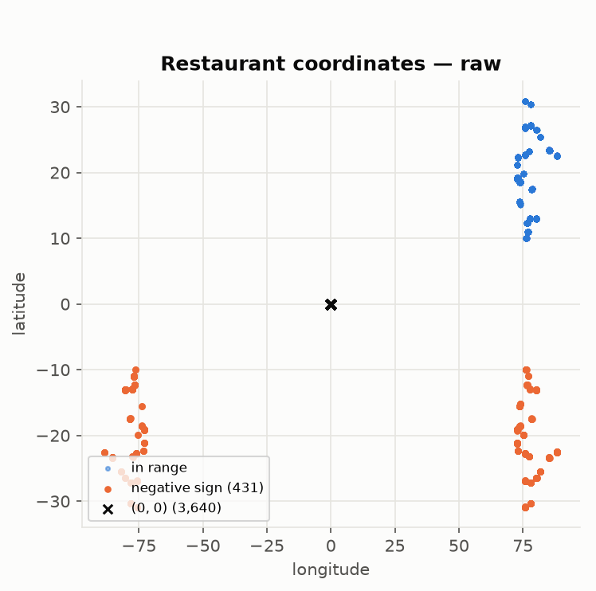
45,593 orders: cleaned, not deleted
45,593 orders · 20 columns · 22 Indian cities · 11 Feb – 6 Apr 2022 · delivery time 10–54 min
What our audit found | Count | What we did
Missing values hidden as the text “NaN” | 4,225 rows | Converted to real blanks; never guessed
Restaurant GPS recorded as (0, 0) | 3,640 | Flagged invalid; never estimated
Coordinates with a flipped minus sign | 431 | Fixed only when 4 geographic checks agreed
Impossible riders (age 15 / rating 1, age 50 / rating 6) | 91 | Blanked as placeholders; originals kept
Missing order time | 1,731 | Kept; never rebuilt from pickup time
0
0
4
rows deleted
duplicate rows
checks before any GPS fix
Raw restaurant locations from the dataset: 431 sign-flipped points (orange) and 3,640 at (0, 0).
Notes:
SPEAKER: K Bonishira Akshaya · ~70 s
We used the food-delivery dataset recommended in the challenge guide, with restaurants standing in for dark stores: 45,593 orders across 22 cities.
Before modelling, we audited every column, and the data was messier than it looked. Missing values were hidden as the text "NaN", so pandas first reported zero missing values; in fact 4,225 rows had gaps. 3,640 restaurants sat at latitude-longitude zero — that's the cross on this chart — and 431 had a flipped minus sign, the orange points. We corrected those only when four independent checks agreed.
Our rule was simple: flag problems, never invent values, and delete nothing. Every cleaning step can be re-run from the raw file and gives an identical result.
TRANSITION: "With the data investigated, here's how we built the models."

Slide 4
From raw data to a prediction — without leakage
Raw CSV
Audit & clean
Build features
Split by date
Compare models
Save models
Prediction app
Used at checkout · 13 features
Held back — only known after checkout
Store location and delivery distance (Haversine)
Order hour, time band, day of week, weekend
Order type, city type, festival day
Pickup time, rider age and rating, vehicle
Multiple deliveries, traffic, weather
Using them at checkout would be data leakage
Train on the past, test on the future
Every model must beat a simple baseline
Preprocessing fitted on training data only
Python · pandas · scikit-learn · Streamlit
Train · 11 Feb – 29 Mar · 37,123 orders
Test · 30 Mar – 6 Apr · 8,470 orders, never used for tuning
Notes:
SPEAKER: K Bonishira Akshaya · ~75 s
Here's our pipeline [the steps build left to right automatically].
The most important decision is in the feature selection. A prediction made at checkout can only use information that exists at checkout. Pickup time, rider details, traffic and weather are known later — or their recording time isn't documented — so using them in the checkout model would be data leakage. We kept 13 order-time features: distance, time of day, day of week, order type, city type and festival.
Second, we split by date: we trained on February and March and tested on the final eight days, 8,470 orders the models never saw during tuning.
Third, every model had to beat a simple baseline, and all preprocessing was fitted on training data only. We built it in Python with pandas and scikit-learn, with a Streamlit interface.
TRANSITION: "Pratik will show how DeliveryIQ turns those inputs into predictions."

Slide 5
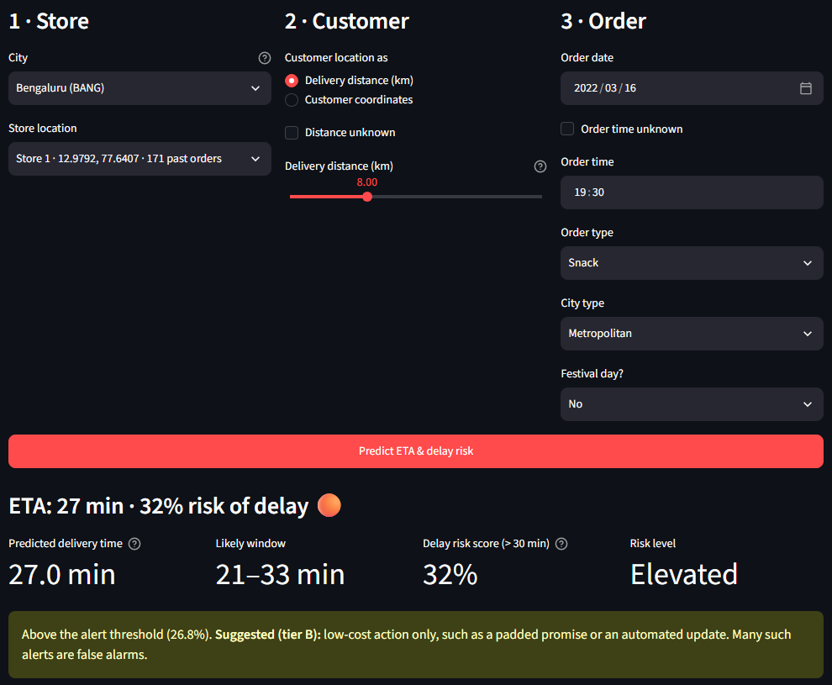
From order details to an actionable prediction
In — what is known at checkout
store · delivery distance · date & time · order type · city type · festival
Out — what DeliveryIQ returns
ETA · late-risk score · risk level · suggested action · why this prediction
A · Weekday 09:15 · 3 km
B · Evening 20:00 · 16 km
18.1 min
32.9 min
risk 2%
LOW
risk 61%
HIGH
morning saves ≈2 min
distance adds ≈4.6 min
Checked earlier: 18/18 automated app tests; the app matched the training pipeline on 600 test orders. Risk % is an uncalibrated ranking score, not a guarantee.
Actual DeliveryIQ screen — local run during our project audit (11 Nov 2026), default example order.
Notes:
SPEAKER: Pratik Jankiram Pattewar · ~2 min 50 s (including the optional live demo)
[Slide works on its own — no live demo needed.]
This is DeliveryIQ's prediction workflow. A user enters only what is known at checkout — the store, the delivery distance, date and time, order type, city type and festival — and gets back an ETA, a late-risk score, a risk level, a suggested action and a short "why this prediction".
On the left is our actual app screen from a local run: this default order gets 27 minutes, a 32% risk score and an "Elevated" level, so the app suggests only a low-cost action.
Two verified examples on the right [they appear automatically]:
A — a weekday morning order at 09:15, 3 km: ETA 18.1 minutes, risk 2%, Low. No action needed.
B — the evening peak at 20:00, 16 km: ETA 32.9 minutes, risk 61%, High. That's an order to prioritise and to warn the customer about early. Distance alone adds about 4.6 minutes here.
The point is to find the orders that deserve attention before they become late. These are model outputs, not delivery guarantees — the risk percentage ranks orders; it isn't a calibrated probability.
OPTIONAL LIVE DEMO (only if the app is already open and working; never debug on stage):
- Start before the session with: .\.venv\Scripts\python.exe -m streamlit run app/streamlit_app.py (first load ≈25 s).
- Quick example → "Weekday morning, short trip" → Predict → expect 18.1 min · 2% · Low.
- Quick example → "Evening peak, long trip" → Predict → expect 32.9 min · 61% · High.
- If it does not respond within 10 seconds, come straight back to this slide and continue.
TRANSITION: "Now let's see how these models performed on unseen test data."

Slide 6
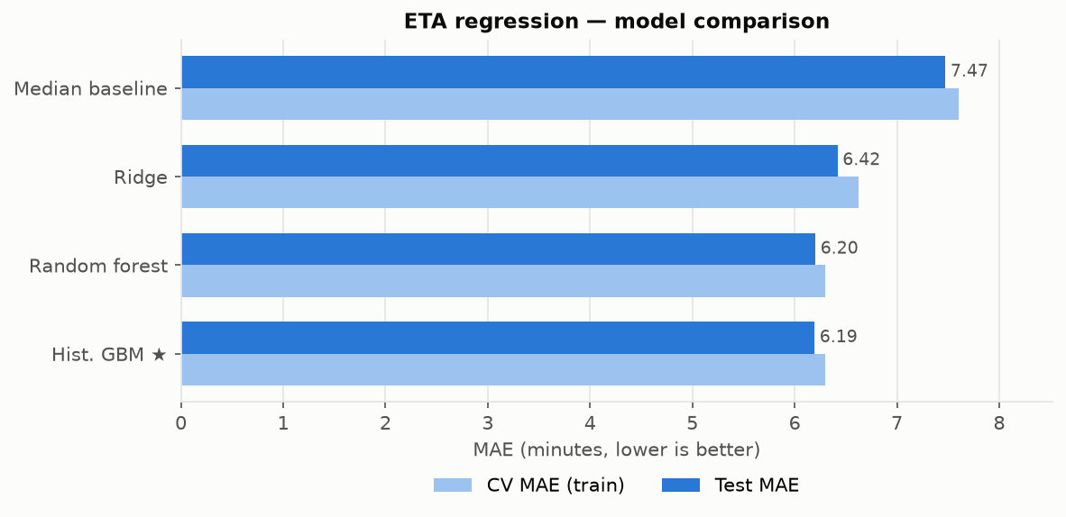
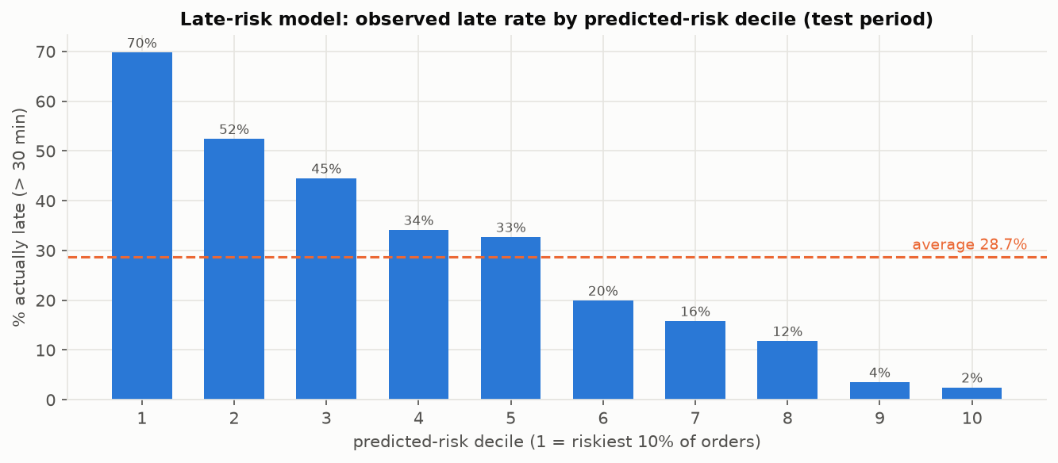
Better than guessing — and built to catch late orders
6.19 min
81%
typical ETA error (MAE) — 17.5% lower than guessing the average (7.51 min)
of late test orders flagged (recall) — precision 47% · ROC-AUC 0.79 · PR-AUC 0.61
Riskiest 10% of orders: ≈70% late — 2.4× the 28.7% average.
1,978 of 2,432 late orders caught · 454 missed · 2,259 false alarms · threshold 0.268 set on training data only.
Random forest (6.20) and gradient boosting (6.19) are a tie; we chose by training cross-validation, and it is lighter to run. RMSE 7.73 · R² 0.31
Notes:
SPEAKER: Yatheesh Chandra Maram · ~80 s
For ETA, we compared three models against simply guessing the average. Gradient boosting reached a typical error of about 6.2 minutes — 17.5% better than guessing. Random forest was practically tied, 6.20 against 6.19, so we chose using cross-validation on the training data only; it's also lighter to run.
[Right side appears automatically.]
For late risk, we optimised for recall, because missing a genuinely late order costs more than sending an extra alert. We catch about 81% of late orders. Look at this chart: among the 10% of orders the model ranks riskiest, about 70% were actually late — roughly two and a half times the normal rate.
The honest trade-off is false alarms: 2,259 against 1,978 caught. That's why our recommendations use different levels of intervention instead of treating every alert the same.
TRANSITION: "So what did the data reveal about why orders are late?"

Slide 7
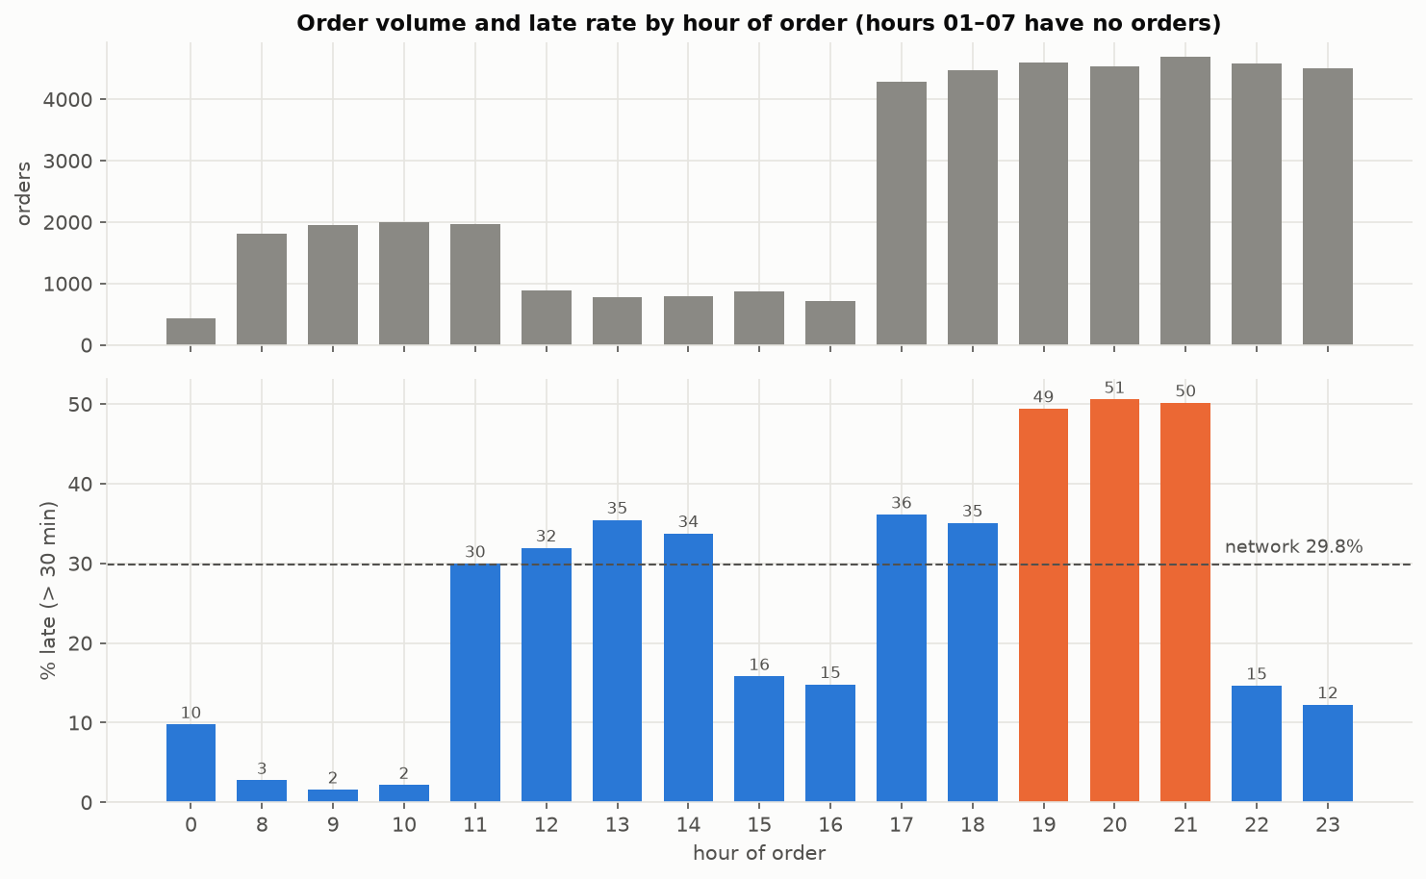
Delays follow the clock, not the map
≈50%
of orders placed 19:00–21:59 were late (overall: 29.8%)
84.5%
of all late orders were placed between 15:00 and 23:59
+58 pp
fog vs sunny late rate in jam traffic — only +4 pp in low traffic
≈9%
of delivery-time variation is explained by distance alone
Where the data stopped us — and how we proved it
Dark-store zones (PS6): our 22 clusters are the 22 cities — city labels alone give the same 0.948 score, and 0 of 22 zones are significantly worse. We claim no store sites.
Rider segments (PS7): 1,320 “rider” IDs, each with 4–22 different ages — they are not people. Real rider IDs would be needed; we claim no rider segments.
Notes:
SPEAKER: Yatheesh Chandra Maram · ~70 s
The strongest pattern is time. Orders placed between 7 and 10 pm are about half late — the orange bars — and the afternoon-to-night window holds about 85% of all late orders.
Weather matters mainly when traffic is heavy: in a jam, fog orders are 58 percentage points more often late than sunny ones, but only 4 points in light traffic. Distance alone explains surprisingly little — about 9%. These are associations we observed, not proven causes.
We were also honest about where the data stopped us. Our clustering found 22 groups, but they are exactly the 22 cities — the city labels alone score the same 0.948 — and no zone was statistically worse, so we don't claim dark-store locations. And each "rider ID" has up to 22 different ages, so the IDs aren't real riders. We tested these limits instead of hiding them.
TRANSITION: "Vikas will now explain what a company can do with these findings."

Slide 8
Three actions a delivery team can start with
ACTION
EVIDENCE
WHAT TO DO
BENEFIT
1
Risk-based alerts at checkout
Flags 81% of late orders; the riskiest 10% were ≈70% late
Top-risk orders: priority dispatch and an early customer update. Others: a low-cost message only
MEASURED 81% of late orders flagged in advance
POTENTIAL earlier intervention
2
Two-stage ETA
Separate post-dispatch experiment (rider + traffic data): ETA error 6.19 → 3.67 min. Not the checkout model; not production-ready
Give an ETA at checkout; refresh it when a rider is assigned
POTENTIAL more reliable ETAs after dispatch
3
Evening surge planning
19:00–21:59 orders ≈50% late; 15:00–23:59 holds 84.5% of late orders
Extra riders 19:00–22:00, wider evening promises, a festival-day plan
POTENTIAL better peak readiness — to be measured in a pilot
Measured = observed on our test data. Potential = expected benefit, not yet measured.
Notes:
SPEAKER: Sanapalli Vikas · ~75 s
We translated our findings into three management actions [each row appears in turn].
One — risk-based alerts at checkout. The highest-risk orders get priority dispatch and an early customer update. Because false alarms exist, the rest get only a cheap automated message. What's measured is that 81% of late orders can be flagged before they're late.
Two — a two-stage ETA: one estimate at checkout, and a refreshed one once a rider is assigned. A separate post-dispatch comparison experiment, using rider and traffic information, cut the ETA error from 6.19 to 3.67 minutes. It is not our checkout ETA model and not production-ready — it's evidence for the idea.
Three — evening surge planning: extra rider capacity from 7 to 10 pm, wider promises in the peak and a festival-day plan.
We've marked clearly what is measured and what is a potential benefit — we're not claiming savings we haven't measured.
TRANSITION: "Here's what we would build next."

Slide 9
What better data would unlock next
Built and validated
1
2
3
ETA model — MAE 6.19 min
Late-risk model — recall 81%
Reproducible data pipeline
Streamlit prediction app
Automated validation (18/18)
Insights + 3 management actions
Better data
Better models
Production
Real rider IDs + trip history → true rider segments (PS7)
Real customer locations, demand and costs → dark-store placement (PS6)
Two-stage ETA, after checking when each field is recorded
Calibrated risk percentages
Live traffic and weather, once their timing is verified
Cloud deployment of the app
Monitoring and periodic retraining
A pilot to measure real impact
Why data comes first: problem statements 6 and 7 were limited by the dataset, not by the method — the same pipeline can run on better data.
Notes:
SPEAKER: Sanapalli Vikas · ~35 s
DeliveryIQ already has a reproducible data pipeline, saved prediction models and a validated app.
The next improvements depend mostly on better data: real rider identities would unlock genuine rider segments, and real customer locations and costs would make dark-store placement meaningful. On the modelling side we'd build the two-stage ETA, calibrate the risk scores and add live traffic and weather once we can confirm when they're recorded. Finally, deployment with monitoring, retraining and a pilot to measure the real impact.
TRANSITION: "To close, here's what DeliveryIQ brings together."

Slide 10
An ETA before the delay.
A warning before it happens.
17.5%
81%
Leakage-aware
lower ETA error than guessing the average
of late test orders flagged at checkout
reproducible pipeline — the data rebuilds byte-for-byte
Thank you — happy to take your questions
TEAM GENESIS GRID · GROUP 4
Manda Lohitha · Pratik Jankiram Pattewar · K Bonishira Akshaya · Yatheesh Chandra Maram · Sanapalli Vikas
Notes:
SPEAKER: Sanapalli Vikas · ~25 s
DeliveryIQ gives a quick-commerce team two things at checkout: an ETA that beats guessing by 17.5%, and a warning for about 8 in 10 late orders — built without data leakage and fully reproducible. We also showed honestly where this dataset stops, and what data would take it further.
Thank you. We are Team Genesis Grid, and we're happy to answer your questions.

