Slide 1
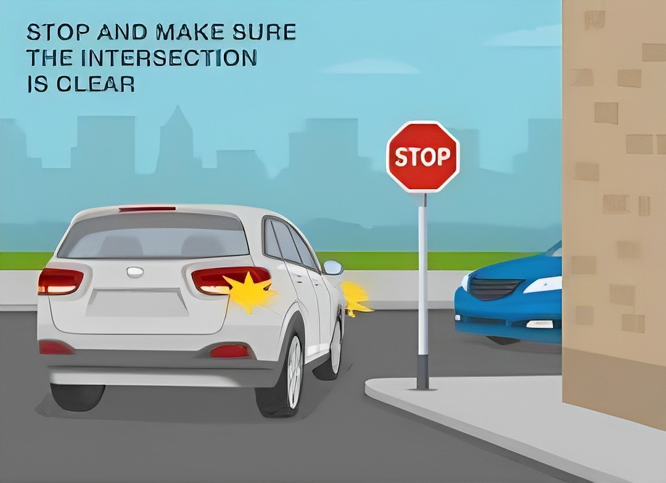
BLIND CORNER COLLISION PREVENTION
" A Deep Learning Approach for Road Safety "

Slide 2
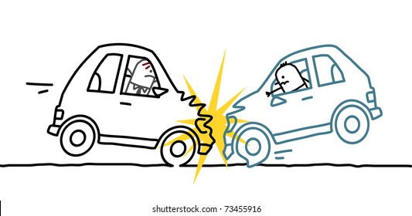

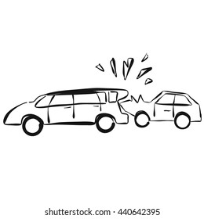
PROBLEM STATEMENT
Introduction to the Problem
In hilly areas with curvy roads, going around sharp turns is a big safety challenge because these turns block the view, making it hard to see, and that raises the chance of accidents.
Importance of Addressing Blind Corner Collisions
Timely intervention (Acting quickly) is really important to reduce the higher chance of accidents at spots where you can't see well around corners. This highlights the importance of creative solutions to make roads safer in hilly areas.

Slide 3
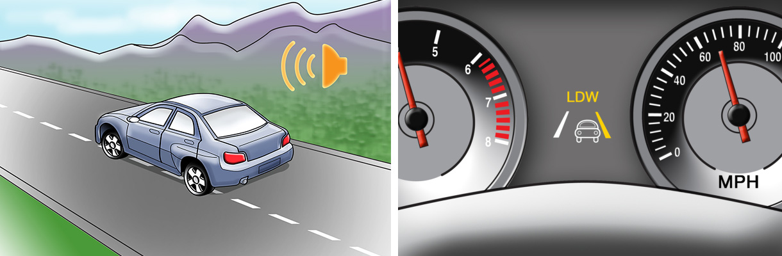
OBJECTIVE
Overview of the Proposed Solution using Vehicle Classification
Our project aims to uses a CNN-based system to identify the vehicles on the road, to prevent the collisions by classifying and alerting drivers about vehicles on-road in blind corners, thereby enhancing safety in challenging areas where we can’t see the vehicle ahead.

Slide 4


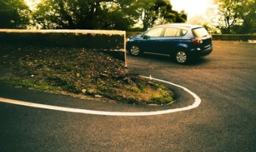
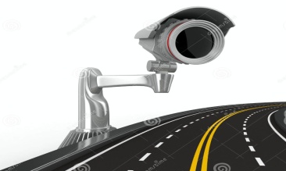

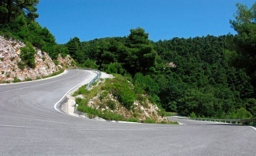
SYSTEM ARCHITECTURE
Vehicle Present On Road
DIGITAL MSG
0
0
Noise And Visual Alerts
Smart
Camera
If 0 Then Vehicle Present
If 1 Then Vehicle Not Present
MODEL
CNN System
1
DIGITAL MSG
1
Digital Alerts
No Vehicle
On Road

Slide 5
MODEL ARCHITECTURE
Data Collection
Model Deployment
Model Building
Model Evaluation
Save Best Model
Data Preprocessing
Model Tuning
Re-Building Of Model
Model Evaluation
Selecting Best Model
Data Insertion For Prediction
Prediction

Slide 6
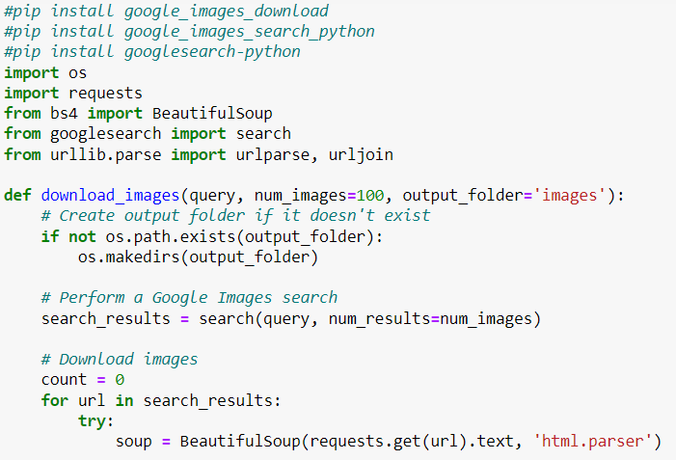
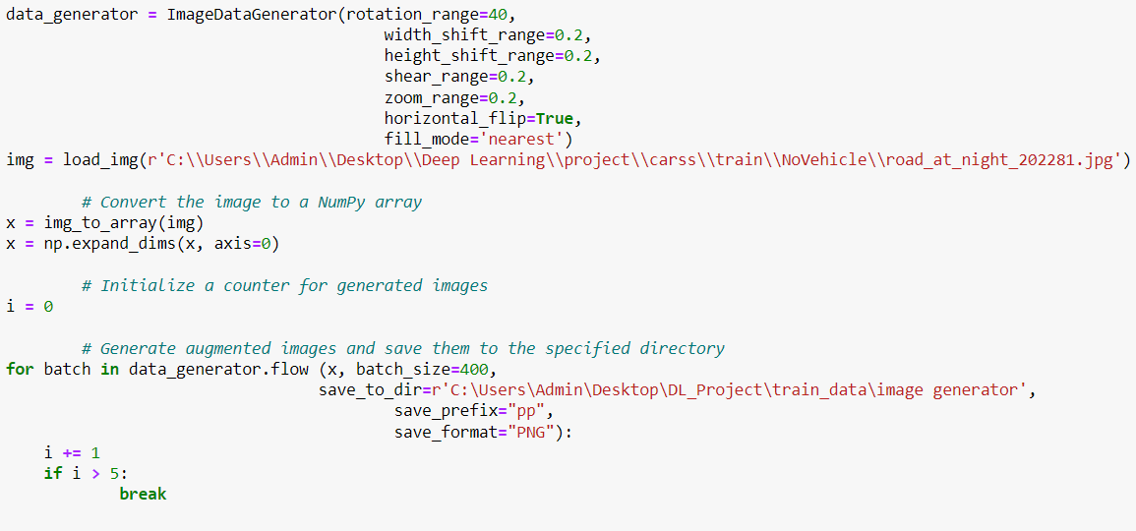
DATA COLLECTION
Image Scraping
Image scraping, a method of automatically extracting images from online sources, serves as a valuable technique for assembling such datasets.
Image Generator
An "image generator" in deep learning creates artificial images to expand and diversify training datasets, crucial for improving model performance in computer vision tasks like image classification and object detection. This tool enhances the dataset's variety, leading to better model generalization and effectiveness.

Slide 7
DATA COLLECTION
Dataset Explanation
We gathered lots of pictures from tricky bends in ghat areas, making a special collection. These pictures help our smart camera (CNN) practice spotting cars in tough spots, so it's ready for any tricky road situation.
Training Process Description
The CNN undergoes a systematic training process where it learns to swiftly identify and classify vehicles based on the dataset. This ensures the model becomes adept at discerning on vehicles present on road and No vehicles Present on road, forming a crucial part of our collision prevention system.

Slide 8
DATA EXTRACTION & PRE-PROCESSING
Image Resizing
Normalization
Data Augmentation
Label Encoding
Splitting into Training and Validation Sets
Batch Processing
Data Shuffling
Handling Imbalanced Classes

Slide 9
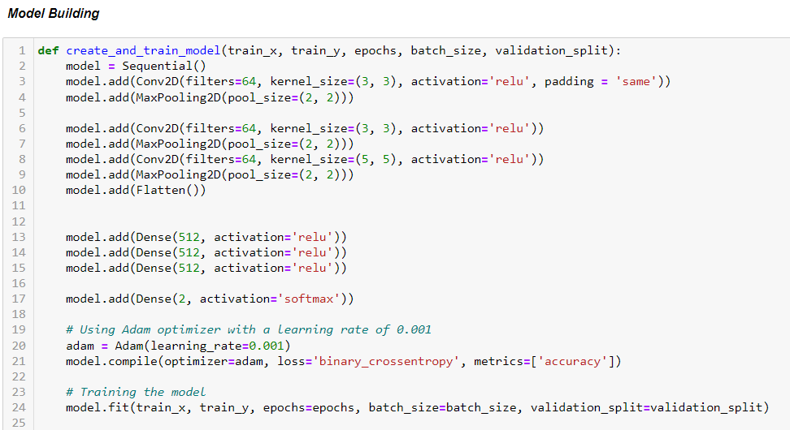
MODEL TRAINING
CNN Model Introduction
Meet our digital detective, the Convolution Neural Network (CNN). It's like the brain of our project, trained to quickly recognize and understand vehicles on the road, especially around tricky bends in ghat areas.
Classification Criteria Explanation
Our CNN follows special rules, like wise traffic guide. It looks at pictures and decides if a vehicle is on the road or not, ensuring it can alert drivers in time about hidden cars in sharp turns like in ghat roads.

Slide 10
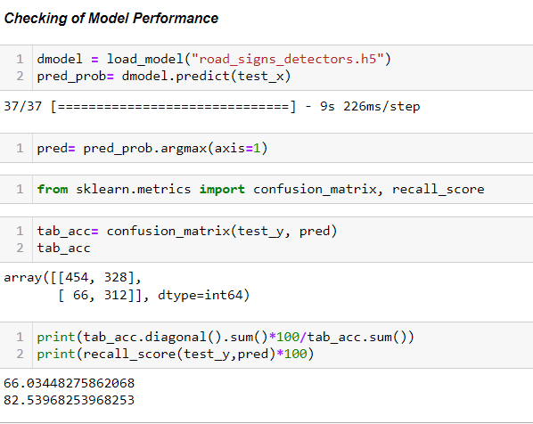
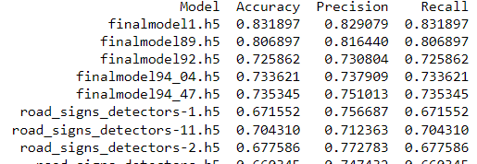
MODEL EVALUATION
MODEL TUNING AND MODEL RE-BUILDING
MODEL EVALUATION

Slide 11
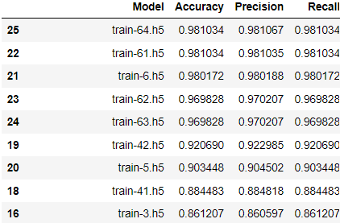
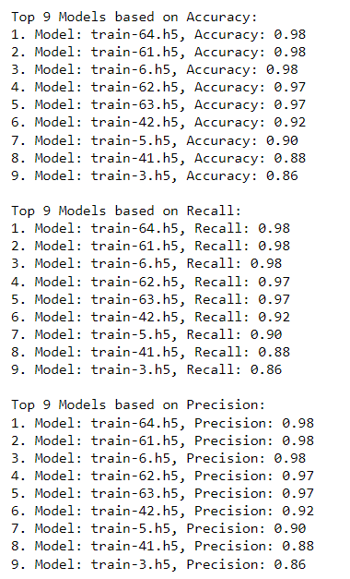
SELECTING BEST MODELS

Slide 12
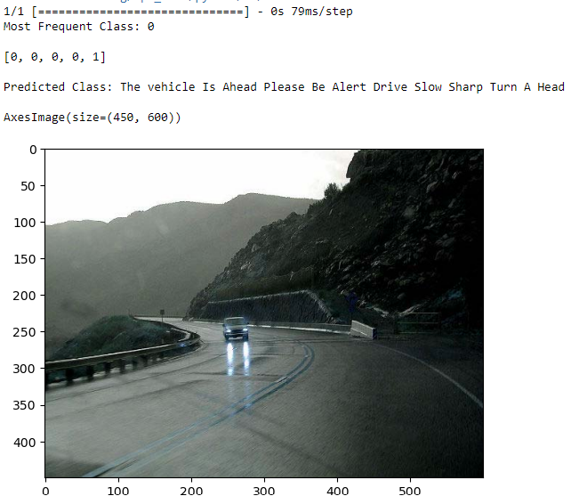
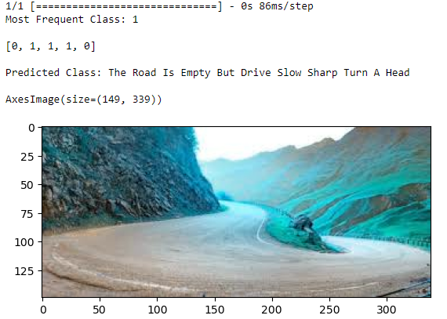
TESTING

Slide 13

SAVE BEST MODEL
Saving Best 9 Models Depending on their performance
'finalmodel94_47.h5',
'finalmodel1.h5',
'finalmodel94_04.h5',
'finalmodel89.h5',
'finalmodel92.h5',
'train-5.h5',
'train-63.h5',
'train-62.h5',
'train-6.h5'
'train-61.h5',
'train-64.h5',
'train-6.h5',
'train-62.h5',
'train-63.h5',
'train-42.h5',
'train-5.h5',
'train-41.h5',
'train-3.h5'
-----.h5

Slide 14
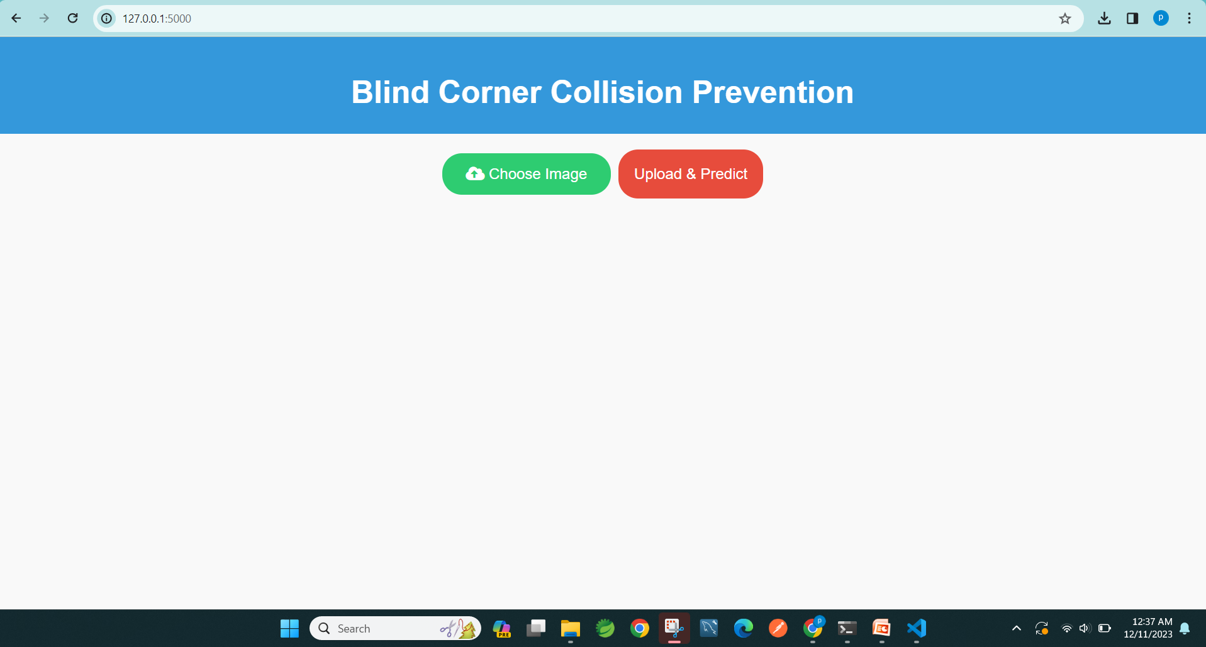
MODEL DEPLOYMENT

Slide 15
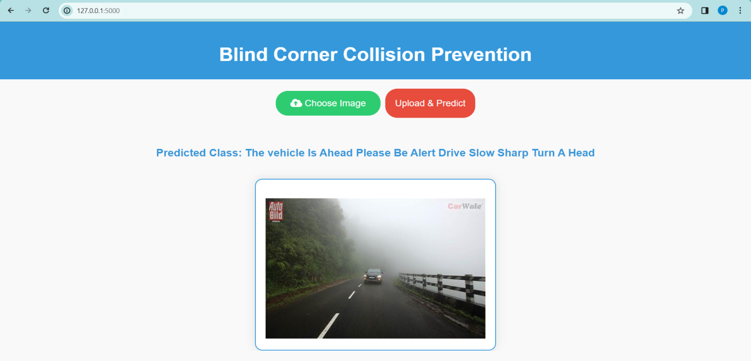
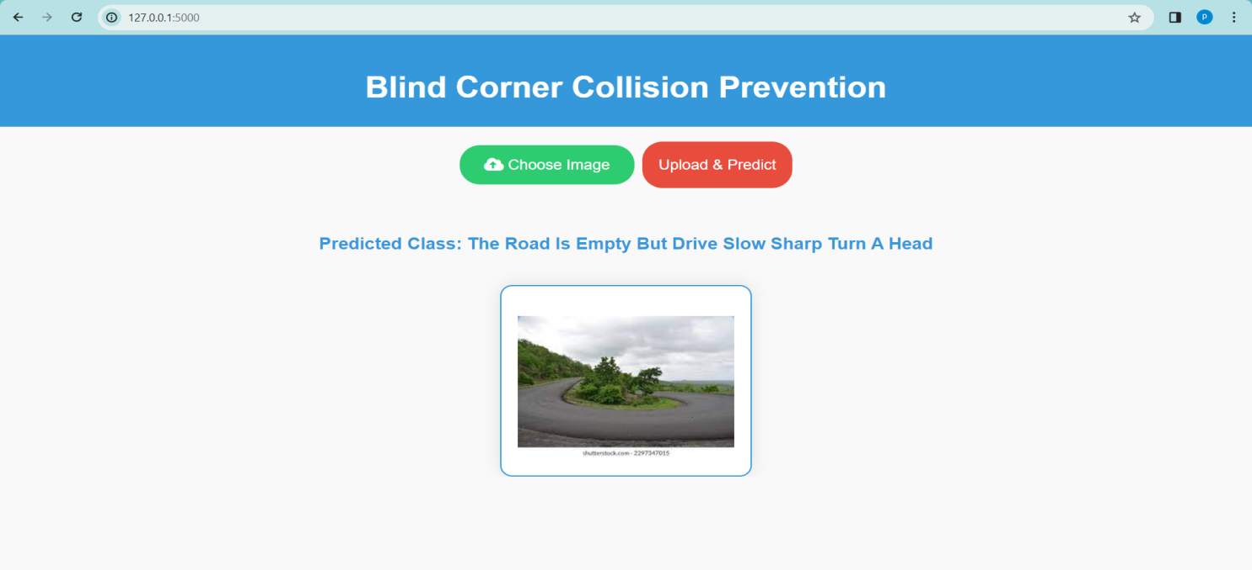
RESULTS

Slide 16

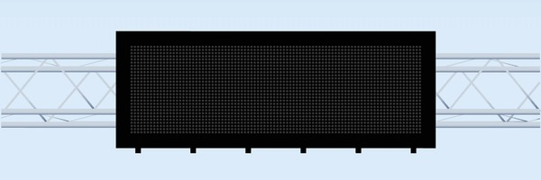

NOISE AND VISUAL ALERTS
Methodology Description
Imagine our system as a watchful guardian. When it spots a vehicle on-road nearing a blind corner, it quickly sends out a warning alert. It's like a digital lookout making sure drivers know about potential dangers ahead.
Noise and Visual Alerts Discussion
To make sure drivers pay attention, our system uses two moves – loud noises and flashing lights. That the system will sounding an alarm and shining a light, ensuring drivers can't miss the warning even in the busiest and trickiest ghat areas.

Slide 17
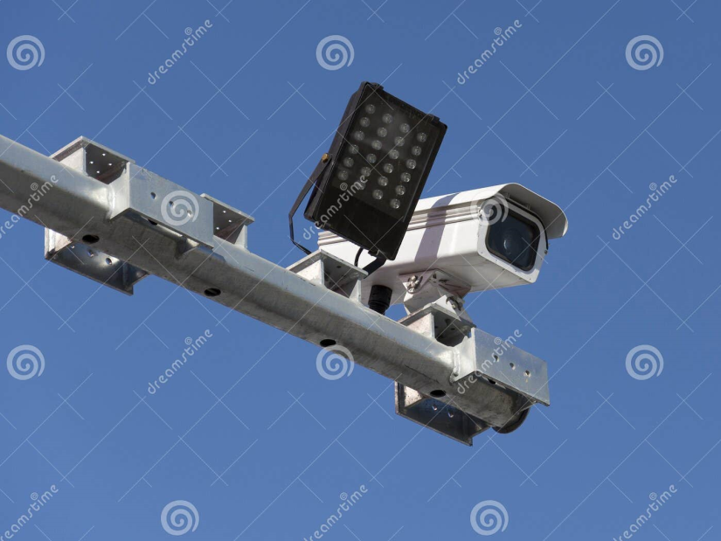
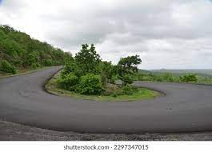
INSTALLATION PROCESS

Slide 18
SYSTEM ARCHITECTURE
Overview
Our system architecture is like a smart guard for ghat roads. It uses a clever camera system (CNN) to spot vehicles on the road and a quick alert system to warn drivers about hidden cars in sharp turns.
Components Highlight
The key players in our system are the smart camera (CNN) that identifies on-road vehicles and an alert system that quickly tells drivers about upcoming dangers, making our roads safer in challenging turns.

Slide 19
BENEFITS
Our system acts as a digital guardian, reducing blind corner collisions and enhancing road safety in ghat areas by alerting drivers about hidden dangers.

Slide 20
CHALLENGES AND FUTURE WORK
Limitations Acknowledgment
While our system is a powerful ally, we acknowledge the challenge of occasional false alerts and the need for continuous fine-tuning. Overcoming these limitations is crucial for ensuring the utmost reliability in blind corner collision prevention.
Future Enhancements Proposal
Looking ahead, envision our system evolving into an even smarter protector. Future enhancements could include refining the classification accuracy, exploring advanced alert mechanisms, and integrating real-time traffic data for a more dynamic and effective blind corner collision prevention system.

Slide 21
CONCLUSION
The innovative blind corner collision prevention system, driven by a Convolution Neural Network (CNN), stands as a formidable solution for ghat areas. By swiftly identifying and alerting drivers about on-road vehicles hidden in sharp turns, it significantly mitigates the risk of collisions
The combination of advanced technology and strategic deployment creates a promising avenue for reducing accidents and fostering secure journeys in ghat regions.

