Slide 1


VISVESVARAYA TECHNOLOGICAL UNIVERSITY BELAGAVI – 590018 , KARNATAKA
GOVERNMENT SKSJT INSTITUTE BANGALORE
DEPARTMENT OF COMPUTER SCIENCE AND ENGINEERING
Internship On
“DETECTION OF AUTISM SPECTRUM DISORDER USING MACHINE LEARNING”
SUBMITTED BY,
BASAVARAJA ANKALAGI (1SK19CS006)
SACHIN CHAVAN ( 1SK19CS038)
UMESH ABBANNA (1SK19CS043)
GURURAJ (1SK20CS403)
UNDER THE GUIDENCE,
L.SRI RAMCHANDRA
Assistant Professor
dept CSE

Slide 2
CONTENTS :
INTRODUCTION
PROBLEM STATEMENT
EXISTING SYSTEM
PROPOSED SYSTEM
LITERATURE SURVEY
OBJECTIVES
REQUIREMENT ANALYSIS
SYSTEM DESIGN
IMPLEMENTATION TECHNOLOGIES
METHODOLOGY
CODE SNIPPETS
RESULTS
CONCLUSION
REFERENCES

Slide 3
INTRODUCTION
Autism is an integral neurodevelopment disorder that affects the functioning of brain. It can occur at any age but usually occur in childhood, mostly children at the age of 2 or 3 have more chances of having ASD.
It occurs due to the combination of both genetic and environmental factors.
Autism is not an illness or a disease rather it is a neurological condition in which child is unable to concentrate, think, learn, focus and solve the problems.
They find difficulty in explaining things through facial expression or by making Gestures, It is fastest growing development disability in all over the world including India.

Slide 4
INTRODUCTION
Autisum can be caused: Genetic- either of parents is suffering from this disorder, some other member in the family is autistic, and Complications during Pregnancy, child has not received proper and timely vaccination and so on.
Detecting autism traits through screening tests is very expensive and time consuming. With the advancement of artificial intelligence and machine learning (ML), autism can be predicted at quite early stage.
This project is to analyze various Machine learning algorithms, used by various researcher like SVM (support Vector Machine), Random Forest, Decision Trees, Logistic Regression and compare the result based on their accuracy and efficiency.

Slide 5
PROBLEM STATEMENT:
Diagnosis of autism can be predicted at quite early stage using machine learning techniques.

Slide 6
EXISTING SYSTEM:
Most of the current existing systems uses older machine learning algorithms like logistic regression, Decision Tree etc which are efficient in processing but fails to generate good accuracy. There are some systems which uses Deep learning for autism detection but they require high processing power are a bit complex to use.
DISADVANTAGES:
Low accuracy.
High complexity.
Difficult to scale.

Slide 7
PROPOSED SYSTEM:
With the advancement of artificial intelligence and machine learning (ML), autism can be predicted at quite early stage. The main aim of this project is to analyze various Machine learning algorithms, used by various researcher like SVM (support Vector Machine), Random Forest, Decision Trees, Logistic Regression, and compare the result based on their accuracy and efficiency.
ADVANTAGES:
High accuracy.
Low complexity.
Easy to scale.

Slide 8
LITERATURE SURVEY:
SL.NO | TITLE | AUTHOR | ALGORITHMS | Advantages | Disadvantages | RESULT
01 | Deep Analysis of Autism Spectrum Disorder Detection Techniques | Anshu Sharma, Dr. Poonam Tanwar (2022) | Convolutional neural network (CNN). Artificial Neural Network (ANN), K Nearest Neighbors’ (KNN) | Long term achieve of data. High Accuracy. | These studies didn’t provide any definitive conclusion about predicting autism traits in terms of different age groups. | Accuracy= 98.27%
02 | A Machine Learning Approach to Predict Autism Spectrum Disorder | Kazi Shahrukh Omar , Prodipta Mondal , Nabila Shahnaz Khan, Md. Rezaul Karim Md Nazrul Islam (2019) | Random Forest(RF), CART algorithm | Easy process of complicated Sessions. Easy to scale | screening tests is very expensive and time consuming. | Accuracy= 85%

Slide 9
LITERATURE SURVEY:
SL.NO | TITLE | AUTHOR | ALGORITHMS | ADVANTAGES | DISADVANTAGES | RESULT
03 | A Survey on Predicting Autism Spectrum Disorder using Machine Learning Techniques. | N. Priya and C. Radhika (2019) | Random Forest(Rf), ANN, | It is easier to implement and very efficient to train. | Difficult to store the data for long period. Children affected by autism will have less social coordination, swinging emotions | Accuracy= 88%
04 | Autism Spectrum Disorder detection Using Machine Learning Approach. | Nabila zaman, jannatul ferdus, Abdus sattar. 2021 | Random forest, SVM,Decision Tree,Adaboost | Helps kid with ASD in learning self-care and social skills. | Difficult to process complicated procedures. | Accuracy= 96.20%

Slide 10
LITERATURE SURVEY:
SL.NO | TITLE | AUTHOR | ALGORITHMS | ADVANTAGES | DISADVANTAGES | RESULT
05 | Detection of Autism Spectrum Disorder Using Machine Learning. | Kruthi C H , Tejashwini H N,Poojitha G S, Shreelakshmi H S ,Asst Prof.Shobha Chandra K (2020) | Random forest, SVM,Decision Tree,Adaboost | screening is important for monitoring the development of children with autism. | It affects social coordination, emotions and motor activity of an individual. | Accuracy=96.20%
06 | Early Stage Detection of Autism Spectrum Disorder using Machine Learning. | Tania Akter, MD. Shahriare satu, MD. Imran khan.(2020) | Convolutional neural network (CNN). Artificial Neural Network (ANN), K Nearest Neighbors’ (KNN),Logistic Regression (LR), Support Vector Machine (SVM). | Prepare children's with autism on how to appropriately respond to specific situations. Logistic regression is less inclined to over-fitting. | Difficult to compare data with intra groups. | Accuracy= 93%

Slide 11
OBJECTIVES:
The proposed module is to find out the most significant traits and automate the diagnosis process.
The proposed model will detect autism by taking less time.
We are using four different machine learning algorithms, and compare each algorithm based on accuracy and efficiency.

Slide 12
REQUIREMENTS ANALYSIS: Non –functional Requirements
Reliability: During runtime, the system is always be up to perform the requested task 99.9%of the time except for some abnormal disruptions.
Performance: Numerous user should be able to use the system at all time
Maintainability: Watching and managing the program should be essential and should be oriented in its approach.
Portability: The system should apply to another application efficiently.
Scalability: The system will be adaptable enough at later level to add new functionalities.
Flexibility: Flexibility is the capacity of a system to respond to changes in the system environments and tom adjust to changes in market strategies and laws.

Slide 13
REQUIREMENTS ANALYSIS: Functional Requirements
Collect the dataset from the internet(Kaggle),which has more than 600 records to find the autism
In this dataset, ten behavioral features(Q-chat-10) plus other individuals characteristics that have provided to be effective in detecting the ASD cases from controls in behavior science are present.
This dataset contained some string value parameter based on that we need to convert string to numeric. then plot the graph for analysing the data.
Split the data into train and test dataset.By making use of trainig data,we are going to train our algorithms namely: Logistic regression, Random forest,SVM classifier.
Then we are compareing all algorithms based on accuracy.

Slide 14
Resources and Environment:
Hardware Requirements:
System : Intel core i7
Hard Disk : 500GB
Ram : 4GB+
Mouse,Keyboard

Slide 15
Resources and Environment:
Software Requirements:
Operating System : Intel core i7
Coding Language :Python
Softwere : Anaconda ,Python 3.6+
IDE : jupyter Notebook

Slide 16
SYSTEM DESIGN

Slide 17
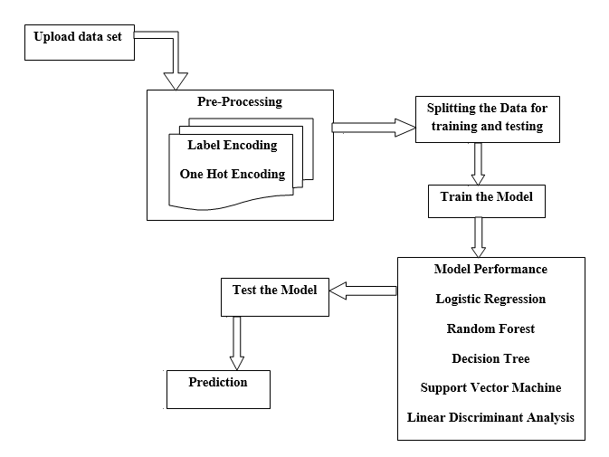
ARCHITECTURE

Slide 18
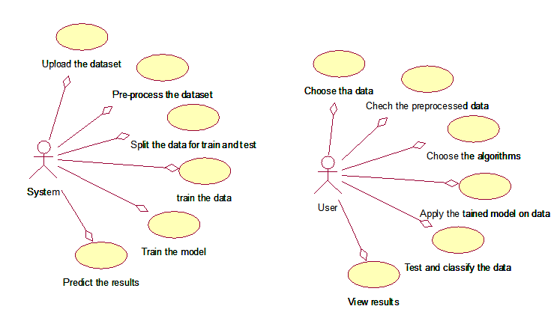
UML DIAGRAMS
USE CASE DIAGRAM:

Slide 19
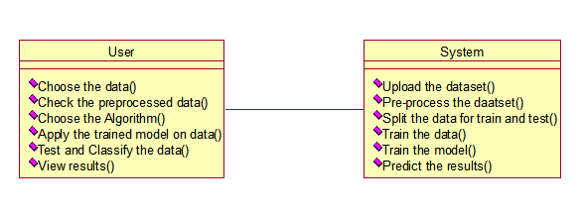
CLASS DIAGRAM :

Slide 20
SEQUENCE DIAGRAM :

Slide 21
Implementation Technologies:
PYTHON
Python is a versatile, easy-to learn progarmminng language.
Python is interpreter- You don’t have to compile your program before it is executed.
Python is platform independent i.e. programs can be implemented on one machine and use them on another machine without any changes.
Python libraries used:
NUMPY: which stands for Numerical python, is a library of multidimensional array objects.

Slide 22
Implementation Technologies:(Cont.)
Pandas : It gives a set of tools to perform data analysis
Matplotlib : It gives a simulation frame work for 2D plotting.
Scikit-learn : Offers sevral supervised and unsupervised machine learning algorithms via simple python framework

Slide 23

Implementation Technologies:(Cont.)
Machine learning :
Machine learning is an application of artificial intelligence (AI) that provides systems the ability to automatically learn and improve from experience without being explicitly programmed.
ML Algorithm used:
Random forest classification: Random forest or random
Decision forest collaborative learning method for
Classification and regression.
It works by building a multiple of decision trees at trainig
Time and outputting the class that is the mode of
classes or mean prediction of individual trees.

Slide 24
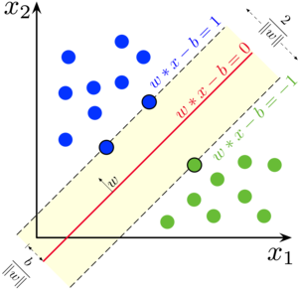
Implementation Technologies:(Cont.)
Support vector Machine :
A Support vector machine (SVM) is machine algorithm that analyzes data for classification and regression analysis.
SVM is controlled learning method that looks at data
And sorts it into one of two categories based on hyperline
In n-Dimensional Space.N is the number of features that
Classify the data points distinctly.

Slide 25
METHODOLOGY:
Variable in Dataset | Corresponding Q-Chat-10 for children features.
A1 | Does your child look at you when you call his/her name?
A2 | How easy is it for you to make eye contact with your child?
A3 | Does your child point to indicate that s/he wants something?
A4 | Does your child point to share an interest with you?
A5 | Does your child pretend?
A6 | Does your child follow where you’re looking?
A7
A8 | Would you describe your child’s first words as?
A9 | Does your child use simple gestures?
A10 | Does your child stare at nothing words no apperent purpose?
Data collection
To develop an effective predictive model,Q-chat-10
data set used.
The dataset has age, sex,ethnicity and Autism.
specific Screening questions focus on different
Domains such as attention to detail,attention switching,
communication, imagination,and social interaction.

Slide 26
METHODOLOGY:(cont)
Developing The predictive model:
By utilizing Random Forest(RF),Support vector Machine(svm),logistic regression algorithms, the performance and accuracy of the prediction model increase
The data will be divided into two sets randomly.one part will be used for training the data
And other is used for testing/evaluating the predictive model.
Evaluating the predictive model:
The proposed model is tested with the Q-chat-10 dataset and accuracy is measured
Developing a web-based application:
By answering a set of closed-ended questions, the user will get a result of having or not having autism traits

Slide 27
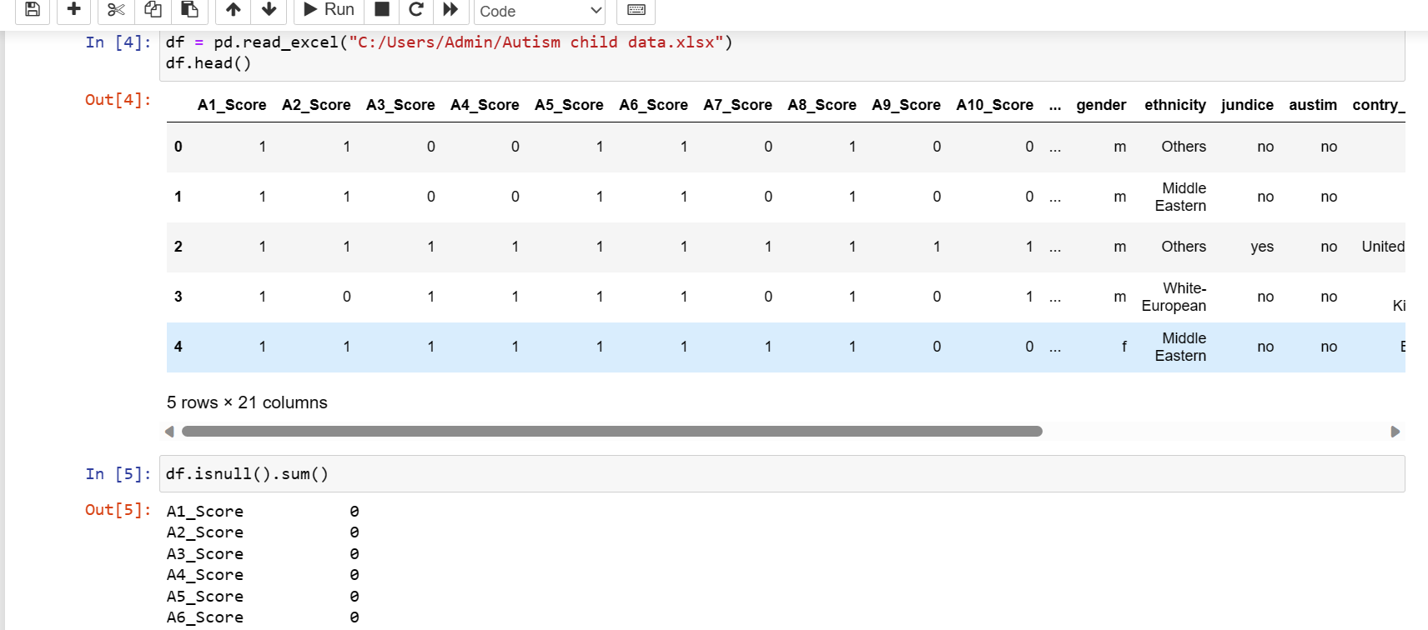
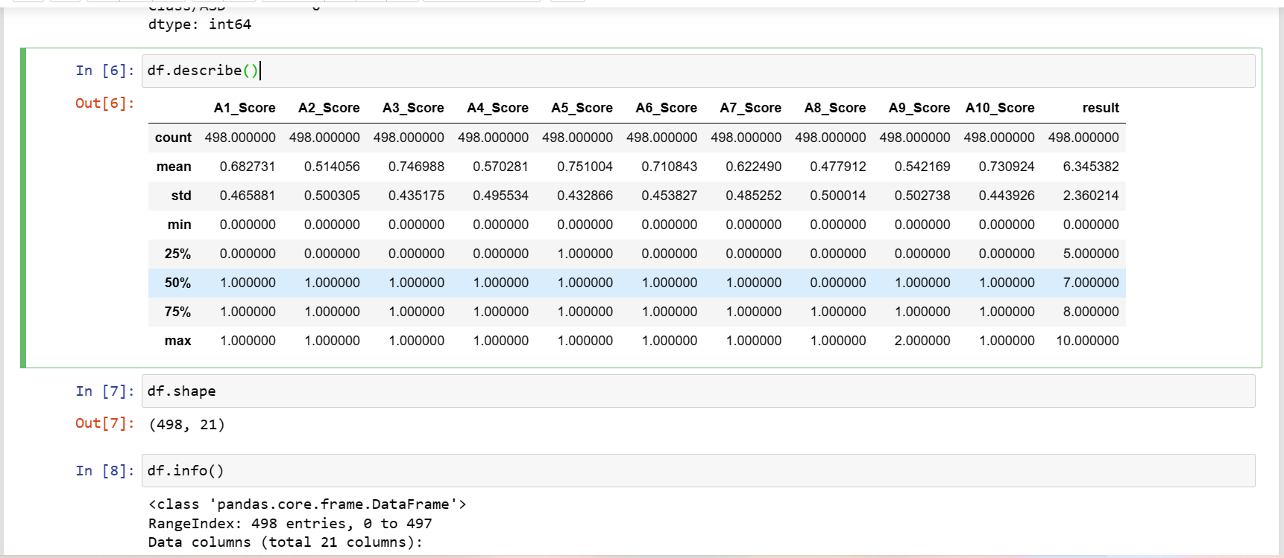
CODE SNIPPETS:
Module :1
Data reading
1.df=pd.read_excel
df.head()
2.df.isnull().sum
3.df.describe()
4.df.shape
5.df.info
6.df.dropna()

Slide 28
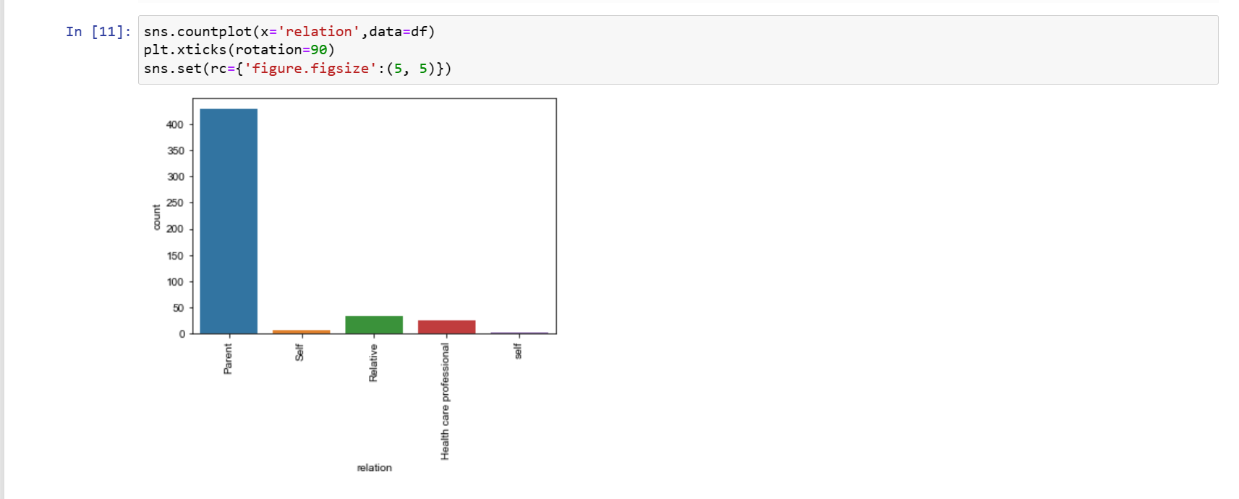
CODE SNIPPETS:
Module :2
Graphical representation
1.sns.countplot(x=“attribute”data.df)
plt.xlinks(rotation =90)
sns.set(rc={‘figure.figsize’:(5,5)})

Slide 29
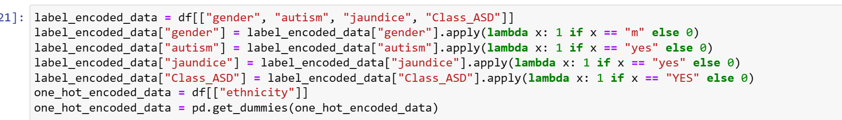
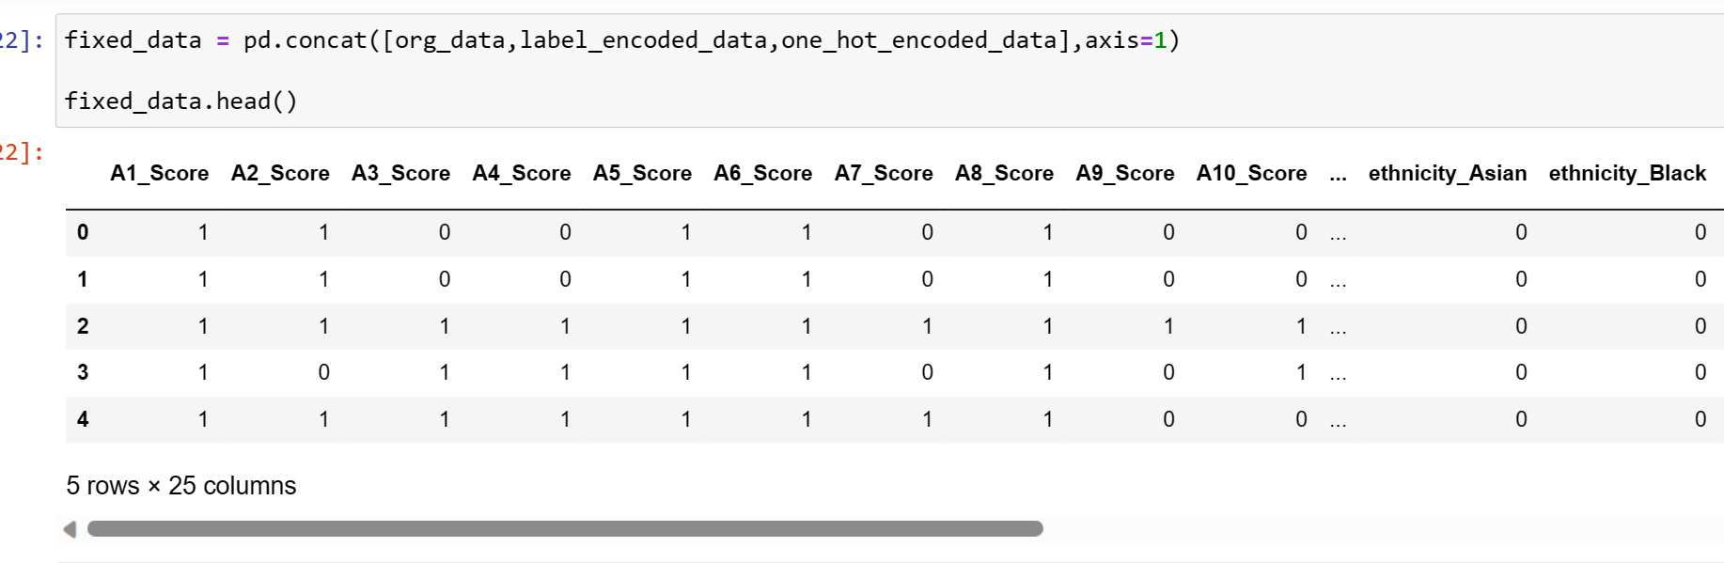
CODE SNIPPETS:
Module :3
Preprocessing:
1.label encoded.data=df[(attribute---)]
label encoded.data=df[(attribute---)]
label encoded.data=df[(attribute---)]
one_hot_encoded_data=df[(attribute--)]
2.fixed_data=pd.concat([----)]
fixed.data.head()

Slide 30
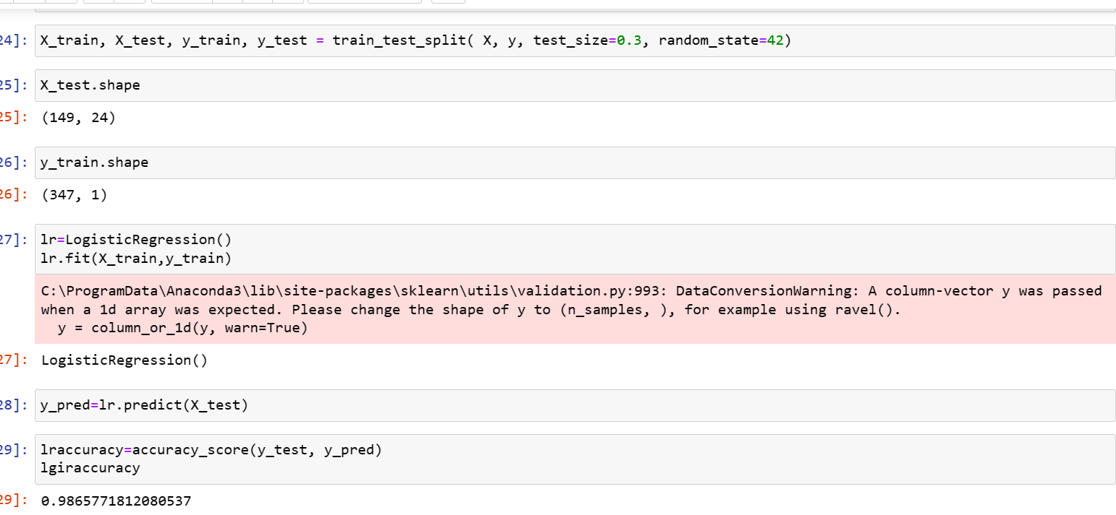
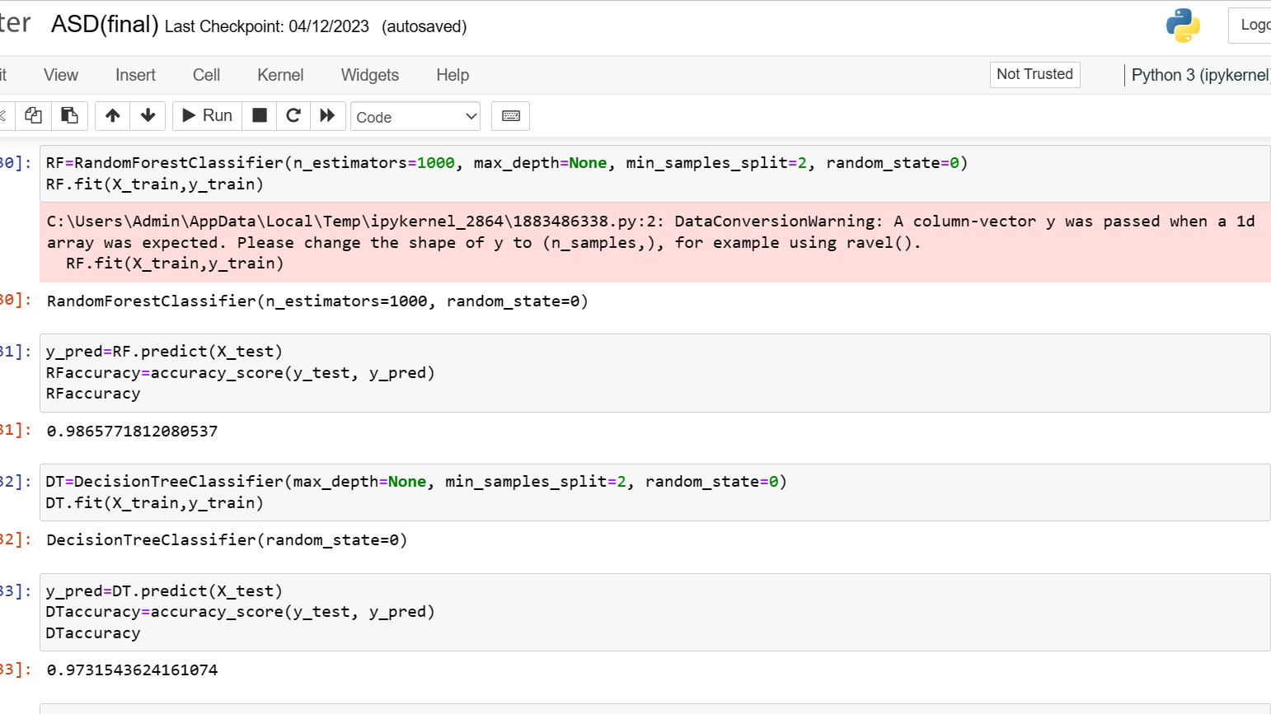
CODE SNIPPETS:
Module :4
Train and Test
1.x_train,x_test,y_train,y_test=-------
Models;
1.Lr = Logistic regression()
lr.fit (x_train,y_train)
y_pred = lr.predict(x_test)
lraccuracy = accuracy_score(y_test,y_pred)
lraccuracy

Slide 31
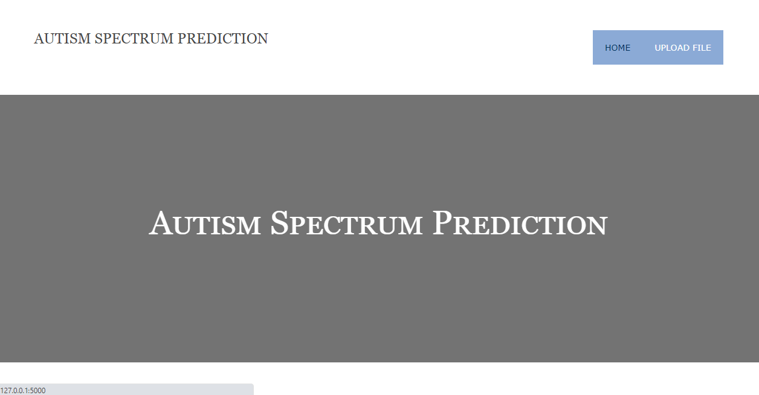
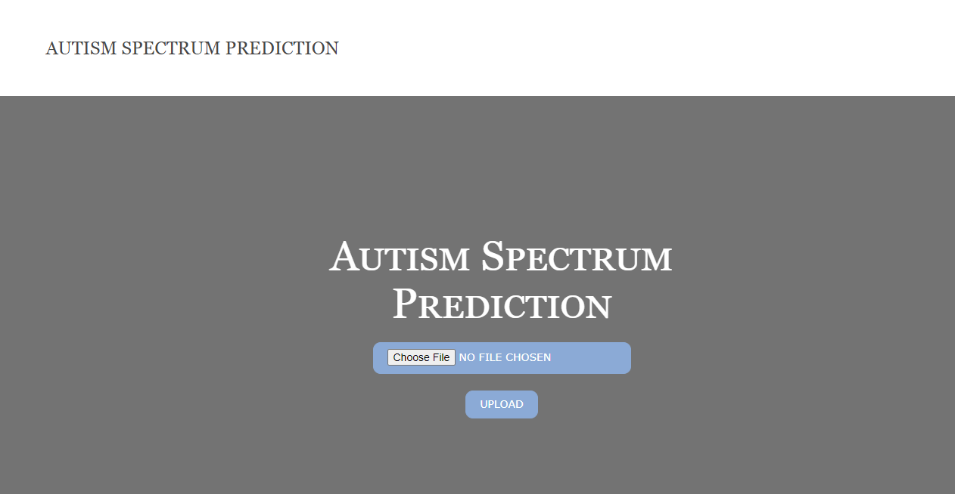
RESULTS:
HOME
File Upload

Slide 32

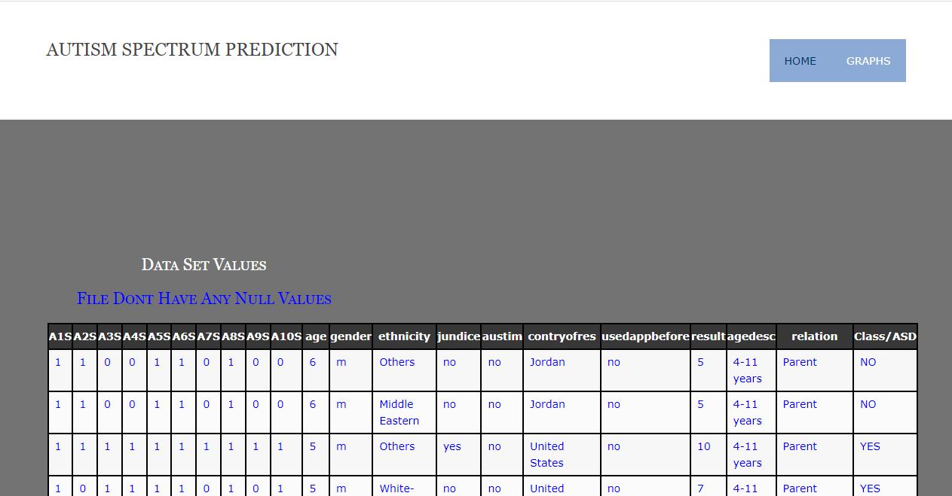
RESULTS:
Upload page with file name
Uploaded data

Slide 33
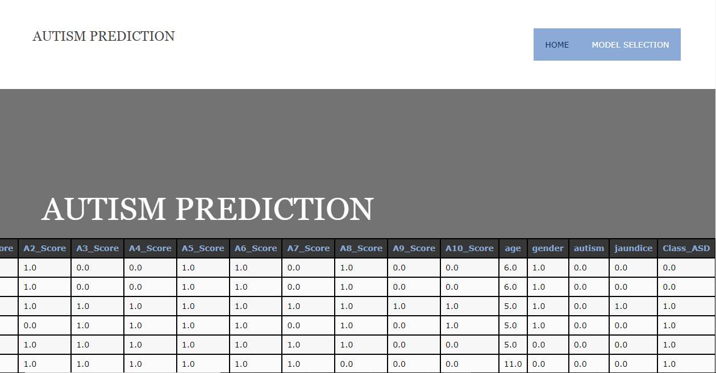
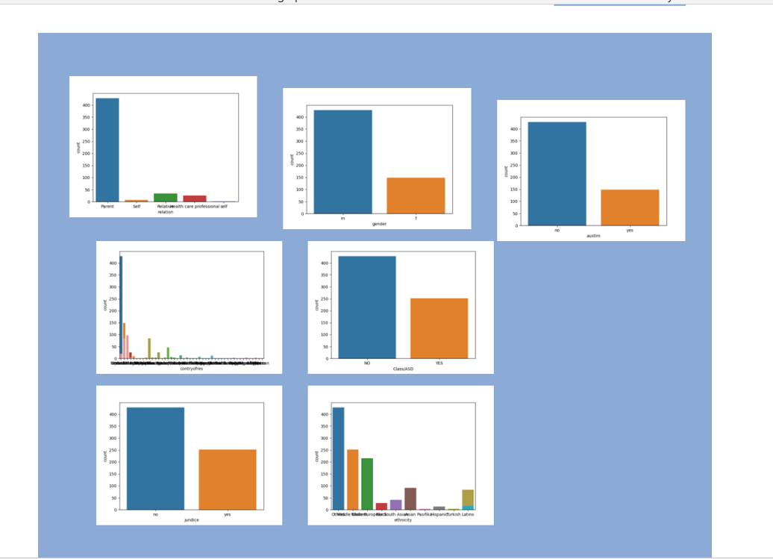
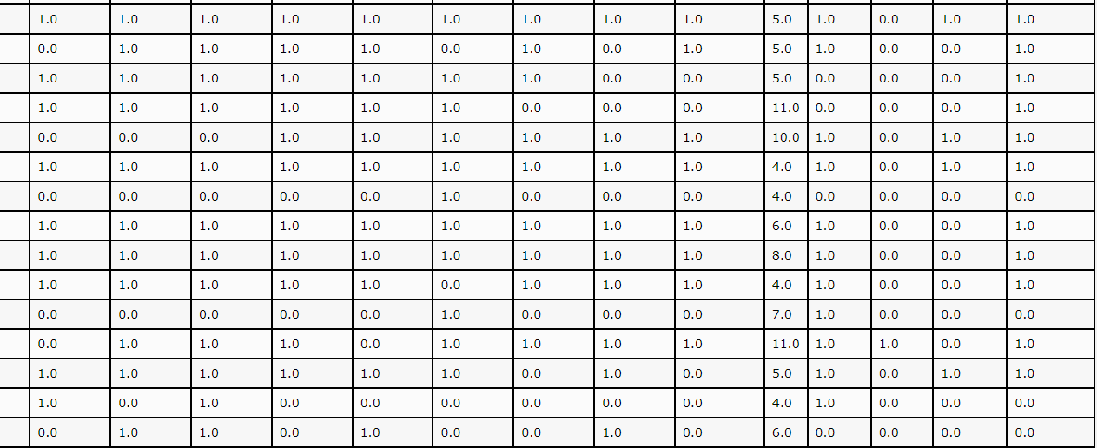
RESULTS:
Preprocessed data
Graphs

Slide 34
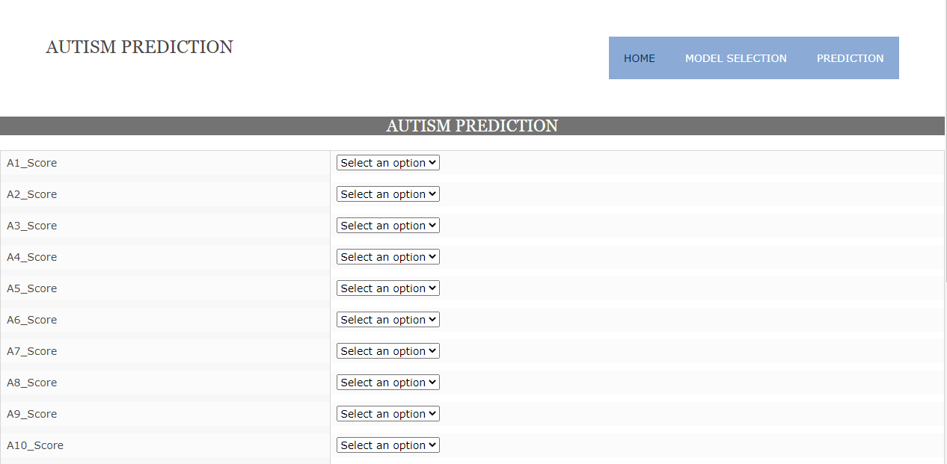
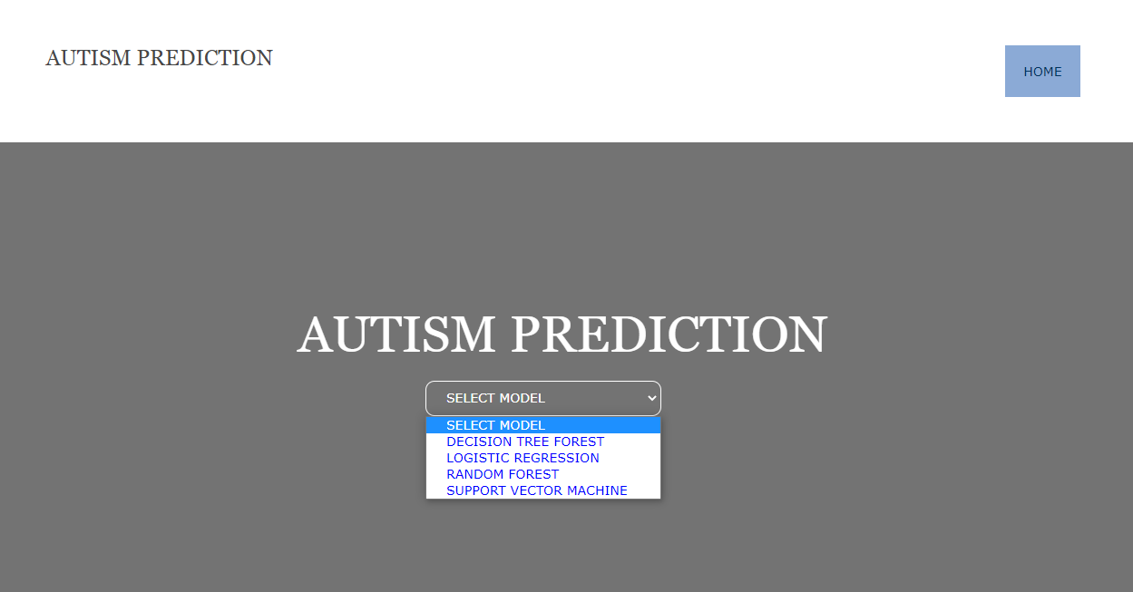
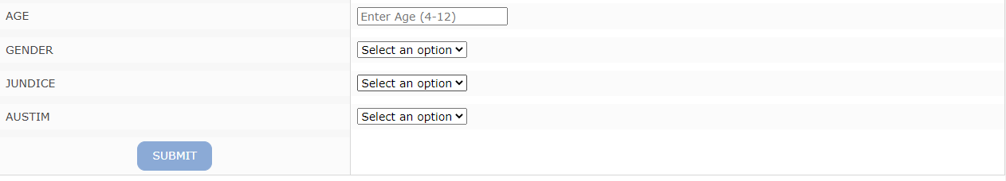
RESULTS:
Prediction
Model Selection

Slide 35
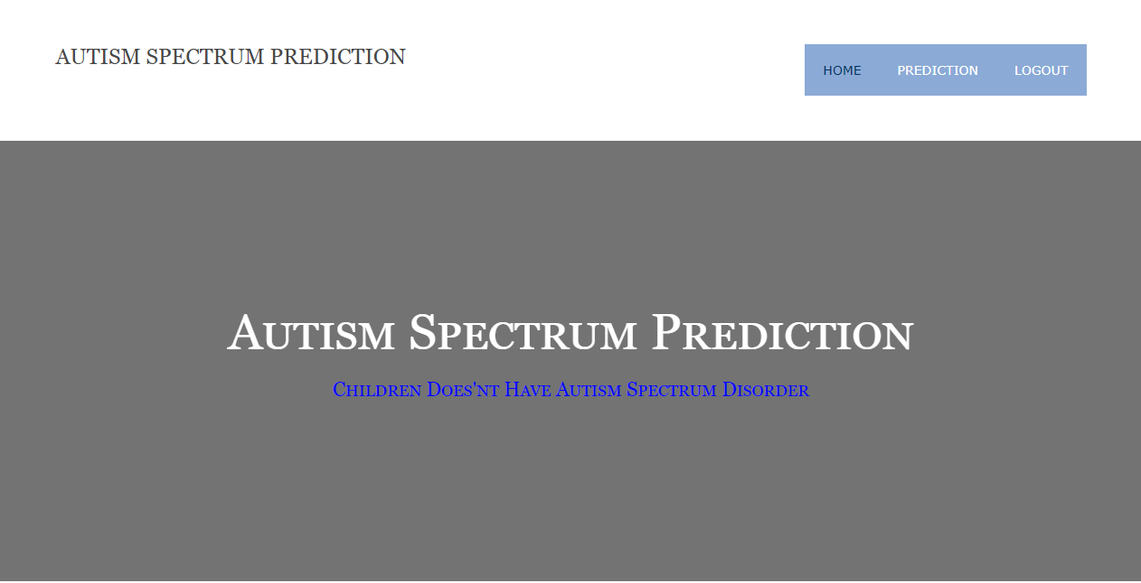
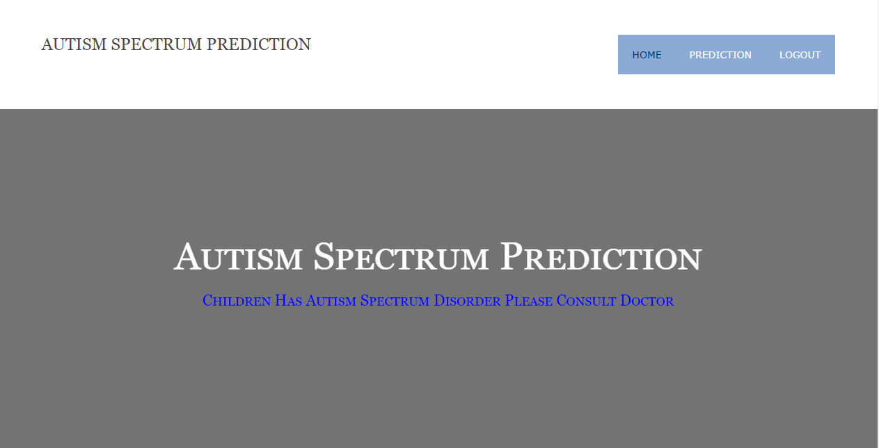
RESULTS:
Output :1
Output :2

Slide 36
CONCLUSION:
The accuracy of prediction using Decision Tree Algorithm ,the accuracy was Random Forest Classification algorithm was and with the Support vector machine (svm) algorithm prediction accuracy was100%
By compareing the results,we can say that the svm algorithm is the most suitable Machine learing algorithm for the prediction of Autism spectrum Disorder
With the help of a web application,the users can answer the 10 questions and get an idea of wheather or not their child has ASD
This may help the parents to consult with the doctors for early intervention.

Slide 37
REFFERENCES:
Deep Analysis of Autism Spectrum Disorder Detection Techniques, Anshu Sharma, Dr. Poonam Tanwar ,2022. https://ieeexplore.ieee.org/document/9160123
A Machine Learning Approach to Predict Autism Spectrum Disorder. Kazi Shahrukh Omar , Prodipta Mondal , Nabila Shahnaz Khan, Md. Rezaul Karim Md Nazrul Islam,2019 https://ieeexplore.ieee.org/document/8679454
Early Stage Detection of Autism Spectrum Disorder using Machine Learning, Tania Akter, MD. Shahriare satu, MD. Imran khan,2019https://ieeexplore.ieee.org/document/8895818
A Survey on Predicting Autism Spectrum Disorder using Machine Learning Techniques, N. Priya and C. Radhika, 2019 https://www.researchtrend.net/ijet/pdf/A%20Survey%20on%20Predicting%20Autism%20Spectrum%20Disorder%20using%20Machine%20Learning%20Techniques%20N.%20PRIYA.pdf
Autism Spectrum Disorder detection Using Machine Learning Approach, Nabila zaman, jannatul ferdus,Abdus sattar,2021 https://ieeexplore.ieee.org/document/9579522.

Slide 38
THANK YOU.!

