Slide 1
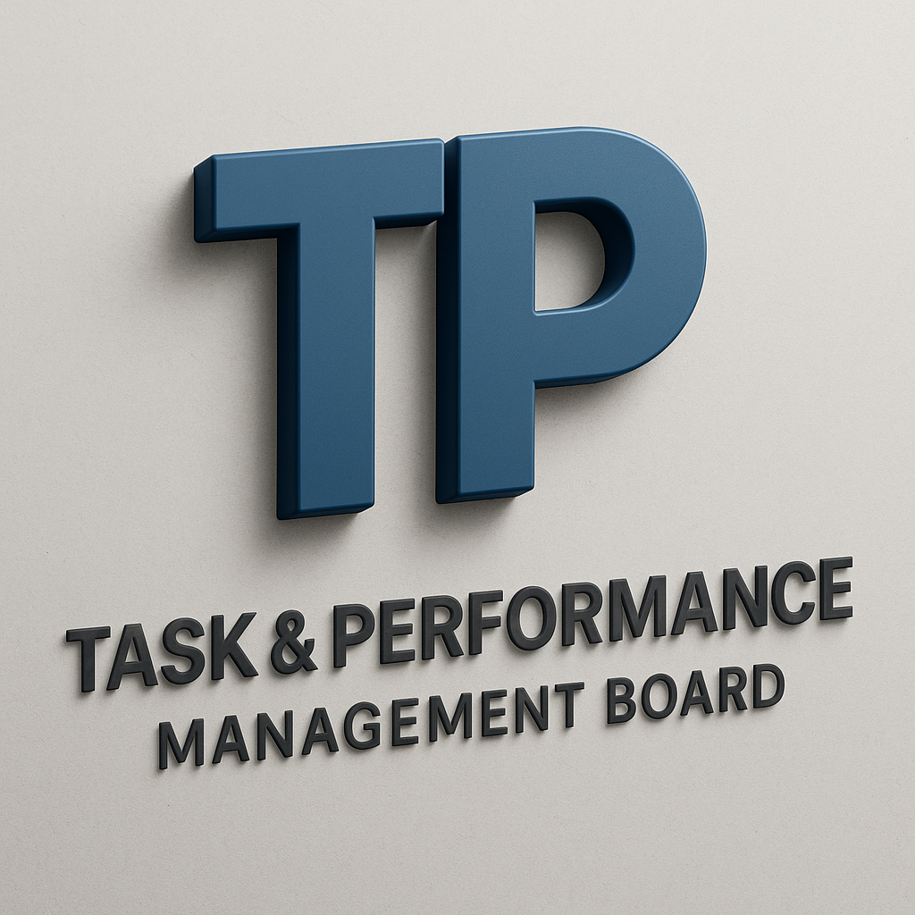
(TP Board) Task & Performance Management Board
First Project Review
Presented by: Pratik Raut

Slide 2
Project Overview
A web-based Kanban Board application for task and performance management.
Inspired by modern agile tools like Trello, Jira.
Built using React.js, Firebase, Zustand, and Firestore.
Helps individuals and teams organize tasks, collaborate, and track performance efficiently.

Slide 3
Objectives
Provide an intuitive and interactive task management UI.
Enable team collaboration via real-time task updates.
Ensure secure authentication and user-specific data.
Maintain performance logs and user productivity insights.

Slide 4
Technology Stack
Frontend: React.js, Tailwind CSS, Zustand (state management)
Backend: Firebase Functions, Firestore Database
Authentication: Firebase Auth
Hosting & Deployment: Firebase Hosting & Emulator Suite
Dev Tools: Vite, npm, GitHub

Slide 5
Firebase Emulator Suite
Emulated services used:
- Firestore
- Auth
- Hosting
- Functions
Allows safe local development with production-like behavior.
Helps in testing login flows and data CRUD without affecting live database.

Slide 6
Current Progress
Completed Login Page UI using MUI and custom validations.
Integrated Firebase Authentication.
Configured Firebase Emulator Suite successfully.
Project structure setup with React components and routing.
Live preview working on Vite Dev Server.

Slide 7
Demo & Screenshots
Login Page
Firebase Emulator Console
Folder structure
(You can add screenshots here before final submission.)

Slide 8
Next Steps
Complete registration and dashboard UI.
Implement CRUD operations for tasks.
Set up team collaboration features.
Add role-based access (admin/user).
Prepare for mid-term demo with full Kanban flow.

Slide 9
Thank You!
Any Questions?

