Slide 1
Online Pathology Booking System Panskura Banamali College (Autonomous) Submitted By Pratik Mukherjee ID: 2019UG012226 Roll: 12161022 No: 251032 Reg. No: 2019PBC00198 of Year: 2019-2020 Guided By Sk. Md. Habibullah
Department of computer science

Slide 2
Index
Objectives.
Introduction.
Review of Existing System.
Problems with Existing System.
Tools and Techniques.
Project Planning.
Iterative Waterfall Mode.
E-R Diagram.
System Flow Chart.
Registration Form Image.
Advantages.
Applications.
Challenges.
Future Enhancements.
Conclusion.

Slide 3
Objectives
It is designed for any pathology lab to replace their existing manual based system to computerized one.
It involves acquisition, management and timely retrieval of great volume of information in just a small time.
Staff scheduling and their permission is wisely organized.
All of these information must be managed in an efficient and cost wise fashion so that institutions resources may be effectively managed in an efficient way.

Slide 4
Introduction
Power Point Presentation provides the details that certification bodies need to evaluate the System. Taken as a whole, voting system documentation must explain the system in several ways to meet the needs of these multiple audiences. As the modern organizations are automated and computers are working as per the instructions, it becomes essential for the coordination of human beings, commodity and computers in a modern organization. Many big cities where the life is busy needs the transaction of the goods within few minutes of time. So, this online information recorded by the distributor helps him to complete this task within the time. The administrators and all the others can communicate with the system through this project, thus facilitating effective implementation and monitoring of various activities of the voting Software.

Slide 5
Review of Existing System
Registering Forms.
All info’s regarding registration First Name, Last Name, email, phone, etc details are filled by the user and then are stored in the records.
Separate databases were kept at separate sites.
Usage of database for each & every records was very high.
Maintenance of record takes very much time. Because everything was manual so maintenance was difficult.
To maintain an admin to chat and query section about users.
The details are filled in database in the user records.

Slide 6
Problems with Existing System
Communication involves a lot of database work. The system was not a computer-based application as a result communication among the five functions involved a lot of database work, that is, in case the user forgot the user ID while filling the complaint then there is no response suddenly in the website about on admin in the help desk.
Being completely manual there is always a possibility of manual mistakes in proceeding with the system.
Large amount of data was stored but it will be hanged system.
There was no web server available in website in domain name of the website, it is available to show only as a local host.

Slide 7
Tools and Techniques
Database: this is a logical space for storing your valuable data with very minimum-security risks. In our system we have given the database name as ‘lifecell’.
MySQL Version 8.0: It is the type of databse I have used in this project.
PyCharm 2021.2.3 Professional Edition: This is the main tool where I have written all my project codes. It is highly integrated software with super intelligence powered by JetBrains.
DataGrip 2021.2.3 Professional Edition: It is used for managing the database. Due to ease of my project work I have used this integrated environment for database management tool powered by JetBrains.

Slide 8
Project Planning
Project Initiation: Development team prepares the project plans and finalizes the outcome of each phase. In this stage team also prepares the comprehensive list of tasks involved in each phase and the project assigns responsibilities to the members, depending on their skills.
Project Execution: In this stage the team develops the project. This stage is consisting of following phases: -
Requirement analysis.
Low level design.
High level design.
Construction.
Testing
Acceptance.
Project Completion: In this stage, the team has to update the site in a regular basis. Each new test item has to be added by the administrator as according to the needs and demands. This stage is very important for freshness of this site.

Slide 9
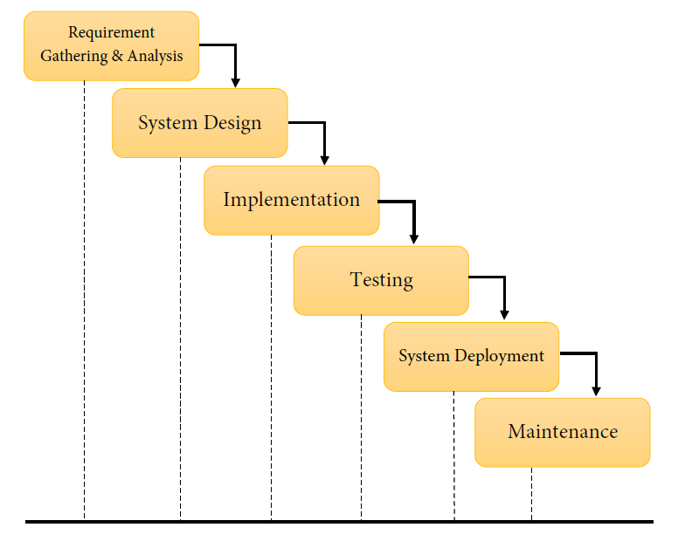
Iterative Waterfall Model
In this context, the iterative waterfall model can be through of as incorporating the necessary change to the classical waterfall model to make it usable in practical software development projects.

Slide 10
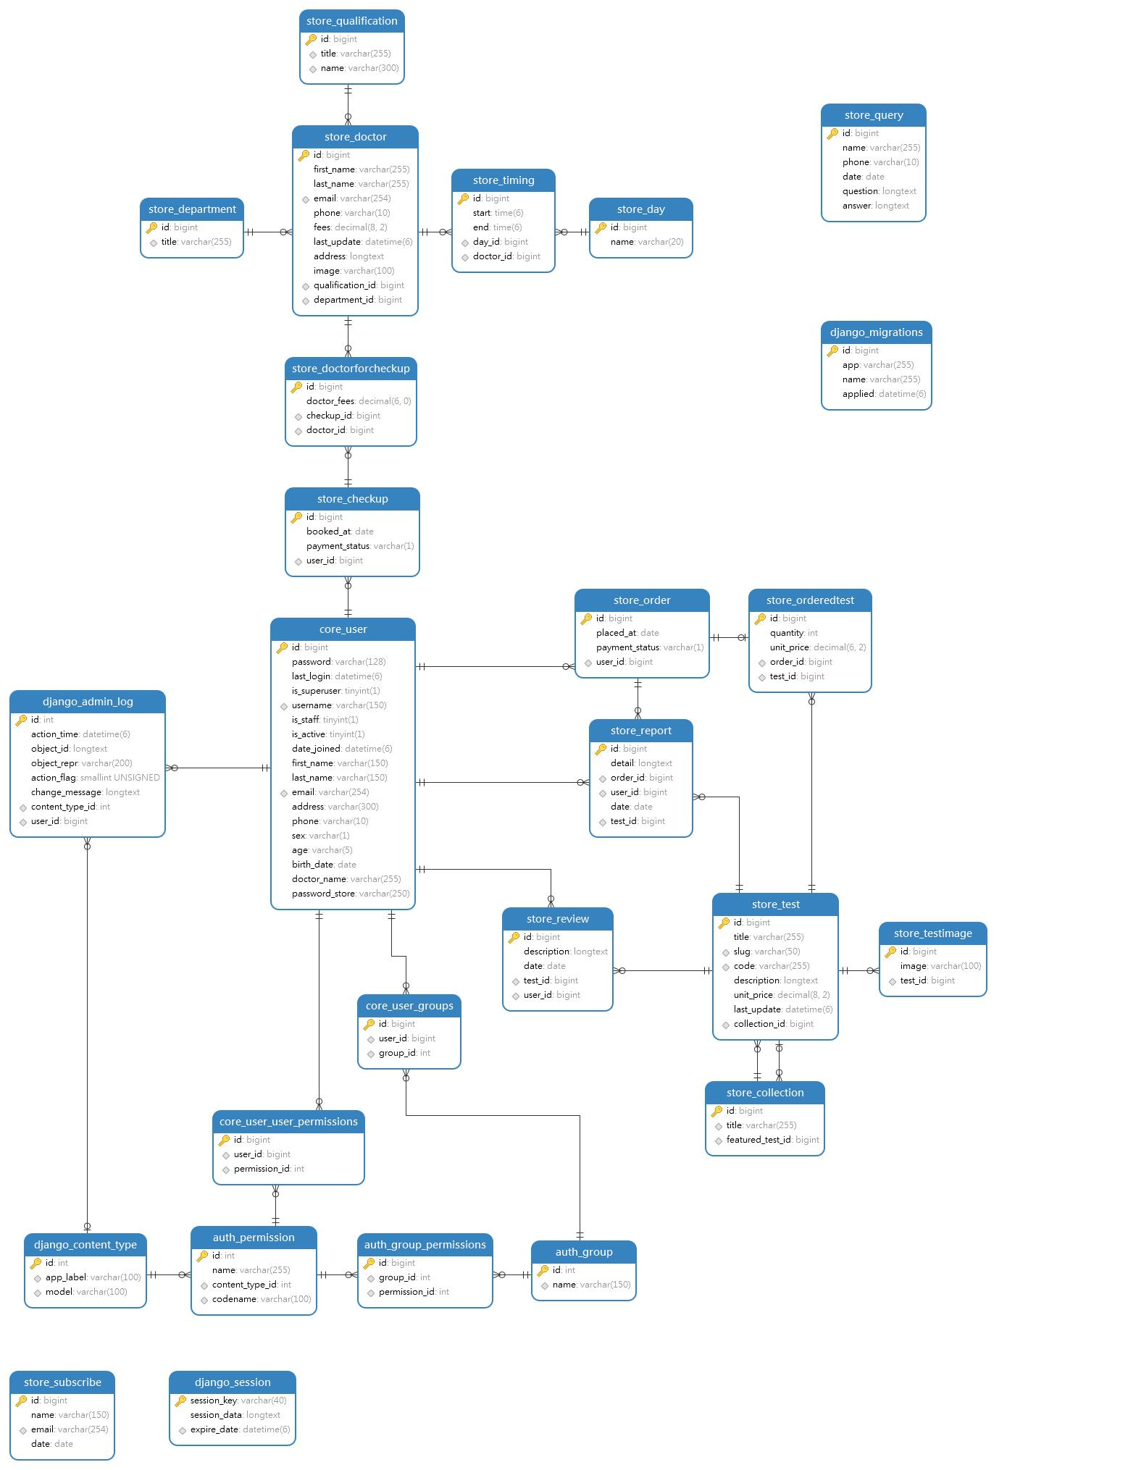
E-R Diagram

Slide 11
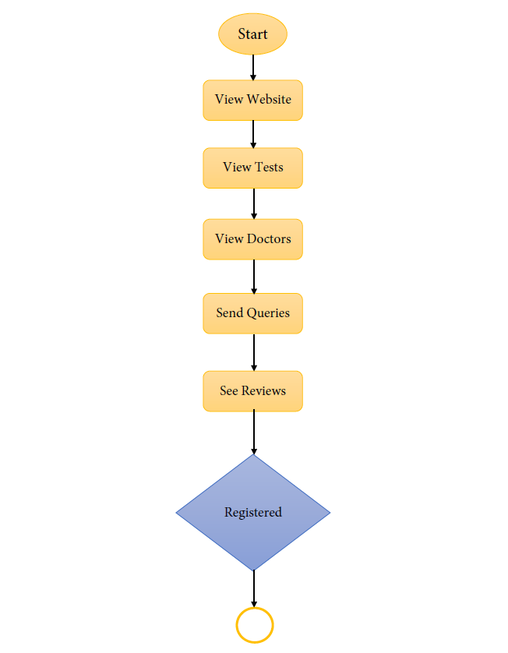
System Flow Chart

Slide 12
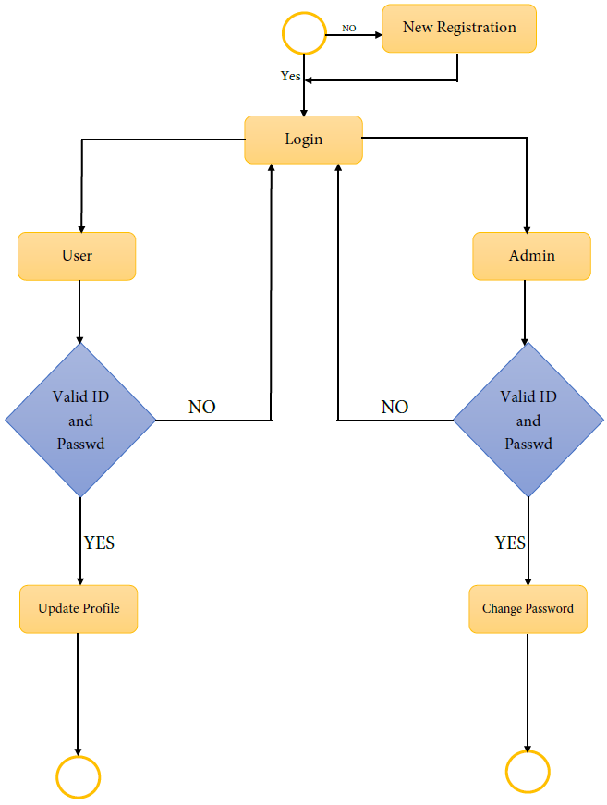

Slide 13
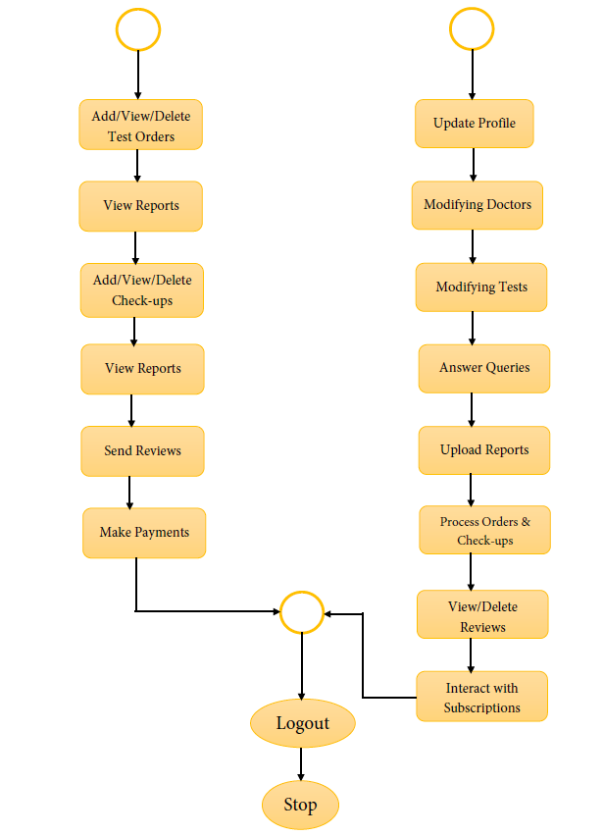

Slide 14
Registration Form Image.

Slide 15
Advantages
Reduces cost and improves efficiency of overall patient’s data management.
It has a flexible reporting system.
Easy information sharing.
Integrates with referral commission reporting.
A centralized patient reporting system is also there, which helps in managing reports with less overhead and accessible by staff members.
Flexibility to accommodate new requirements improves quality and compliance.

Slide 16
Applications
Partially challenged patients can order tests or book check-ups by their own.
The main aim of this project is to help patients to make their tests on their own. They should be able to register themselves to the diagnostic centre and get their tests done.
It can be applied by any pathology and diagnostic centres to get their maintenance job done so easily

Slide 17
Challenges
In remote area this service may be unreachable due to lack to support system.
There was a lot of issues to build this project as technical support was not always handy.
As this is my first project so I have to find the suitable process to get rid off my errors for over and over again.
As I went through this project, I faced a major problem on the sequence of categories I have to do make this fully responsible website.

Slide 18
Future Enhancements
This application avoids the manual work and the problems concern with it. It is an easy way to obtain the information regarding the various travel services that are present in our System.
Well me and my team member have worked hard in order to present an improved website better than the existing one’s regarding the information about the various activities. Still, we found out that the project can be done in a better way. Primarily, in this system patient login and then go to reception. By using this patient will send request for consulting the doctor. Reception will set the date for doctor appointments. After that doctor see his appointments and see the patients, surgeries also done.
The next enhancement is, we will develop online services. That mean, if patient have any problems, he can send his problem to the doctor through internet from his home then doctor will send reply to him. In this patient have some login name and password.

Slide 19
Conclusion
The package was designed in such a way that future modifications can be done easily. The following conclusion can be deduced from the development of the project.
Automation of the entire system improves the efficiency
It provides a friendly graphical user interface which proves to be better when compared to the existing system.
It gives appropriate access to the authorized users depending on their permissions.
It effectively overcomes the delay in communications.
Updating of information becomes so easier.
System security, data security and reliability are the striking features.
The System has adequate scope for modification in future if it is necessary.

Slide 20
The End

