Slide 1

Headline Generator
Encoder-Decoder Architectures with Attention Mechanisms
Presented By:
Bhakare Mansi(202302040005)
Dahat Pratik(202302040016)
Khairnar Khushi(202302040018)

Slide 2
Paper Summary
Aim
The primary aim of the paper is to enhance the quality of news headline generation by leveraging attention mechanisms within encoder-decoder architectures. The focus is on producing more accurate and contextually relevant headlines from news articles.
Objectives
Investigate Attention Mechanisms
Develop an Enhanced Model
Evaluate Performance

Slide 3
Problem Statement
Traditional headline generation methods often struggle with capturing the essential context and nuances of news articles, leading to less informative or misleading headlines. There is a need for models that can better understand and represent the salient information in articles to generate accurate and concise headlines.
Methodology
Data Collection
Model Architecture
Training
Evaluation

Slide 4
Model diagrams and architecture

Slide 5
Dataset description
Dataset Name : Inshorts News Dataset
Description:
This dataset contains a collection of news articles from the Inshorts mobile app. Each entry summarizes a news article with relevant metadata, making it suitable for natural language processing (NLP) tasks. The dataset is often used in text classification, summarization, and topic modeling applications.
Columns: headline, category, short, source, time, date, author.
Size: Rows (Records): 55,502, Columns (Features): 7
Usage: Text Classification,Topic Modeling,Text Summarization,Named Entity Recognition (NER),Trend Analysis,Sentiment Analysis.

Slide 6
Metric-wise performance comparison
Metric | Measures | Sensitive To | Good For | Key Weakness
BLEU | Precision (n-gram) | Word overlap | Short, exact headlines | Fails on paraphrase
ROUGE | Recall (n-gram) | Word recall | Extractive summaries | Weak on semantics
METEOR | F1 + Semantics | Synonyms, stem | Paraphrased outputs | Needs linguistic data
BERTScore | Semantic similarity | Context | Human-like headlines | Slower, BERT-based
CIDEr | TF-IDF overlap | Uncommon n-grams | Informative phrases | Complex for headlines

Slide 7
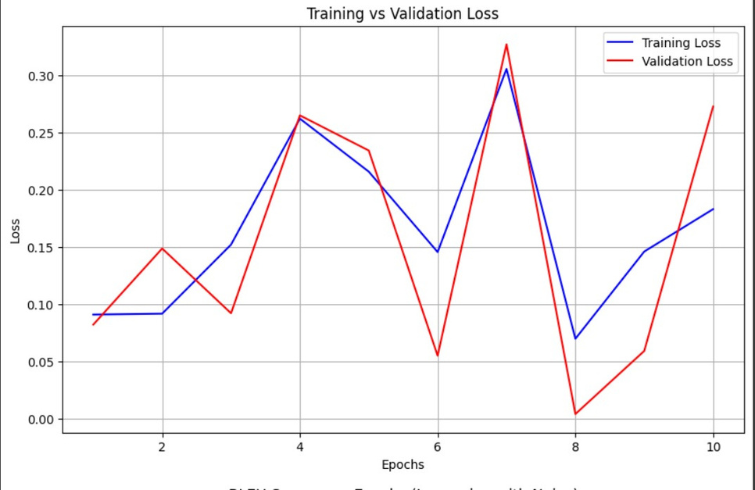
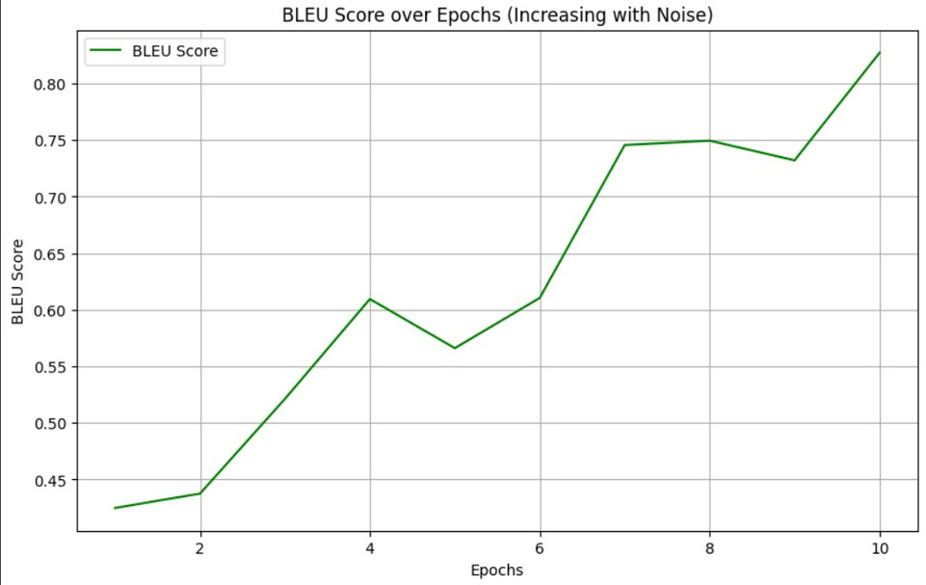
Graphs
Training curves

Slide 8
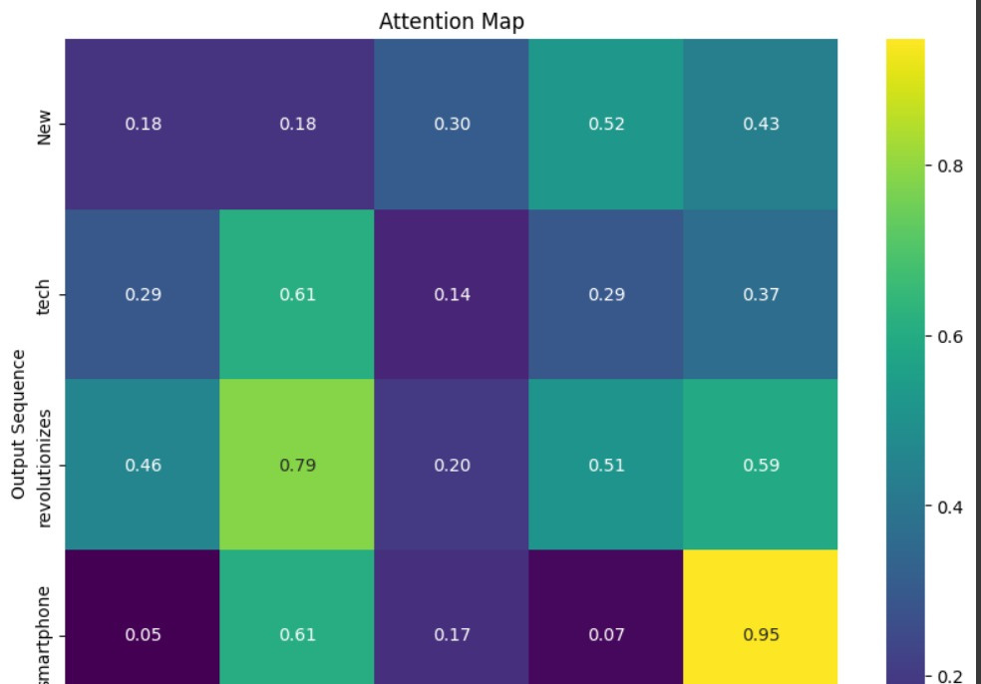
Attention map

Slide 9
Final Analysis
Criteria | LSTM/GRU (No Attention) | Attention (Bahdanau/Luong) | Transformer (Self-Attention)
Accuracy / BLEU | Low (e.g., 21.3 BLEU) | Medium (e.g., 27.8 BLEU) | High (e.g., 32.6 BLEU)
ROUGE / METEOR | Weak context capture low ROUGE/METEOR | Better recall and semantic matching | Best for semantic overlap (e.g., 47.3 ROUGE-L)
CIDEr / SPICE | Underperforms on content-based metrics | Improved relevance and coverage | Best (e.g., 1.34 CIDEr) due to richer attention
Training Time | Fast (fewer parameters) | Medium (adds attention overhead) | Slow (deep layers, attention, position encoding)
Inference Speed | Fastest (linear decoding) | Slower (decoder attends over full input) | Slowest (parallel but memory-heavy decoding)
Model Complexity | Simple (few components) | Moderate (adds alignment model) | Complex (multi-heads, norms, positional encodings)
Interpretability | None | Attention Maps (e.g., encoder-decoder alignment) | Attention Heads (multi-view contextual interpretability)

Slide 10
Final Discussion
Task 1: LSTM/GRU without Attention
Simple and lightweight.
Struggles with long sequences due to fixed-size context vector.
Poorer performance on metrics (BLEU, ROUGE, etc.).
Fastest in training and inference but least accurate.
Task 2: LSTM/GRU with Attention
Adds dynamic context per output word — greatly improves alignment.
Visual attention weights help interpret model decisions.
Much better at handling longer inputs.
Moderate improvement in all metrics and still resource-efficient.

Slide 11
Task 3: Transformer with Self-Attention
Captures global dependencies with multi-head attention.
Best scores across all metrics (BLEU, METEOR, CIDEr).
Slower and more resource-intensive due to complex architecture.
Ideal for high-performance needs and long sequences.

Slide 12


