Slide 1

Computer Engineering Department
A.P. Shah Institute of Technology
G.B.Road,Kasarvadavali, Thane(W), Mumbai-400615
UNIVERSITY OF MUMBAI
Academic Year 2021-2022

Slide 2
A Project Report on
Image Encryption & Decryption Using AES Algorithm
Submitted in partial fulfillment of the degree of
Bachelor of Engineering(Sem-IV)
in
Computer Engineering
By
Kirti Dubey , Moodle: 20102204 Pratik Chaudhari , Moodle :20102205 Arpit Chauhan, Moodle:20102085 Ranjan Shettigar, Moodle:20102177 Under the Guidance of
Prof. Vishakha Kiran Chaudhari

Slide 3
1.Project Conception and Initiation

Slide 4
1.1 Abstract
With the fast evolution of digital data exchange, security information becomes much more important in data storage and transmission.
Due to the increasing use of images in industrial processes, it is essential to protect confidential image data from unauthorized access.
In this project, we analyse the Advanced Encryption Standard (AES), and we add a keystream generator to AES to ensure improving the encryption performance; mainly for images characterised by reduced entropy.
Detailed results in terms of security analysis and implementation are given. Comparative study with traditional encryption algorithms is shown the superiority of the modified algorithm

Slide 5
1.2 Objectives
The main objective of our project is to provide security of the digital image by encrypting it by block cipher approach using dynamic key encryption and decryption. We can share the encrypted string and the key to the user who had already registered. The Registered user can easily access the data needed for the decryption. After encryption and decryption there should be no reduction in image quality.
(1) Can resist all known attacks.
(2) Fast and coding compaction.
(3) Simple in design.

Slide 6
1.3 Literature Review
[2] In this paper, an algorithm for image encryption and decryption is proposed along with its very large scale integration and keeping three main features in mind: 1) High security. 2) Low complexity. 3) No distortion in image quality.
[3] Advanced Encryption Standard(AES), also called Rijndael encryption. It is the block encryption standard which set by the United States Federal Government lately. AES is used instead of DES. After several rounds of screening that AES was widely used. On November 26, 2011 the NIST released the latest encryption standard screening after five years, and took effect in May 2002.After four years of precipitation and the test, AES became one of the most popular symmetric encryption algorithm

Slide 7
1.4 Problem Definition
In order to protect the data in an image from getting manipulated we had used one of the strong, efficient and reliable algorithms called Advanced Encryption Standard (AES) algorithm. It works on block cipher technique. It supports data length of 128, 192 and 256 bits. It consists of multiple rounds for processing different keys ranging from 10 to 14 rounds. All the information is transferred into matrix form. The digital image is first converted into textual data and the AES encryption is applied to it. It is asymmetric key encryption algorithm. With the help of this digital images can be shared without the risk of them getting manipulated

Slide 8
1.5 Scope
The data in which the image is getting converted along with key is stored in the local database. The key and the string can be shared with the users registered on the portal with just a simple click. The person receiving the image will get a pop-up in his mail box along with the credentials of the image. Using the portal encrypted images can be shared effectively. The program also displays the size of the encrypted and decrypted image to the respective users.

Slide 9
1.6 Technology stack
Hardware Requirements:
RAM : 4GB or Above
Processor : Intel i3 Gen 5 and above/ Ryzen 3 Gen 2 and above.
Software Requirements:
Operating System : Windows 7 or Above
Storage : 64GB or above
Development Kit : Java JDK
Software Used : Netbeans IDE 12.5, MySQL Workbench

Slide 10
2. Project Design

Slide 11
2.1 Design(Flow Of Modules)
Registration
Login
Encryption
Decryption
Database

Slide 12
2.2 Description Of Modules / Use Case
Registration : The User has to register first for using the application.
Login : After the user has registered he needs to login .
Encryption: In encryption page we get the encrypted string and a random Security key is generated.
Decryption: The key used for encryption along with the encrypted string is used to decrypt the image.

Slide 13
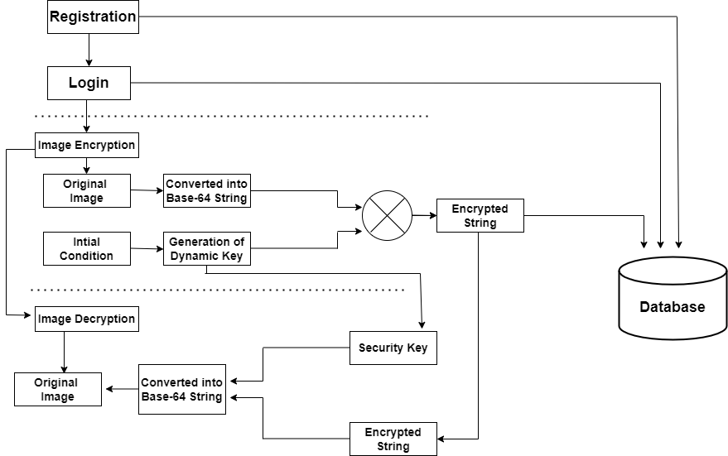
Block Diagram

Slide 14
4. Results
The size of decrypted image is same as the encrypted image indicating no loss in the image quality.
This is valid for all types of files jpeg, png etc.
The encryption of the image takes around 1.5 seconds and decryption takes around 1.8 seconds.
This indicates the consistency, speed and reliability of AES algorithm.
The digital image is getting converted to String and data is encrypted successfully using AES

Slide 15

Snapshots

Slide 16
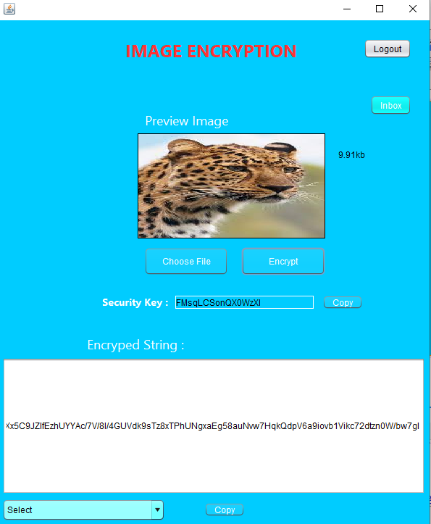

Slide 17
5.Conclusion
Thus we have made an image encryption and decryption application based on AES algorithm by converting it into text file and applying 10-key round encryption on it. The program is the connected to a database to store the user’s credentials and also the encrypted string. By using this process security of the data is ensured.
Currently, this system works offline and the image is stored on the local hard drive also, the encryption key is of 128-bit which performs 10-round encryption. In the future, we will scale this model as a web-based application and store the data on online servers and the user credentials will be stored

Slide 18
6. References
[1] Chen, Chao-Shen, and Rong-Jian Chen. "Image encryption and decryption using SCAN methodology." 2006 Seventh International Conference on Parallel and Distributed Computing.”
[2] M.Zeghid, M.Machhout, L.Khriji, A.Baganne and R.Tourki, “A Modified AES based Algorithm for Image Encryption.”
[3] QiZhang, Qunding, Electronic Engineering College,Heilongjiang University, Harbin, China. “Digital Image Encryption Based On Advanced Encryption Standard Algorithm.

Slide 19
Thank You

