Slide 1
Strings team

Slide 2
Project Definition
Having easy access to projects and their organizers
Provide the platform for interactions
Restructure of local sustainability programs
Provide structured information of the projects
Engaging contribution

Slide 3
Opportunities
To make eye-catchy website
Increase engagement
Ease of use
Know RCE Saskatchewan better
Think globally act locally

Slide 4
WordPress configuration(MVP1)
Theme: Twenty Twenty
Plugins: next slides…

Slide 5







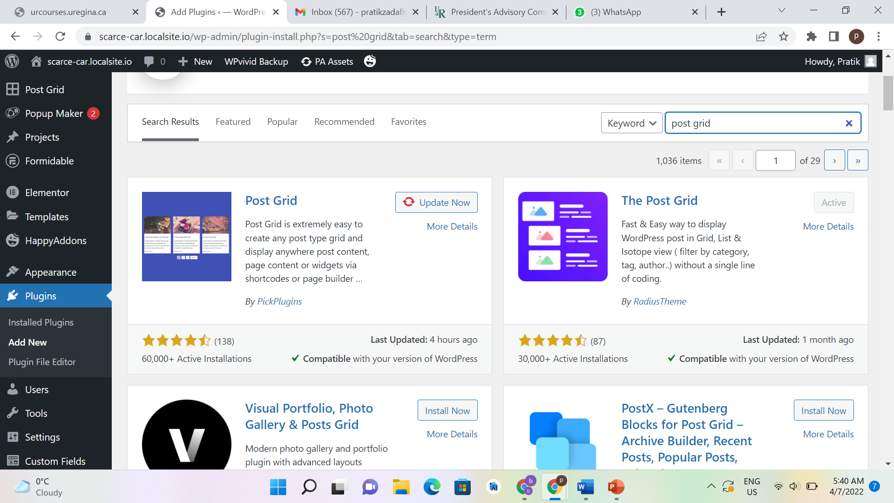


# Active installations
Last Updated
Rating
Compatibility
Functionality
Plugin
Backup
WPvivid Backup
100,000+
5 days ago
Form builder
Formidable
300,000+
2 weeks ago
Menu
Max Mega Menu
400,000+
2 months ago
Search
Search & Filter
50,000+
2 months ago
Popup
Popup Maker
700,000+
2 days ago
Poll
Poll Maker
3,000+
2 days ago
Post Layout
Post grid
30,000+
1 month ago
Builder
Elementor
5+ Million
3 days ago
Builder
premium addons elementor
500,000+
4 hours ago

Slide 6
Constraints

Slide 7
Search plugins
Search & Filter
Formidable forms
Ajaxt search lite
Jet Smart Filters
Search everything
Advanced Custom Fields
ACF: Better Search
Elementor
WooCommerce

Slide 8
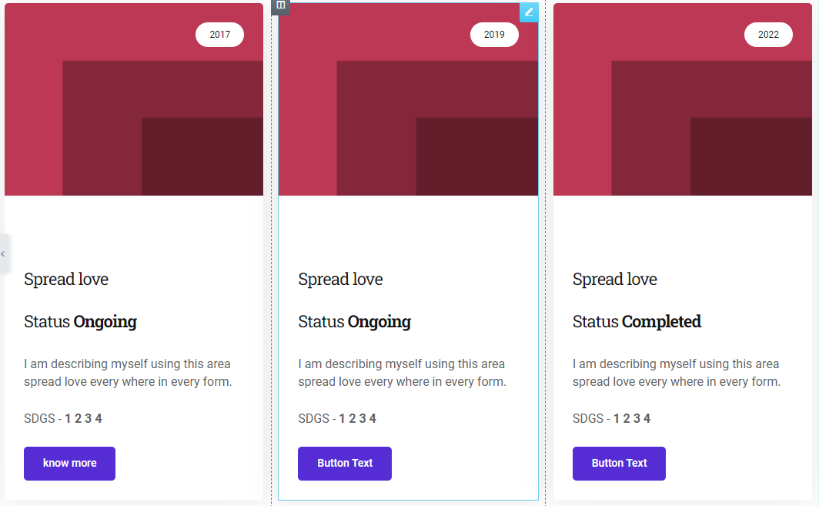

Slide 9
Thank you for your attention!

